Slide 1

Currency Converter
Callum Blears
Heinrich Hobbach
Daniel Casey Chirag Dattani

Slide 2
Outline
Methodologies/Concepts Used
Java XML – JDOM2
Use Case
Class Diagram
Application Demo
References
Questions

Slide 3
Methodologies Used
Project
Maven
Junit Testing
MVC
Model View Controller structure
Packages
XML-Java library: Jdom 2
Exception handling
UML behaviour
Use case
OOP concepts
Inheritance
Interface
Encapsulation
Defensive Code

Slide 4
Java XML – JDOM2
JDOM is an in-memory XML model that can be used to read, write, create and modify XML Documents.
Packages Used
import java.net.URL;
// to import file from an URL
import javax.xml.parsers.DocumentBuilder;
import javax.xml.parsers.DocumentBuilderFactory;
//Using this class a programmer can obtain a document from XML.
import org.w3c.dom.Document;
// Document – Represents the complete XML document. It provides access to the root element of the XML file.
import org.w3c.dom.Element;
//Element – Represents an XML element.
import org.w3c.dom.NodeList;
//To obtain xml elements as nodes.

Slide 5
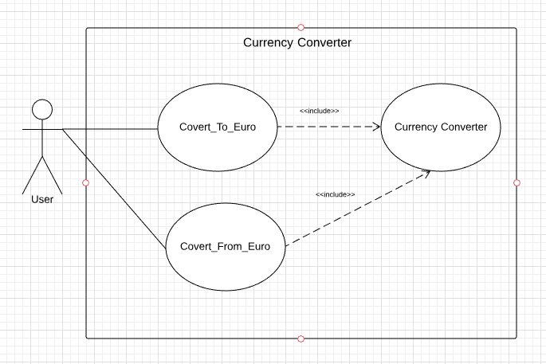
Use Case

Slide 6
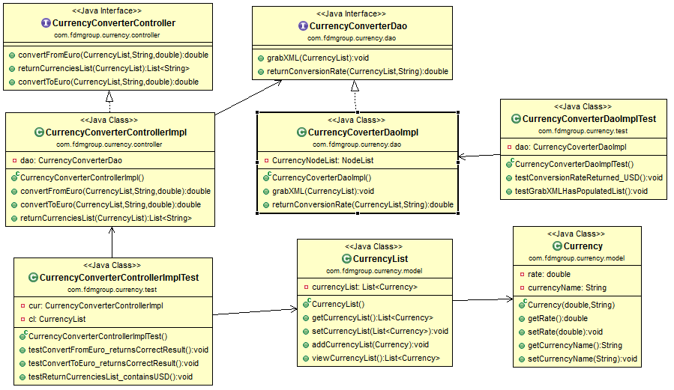
Class Diagram

Slide 7

Application Demo

Slide 8
References
https://www.w3schools.com/xml/dom_intro.asp
http://www.jdom.org/docs/faq.html
http://www.studytrails.com/java/xml/jdom2/java-xml-jdom2-introduction/
https://docs.oracle.com/javase/tutorial/

Slide 9

Questions

