Slide 1
Title Slide
Winner Bot
Arbitrage Trading Bot
Investor Pitch Deck
RGM

Slide 2
Problem
Crypto markets are fragmented, leading to price inefficiencies.
Manual trading cannot capture these opportunities consistently.

Slide 3
Solution
Winner Bot is an advanced Solana-based arbitrage trading bot.
It guarantees near-instant execution and zero-loss trading.

Slide 4
Market Opportunity
Global crypto trading volume exceeds $100B daily.
The opportunity for risk-free arbitrage profits is massive.

Slide 5
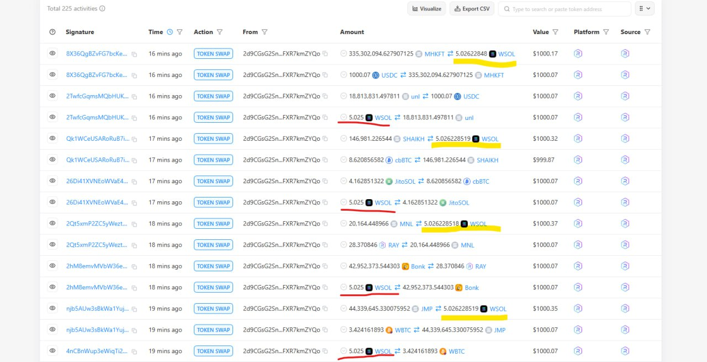
Product Demo

Slide 6
Business Model
Revenue via profit-sharing with investors and licensing fees.
Scalable with higher capital allocation.

Slide 7
Traction
Tested with $1,000 capital.
Achieved full ROI in 1 month.
Consistent profitability with no recorded losses.

Slide 8
Competitive Advantage
Fast execution on Solana blockchain.
Low fees and negligible slippage.
Proprietary high-probability algorithm.

Slide 9
Go-to-Market
Targeting crypto funds, institutional traders, and high-net-worth individuals.
Marketing via crypto communities and partnerships.

Slide 10
Financial Projections
Potential of $15K~$30k+ monthly profit per $50K capital.
Scalable with investor funding.

Slide 11
Team
Experienced blockchain developer and quant trader (Me).

Slide 12
Investment Ask
Seeking strategic investors to scale capital and infrastructure.
Offering profit-sharing and/or full acquisition opportunities.

