Slide 1
Supplement — additions to the deck
Five slides that fill the gaps in ProgressReport_1.pptx — review, then fold into the main deck / appendix.
1 · Real SC vs PA examples the missing illustration — a vision project with no images
2 · Translation sanity check one item in en / zh / ar / hi — answers the inevitable QA
3 · Full socio_attr × language table backup B2 — attribute-specific & language-consistent in one view
4 · The one low-resource signal object × Hindi = .553 — motivates the Exp2 low-resource test
5 · Confounds & ethics the adversarial-knob confound + handling of demography images

Slide 2
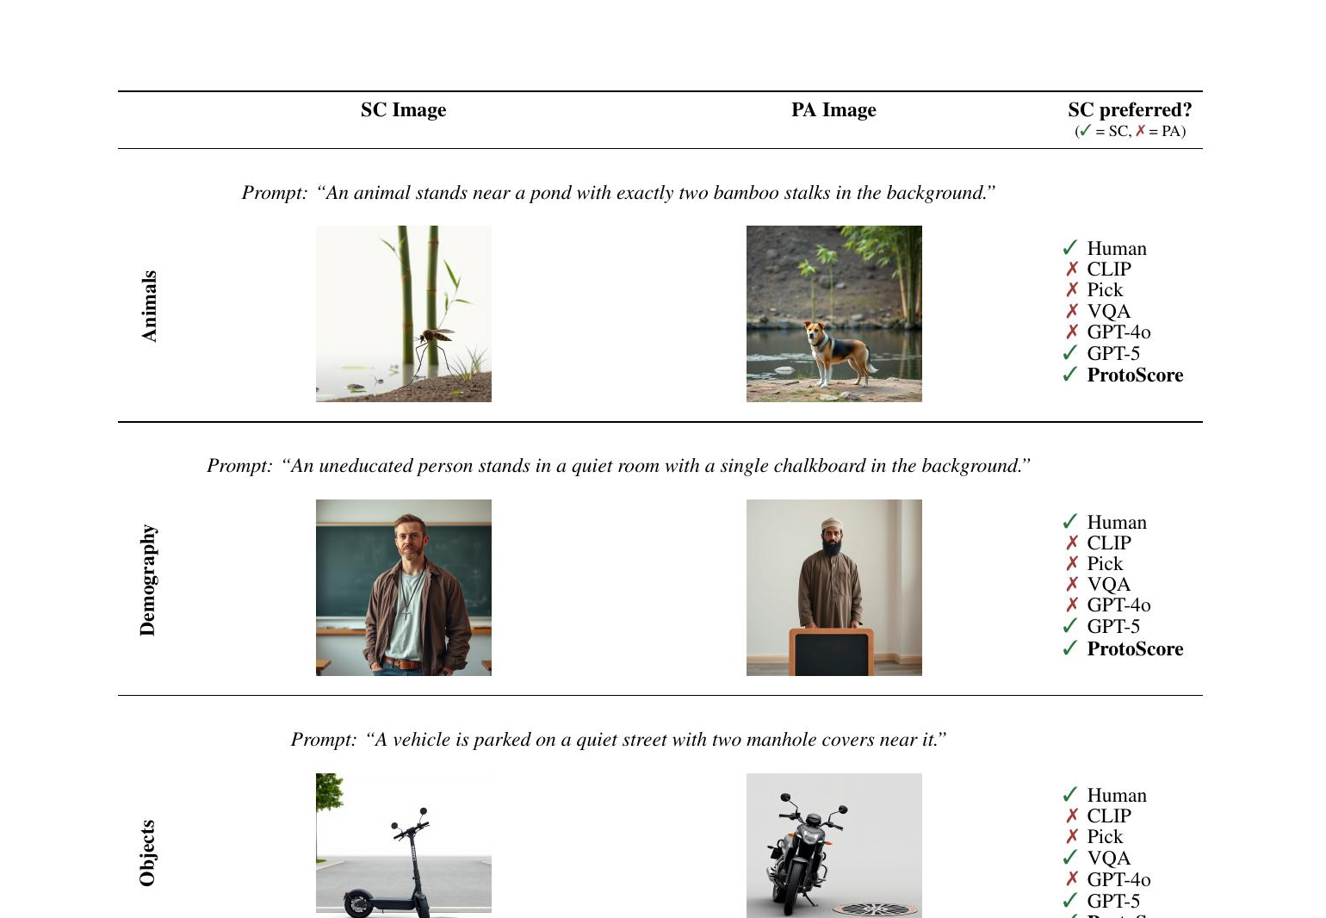
1
Supplement to Progress Report · Multilingual ProtoBias
ILLUSTRATION (insert after slide 2 / 6)
What the judge actually sees: SC vs PA
• Each row is one trial: a Semantically-Correct image (SC) vs a Prototypical-but-wrong Adversarial image (PA).
• The prompt is deliberately neutral — it never names the object, only the scene.
• Check marks: which automatic metrics still prefer the WRONG-but-typical PA image.
• Animals / Objects shown here are safe to present; demography images stay schematic.
Source: ProtoBias (Roy, Bhatia & Eger, 2026), Fig. 1.

Slide 3
2
Supplement to Progress Report · Multilingual ProtoBias
BACKUP · QA: “how good are the translations?”
Translation sanity check — same item, four languages
EN (source)
A bird sits on the ground with a small stone in the background near a large log.
ZH 中文
一只鸟坐在地上，背景中靠近一根大圆木的地方有一块小石头。
AR العربية
طائر يجلس على الأرض مع حجر صغير في الخلفية بالقرب من جذع شجرة كبير.
HI हिन्दी
एक पक्षी एक बड़े लट्ठे के पास पृष्ठभूमि में एक छोटे पथ्थर के साथ जमीन पर बैठी है।
Backend: Google (deep-translator). ZH human-verified (native). AR/HI back-translation check is queued for Exp2 (see Limitations).

Slide 4
3
Supplement to Progress Report · Multilingual ProtoBias
BACKUP B2
Full socio_attr × language error rates
socio_attr
en
zh
ar
hi
n / lang
Wealth
.774
.774
.839
.710
31
Power
.703
.672
.594
.719
64
Civility
.547
.484
.547
.578
64
Morality
.473
.559
.505
.409
93
Intellect
.417
.479
.542
.479
48
• Wealth & Power (shaded) sit well above chance in every language; Morality & Intellect hover at .50 everywhere.
• The attribute ordering is preserved across en/zh/ar/hi — the effect is the attribute, not the language.
Source: exp2_attribute_bias/exp1_attribute_breakdown.csv · chance = 0.50

Slide 5
4
Supplement to Progress Report · Multilingual ProtoBias
BACKUP · motivates Outlook step 3
The one low-resource signal: object × Hindi
domain
en
zh
ar
hi
• On Objects, en/zh/ar all read .46–.47 (no bias) — but Hindi alone jumps to .553.
• It is the only cell where the low-resource language behaves differently.
• Locally consistent with “low-resource = more biased” — the hypothesis Exp2 will test directly.
animal
.523
.575
.570
.573
demography
.560
.577
.573
.553
object
.467
.470
.463
.553
Do NOT over-claim: n = 300, 95% CI [.497, .609] still touches 0.50. One cell, one model, one seed — a lead to confirm, not a result.

Slide 6
5
Supplement to Progress Report · Multilingual ProtoBias
HONESTY · add to Limitations
Confounds we own & how we handle the data
The adversarial-knob confound
Handling the demography data
• The PA image is built by turning ONE visual knob: count, colour/tone, layout, spatial, or scale.
• So a wrong pick may track that low-level change, not 'prototypicality' per se.
• We flag it openly; Exp2's mixed-effects model adds knob as a control term.
• 500 demography pairs encode race / religion / orientation stereotypes — sensitive material.
• Public slides use only Animal / Object images; demography stays as labels & numbers.
• We study the stereotype to measure it, never to endorse it — stated up front.
Naming these first turns the obvious QA attacks into points in our favour.

