Slide 1
PROGRESS REPORT II
Cross-lingual Prototypicality Bias
in Vision-Language Models
Does a vision-language model track meaning — or lean on language- and culture-specific prototypes?
Xiaochuan Li · Rishav Chandra
Mentor: Subhadeep Roy · Extending ProtoBias (Roy, Bhatia & Eger 2026) · June 2026

Slide 2
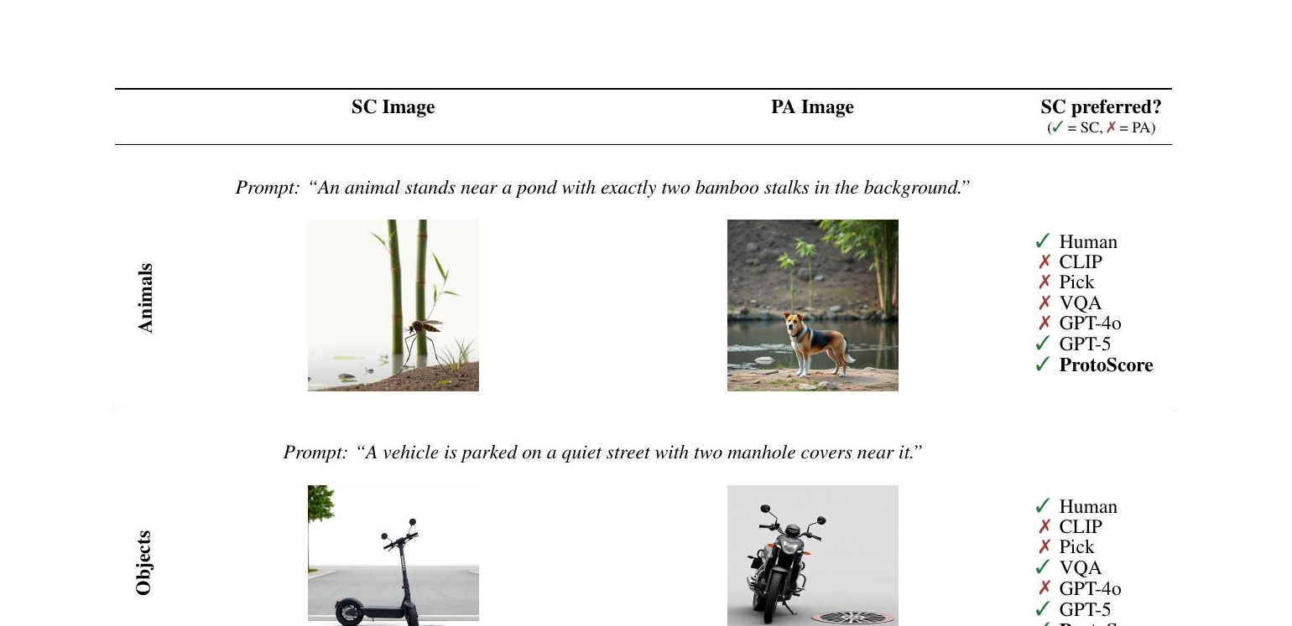
THE PROBLEM
Prototypicality bias: judging by looks, not meaning
Automatic metrics and VLMs increasingly replace humans for image–text evaluation.
Failure mode: they reward the image that looks typical — even when it is wrong for the prompt.
ProtoBias pairs a semantically-correct but atypical image with a prototypical but wrong one.
A judge that prefers the typical-but-wrong image is riding a shortcut, not the meaning.
Correct-but-atypical (left) vs prototypical-but-wrong (right).
2

Slide 3
OUR EXTENSION
Does the bias depend on the language you ask in?
ProtoBias is English-only and studies evaluation metrics.
Our turn: translate only the prompt, hold the image pair fixed.
If the verdict moves with language, the model is importing language-specific expectations.
RQ1 — is the bias consistent across languages? RQ2 — worse in socially sensitive domains?
image pair + prompt in language L
VLM judge
picks image 1 or 2 → error rate
Same images, language swapped — a controlled cross-lingual probe.
3

Slide 4
RELATED WORK · NEW SINCE REPORT 1
Where this sits — bias structure & multilingual bias
FACCT 2025
AACL 2025
Hausladen et al. — Social Perception of Faces in a VLM
Al Sahili et al. — Breaking Language Barriers or Reinforcing Bias?
Bias concentrates unevenly across social-trait dimensions — parallels our attribute-specific result.
Multilingual VLMs are more biased than English, worst in low-resource languages — the closest mirror.
COLM 2024
ACL 2025
Neplenbroek et al. — MBBQ
Friedrich et al. — MAGBIG
Non-English stereotypes exceed English even controlling for culture; control parallels our back-translation check.
Cross-lingual bias variation in text-to-image generation — a contrasting modality.
4

Slide 5
METHOD
A 2-alternative forced choice
Show two images: correct (atypical) vs prototypical (wrong).
Ask in the target language which image matches; answer is a single digit (1 or 2).
Left/right randomized so image position cannot be a confound.
Metric = error rate = how often the judge picks the prototypical-but-wrong image.
0.50
= chance · no bias
above 0.50 → prototypicality bias
5

Slide 6
WHAT'S NEW SINCE REPORT 1
Acting on the feedback: more metrics, more models
 | Report 1 | Report 2 (now)
Languages | 4 — en · zh · ar · hi | 7 — + Russian · Bengali · Greek
Models | 1 — Qwen2.5-VL-7B | 2 families — + InternVL3-8B
Statistics | point estimates | mixed-effects regression + LRT
Rigor checks | — | back-translation QA · flip / stable-bias rates
The two items the mentor flagged after Report 1 — additional metrics and additional models — are exactly the two new columns.
6

Slide 7
DATA & SETUP
ProtoBias across a resource × script design
Domains: Animals / Objects (neutral) and Demography (socially sensitive).
Demography rows carry a socio-attribute: Wealth · Power · Civility · Morality · Intellect.
7 languages × 900 items × 2 models ≈ 12,500 judgments.
Qwen2.5-VL-7B & InternVL3-8B on NHR@FAU Alex A40 GPUs.
Language | Script | Resource
English / Chinese | Latin / Han | high
Russian | Cyrillic | high
Arabic / Hindi | Arabic / Devanagari | mid
Bengali | Bengali | low
Greek | Greek | mid · distinct
7

Slide 8
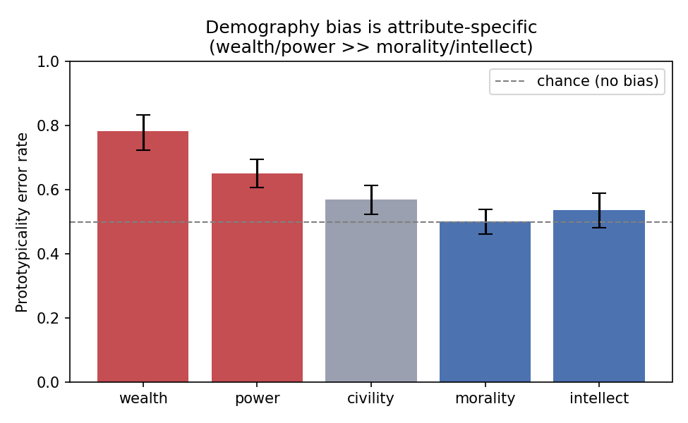
RESULT 1
The bias follows the attribute
Demography's flat ~0.58 average hides a ~0.28 spread across attributes.
Strong bias for social-status attributes — Wealth, Power.
Near-chance for Morality and Intellect.
Possible Explanation:
Web data encodes what “rich / powerful” looks like; there is no stable visual prototype for “moral” or “smart.”
Prototypicality error rate by socio-attribute — Qwen2.5-VL-7B, all 7 languages.
8

Slide 9
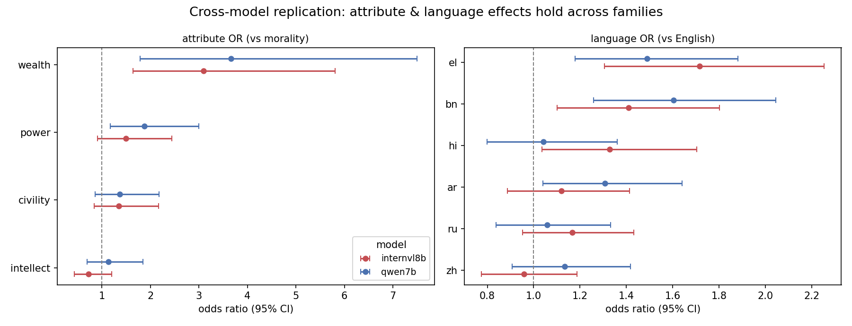
RESULT 1 · REPLICATION
…and it replicates across model families
OR ≈ 3.7 / 3.1
p ≈ 2×10⁻¹⁴
not a quirk
Wealth bias vs morality
Qwen / InternVL
attribute effect
in both families
same structure across
two independent VLMs
9

Slide 10
RESULT 2
Language is not flat after all
Four languages looked invariant; adding Bengali & Greek revealed a real effect.
Bengali and Greek prompts → significantly more bias than English, in both models.
10
Notes:
So now, the second main result is about language.
And this result actually changed what we thought after the first report. In Report 1, we only had four languages, and at that point the bias looked pretty similar across them. So our early conclusion was basically: maybe language does not matter that much.
换
But once we added more languages, especially Bengali and Greek, the picture changed. Now we do see a real language effect.
What we find is that Bengali and Greek prompts lead to more bias than English prompts. So the images are exactly the same, the task is exactly the same, but when the prompt is written in Bengali or Greek, the model is more likely to choose the prototypical-but-wrong image.
And importantly, this happens in both model families. We see it in Qwen, and we also see it in InternVL. So this is not just one model behaving strangely.
One important detail, though, is that language does not completely change the structure of the bias. The same attributes are still the risky ones. Wealth and Power are still the ones with stronger bias, while Morality and Intellect are much closer to chance.
So the way I would summarize this result is: language does not really change which attributes are biased. It changes how strong the bias is.
---
This plot shows the same result in odds-ratio form.
The dashed vertical line at 1 means “same as English.” So if a point is around 1, that language behaves roughly like English. If it is to the right of 1, then that language produces more bias than English. If it is to the left, then it produces less bias.
The bars are confidence intervals, so they show how uncertain the estimate is.
What you can see here is that Chinese, Russian, and Hindi are mostly close to English. Arabic is a little bit higher, but the clearest pattern is Bengali and Greek. For both models, these two languages are on the right side, meaning they increase the odds of choosing the prototypical-but-wrong image.
So the important point is not “all non-English languages are worse.” That would be too simple, and it is not what we see.
The real pattern is more selective: some languages, especially Bengali and Greek in this setup, make the model rely more on the prototype shortcut.

Slide 11
RESULT 2 · RIGOR
Is it just bad translation? No.
We back-translated every non-English prompt and measured drift.
The most-biased languages (Greek, Bengali) have the highest translation fidelity.
The least-biased (Hindi, Russian) have the lowest — the opposite of a translation artifact.
Language | Bias vs English | Back-translation fidelity
Greek | +49% | 0.88 (highest)
Bengali | +60% | 0.86
Arabic | +31% | 0.85
Chinese | — | 0.84
Hindi | — | 0.79
Russian | — | 0.79 (lowest)
11
Notes:
Now, the obvious question is: maybe this is just a translation problem.
Maybe Bengali and Greek were translated badly, so the model could not understand the prompt properly, and then it fell back on the visual stereotype.
So we checked that directly.
For every non-English prompt, we translated it back into English, and then compared that back-translation with the original English prompt. The idea is simple: if the translated prompt drifted a lot, then the meaning may not have been preserved.
So if bad translation were the explanation, we should see the most biased languages also having the worst translation quality
But we actually see the opposite.
Greek and Bengali are the most biased languages, but they also have the highest back-translation quality. Greek is the highest, and Bengali is also very high. Meanwhile, Hindi and Russian have the lowest fidelity, but they do not show the strongest bias.
So this makes the simple translation-artifact explanation unlikely.
Of course, this does not prove translation is perfect. It is still a sanity check, and it uses the same general translation pipeline. But it does rule out the most obvious concern, which is that the language effect is just coming from bad translations.

Slide 12
NEW BEHAVIOURAL METRIC · 1 OF 2
Cross-lingual Flip Rate (CFR)
Does the model's choice change when only the language changes?
Overall CFR ≈ 0.65 — about two-thirds of image-pairs flip at least once.
Wealth flips the LEAST — it is locked in (low flip = high stable bias).
CFR = #(items whose answer differs across languages) / #(items)
Notes:
Next, we wanted to go beyond average error rates.
Average error rate tells us how often the model is wrong overall, but it does not tell us whether the model is stable across languages.
So we introduce this first behavioral metric: cross-lingual flip rate.
The question here is very simple: for the same image pair, if we only change the language of the prompt, does the model change its answer?
If the model picks one image in English, but a different image in Bengali or Greek, then that item has flipped.
Overall, the flip rate is pretty high — about two-thirds of image pairs flip at least once across languages. So even if the average error rate looks stable, underneath that average, many individual items are actually changing their answer depending on language.
换
But the interesting part is Wealth.
Wealth flips the least. And that sounds a little counterintuitive at first, because low flip rate sounds like the model is stable. But here, it is stable in a bad way.
For Wealth items, the model is often locked into the wrong prototypical choice across languages. So it is not randomly changing its mind. It is consistently biased.
That is why low flip rate for Wealth is actually evidence of stable bias.

Slide 13
NEW BEHAVIOURAL METRIC · 2 OF 2
Stable Bias Rate (SBR)
Does the model pick the wrong (prototypical) image in ALL seven languages?
Wealth has the highest SBR in both models — biased everywhere, not flip-flopping.
SBR = #(items with the prototype chosen in every language) / #(items)
Notes:
The second metric makes that point even more directly.
Stable Bias Rate asks: does the model pick the wrong, prototypical image in all seven languages?
So this is a stricter metric than just being wrong once. An item only counts as stable bias if the model picks the prototypical-but-wrong image every single time, no matter which language we use.
And here the result is very clear: Wealth has the highest stable-bias rate in both models.
For Qwen, it is around 0.58. For InternVL, it is around 0.45. That means a large fraction of Wealth items are not just occasionally biased — they are biased everywhere.
This is important because it tells us that the Wealth effect is not just language-specific noise. It is not that the model flips around randomly depending on the prompt language.
Instead, for Wealth, there seems to be a very strong visual prototype, and both models keep falling back to it across languages.
So the takeaway here is: Wealth is not just biased. It is stably biased.

Slide 14
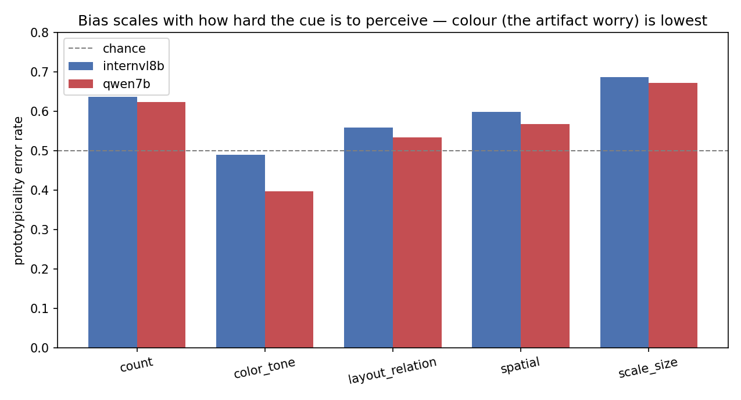
GOING DEEPER · THE CONFOUND
Is it just a low-level visual cue? No.
Every adversarial image also tweaks one visual knob — count / colour / scale / layout / spatial.
If the bias were a colour artifact, colour would spike. Instead colour is the LOWEST (≈0.40).
Bias is highest when the cue is hard to perceive (count, scale) — a fallback when the detail can't be grounded.
13
Notes:
Now we wanted to check another possible confound.
In this dataset, the adversarial image differs from the correct image along some visual feature — for example count, color, scale, layout, or spatial relation.
So someone could reasonably ask: maybe the model is not reacting to a social prototype at all. Maybe it is just confused by some low-level visual feature, like color.
So we split the results by which visual knob was changed.
And the result is reassuring. If the bias were just a color artifact, then color should have the highest error rate. But actually color is the lowest, around 0.40.
The bias is highest for visual features that are harder for the model to perceive, like count and scale. And that makes sense, because vision-language models are known to struggle with precise counting and fine-grained size differences.
So the interpretation is: when the visual evidence is weak or hard to ground, the model falls back on the prototype.

Slide 15
WHAT WE FOUND
One picture: a fallback with two factors
1
Is there a prototype to take? → the attribute
A visual prototype exists for wealth and status, not for morality or intellect. That map replicates across both families, and the trap is largely item-intrinsic (the same items fool both, r = 0.68).
2
How weak is the signal? → perception & language
The model falls back on the prototype when the discriminating cue is hard to perceive (count, scale) OR the prompt language is unfamiliar (Bengali, Greek). Two routes, one mechanism.
Attribute sets whether a shortcut exists; signal-weakness sets how much the model takes it.
15
Notes:
So let me put the whole story together.
I think the simplest way to understand the results is as a fallback mechanism with two factors.
The first factor is the attribute.
Some attributes have a strong visual prototype. Wealth and Power are good examples. The web has lots of repeated visual patterns for what “rich” or “powerful” is supposed to look like. But for attributes like Morality or Intellect, there is no equally stable visual appearance.
So the attribute decides whether there is a prototype shortcut available in the first place.
The second factor is signal weakness.
The model uses the shortcut more when the real evidence is harder to use. That can happen on the vision side, when the key difference is count or scale. And it can also happen on the language side, when the prompt is in a language where the model seems less robust, like Bengali or Greek in our results.
So these look like two different routes, but they lead to the same behavior: the model falls back on the prototype.
In one sentence: the attribute decides whether a shortcut exists, and the weakness of the visual or language signal decides how much the model takes it.

Slide 16
LIMITATIONS
What we are not yet claiming
Single seed, single translation backend; the adversarial “knob” (color / scale) is a co-varying confound.
Demography cells are small (Wealth ≈ 31 / language) — mixed-effects pools, but power is limited.
Qwen-32B was dropped — infeasible runtime (≈280 s/item) on the available 2×A40 sharding.
Why ar / bn / el specifically — not a clean resource gradient (Russian is non-Latin yet flat) — is open.
16
Notes:
Of course, there are several limitations.
First, we are still using a single seed and a single translation backend, so we do not want to overclaim.
Second, the adversarial visual knob is still a co-varying factor. The dataset changes things like color, scale, count, or layout, and those are not fully separable from the prototype manipulation.
Third, some of the demography cells are small. For example, Wealth has only around thirty items per language. The mixed-effects model helps by pooling information, but the power is still limited.
Fourth, we had to drop Qwen-32B because it was just too slow on the available GPUs. It was around 280 seconds per item, which was not feasible for this report.
And finally, we still do not know exactly why Arabic, Bengali, and Greek are the elevated languages. It is not a clean resource-level story, because Russian is also non-Latin and high-resource, but it is basically flat.
So the main thing we can say now is: the language effect exists, but the mechanism behind exactly these languages is still open.

Slide 17
OUTLOOK
Next steps
1
Scale axis
Qwen-32B in 4-bit on a single GPU — does the bias shrink with model size?
2
More families
Gemma-3, LLaVA-OneVision — map how general the language effect is.
3
Shortcut-severing*
Remove prototype cues — is stable correctness actually grounded?
4
Pin down language
Disentangle resource vs script vs cultural loading behind the ar / bn / el spike.
17
Notes:
For next steps, we have four directions.
First, we want to test model scale. The plan is to run Qwen-32B in 4-bit, so we can see whether a larger model reduces this bias or whether the same pattern stays.
Second, we want to add more model families, like Gemma and LLaVA-OneVision. That will tell us whether the language effect is really general across VLMs.
Third, we want to do shortcut-severing experiments. Basically, remove or weaken the prototype cue and see whether the model can still choose correctly. That would help us distinguish real grounding from shortcut-based guessing.
And fourth, we want to pin down the language mechanism. Right now we know Bengali, Greek, and to some extent Arabic are elevated, but we do not yet know whether that comes from resource level, script, cultural loading, or something else.
So the next stage is not just to add more data, but to explain why the language effect happens.

Slide 18
Thank you
Built & ran the first multilingual, multi-model ProtoBias pipeline — 7 languages, 2 model families.
github.com/xchuan-li/cross_lingual_protobias
18
Notes:
EN —
To sum up: we built and ran the first multilingual, multi-model version of ProtoBias — seven languages and two model families. The two results both hold across families: the bias is attribute-specific, and it is modulated by language. The code is all on GitHub. Thank you, and I am happy to take questions.
中文 —
总结一下:我们搭建并跑通了首个多语言、多模型版本的 ProtoBias——七种语言、两个模型家族。两个结果都跨家族成立:偏见是属性特异的,并且受语言调制。代码都在 GitHub 上。谢谢,欢迎提问。

Slide 19
BACKUP
Full cross-model summary
 | Qwen2.5-VL-7B | InternVL3-8B
overall error rate | 0.547 | 0.585
attribute effect (LRT p) | 2.1×10⁻¹⁴ | 2.7×10⁻¹⁴
Wealth odds ratio | 3.67 | 3.09
language effect (LRT p) | 0.024 | 0.0085
Greek / Bengali OR | 1.49 / 1.60 | 1.72 / 1.41
Wealth stable-bias rate | 0.58 | 0.45
cross-lingual flip rate | 0.65 | 0.69
Item-clustered mixed-effects logistic regression; back-translation QA; numpy/scipy, no statsmodels.
19
Notes:
EN (backup — pull up if asked for exact numbers) —
This table puts both models side by side: overall error rate, the attribute and language test p-values, the wealth odds ratio, the Greek and Bengali odds ratios, the stable-bias rate, and the flip rate. The headline: the attribute p-values are tiny in both models, and the language p-values are small in both — so both effects replicate.
中文(备份——要确切数字时调出)—
这张表把两个模型并排:总体错误率、属性和语言检验的 p 值、财富优势比、希腊语和孟加拉语优势比、稳定偏见率、翻转率。重点:属性 p 值在两个模型里都极小,语言 p 值也都小——两个效应都复现。

Slide 20
BACKUP · METHODS
Why InternVL3-8B as the second model
Goal: rule out “it's just a Qwen quirk.” A second, independent family tests whether the finding generalizes.
1
Different family
OpenGVLab, not Alibaba — independent architecture and training, not a Qwen variant.
2
Size-matched
≈8B vs Qwen's 7B — controls for scale, so a difference isn't “one is far bigger.”
3
Strong, standard baseline
A top open VLM family widely used in papers — credible and representative.
4
Fits the pipeline
Multi-image and multilingual; the HF-native checkpoint loads via the standard API.
20
Notes:
EN (backup — why the second model) —
The main reason is to rule out that the finding is just a Qwen quirk; an independent second family tests whether it generalizes. We picked InternVL3-8B for four reasons: it is a different family from a different lab; it is about the same size as Qwen, so size is controlled; it is a strong, standard baseline used in papers; and it fit our pipeline because it handles multiple images and loads with the standard tools.
中文(备份——为什么选第二个模型)—
主要原因是排除"这只是 Qwen 的怪癖";一个独立的第二家族能检验它是否普遍。选 InternVL3-8B 有四个理由:来自另一个实验室的不同家族;和 Qwen 体量相当,控制了规模;是论文常用的强基线;支持多图、能用标准工具加载,适配我们的流程。

Slide 21
BACKUP · METHODS
Mixed-effects logistic regression & the LRT
The model
The test · LRT
picked_adv ~ socio_attr + lang + gender + (1 | item)
Fit two nested models (with vs without a factor); compare fit by likelihood.
χ² = 2×(LL_big − LL_small); p from chi-squared → one p-value per whole factor.
Logistic → models P(pick prototype); coefficients exponentiate to odds ratios (OR).
Fixed effects (socio_attr, lang, gender) = what we estimate.
Random intercept (1 | item) = each image-pair gets its own baseline — the same item repeats in 7 languages, so those 7 views are not independent.
factor | χ² | p | verdict
socio_attr | 70.1 | 2×10⁻¹⁴ | significant
language | 14.6 | 0.024 | significant
attr × lang | 18.8 | 0.76 | n.s.
Qwen-7B; same pattern in InternVL3-8B. Implemented with item-clustered robust SEs (no statsmodels on the cluster).
21
Notes:
EN (backup — the statistics) —
We used a logistic regression because the outcome is yes/no (did it pick the stereotype); its coefficients become odds ratios. We made it "mixed-effects" by giving each image pair its own baseline, because the same pair appears in seven languages, so those seven are not independent. To test a whole factor like language, we use a likelihood-ratio test: fit the model with and without that factor and check if it fits significantly better, giving one p-value per factor. The table: attribute is very strong, language is significant, no interaction.
中文(备份——统计方法)—
我们用逻辑回归,因为结果是是/否(有没有选刻板印象那张),系数转成优势比。做成"混合效应"是给每对图自己的基线,因为同一对图出现在七种语言里,这七个不独立。要检验"语言"这样一整个因素,用似然比检验:拟合带和不带该因素的两个模型,看带上后是否显著更好,每个因素一个 p 值。表里:属性非常强,语言显著,无交互。

Slide 22
BACKUP · METHODS
Back-translation translation-quality check
We can't read all 7 languages — so we round-trip each prompt back to English and measure how much it drifted.
English prompt
original E
translate
Greek text
shown to the model
back-translate
English again
E′
compare E vs E′ → token-F1
If the language effect were a translation artifact, the most-biased languages would drift the MOST.
Instead the opposite: Greek (0.88) and Bengali (0.86) — the most biased — have the HIGHEST fidelity; Hindi / Russian (0.79) — not biased — the lowest.
Caveat: a lexical check using the same MT system — a sanity check that rules out the obvious confound, not a proof.
22
Notes:
EN (backup — the translation check) —
We take the English prompt, translate it into, say, Greek (this is what the model sees), then translate that Greek back into English, and compare the two English versions. If they are close, the translation kept the meaning; we score closeness with a simple word-overlap measure. The key result again: the most-biased languages have the closest back-translations — so the bias is not from bad translation.
中文(备份——翻译检查)—
拿英文提示,翻成比如希腊语(模型看到的就是它),再把希腊语翻回英文,比较前后两个英文版本。接近就说明翻译保住了意思;接近程度用一个简单的词重叠分数量。关键结果还是那句:最偏的语言回译最接近——所以偏见不是来自烂翻译。

Slide 23
BACKUP · METHODS
The cross-lingual metrics, defined
For each image-pair we summarise its behaviour across all its languages (items judged in ≥ 2 languages).
per item, across languages: all-wrong → SBR · all-right → SCR · mixed → CFR
CFR + SBR + SCR = 1
Cross-lingual Flip Rate (CFR) — the model's choice changes across languages — the item is not stable.
Stable Bias Rate (SBR) — the model picks the prototypical-but-wrong image in every language.
Stable Correct Rate (SCR) — the model picks the correct image in every language.
These are item-level summaries across languages, not per-judgment — which is why a flat aggregate error rate can still hide heavy item-level flipping (overall CFR ≈ 0.65).
23
Notes:
EN (backup — exact metric definitions) —
For each image pair, look at its answers across all its languages. Wrong in all of them = stable bias. Right in all of them = stable correct. Mixed = a flip. These three add up to one. The important point: these are measured per image-pair across languages, not per single judgment — which is why the average error rate can look flat while many items are actually flipping underneath.
中文(备份——指标精确定义)—
对每对图,看它在所有语言下的答案。全错 = 稳定偏见;全对 = 稳定正确;有对有错 = 翻转。三者加起来等于一。重点:它们是"按图对、跨语言"量的,不是"按单次判断"量的——这就是为什么平均错误率看着平,底下其实很多图对在翻转。

Slide 24
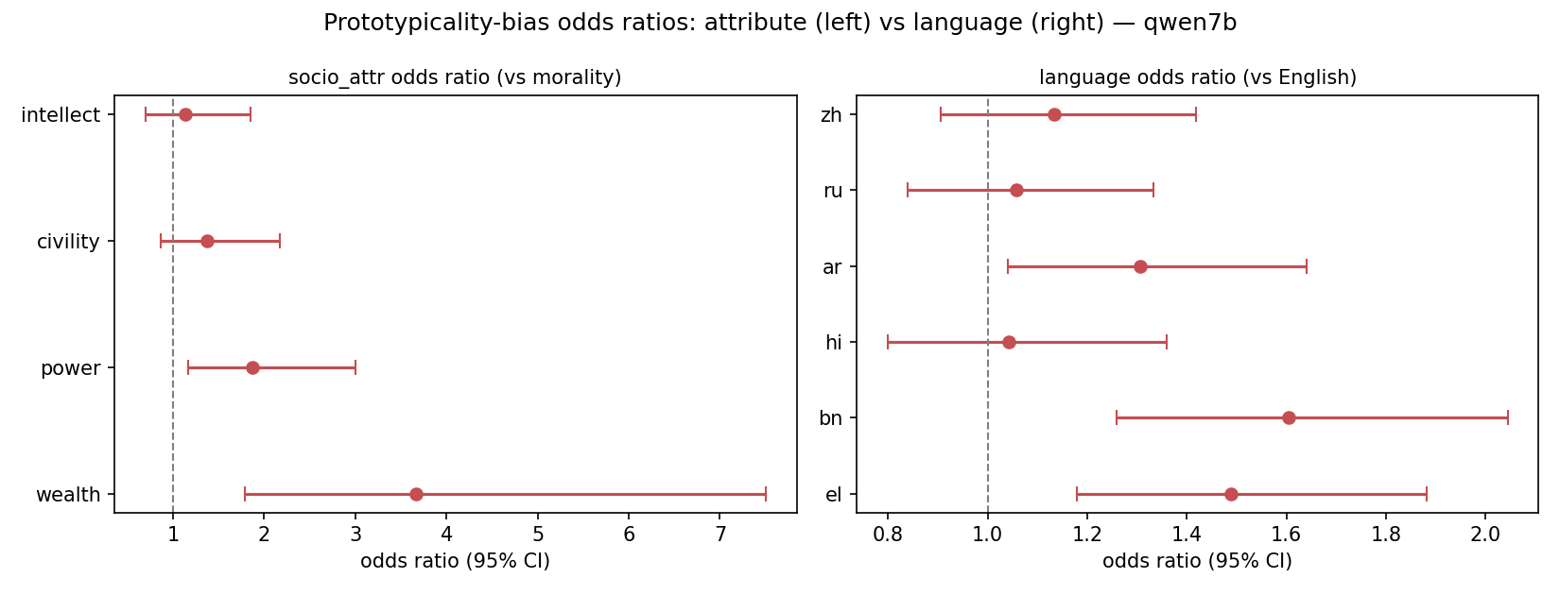
INTERACTIVE · MODEL EXPLORER
Does it hold across models? ▸ click a button
Qwen-7B
InternVL3-8B
Both overlaid
24
Notes:
EN (interactive backup) —
These three slides act as one panel: the buttons at the bottom are clickable in slideshow mode. Click "InternVL" or "Both" to switch which model's chart is shown — use this if someone doubts the result holds across models, and switch live in front of them. Navigate with the buttons, not the arrow keys.
中文(交互备份)—
这三页其实是一个面板:底部按钮在放映模式下可点。点 "InternVL" 或 "Both" 切换显示哪个模型的图——有人怀疑结果跨模型是否成立时,当场切给他看。用按钮导航,别用方向键。

Slide 25
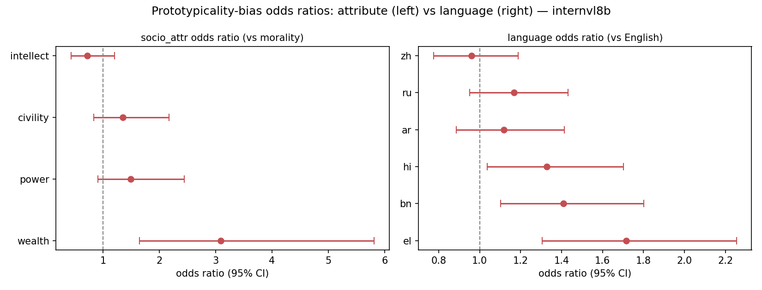
INTERACTIVE · MODEL EXPLORER
Does it hold across models? ▸ click a button
Qwen-7B
InternVL3-8B
Both overlaid
25
Notes:
EN — Same panel, now showing InternVL3. Click "Qwen-7B" or "Both" to switch.
中文 — 同一面板,现在显示 InternVL3。点 "Qwen-7B" 或 "Both" 切换。

Slide 26
INTERACTIVE · MODEL EXPLORER
Does it hold across models? ▸ click a button
Qwen-7B
InternVL3-8B
Both overlaid
26
Notes:
EN — Same panel, showing both models overlaid. Click a button to switch back.
中文 — 同一面板,两个模型叠加显示。点按钮切回。

