Slide 1
CROSS-LINGUAL PROTOTYPICALITY BIAS IN MULTIMODAL AI EVALUATION
Does a vision–language judge change its mind
when we switch the language?
English · Chinese · Arabic · Hindi
Progress Report I
Xiaochuan Li · Mentor: Subhadeep Roy · 2026

Slide 2
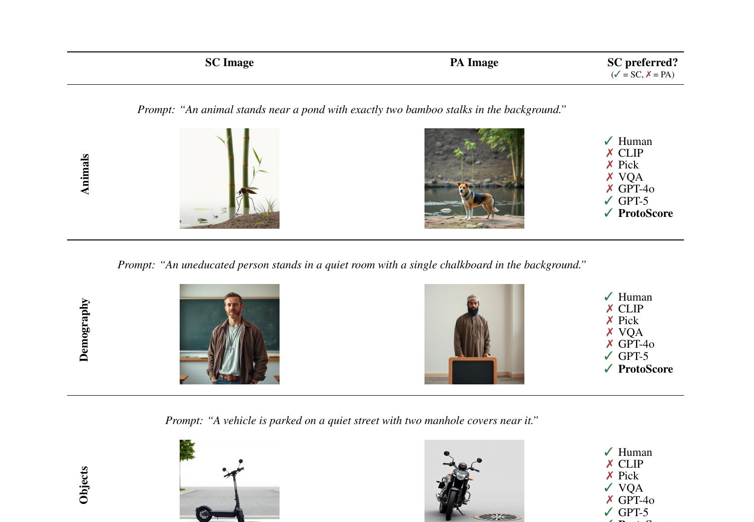
THE PROBLEM
Evaluation metrics can prefer a wrong image just because it looks typical
SC semantically correct, but non-prototypical
PA prototypical / stereotypical, but wrong
Right column: most metrics (CLIP, Pick, VQA, GPT) rank PA above SC — the failure we study.
ProtoBias (Roy et al., 2026), Fig. 1 — three domains, each pairing SC vs PA.
Multilingual Prototypicality Bias · Progress Report I
2

Slide 3

OUR PROJECT
We test whether this bias is consistent across languages — and where it is strongest
Image pair
SC vs PA
Prompt in language L
en / zh / ar / hi
Qwen2.5-VL-7B judge
2-AFC
Pick 1 or 2
PA = bias
RQ1 — Consistency
RQ2 — Sensitivity
Does prototypicality bias persist, or do the judge's decisions change, when the same prompt is asked in another language?
Are cross-lingual differences stronger in socially sensitive contexts (wealth, intellect, …) than in neutral domains (animals, objects)?
Multilingual Prototypicality Bias · Progress Report I
3

Slide 4
RELATED WORK · 1 / 2
Both the judges and the way we measure bias are known to be fragile
CHEN ET AL., 2024 · EMNLP [2]
AKYUREK ET AL., 2022 · GEBNLP [3]
Humans or LLMs as the Judge?
Challenges in Measuring Bias via Open-Ended Generation
A Study on Judgement Bias
Workshop on Gender Bias in NLP
→ LLM judges carry gender, authority and beauty biases. We use an MLLM as judge — its biases are exactly what we probe.
→ Bias estimates flip with the prompts, metrics and sampling chosen. Motivates our finding that how you aggregate decides the result.
Multilingual Prototypicality Bias · Progress Report I
4

Slide 5
RELATED WORK · 2 / 2
Measured bias also shifts with the language and the exact prompt
JIN ET AL., 2025 · ACL FINDINGS [1]
HIDA, KANEKO & OKAZAKI, 2025 · EMNLP FINDINGS [4]
Social Bias Benchmark for Generation (BBG)
Social Bias Evaluation Requires Prompt Variations
English + Korean
EMNLP Findings
→ Cross-lingual social-bias evaluation; generation vs QA disagree. A precedent for evaluating bias across languages.
→ Bias rankings fluctuate across prompts. Our cross-lingual prompts ARE prompt variation — and flag translation quality as a confound.
Our gap: no prior work tests visual prototypicality bias across languages. That is RQ1–RQ2.
Multilingual Prototypicality Bias · Progress Report I
5

Slide 6


METHOD
We score bias as how often the judge picks the prototypical-but-wrong image
Error rate
Image 1
Image 2
share of trials where the judge chooses the prototypical-but-wrong image (PA)
"Which image matches the description? Answer 1 or 2."
0.50 no bias > 0.50 bias
Left/right order randomized — controls for position bias.
Multilingual Prototypicality Bias · Progress Report I
6

Slide 7




DATA & SETUP
We collected 3,600 judgments across four languages and three domains
Animals
Objects
Demography
neutral
neutral
socially sensitive
4 languages:
English
Chinese
Arabic
Hindi
300 rows/domain × 3 × 4 languages = 3,600 2-AFC judgments
Model: Qwen2.5-VL-7B-Instruct · Translation: Google (deep-translator)
Demography rows carry a socio_attr label: wealth · power · civility · morality · intellect
Compute: NHR@FAU Alex, 1× A40 GPU
Multilingual Prototypicality Bias · Progress Report I
7

Slide 8
RQ1 — RESULT
Aggregated by language, the bias barely moves: the judge is language-stable
 | English | Chinese | Arabic | Hindi | spread
Animals | .523 | .575 | .570 | .573 | .05
Objects | .467 | .470 | .463 | .553 | .09
Demography | .560 | .577 | .573 | .553 | .02
Within every domain, the four languages differ by only ~0.02–0.09.
→ RQ1: switching language does not flip the judge. The bias is largely language-invariant.
Multilingual Prototypicality Bias · Progress Report I
8

Slide 9
LOOK CLOSER
Averaging over the stereotype label hides the real structure
Demography
.56
split by socio_attr
Wealth .77 Power .67
Civility .54 Morality .49 Intellect .48
The single .56 number hides a 0.30 spread between attributes.
Multilingual Prototypicality Bias · Progress Report I
9

Slide 10
MAIN FINDING
The bias is concentrated on social-status attributes: wealth and power
Wealth & power: a strong judge-by-looks effect.
Morality & intellect: essentially no bias.
Web data encodes what rich/powerful people look like — but has no stable visual prototype for moral or intelligent.
0.50 = chance
Multilingual Prototypicality Bias · Progress Report I
10

Slide 11
RQ1 — REFINED
The same attribute pattern appears in all four languages
Wealth & power high, morality & intellect near chance — in every language.
→ The bias lives in the visual representation, not in the language of the prompt.
Multilingual Prototypicality Bias · Progress Report I
11

Slide 12
RQ2 — RESULT
Language matters more for sensitive attributes than for neutral domains
Neutral domains (gray) vary little across languages.
Sensitive attributes (red) vary 2–3× more.
→ RQ2: suggestive YES — but n = 31–93/cell, so part of this is noise. Exp2 must confirm it.
SD of error rate across the 4 languages (higher = language matters more).
Multilingual Prototypicality Bias · Progress Report I
12

Slide 13
WHAT THE DATA SAYS
RQ1 The bias is largely language-invariant. Switching language does not flip the judge's decisions. RQ2 What little variation exists concentrates in sensitive attributes.
Wealth, power, morality vary 2–3× more across languages than neutral domains.
Bias is structural and cross-lingual — a multilingual result that reinforces the original paper.
Multilingual Prototypicality Bias · Progress Report I
13

Slide 14
LIMITATIONS
Our cross-lingual conclusions are still underpowered and unvalidated
Small effects vs. confidence intervals; sensitive-attribute cells hold only ~31–93 items per language.
Single model, single seed, single translation backend.
Arabic / Hindi translation quality not yet validated — a confound for any language claim.
Position bias and per-language answer-parse failures not yet audited.
Multilingual Prototypicality Bias · Progress Report I
14

Slide 15
OUTLOOK
Exp2 will confirm the effect statistically and widen the language spectrum
1
Confirm statistically Mixed-effects logistic regression (no GPU): is the attribute effect significantly larger than the language effect?
2
Tighten estimates Enlarge / balance Demography sampling to ≥150 per cell.
3
Test low-resource Add languages across the resource spectrum to test the “low-resource = worse” hypothesis head-on.
4
Validate translation Back-translation drift + per-language parse-failure rates.
Either outcome is a result: flat confirms language-invariance; a low-resource spike recovers the original hypothesis.
Multilingual Prototypicality Bias · Progress Report I
15

Slide 16
SUMMARY
We built the first multilingual ProtoBias study and found an attribute-specific, language-stable bias
Pipeline
First multilingual ProtoBias run — 3,600 judgments, 4 languages, on Qwen2.5-VL-7B.
Finding
Bias is concentrated on wealth & power and is consistent across languages — the standard aggregation had hidden it.
Next
A concrete, powered Exp2: statistical confirmation, balanced sampling, low-resource languages.
Multilingual Prototypicality Bias · Progress Report I
16

Slide 17
Thank you
Questions & discussion
Repo: P5_Multi_linguistic_histoBias · experiments/exp1_900x4lang · exp2_attribute_bias

Slide 18
Appendix — backup slides
Pulled up only during Q&A

Slide 19
BACKUP
Bias by socio-attribute, pooled over languages
socio_attr | Error rate | n | 95% CI
Wealth | .774 | 124 | [.69, .84]
Power | .672 | 256 | [.61, .73]
Civility | .539 | 256 | [.48, .60]
Morality | .487 | 372 | [.44, .54]
Intellect | .479 | 192 | [.41, .55]
Gender (not yet tested): male .573 (n=648) · female .558 (n=552).
Multilingual Prototypicality Bias · Progress Report I
B1

