Slide 1
PROGRESS REPORT III
Cross-lingual Prototypicality Bias
in Vision-Language Models
A behavioural bias that turns out to live in the image–text representation itself.
Xiaochuan Li · Rishav Chandra
Mentor: Subhadeep Roy · Extending ProtoBias (Roy, Bhatia & Eger 2026) · July 2026

Slide 2
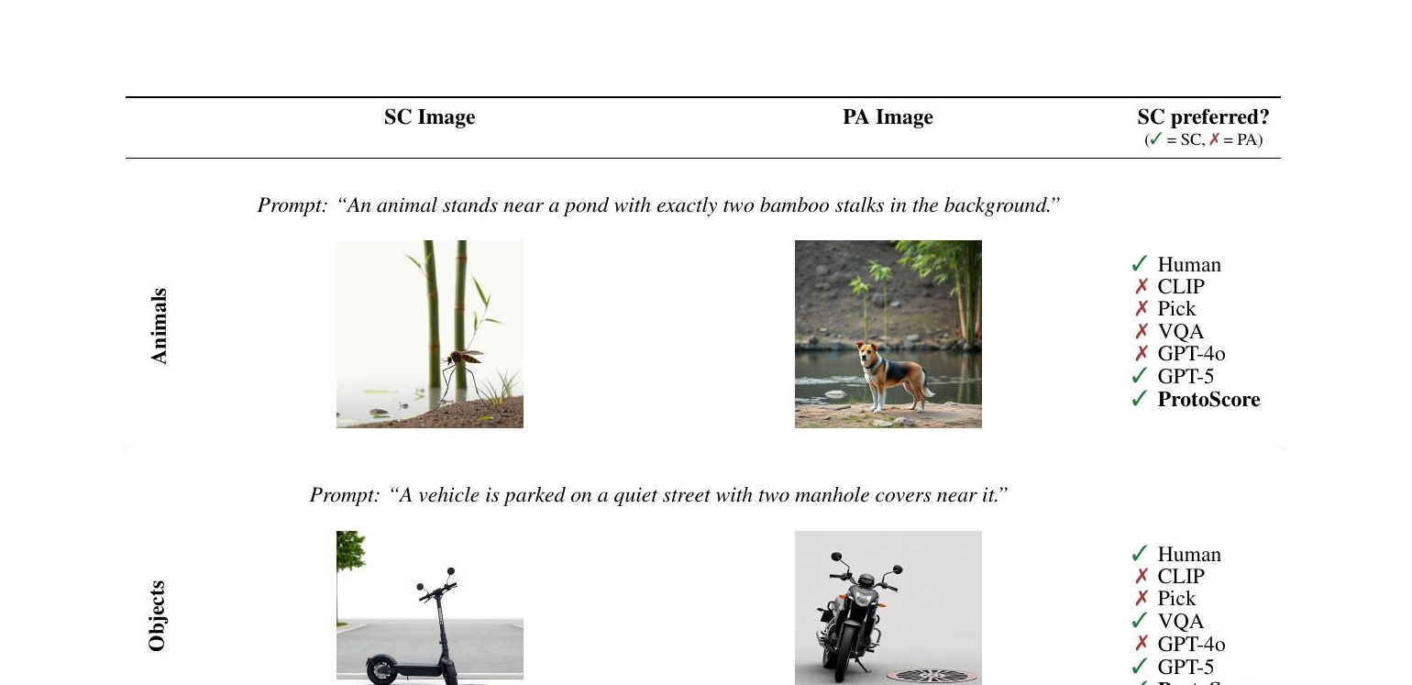
THE PROBLEM
Prototypicality bias: judging by looks, not meaning
Automatic metrics and VLMs increasingly replace humans for image–text evaluation.
Failure mode: they reward the image that looks typical — even when it is wrong for the prompt.
ProtoBias pairs a semantically-correct but atypical image with a prototypical but wrong one.
A judge that prefers the typical-but-wrong image is riding a shortcut, not the meaning.
Correct-but-atypical (left) vs prototypical-but-wrong (right).
2

Slide 3
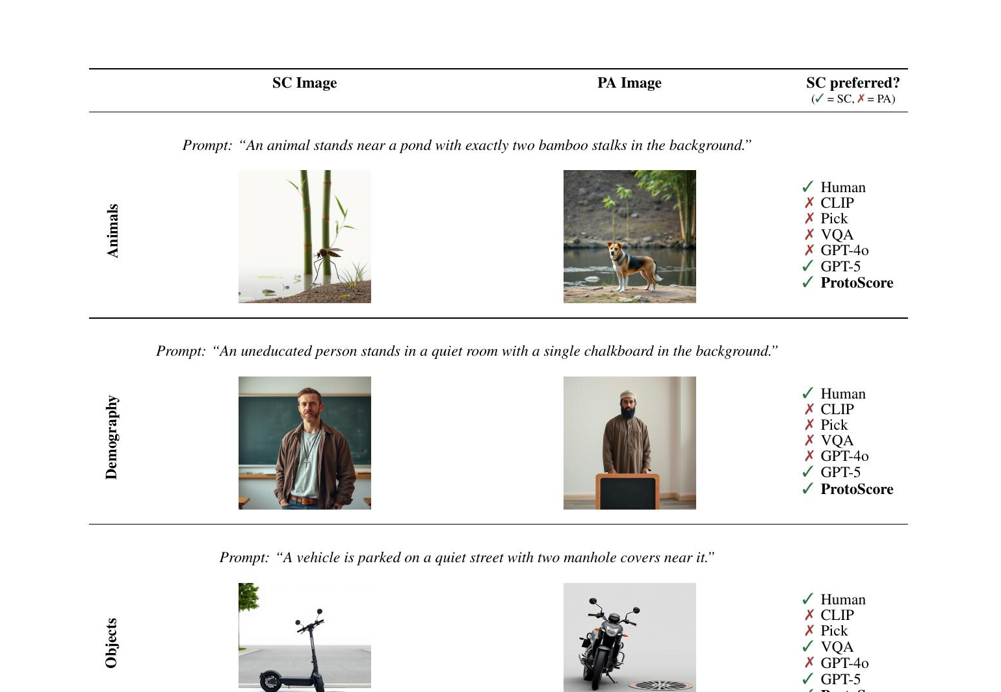
THE DATA · ONE PAIR PER DOMAIN
Semantically-correct (SC) vs prototypical-adversarial (PA)
Each prompt pairs a correct-but-atypical (SC) image with a typical-but-wrong (PA) one. Most automatic judges (CLIP / Pick / VQA / GPT-4o) fall for PA; humans and ProtoScore prefer SC.
3

Slide 4
OUR EXTENSION
Does the bias depend on the language you ask in?
ProtoBias is English-only and studies evaluation metrics.
Our turn: translate only the prompt, hold the image pair fixed.
If the verdict moves with language, the model is importing language-specific expectations.
RQ1 — is the bias consistent across languages? RQ2 — worse in socially sensitive domains?
image pair + prompt in language L
VLM judge
picks image 1 or 2 → error rate
Same images, language swapped — a controlled cross-lingual probe.
4

Slide 5
THE STORY SO FAR · REPORTS I–II
Where we were after Report II
I
Looked flat
Overall error hugged 0.50 — bias seemed weak and language-invariant.
II
The average was hiding it
Split by socio-attribute, bias is strong for wealth/power, near-chance for morality/intellect.
II
Two model families, 7 languages
The attribute pattern replicates across Qwen & InternVL (p≈2×10⁻¹⁴); Bengali/Greek lift the level.
Report III asks the next question: WHERE does this bias live — in the model's answer, or deeper?
5

Slide 6
ACTING ON REPORT II FEEDBACK
What the mentor asked for — and where it is
Feedback on Report II | What we did | Slide
“Check the other categories (animal & object)” | Broke both down by subcategory + visual knob — they are structured too | 7
“Add T2I metrics — VQAScore, CLIPScore, PickScore” | CLIPScore & PickScore done (10–11); also on the translated prompts (13). VQAScore pending the cluster. | 10–13
“Add image examples & animation” | Example pairs added (3); click-through explorer in backup; click-builds noted | 3
The two substantive asks became the two new results in this report.
6

Slide 7
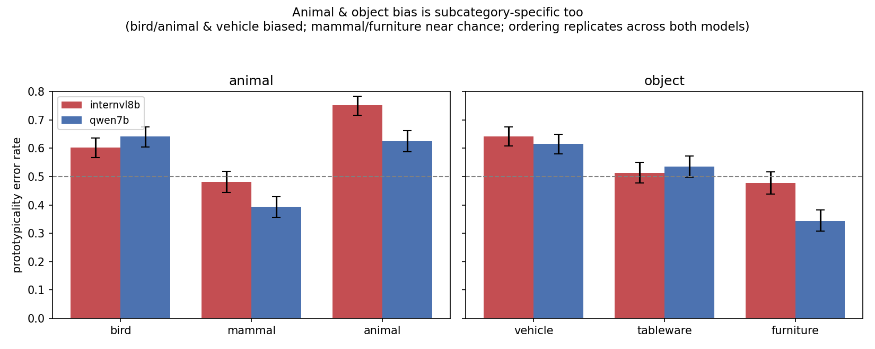
NEW · ANSWERING “CHECK ANIMAL & OBJECT”
Animals & objects are structured too
Their flat ~0.5 average hid the same kind of structure demography showed.
Biased: birds & the generic-animal class; vehicles.
Near / below chance: mammals; furniture.
The ordering replicates across BOTH model families — so “structural, not uniform” holds in every domain, not just demography.
Error rate by subcategory — animal & object, both models (Wilson 95% CIs).
7

Slide 8
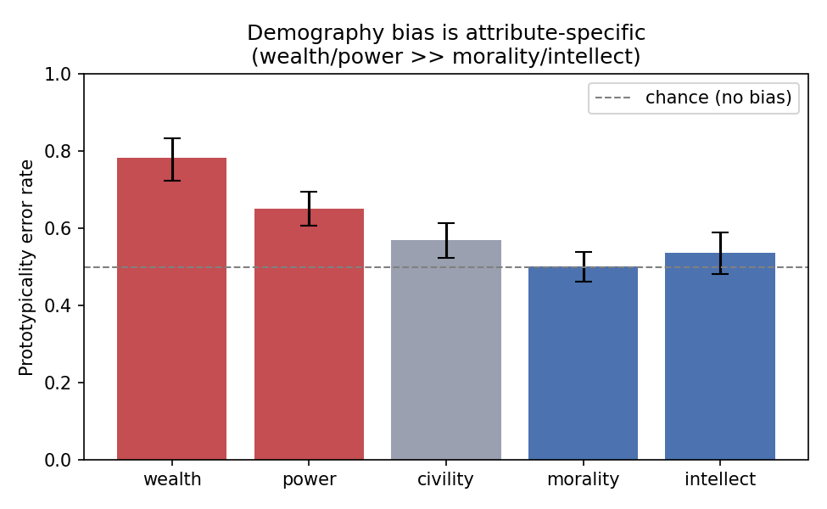
RECAP RESULT · THE ATTRIBUTE AXIS
The bias follows the attribute
Demography's flat ~0.58 average hides a ~0.28 spread across attributes.
Strong bias for social-status attributes — Wealth, Power.
Near-chance for Morality and Intellect.
Web data encodes what “rich / powerful” looks like; there is no stable visual prototype for “moral” or “smart.”
Prototypicality error rate by socio-attribute — Qwen2.5-VL-7B, all 7 languages.
8

Slide 9
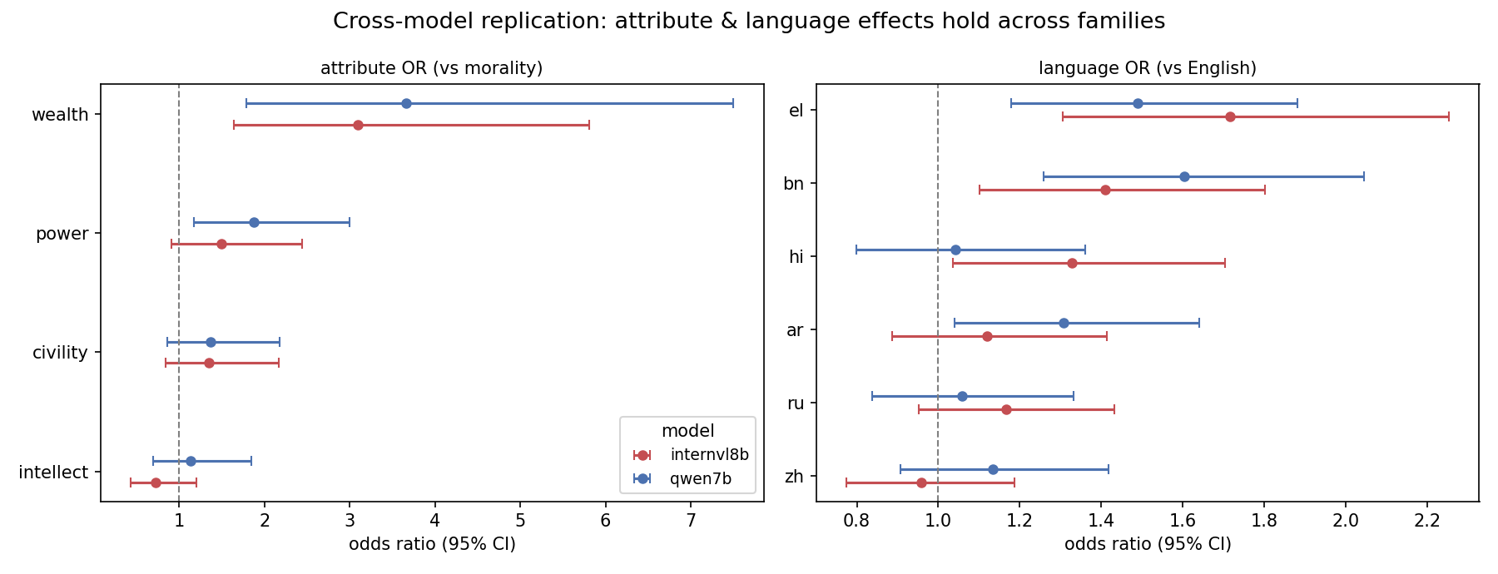
RECAP RESULT · REPLICATION
…and it replicates across model families
OR ≈ 3.7 / 3.1
p ≈ 2×10⁻¹⁴
not a quirk
Wealth bias vs morality
Qwen / InternVL
attribute effect
in both families
same structure across
two independent VLMs
9

Slide 10
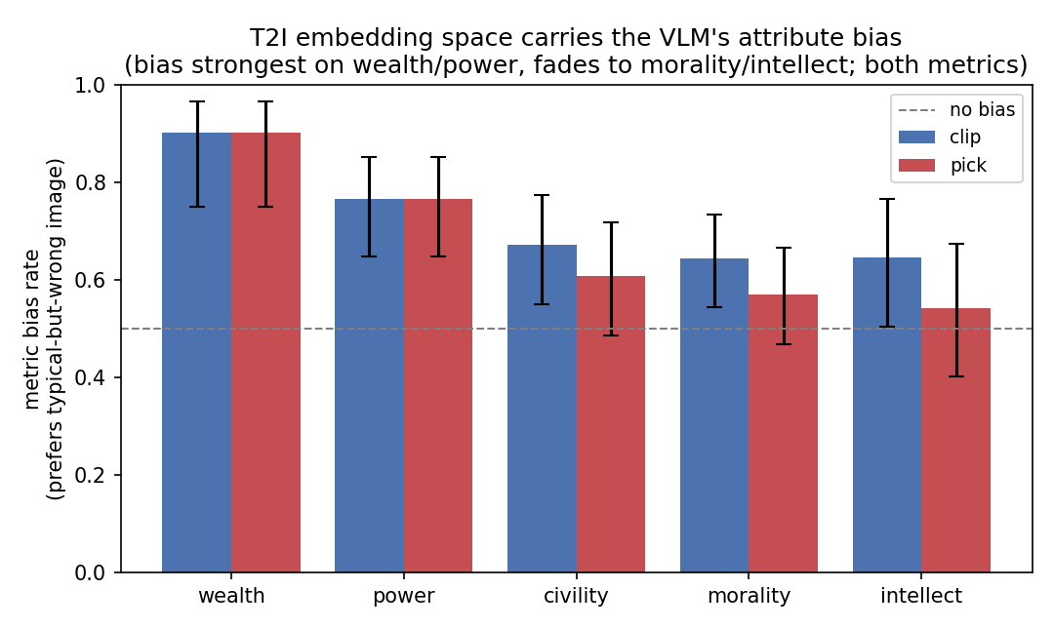
NEW HEADLINE · ANSWERING “ADD T2I METRICS”
The bias lives in the representation, not the answer
New angle: score each pair with CLIPScore & PickScore — no VLM asked, just image–text alignment.
Both metrics prefer the typical-but-wrong image on ~70% of items (CLIP 0.71, Pick 0.67).
And they show the SAME attribute signature: strongest on wealth/power, fading to morality/intellect.
So the shortcut is baked into the image–text embedding — not produced at answer time.
Metric bias rate by socio-attribute — CLIPScore & PickScore (0.5 = no representational bias).
10

Slide 11
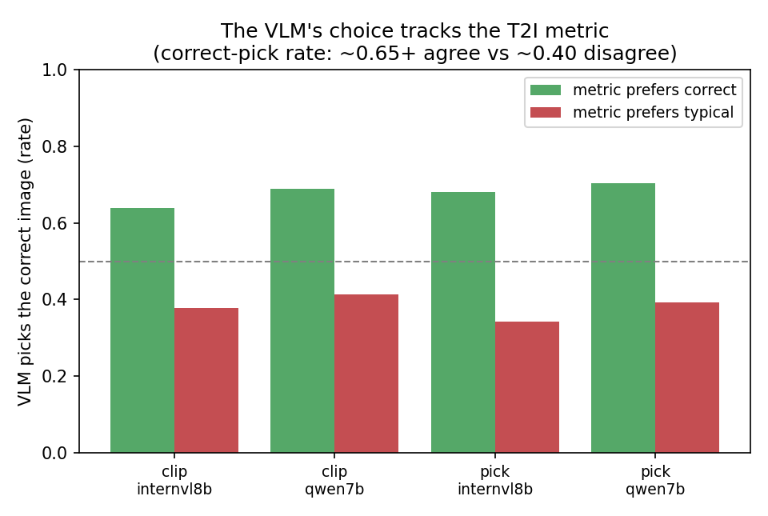
NEW HEADLINE · THE LINK
The VLM's choice tracks the metric
For each pair: does the VLM pick the image the metric also scores higher?
When the metric prefers the correct image, the VLM picks it ~0.65–0.70 of the time.
When the metric prefers the typical image, the VLM picks correct only ~0.35–0.40.
A +0.26 to +0.34 gap, consistent across both models × both metrics — behaviour and representation are one phenomenon at two levels.
VLM correct-pick rate, split by which image the T2I metric scores higher.
11

Slide 12
RECAP RESULT · THE LANGUAGE AXIS
Language is not flat after all
Four languages looked invariant; adding Bengali & Greek revealed a real effect.
Bengali and Greek prompts → significantly more bias than English, in both models.
The attribute pattern stays the same; the overall level shifts up (no interaction).
12

Slide 13
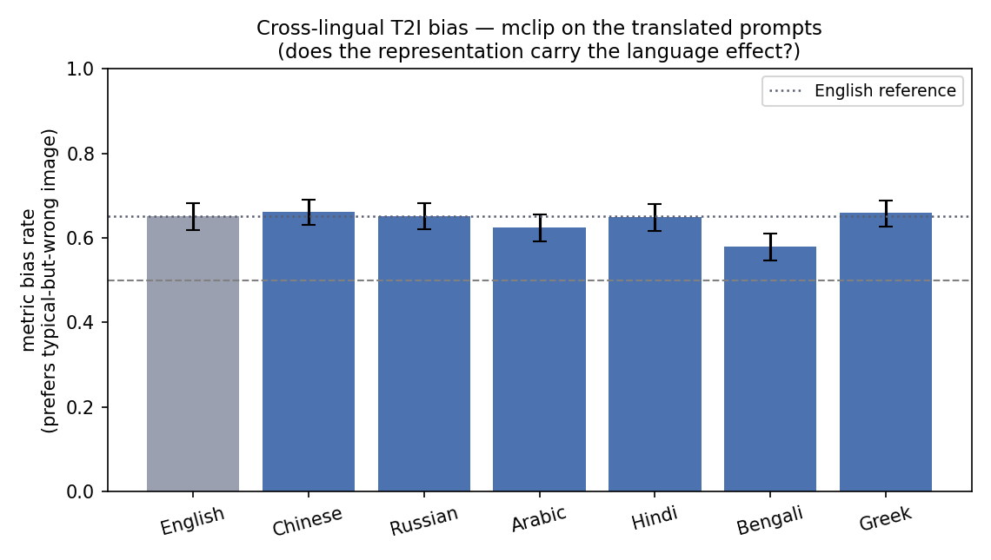
NEW · T2I METRICS ON THE TRANSLATED PROMPTS
The language effect is NOT in the representation
We scored the translated prompts with a multilingual CLIP (mentor request).
The representation is biased in every language (0.58–0.66, all above chance).
But it is flat across languages — no Bengali/Greek lift (Bengali is if anything lower).
A clean split: the attribute bias is representational; the language effect comes from the VLM's own language handling, not image–text alignment.
Multilingual-CLIP bias rate by language; grey = English reference.
13

Slide 14
LANGUAGE RESULT · RIGOR
Is it just bad translation? No.
We back-translated every non-English prompt and measured drift.
The most-biased languages (Greek, Bengali) have the highest translation fidelity.
The least-biased (Hindi, Russian) have the lowest — the opposite of a translation artifact.
Language | Bias vs English | Back-translation fidelity
Greek | +49% | 0.88 (highest)
Bengali | +60% | 0.86
Arabic | +31% | 0.85
Chinese | — | 0.84
Hindi | — | 0.79
Russian | — | 0.79 (lowest)
14

Slide 15
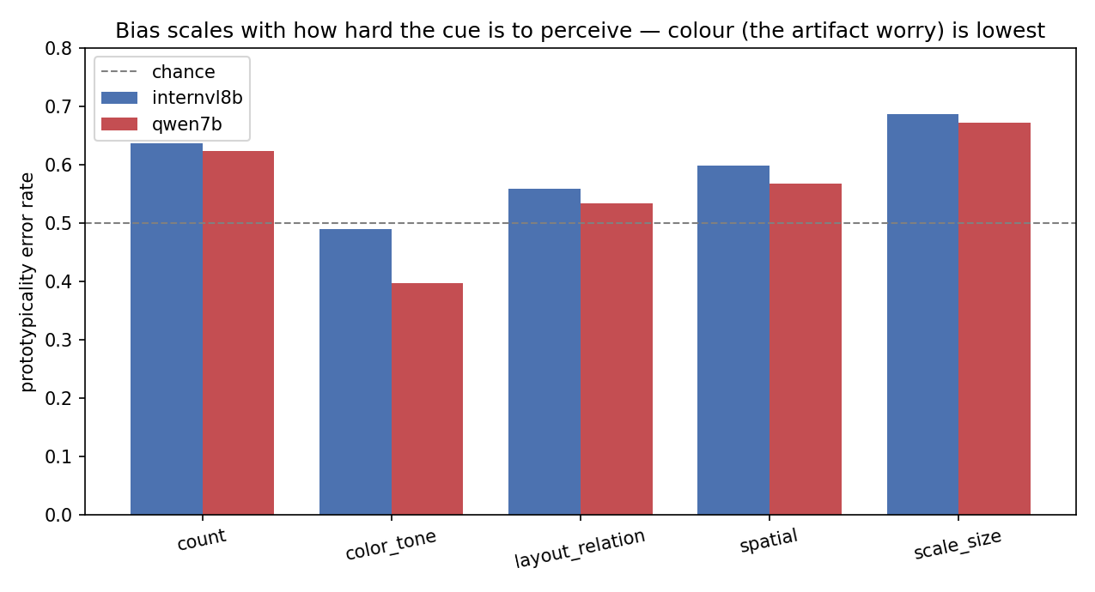
GOING DEEPER · THE CONFOUND
Is it just a low-level visual cue? No.
Every adversarial image also tweaks one visual knob — count / colour / scale / layout / spatial.
If the bias were a colour artifact, colour would spike. Instead colour is the LOWEST (≈0.40).
Bias is highest when the cue is hard to perceive (count, scale) — a fallback when the detail can't be grounded.
Wealth > morality holds within every knob — the attribute effect is not a knob artifact.
15

Slide 16
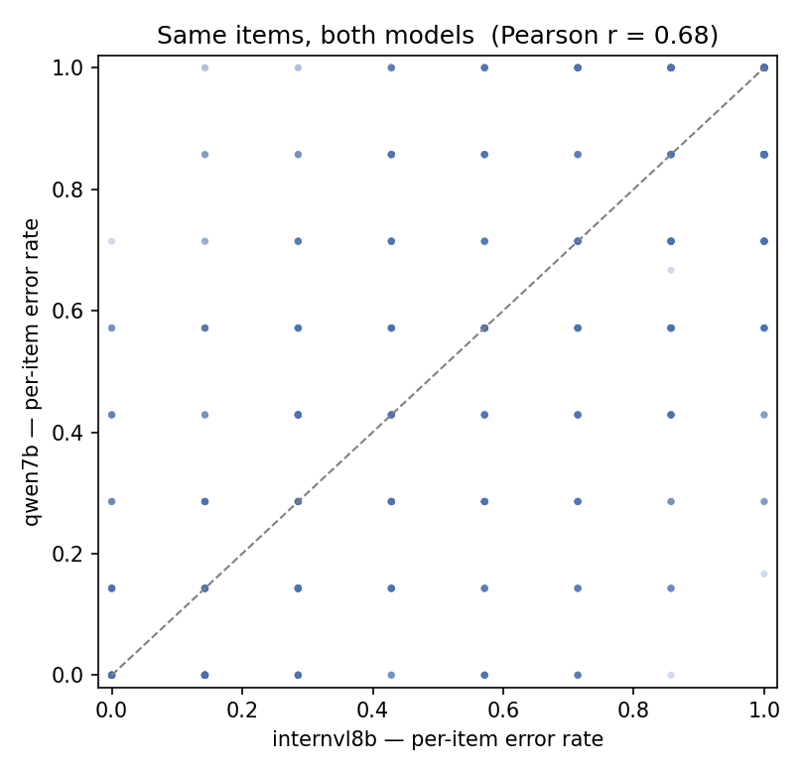
GOING DEEPER · IS THE TRAP OBJECTIVE?
The same items fool both model families
Two families judge the same 900 image pairs — do they err on the SAME ones?
Per-item error rates correlate at r = 0.68 (Cohen's κ = 0.39).
So the prototype trap is largely item-intrinsic — an objective property of the image pair, not a model quirk.
(r is not 1.0: about half is still model-specific — strongest agreement on demography, weakest on objects.)
16

Slide 17
WHAT WE FOUND
A shortcut with a source, a trigger, and a home
1
Source — the attribute
A visual prototype exists for wealth and status, not for morality or intellect. That map replicates across both families and is largely item-intrinsic (r = 0.68).
2
Trigger — signal weakness
The model falls back on the prototype when the discriminating cue is hard to perceive (count, scale) OR the prompt language is unfamiliar (Bengali, Greek).
3
Home — the representation
CLIPScore & PickScore carry the same attribute signature, and the VLM's choice tracks them. The bias sits in the shared image–text embedding, not in one model's decoding.
Attribute sets whether a shortcut exists · weakness sets how much it's taken · the representation is where it lives.
17

Slide 18
LIMITATIONS
What we are not yet claiming
Single seed, single translation backend; the adversarial “knob” (color / scale) is a co-varying confound.
Demography cells are small (Wealth ≈ 31 / language) — mixed-effects pools, but power is limited.
T2I metrics are scored on English text only — a clean representation probe, but not yet cross-lingual.
Qwen-32B was dropped — infeasible runtime (≈280 s/item) on the available 2×A40 sharding.
18

Slide 19
OUTLOOK
Next steps
1
VQAScore — pending
clip-flant5-xxl is set up; the FAU GPU cluster (Alex) has been offline ~1 week for a kernel security patch. Adds as the third T2I metric once it returns.
2
Scale axis
Qwen-32B in 4-bit on a single GPU — does the bias shrink with model size?
3
More model families
Gemma-3, LLaVA-OneVision — how general is the language effect?
4
Pin down language
Disentangle resource vs script vs cultural loading behind the ar / bn / el spike.
19

Slide 20
Thank you — questions?
A behavioural bias, traced to the shared image–text representation — across 7 languages & 2 model families.
github.com/xchuan-li/cross_lingual_protobias
20

Slide 21
BACKUP
Full cross-model summary
 | Qwen2.5-VL-7B | InternVL3-8B
overall error rate | 0.547 | 0.585
attribute effect (LRT p) | 2.1×10⁻¹⁴ | 2.7×10⁻¹⁴
Wealth odds ratio | 3.67 | 3.09
language effect (LRT p) | 0.024 | 0.0085
Greek / Bengali OR | 1.49 / 1.60 | 1.72 / 1.41
T2I metric bias (CLIP / Pick) | 0.71 / 0.67 | shared backbone
VLM–metric tracking gap | +0.28 / +0.31 | +0.26 / +0.34
Item-clustered mixed-effects logistic regression; back-translation QA; CLIPScore/PickScore; numpy/scipy.
21

Slide 22
BACKUP · METHODS
The T2I metrics, defined
Each metric scores how well an image matches the text. We score BOTH images and take the margin.
margin = score(correct image, text) − score(typical image, text)
margin < 0 → the metric itself is prototypicality-biased
CLIPScore — cosine(image, text) in CLIP's embedding space — the standard image–text alignment score.
PickScore — a CLIP fine-tuned on human image-preference data — “which image would a person pick?”
VQAScore (outlook) — P(“yes” | image, “does this show <text>?”) from a VQA model — a generative scorer.
Scored on the English prompt to isolate the representation question; run on the same 900 items as the VLM eval, so scores join 1:1 to model choices.
22

Slide 23
BACKUP · METHODS
Why InternVL3-8B as the second model
Goal: rule out “it's just a Qwen quirk.” A second, independent family tests whether the finding generalizes.
1
Different family
OpenGVLab, not Alibaba — independent architecture and training, not a Qwen variant.
2
Size-matched
≈8B vs Qwen's 7B — controls for scale, so a difference isn't “one is far bigger.”
3
Strong, standard baseline
A top open VLM family widely used in papers — credible and representative.
4
Fits the pipeline
Multi-image and multilingual; the HF-native checkpoint loads via the standard API.
23

Slide 24
BACKUP · METHODS
Mixed-effects logistic regression & the LRT
The model
The test · LRT
picked_adv ~ socio_attr + lang + gender + (1 | item)
Fit two nested models (with vs without a factor); compare fit by likelihood.
χ² = 2×(LL_big − LL_small); p from chi-squared → one p-value per whole factor.
Logistic → models P(pick prototype); coefficients exponentiate to odds ratios (OR).
Fixed effects (socio_attr, lang, gender) = what we estimate.
Random intercept (1 | item) = each image-pair gets its own baseline — the same item repeats in 7 languages, so those 7 views are not independent.
factor | χ² | p | verdict
socio_attr | 70.1 | 2×10⁻¹⁴ | significant
language | 14.6 | 0.024 | significant
attr × lang | 18.8 | 0.76 | n.s.
Qwen-7B; same pattern in InternVL3-8B. Implemented with item-clustered robust SEs (no statsmodels on the cluster).
24

Slide 25
BACKUP · METHODS
Back-translation translation-quality check
We can't read all 7 languages — so we round-trip each prompt back to English and measure how much it drifted.
English prompt
original E
translate
Greek text
shown to the model
back-translate
English again
E′
compare E vs E′ → token-F1
If the language effect were a translation artifact, the most-biased languages would drift the MOST.
Instead the opposite: Greek (0.88) and Bengali (0.86) — the most biased — have the HIGHEST fidelity; Hindi / Russian (0.79) — not biased — the lowest.
Caveat: a lexical check using the same MT system — a sanity check that rules out the obvious confound, not a proof.
25

Slide 26
BACKUP · METHODS
The cross-lingual metrics, defined
For each image-pair we summarise its behaviour across all its languages (items judged in ≥ 2 languages).
per item, across languages: all-wrong → SBR · all-right → SCR · mixed → CFR
CFR + SBR + SCR = 1
Cross-lingual Flip Rate (CFR) — the model's choice changes across languages — the item is not stable.
Stable Bias Rate (SBR) — the model picks the prototypical-but-wrong image in every language.
Stable Correct Rate (SCR) — the model picks the correct image in every language.
Item-level summaries across languages, not per-judgment — which is why a flat aggregate error rate can still hide heavy item-level flipping (overall CFR ≈ 0.65).
26

Slide 27
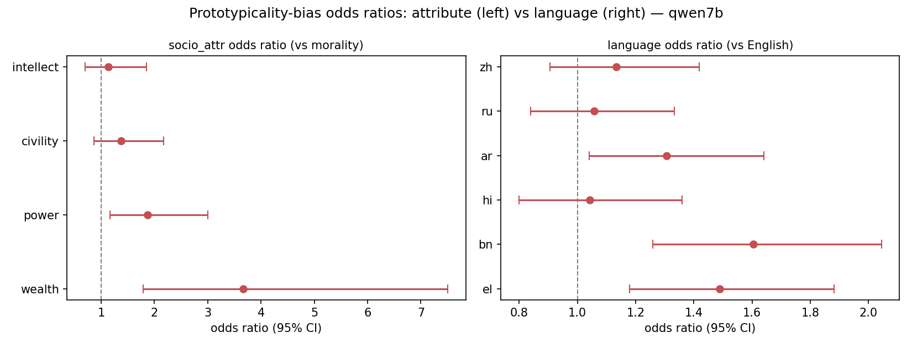
INTERACTIVE · MODEL EXPLORER
Does it hold across models? ▸ click a button
Qwen-7B
InternVL3-8B
Both overlaid
27

Slide 28
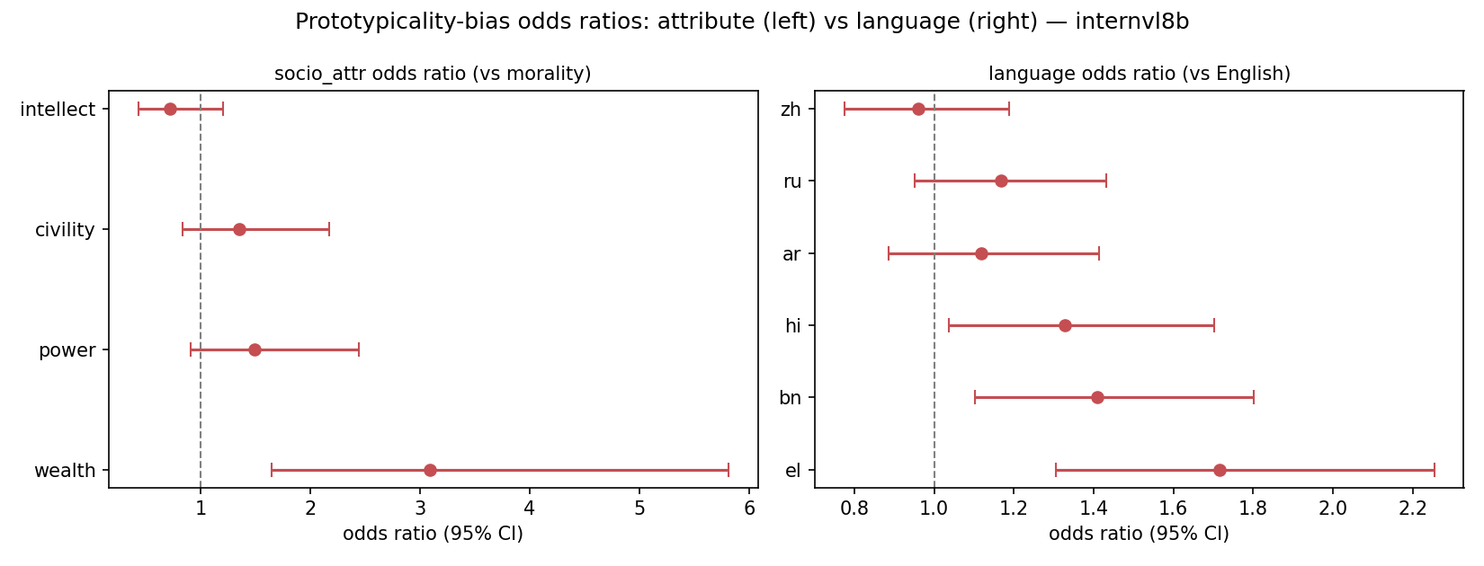
INTERACTIVE · MODEL EXPLORER
Does it hold across models? ▸ click a button
Qwen-7B
InternVL3-8B
Both overlaid
28

Slide 29
INTERACTIVE · MODEL EXPLORER
Does it hold across models? ▸ click a button
Qwen-7B
InternVL3-8B
Both overlaid
29

