Slide 1
Visualization & CAD
Animation of the procession of penitents among penitents
29. dubna 2020
Patrik Chukir
Faculty of Information Technology
Brno University of Technology

Slide 2
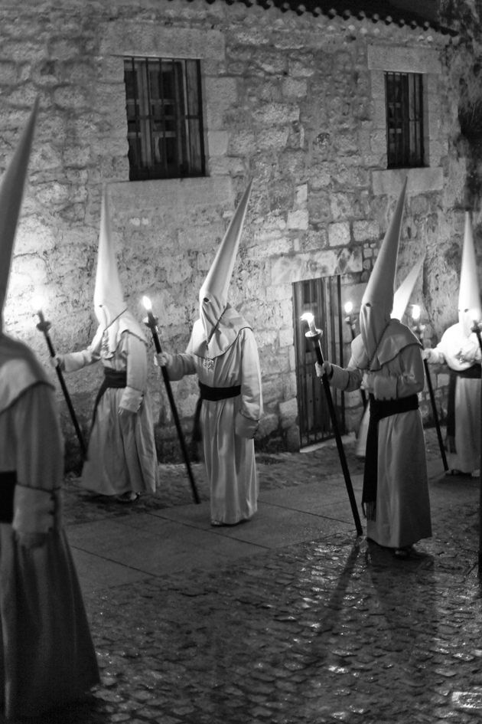
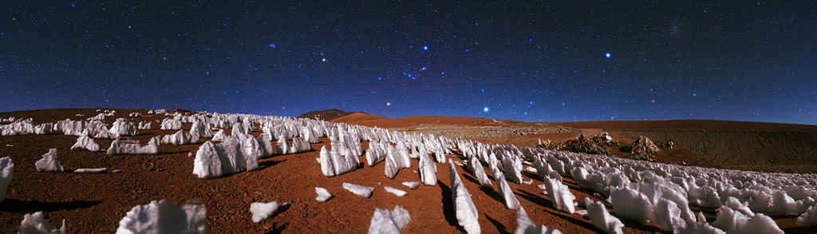
Penitente and Penitentes
Snow formation
Flagellant orgin from spain
Source:https://www.pinterest.es/pin/419116309057507217/
Source:https://en.wikipedia.org/w/index.php?title=Penitente_(snow_formation)

Slide 3
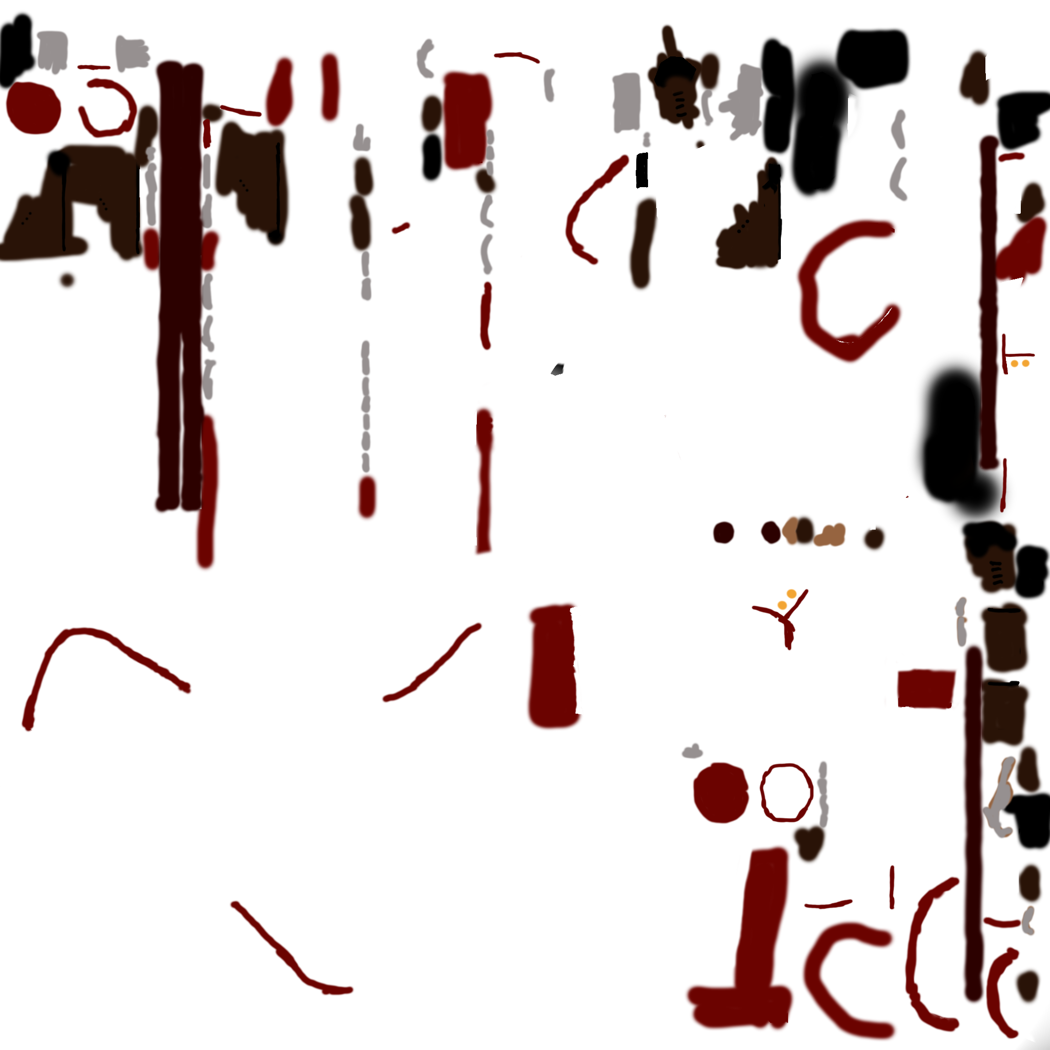
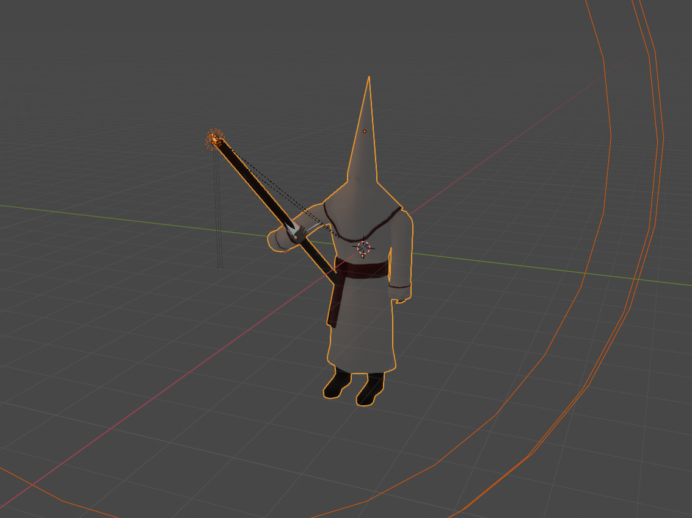
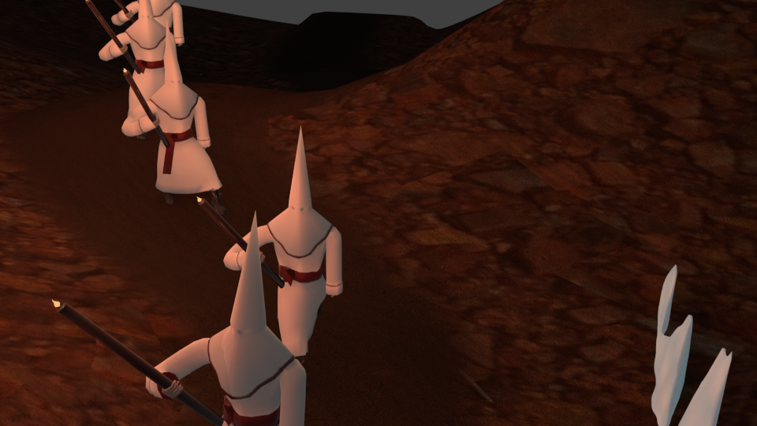
Penitente Model
Combination of 6 meshes,
3 light source and bones/armature.

Slide 4
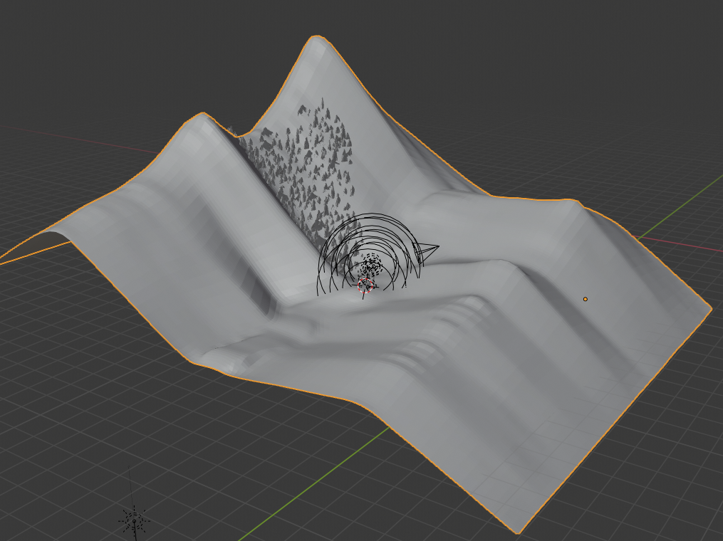
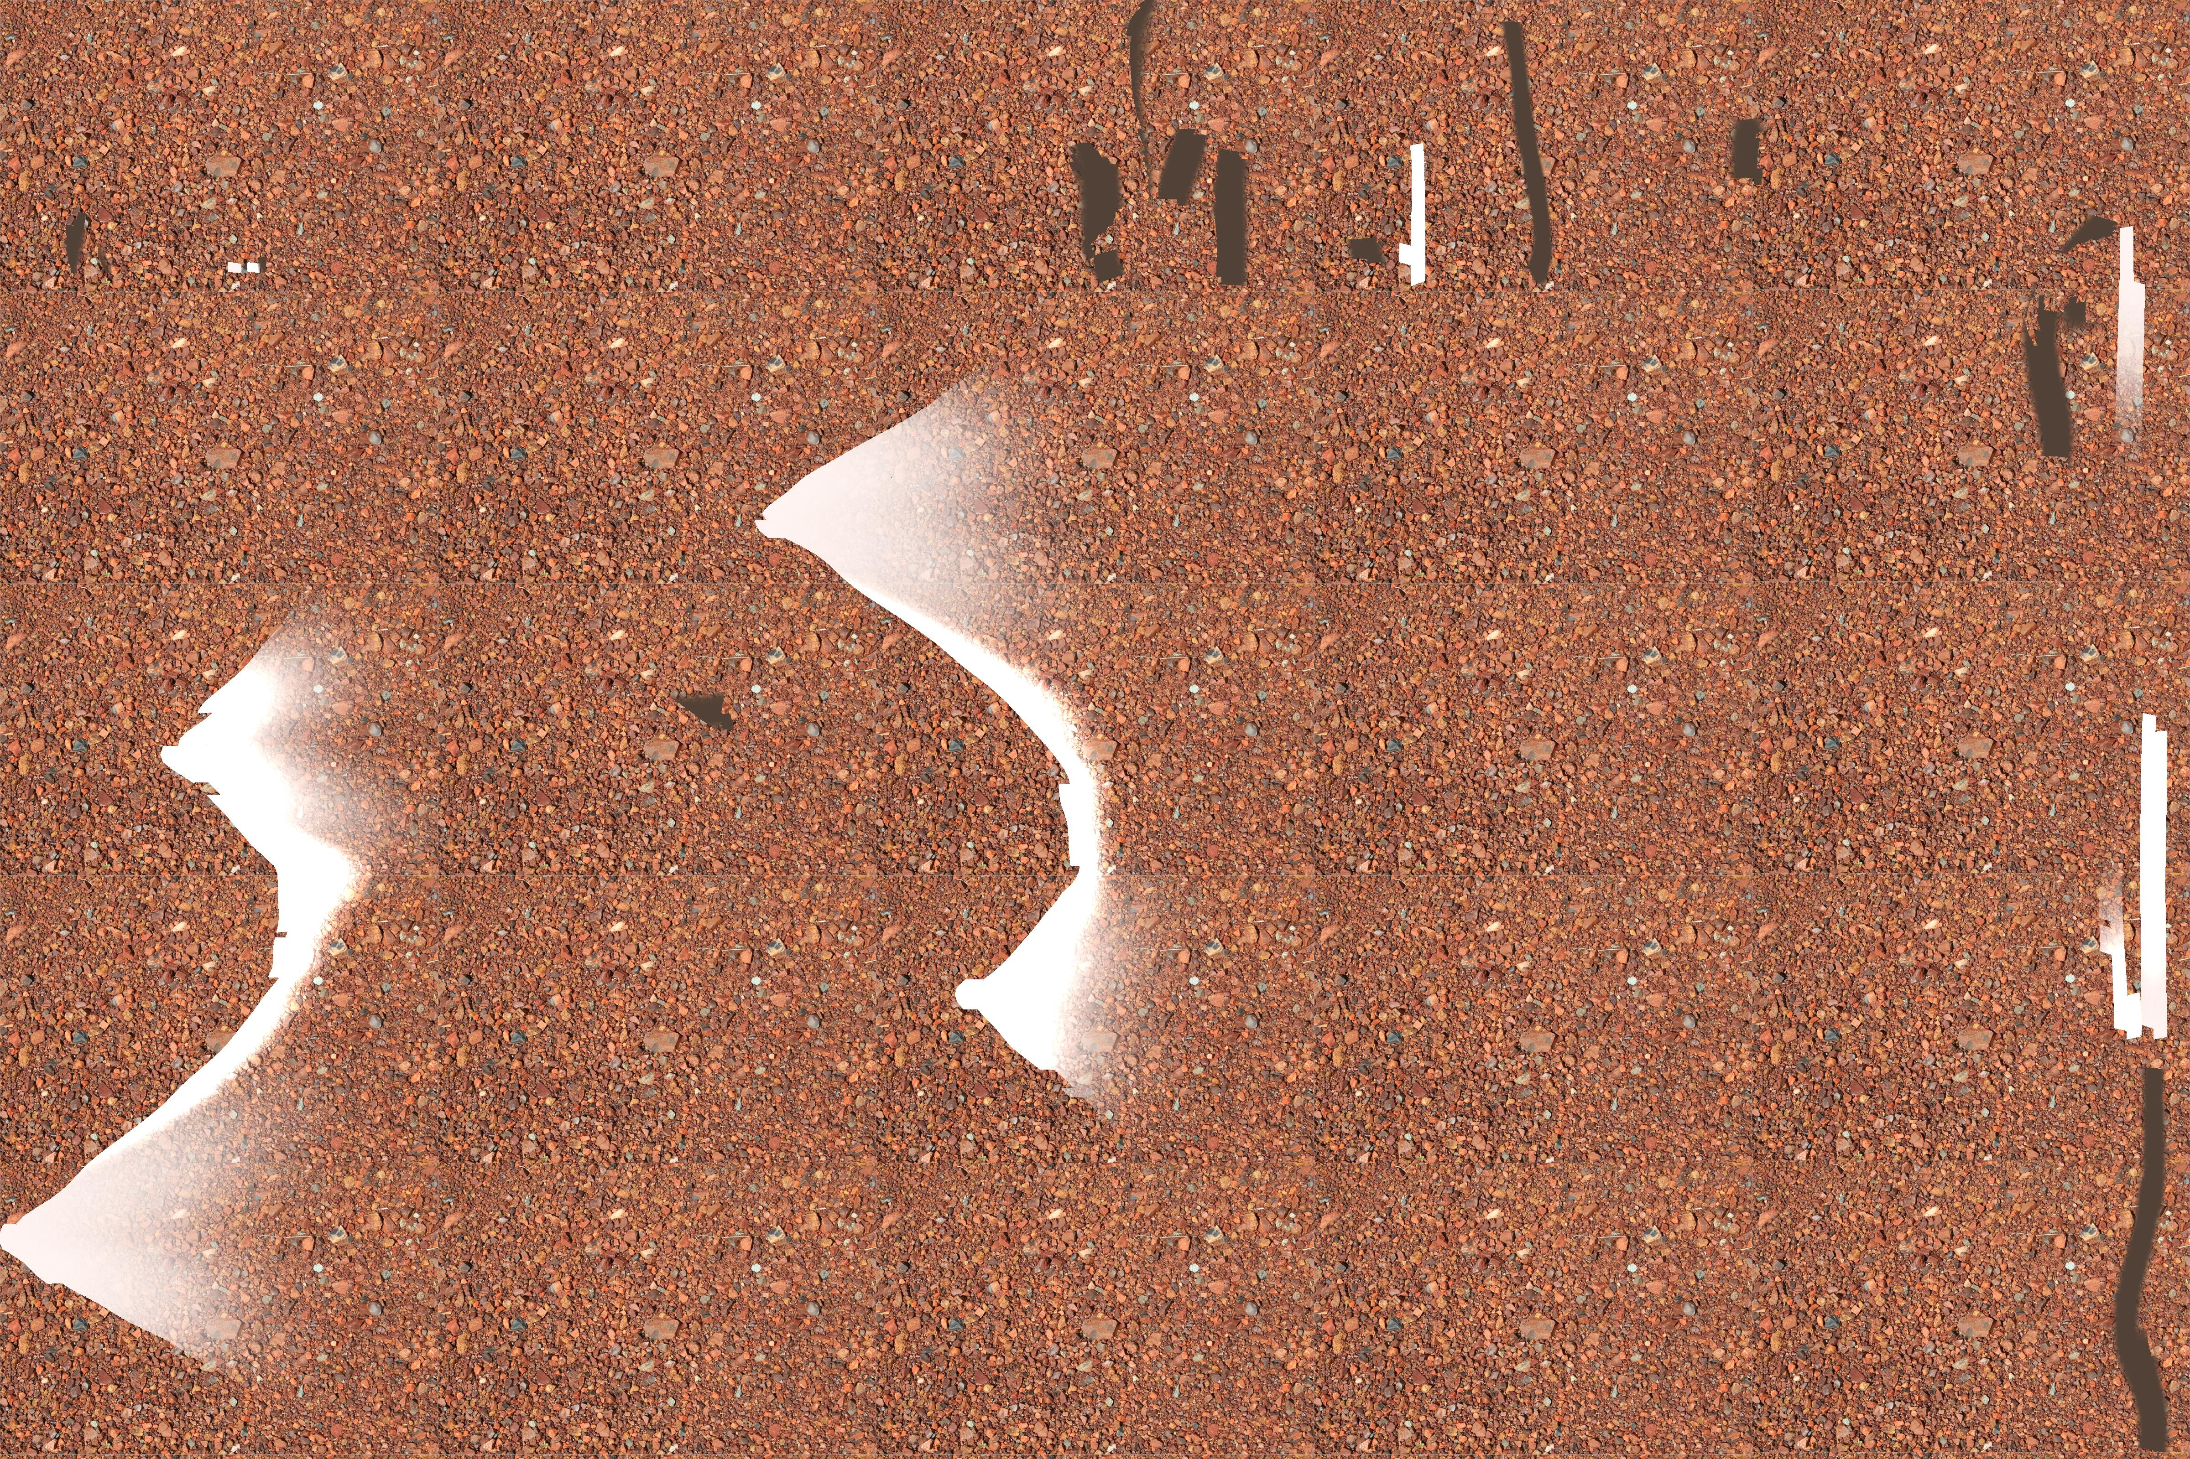
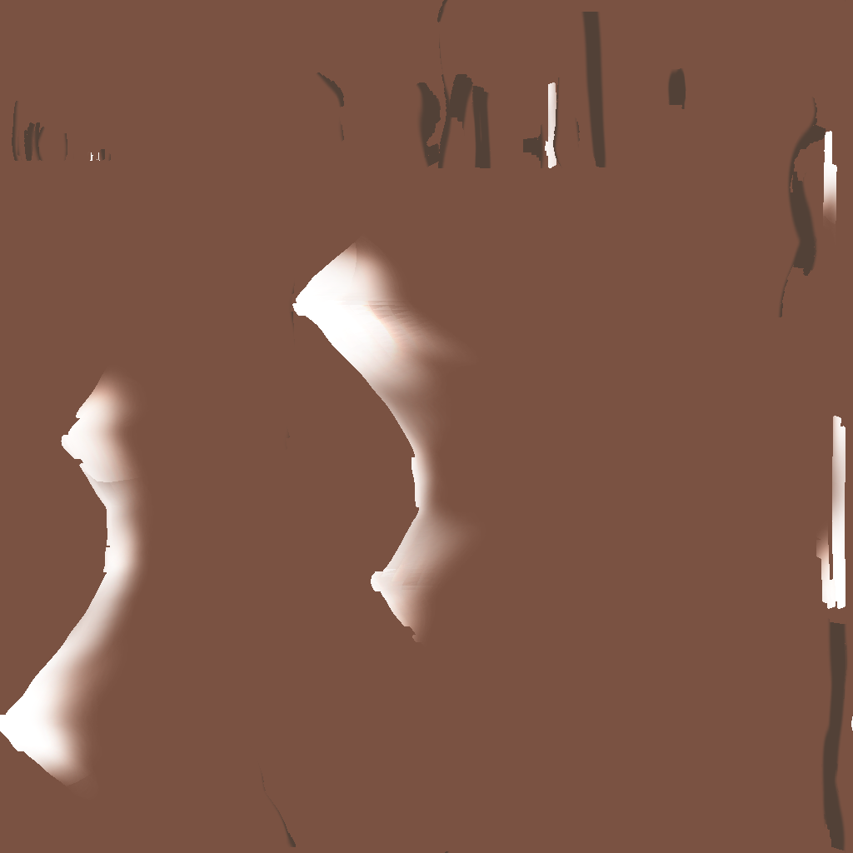
Terrain and textures
From plane by subdivision and scult mode
Texture is based on image form pixbay
Mixed with three other red/brown colors and randomise normals and roughnes
Source:https://cdn.pixabay.com/photo/2015/04/18/07/13/rocks-728393_960_720.jpg

Slide 5
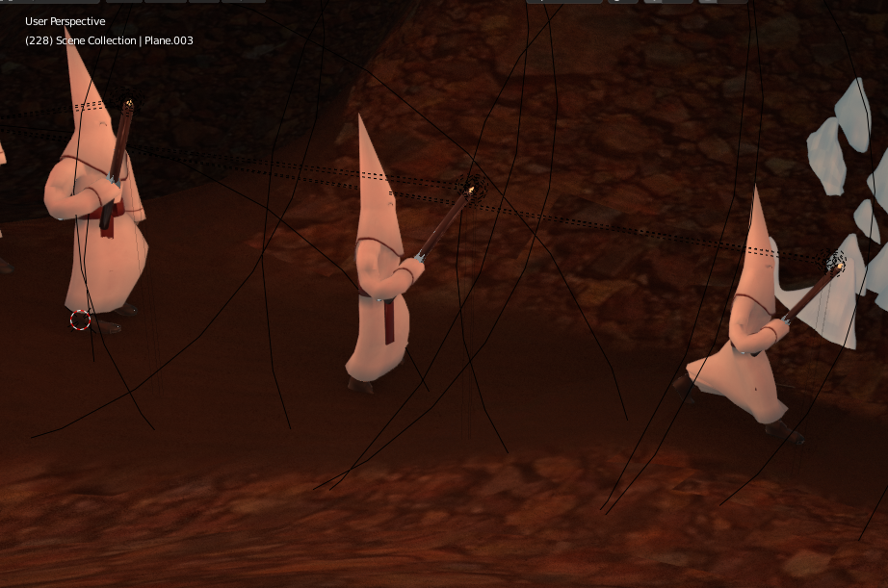
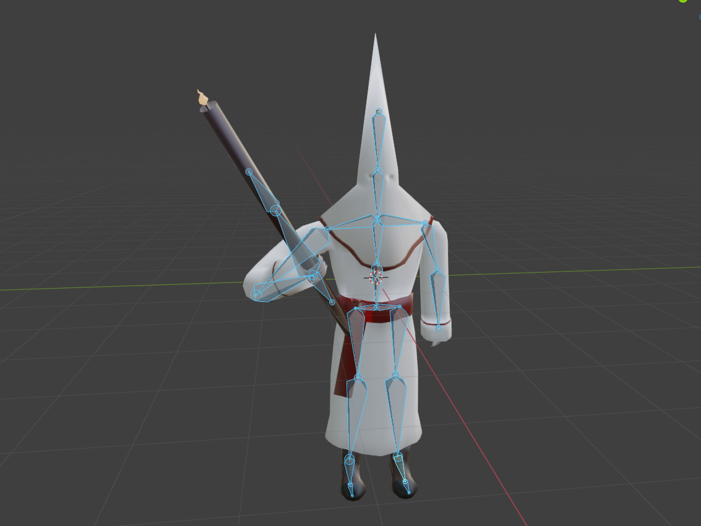
Skeletal animation

Slide 6


