Slide 1
A Soft Label Strategy for Target-Level Sentiment Classiﬁcation
Da Yin¹, Xiao Liu¹, Xiuyu Wu¹, Baobao Chang¹
¹MOE Key Lab of Computational Linguistics, School of EECS, Peking University
10th Workshop on Computational Approaches to Subjectivity, Sentiment & Social Media Analysis Workshop 2019

Slide 2
Outline
Target-level Sentiment Classification
Introduction
Problem Formulation
Soft Label Strategy for Target-level Sentiment Classification
Motivation
The Proposed Model
Experiment
Settings
result
Ablation Study
Case study
Error Analysis

Slide 3
Introduction
Target-level sentiment classiﬁcation (TLSC) aims to identify the sentiment polarities towards given targets by analyzing sentence context.
TLSC has been investigated extensively in other names:
– Target-Oriented Sentiment Classiﬁcation
– Aspect-level Sentiment Classiﬁcation.
– Targeted Sentiment Prediction.
– Target-Dependent Sentiment Classiﬁcation.

Slide 4
Outline
Target-level Sentiment Classification
Introduction
Problem Formulation
Soft Label Strategy for Target-level Sentiment Classification
Motivation
The Proposed Model
Experiment
Settings
result
Ablation Study
Case study
Error Analysis

Slide 5
Problem Formulation
Target-level sentiment classiﬁcation is a typical classiﬁcation task. Given the original sentence and explicitly mentioned phrase of opinion target, the task is to figure out the sentiment/attitude towards target words.
Original Sentence | Target Words | Sentiment
The food is good but service is bad. | food | positive
The food is good but service is bad. | service | negative

Slide 6
Outline
Target-level Sentiment Classification
Introduction
Problem Formulation
Soft Label Strategy for Target-level Sentiment Classification
Motivation
The Proposed Model
Experiment
Settings
Result
Ablation Study
Case study
Error Analysis

Slide 7
Motivation
Problems of attention-based model
Attention-based model might introduce noise into the model
Example “The dish tastes [bad] but its vegetable is [delicious] though it looks [ugly].” Attention-based methods might highlight some other words like “bad”, “ugly”.
Attention-based weighted combination of word-level features may introduce some noises (e.g., “bad” and “ugly” in above sentence).

Slide 8
Motivation
Hard label approach vs. Soft label approach
Hard label approach: First extract opinion words and then predict with the help of the extracted opinion words.
Hard label strategy which directly determines whether a token is an opinion word related to the given target, is non-differentiable and hinders training through normal back-propagation.
Soft label approach: Measure the likelihood of a context word as an opinion word related to target at each time step in an end-to-end way.
The larger the value of one word's soft label, the greater its effect on target sentiment.
We use a soft label strategy to extract information from words which are related to target.

Slide 9
Motivation
Soft label approach
Intuition: Given a target, people can go through a sentence from beginning to end, and to judge whether current word is highly related to the target at each step with comparison of history information till the current word in the reading process.
Details:
If history information is more closely connected with the target representation, we choose to keep history information to the next time step and current word will be paid less attention to;
If current word is more closely connected with the target representation, we choose to introduce current word information more and history information will be paid less attention to;
Core Idea: To decide which part is more relevent with the target at each time step: history information or current word information.

Slide 10
Motivation
Convolutional Neural Network does better in capturing local active features
Some key phrases contribute to the sentiment classification. CNN is good at capturing the most informative n-grams in the sentence.
We employ CNN as the feature extractor instead of attention-based RNN models.
We also use positional weights, determined by the distance between word and target to help CNN to extract active features most associated with the target rather than the global active features.

Slide 11
Motivation
Building interaction between target and context helps getting better target representation
Target words in the sentence have strong dependencies with other words.
The target representation, which is simply the average of target embeddings, does not incorporate contextual information.
We train target representation together with context tokens to obtain more informative representation dependent on contextual information.

Slide 12
Outline
Target-level Sentiment Classification
Introduction
Problem Formulation
Soft Label Strategy for Target-level Sentiment Classification
Motivation
The Proposed Model
Experiment
Settings
Result
Ablation Study
Case study
Error Analysis

Slide 13
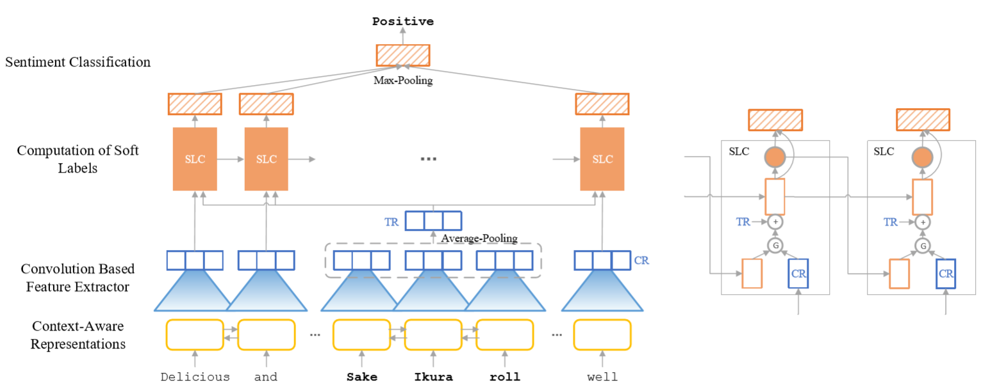
Model Overview

Slide 14
Model Overview
(BOTTOM) Bi-LSTM layer to get context-aware representations.
(MIDDLE) Convolution based feature extractor.
(MIDDLE) Computation of soft labels.
(TOP) Sentiment classiﬁcation using the soft labels and positional weights.

Slide 15

Bi-LSTM Layer
We concatenate the forward and backward hidden outputs of LSTM whose dimension is $d_{0}$
We regard $x_{i} ∈ R^{2d_{0}}$as the context-aware representation of word $w_{i}$, and feed it to following layers.
(1)

Slide 16
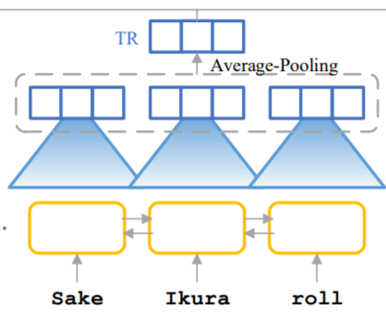
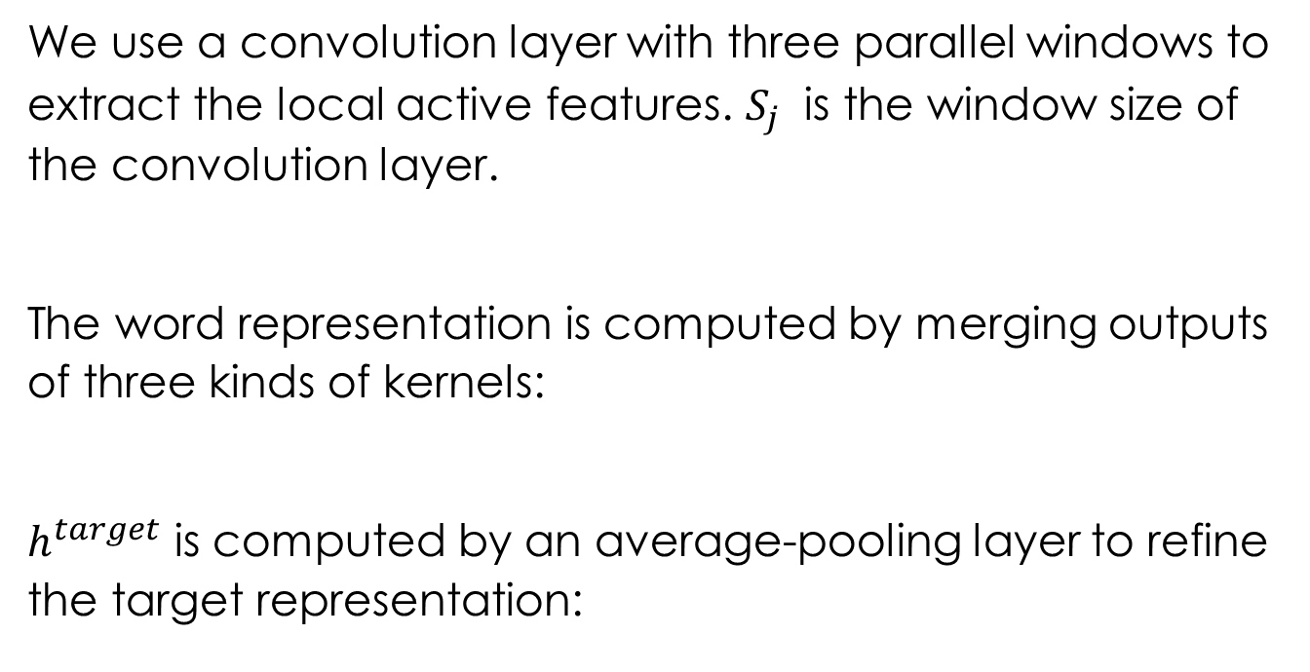
Convolution Based Feature Extractor
We use a convolution layer with three parallel windows to extract the local active features. $S_{j}$ is the window size of the convolution layer.
The word representation is computed by merging outputs of three kinds of kernels:
$h^{target}$ is computed by an average-pooling layer to refine the target representation:
(2)
(3)
(4)

Slide 17
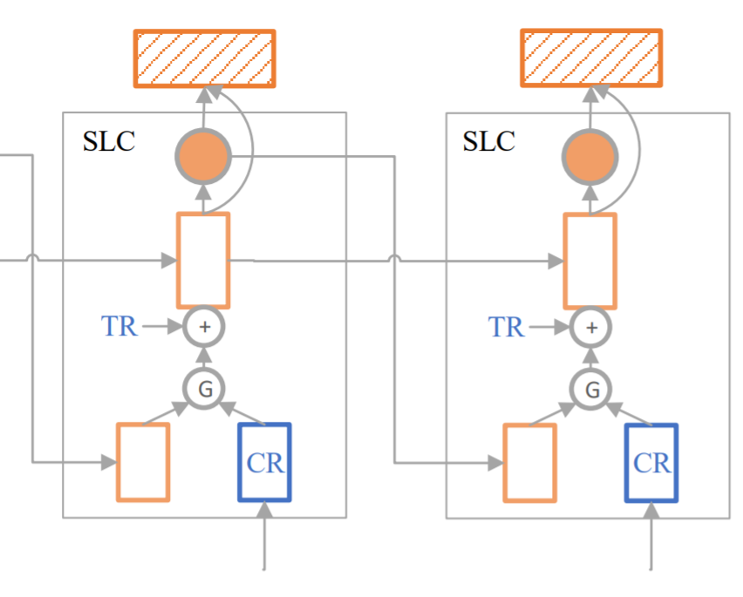

Computation of Soft Labels
We use LSTM to compute the final word representation $h^{D}$, and treat cell state $c^{D}$ as history information till $i^{th}$ word:
We apply a gate mechanism to determine the proportion of the history information in the input, according to the ratio of history information and current word information’s correlation with the target:
(5)
(6)

Slide 18
Computation of Soft Labels
We further incorporate target information into the input to strengthen the influence from target representation.
Instead of using a hard label strategy, we define soft label as the probability of each context word as an opinion word. The soft label is computed by:
(7)
(8)

Slide 19
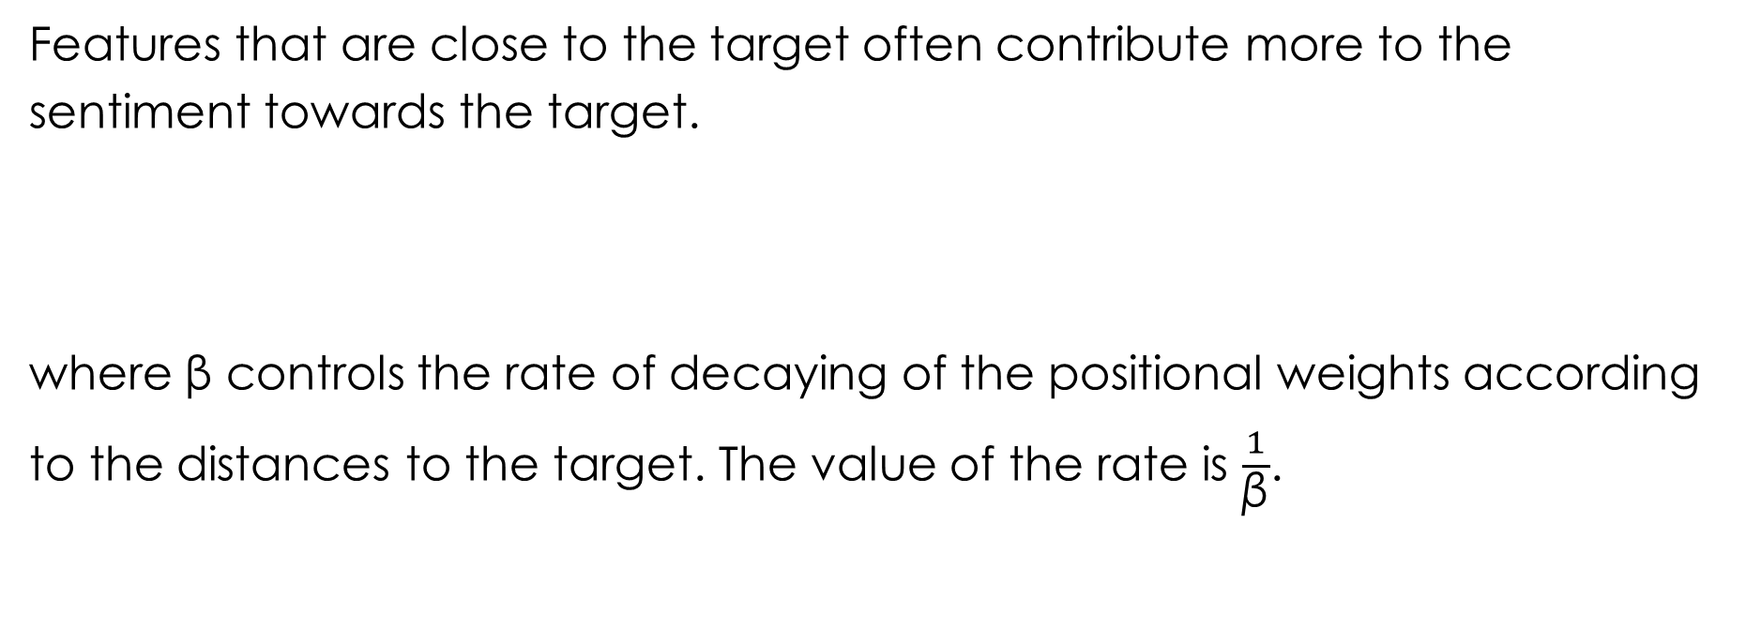
Sentiment Classiﬁcation
Features that are close to the target often contribute more to the sentiment towards the target.
where β controls the rate of decaying of the positional weights according to the distances to the target. The value of the rate is $\frac{1}{\text{β}}$.
(9)
(10)
(11)

Slide 20
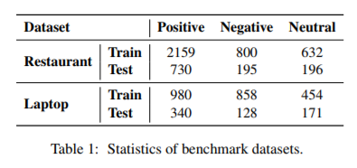
Settings
Dataset:
We conduct experiments using the benchmark datasets of SemEval 2014 Task 4.

Slide 21
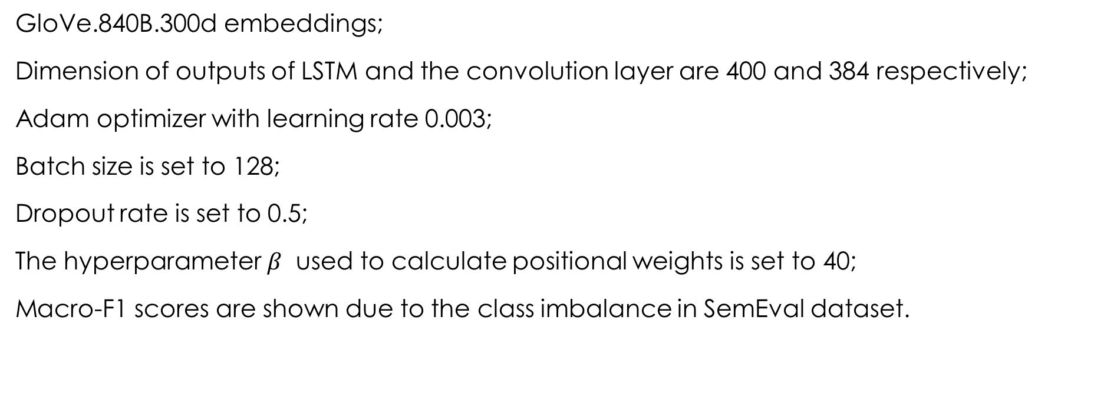
Settings
GloVe.840B.300d embeddings;
Dimension of outputs of LSTM and the convolution layer are 400 and 384 respectively;
Adam optimizer with learning rate 0.003;
Batch size is set to 128;
Dropout rate is set to 0.5;
The hyperparameter $β$ used to calculate positional weights is set to 40;
Macro-F1 scores are shown due to the class imbalance in SemEval dataset.

Slide 22
Outline
Target-level Sentiment Classification
Introduction
Problem Formulation
Soft Label Strategy for Target-level Sentiment Classification
Motivation
The Proposed Model
Experiment
Settings
Result
Ablation Study
Case study
Error Analysis

Slide 23
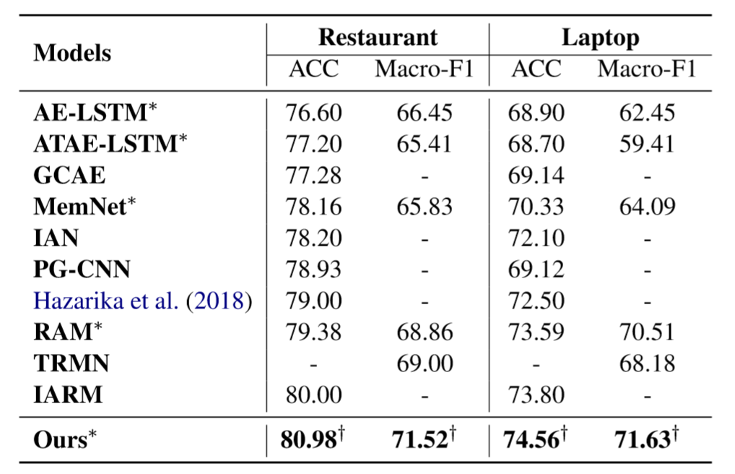
Result

Slide 24
Result
Except for AE-LSTM, GCAE and PG-CNN, the other baseline models all utilize attention mechanism.
However, the attention score for each word is distributed simultaneously according to simple computation by weight matrices.
Intuition: Given a target, people can go through a sentence from beginning to end, and to judge whether current word is highly related to the target at each step with comparison of history information till the current word in the reading process.
We intend to estimate the probability of being an opinion word at each time step based on the history information and current word informarion.

Slide 25
Result
MemNet, RAM, TRMN and IARM are based on memory network.
The memories of these models are all based on the general sentence-level representations which might lose individual consideration and dilute the information of opinion words.
Thus, it is better to take advantage of the history information at each time step as a kind of 'memory'.

Slide 26
Result
IAN outperforms AE-LSTM and ATAE-LSTM. The importance of interaction between contexts and target could be observed.
Vanilla convolution based models, like GCAE and PG-CNN, tend to find the salient features in the whole sentence rather than figure out the active features which are strongly associated with the target.

Slide 27
Outline
Target-level Sentiment Classification
Introduction
Problem Formulation
Soft Label Strategy for Target-level Sentiment Classification
Motivation
The Proposed Model
Experiment
Settings
Result
Ablation Study
Case study
Error Analysis

Slide 28
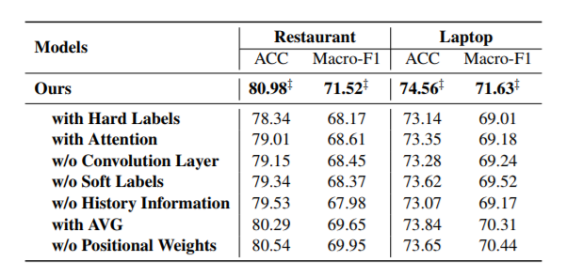
Ablation Study
Each component in our model contributes to the overall performance improvement.

Slide 29
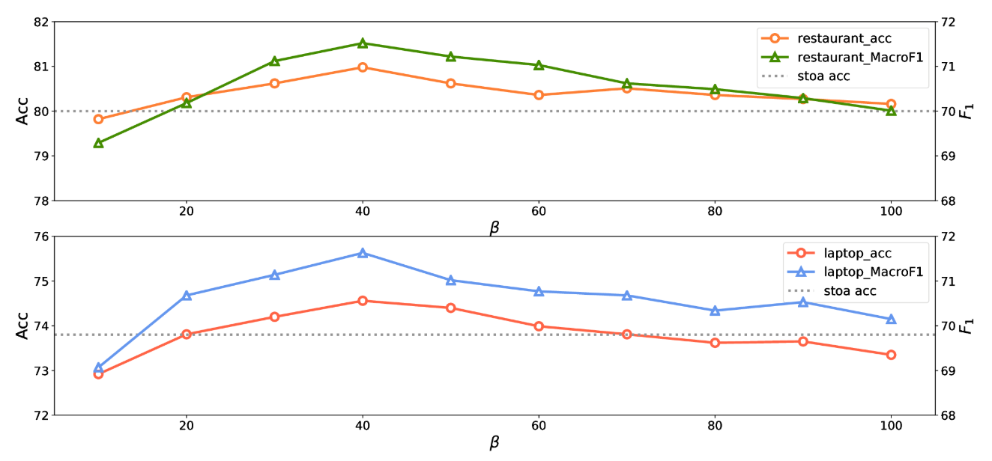
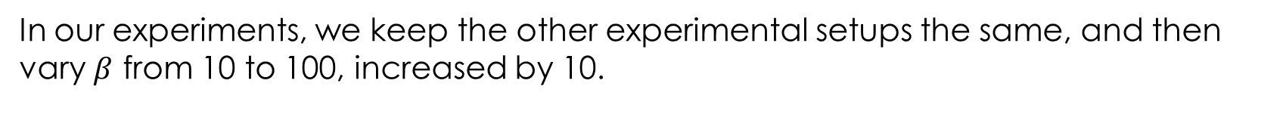
Ablation Study
In our experiments, we keep the other experimental setups the same, and then vary $β$ from 10 to 100, increased by 10.

Slide 30
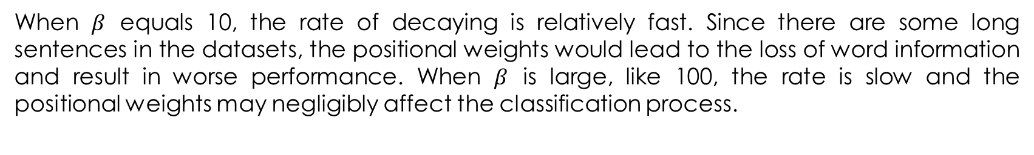
Ablation Study
When $β$ equals 10, the rate of decaying is relatively fast. Since there are some long sentences in the datasets, the positional weights would lead to the loss of word information and result in worse performance. When $β$ is large, like 100, the rate is slow and the positional weights may negligibly affect the classification process.

Slide 31
Outline
Target-level Sentiment Classification
Introduction
Problem Formulation
Soft Label Strategy for Target-level Sentiment Classification
Motivation
The Proposed Model
Experiment
Settings
Result
Ablation Study
Case study
Error Analysis

Slide 32
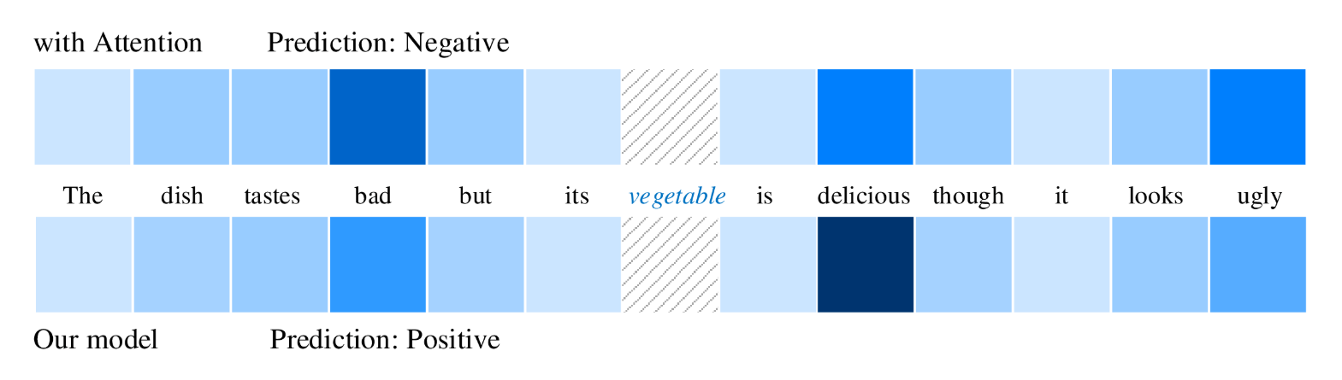
Case Study
The challenge the model faces is to find out which sentiment word contributes more to the sentiment polarity of “vegetable”.
The upper part is the visualization results of attention weights of the model with attention mechanism.
The lower part indicates the visualization results of the value of soft labels.

Slide 33
Case Study
The lower parts also represents the process of soft label computation from the beginning of the sentence to the end.
The proportions of history information are all above 0.4 in our model, except for those of “bad” and “delicious”, which are 0.217 and 0.105, respectively. The relatively small value means that there might be a sentiment change in the place of the word.

Slide 34
Case Study
1. When the model browses to the word “bad”, as words before do not contain strong emotions, the cell states are now combined with the sentiment information of “bad”.
2. When turning to “delicious”, the model recognizes that “delicious” is more relevant to the target while competing with the previous memory. Thus, its soft label's value becomes higher than that of “bad”, and “delicious” will account for relatively great proportion of the cell states.

Slide 35
Case Study
3. Lastly, the model considers the cell states containing the information of “delicious” are more closely connected with the target than the word “ugly” is.
4. Since the value of the soft label of “delicious” is the highest among those of all the other tokens in the sentence, the model predicts the sentiment correctly.

Slide 36
Outline
Target-level Sentiment Classification
Introduction
Problem Formulation
Soft Label Strategy for Target-level Sentiment Classification
Motivation
The Proposed Model
Experiment
Settings
Result
Ablation Study
Case study
Error Analysis

Slide 37
Error Analysis
Example: “The staff should be a bit more friendly.''
Our model may ignore the implicit meaning represented by the modal verb “should”.
Example: “Startup times are incredibly long: over two minutes.”
The fact that the same opinion word represents totally different sentiments in different contexts may lead to the error. When modifying 'battery life', 'long' will express positive sentiment, but when modifying 'startup times', 'long' will express negative one.

Slide 38
Conclusion
Our model benefits from the soft label strategy based on:
history information
positional weights
interaction between target and context tokens
good classification performance of CNN
Experimental results on two benchmark datasets show that our model indeed substantially outperforms previous works.
We will do further researches on mining implicit semantics and distinguishing different sentiments expressed by the same opinion word in various kinds of contexts.

Slide 39
References
Peng Chen, Zhongqian Sun, Lidong Bing, and Wei Yang. 2017. Recurrent attention network on memory for aspect sentiment analysis. In Proceedings of the 2017 Conference on Empirical Methods in Natural Language Processing, pages 452–461. Association for Computational Linguistics.
Shuqin Gu, Lipeng Zhang, Yuexian Hou, and Yin Song. 2018. A position-aware bidirectional attention network for aspect-level sentiment analysis. In Proceedings of the 27th International Conference on Computational Linguistics, pages 774–784. Association for Computational Linguistics.
Devamanyu Hazarika, Soujanya Poria, Prateek Vij, Gangeshwar Krishnamurthy, Erik Cambria, and Roger Zimmermann. 2018. Modeling inter-aspect dependencies for aspect-based sentiment analysis. In Proceedings of the 2018 Conference of the North American Chapter of the Association for Computational Linguistics: Human Language Technologies.

Slide 40
References
Binxuan Huang and Kathleen Carley. 2018. Parameterized convolutional neural networks for aspect level sentiment classification. In Proceedings of the 2018 Conference on Empirical Methods in Natural Language Processing, pages 1091–1096. Association for Computational Linguistics.
Binxuan Huang, Yanglan Ou, and Kathleen M. Carley. 2018. Aspect level sentiment classification with attention-over-attention neural networks. In Social, Cultural, and Behavioral Modeling - 11th International Conference, SBP-BRiMS 2018.
Svetlana Kiritchenko, Xiaodan Zhu, Colin Cherry, and Saif Mohammad. 2014. Nrc-canada-2014: Detecting aspects and sentiment in customer reviews. In Proceedings of the 8th International Workshop on Semantic Evaluation (SemEval 2014), pages 437–442.

Slide 41
References
Xin Li, Lidong Bing, Wai Lam, and Bei Shi. 2018. Transformation networks for target-oriented sentiment classification. In Proceedings of the 56th Annual Meeting of the Association for Computational Linguistics (Volume 1: Long Papers), pages 946–956. Association for Computational Linguistics.
Dehong Ma, Sujian Li, Xiaodong Zhang, and Houfeng Wang. 2017. Interactive attention networks for aspect-level sentiment classification. In Proceedings of the Twenty-Sixth International Joint Conference on Artificial Intelligence, IJCAI 2017, Melbourne, Australia, August 19-25, 2017, pages 4068–4074.
Navonil Majumder, Soujanya Poria, Alexander Gelbukh, Md Shad Akhtar, Erik Cambria, and Asif Ekbal. 2018. Iarm: Inter-aspect relation modeling with memory networks in aspect-based sentiment analysis. In Proceedings of the 2018 Conference on Empirical Methods in Natural Language Processing, pages 3402–3411.

Slide 42
References
Shuai Wang, Sahisnu Mazumder, Bing Liu, Mianwei Zhou, and Yi Chang. 2018. Target-sensitive memory networks for aspect sentiment classification. In Proceedings of the 56th Annual Meeting of the Association for Computational Linguistics (Volume 1: Long Papers), volume 1, pages 957–967.
Yequan Wang, Minlie Huang, Xiaoyan Zhu, and Li Zhao. 2016. Attention-based lstm for aspect-level sentiment classification. In Proceedings of the 2016 Conference on Empirical Methods in Natural Language Processing, pages 606–615. Association for Computational Linguistics.
Wei Xue and Tao Li. 2018. Aspect based sentiment analysis with gated convolutional networks. In Proceedings of the 56th Annual Meeting of the Association for Computational Linguistics (Volume 1: Long Papers), pages 2514–2523. Association for Computational Linguistics.

Slide 43
Thanks for listening!

