Slide 1
Causes of Gender Wage Gap in China: Evidence from 2018 CHIP Data
Chenning Xu
5/13/2025

Slide 2
Outline
Introduction
Literature Review
Data & Methodology
Empirical Results
Theory & Policy Implication
Conclusion

Slide 3
Introduction
Motivation: 1) Rapid economic growth in China accompanied by persistent and substantial gender wage inequality. 2) Importance of understanding the role institutional factors play in shaping wage disparities.
Research objective: Investigate the key drivers behind China’s contemporary gender wage gap. Specifically focus on institutional constraints linked to marriage, age, and occupational segregation.
Summary of main findings: 1) Marriage significantly expands the gender wage gap. 2) Age-related wage gaps widen notably during typical marriage and childbearing years, highlighting deeper structural constraints. 3) Observable characteristics (e.g., education, experience) account for a limited portion of wage disparities, pointing to institutional and structural factors as primary drivers.

Slide 4
Literature Review – China’s reform
China initiated market reform in 1978. Achieved over 9% average annual GDP growth rate for the last 47 years. (World Bank,2025)
Late 70s and 1980s: rural land distribution (household responsibility reform), export-processing zones (Shenzhen, etc), and township village enterprises. Limited data and study.
1990s: State-owned enterprises privatization, with massive lay offs.
2001: China joined the WTO. FDI and export grew significantly thereafter.

Slide 5
Literature Review: Gender Wage Gap
China’s gender wage gap has progressively widened following the economic liberalization initiated in the 1990s.
Gustafasson & Li (2000): the gender earnings gap rose from 15.6% in 1988 to 17.5% in 1995. (CHIP data)
Song et al. (2017): the gender wage gap rose from 15.5% in 1995 to 23.9% in 2002 and peaked at 35.6% by 2007. Moderated to 28.2% in 2013. (CHIP data)
Liu (2011) and Brussevich et al. (2021) reported that during the SOE privatization, 60% of those laid off were women, and the reemployment rate was lower, resulting in prolonged female unemployment or permanent withdrawal from the labor force.
Chen et al. (2013) & Wang et al. (2020) reported that globalization increased female employment, lowered the gender wage gap and discrimination in the export sector. Yet this reinforces job segregation, as the export sector typically offers low-wage jobs.
Notes:
The first three points show that China’s structural reform and strong growth coincide with a rising gender wage gap.

Slide 6
Literature review – Marriage and care work
Ma (2022) finds that women consistently faced significant motherhood wage penalties while men have a fatherhood premium. (CHIP data)
Song et al. (2017) report that married workers have more than twice the gender wage gap than unmarried workers, using gender- controlled regression partitioned by marriage. (CHIP data)
Dong et al.(2015) used the 2008 China time use survey to show that women spent 27.3 hours on unpaid care work while men spent 10.6 hours. Connelly et al. (2018) argue that the state’s retreat from care provisioning burdened women.
Notes:
In conclusion, the existing literature underscores that China's economic reforms and global integration have played a significant role in shaping gender wage disparities. While economic liberalization has expanded employment opportunities for women, particularly in export-oriented sectors, structural transformations and institutional barriers such as occupational segregation, marriage, and parenthood have simultaneously reinforced and sustained considerable wage inequalities.

Slide 7


Data and Methodology
Data: 2013 and 2018 Chinese Household Income Project (CHIP) surveys.
Methodology: OLS regression and two-fold pooled Oaxaca-Blinder decomposition, using the Oaxaca library in Stata (Oaxaca, 1973; Blinder, 1973; Jann, 2008)
Gender wage gap
Pooled regression coefficients
Male coefficients – pooled coefficients

Slide 8
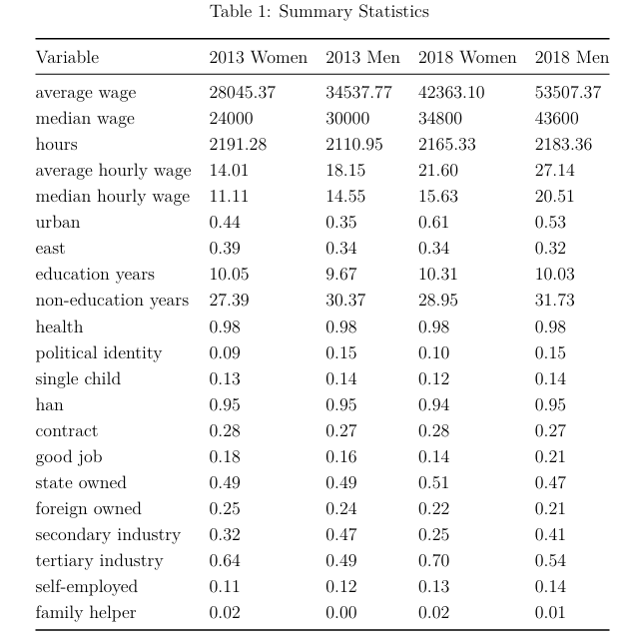
Results
Men earn about 20% more than women.
Women work similar, if not more, hours than men.
Women have higher educational attainment.
Women have less experience, proxied by non-education age.
Women tended to have more management and professional jobs in 2013, but no longer in 2018.
Industry segregation is obvious.

Slide 9
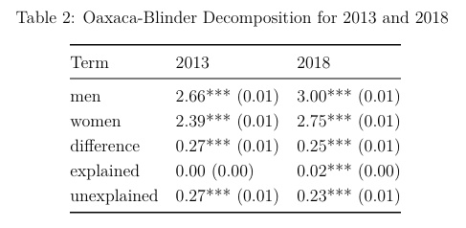
Results
The gender wage gap slightly narrowed from 2013 to 2018 (31% to 28%), consistent with earlier observations that China’s gender wage gap has been moderating since the late 00s.
In either year, personal characteristics, including endowment and segregation proxies, could not explain the gap.
Most of the gap comes from differential returns to characteristics or potential discrimination.

Slide 10
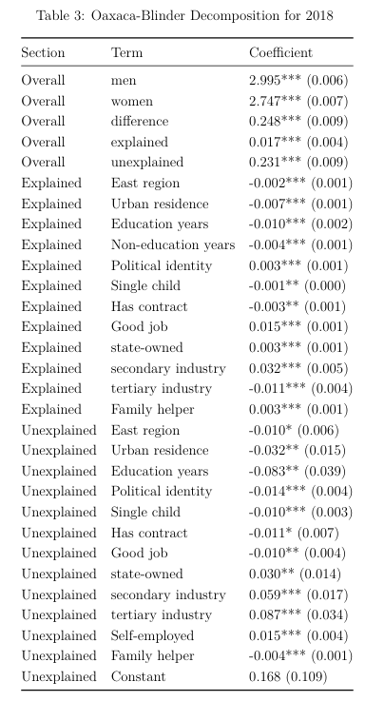
Women have better endowments in many aspects. Regional residence, urban residence, education, non-education years (experience proxy), and formal work contract. But they explain almost nothing.
Women are segregated in tertiary industries and away from high-paying secondary industries, contributing 0.02 log points in total.
Most of the gender wage gap is due to differential returns to characteristics. Women have a higher return for education (In % terms, not necessarily by level), being a party member, having a work contract, being a manager or professional worker.
However, the above higher returns are overwhelmed by women’s lower returns in working for state-owned entities, secondary industries, tertiary industries, and self-employment.
A speculative (so far) interpretation is that even if women can move from the primary sector (farming and fishing) to secondary and tertiary industries, they are still segregated into low-pay jobs.
A large part of the wage gap is left in the constant term, which could be attributed to omitted variables but also to potential pure discrimination.
Notes:
Interpretation is key. To understand why there are differential returns in occupation and the unexplained constant term, and whether they are related to women’s pronounced role in social reproduction and provisioning, this study performs Oaxaca-Blinder decomposition on the sample stratified by marital status and age groups.

Slide 11
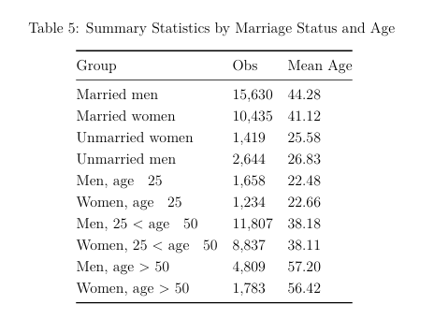
Notes:
Both married and unmarried individuals are younger than men. For different reasons, of course. Since there is a big structural change in the data for women above 50 years old, both women and male workers above 50 are excluded from the decomposition stratified by marital status, but they are specifically studied in the later decomposition stratified by age.

Slide 12
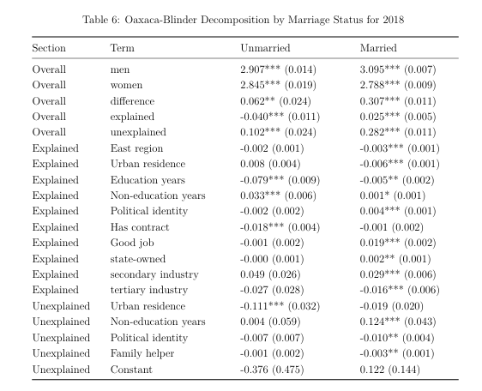
The gender wage gap for married workers is significantly larger than for unmarried workers
Unmarried women have a much better education endowment but less experience than men. Not significant for married women and men.
Unmarried women have a higher return for urban residence, which could be due to their higher education. No significant unexplained contributor to the wage gap. The disadvantage for women has not really emerged.
The gender wage gap is huge for married workers. Industrial segregation emerges.
The most significant finding is that married women have a significantly lower return for experience. In other words, the disadvantage of married women accumulates over time.
Consistent with the literature that marriage is the most significant life event that leads to the gender wage gap, rather than endowment. The relative disadvantage of women accumulates after marriage, due to career interruption due to childbirth, and disproportionate care work.
Notes:
For robustness and deeper insight, the same decompositions are conducted on age groups.

Slide 13
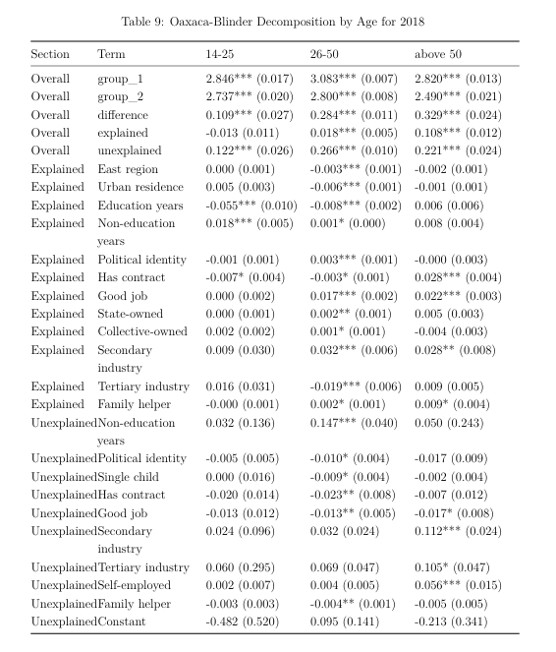
The gender wage gap is much smaller for the sample below 26 years old, about the average unmarried age.
Industry segregation emerges in the 26-50 group.
Women have a much lower return for non-education age in the 26-50 group, consistent with the previous results.
Wage gap further expanded for those above 50, but now a considerable portion can be explained by observable characteristics (still not endowment).
Women have much lower returns in secondary and tertiary industries. A speculative explanation is that women with good jobs are gradually retiring after 50, but women with informal and low-pay jobs keep working.
Notes:
In conclusion, the analysis reveals substantial heterogeneity in the gender wage gap across marital status and age groups in China. Marriage stands out as a critical life event, significantly reshaping both the magnitude and structure of gender wage disparities. Married women consistently suffer more pronounced wage penalties, likely driven by career interruptions, reduced advancement opportunities, and limited access to better-paying positions. Furthermore, clear age-related differences emerge, with women increasingly disadvantaged starting in their mid-to-late twenties, indicating cumulative penalties over their working lives. Notably, education plays a minimal role in driving wage differences and even slightly reduces wage disparities across all subgroups. These findings underscore the importance of examining deeper structural and institutional factors beyond educational differences. Further research remains essential to pinpoint the precise causal mechanisms behind this observed heterogeneity in gender wage outcomes.

Slide 14
Theory and policy implications
Capability Approach Framework (Sen, 1999):
Economic inequalities are viewed through differences in real capabilities rather than just resources.
Marriage and caregiving responsibilities represent institutional barriers limiting women's capability to convert human capital into equal economic outcomes.
This study finds that Marriage dramatically expands the gender wage gap by imposing economic penalties on women and premiums on men. The gap significantly widens between ages 26 and 50, corresponding to key life transitions such as marriage and childbirth.

Slide 15
Theory and policy implications
To reduce the gender wage gap to achieve a gender-equitable market outcome, government and social efforts must address deeper structural issues rather than merely improving education or skills, reflecting a shift from traditional endowment-focused interventions to capability-oriented strategies.
Policies such as providing free or affordable childcare and eldercare release the care burden upon women.
A gender-equal maternal and parental leave government policy might alleviate the cost of career disruption for women.
Harmonization of retirement ages could allow women to leverage their professional experience fully.

Slide 16
Conclusion
The gender wage gap in China persisted in 2018, despite some moderation from 2013.
The gender wage gap demonstrates considerable heterogeneity across marital status and age groups, with a much smaller gap between the young and married population.
Marriage is the most important life event that expands the gender wage gap, and married women become disadvantaged relative to men as age grows.
The government should adopt a capability-enhancing focus and actively address the institutional barriers to women’s utilization of their endowment in the labor market.
Policies such as public care provisioning, improving equal parental leaves, harmonizing retirement age, and incentivizing occupational integration should be more effective than traditional endowment-focused policies.

