Slide 1
SFC Model Presentation
Chenning Xu
5/15/2025

Slide 2
Motivation
To understand the dynamics within an economy where there is regional development imbalance.
Examples: East/west disparity in China. North/south divide in Italy.
If there are inter-regional trade and remittance, how will policies and shocks affect the regional and aggregate economy?
SFC models allow us to simulate both the short-run disturbance and long-run impact.

Slide 3
Some Literature Review
Caliendo et al. (2018) Review of Economic Studies:
A Spatial GE model shows that propagation of regional shocks depends on the position of a region in the trade network. Shocks in well-connected region will significantly affect aggregate economy.
Snudden (2017) IMF:
A global DSGE model shows that remittance serve as a stabilizing force for recipient economies against external shocks, but the effect depends on the nature of labor market, shock and the economic linkages between countries.

Slide 4
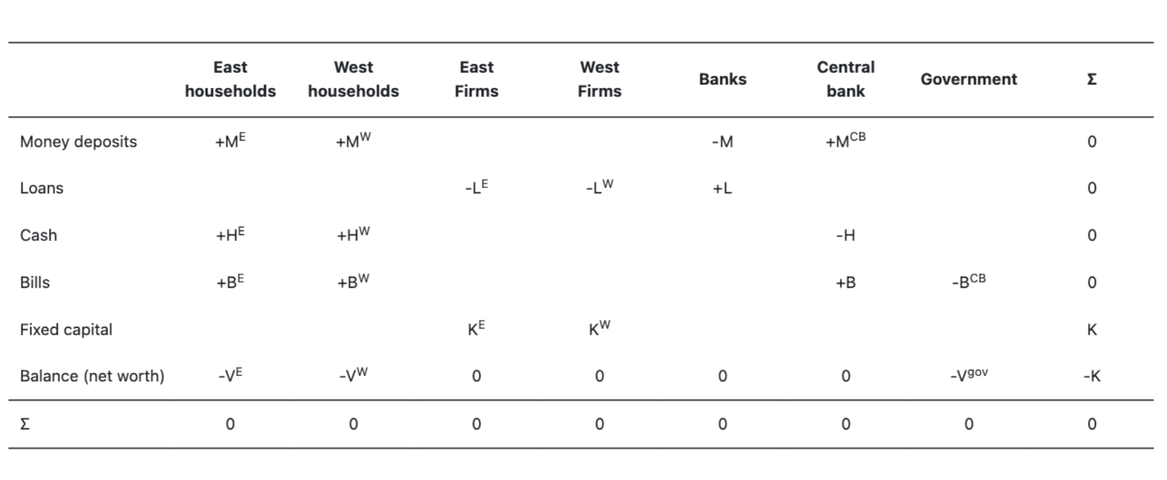
Model design – Balance Sheet Matrix

Slide 5
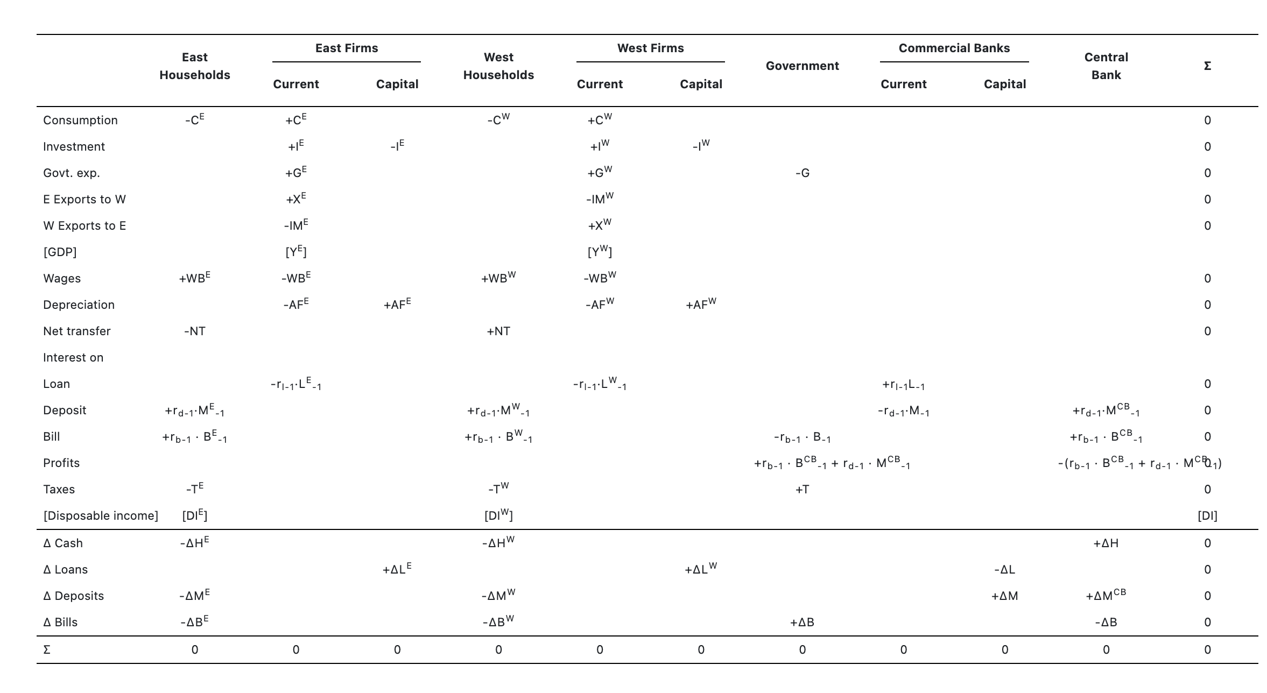
Model design – Transaction flow matrix

Slide 6
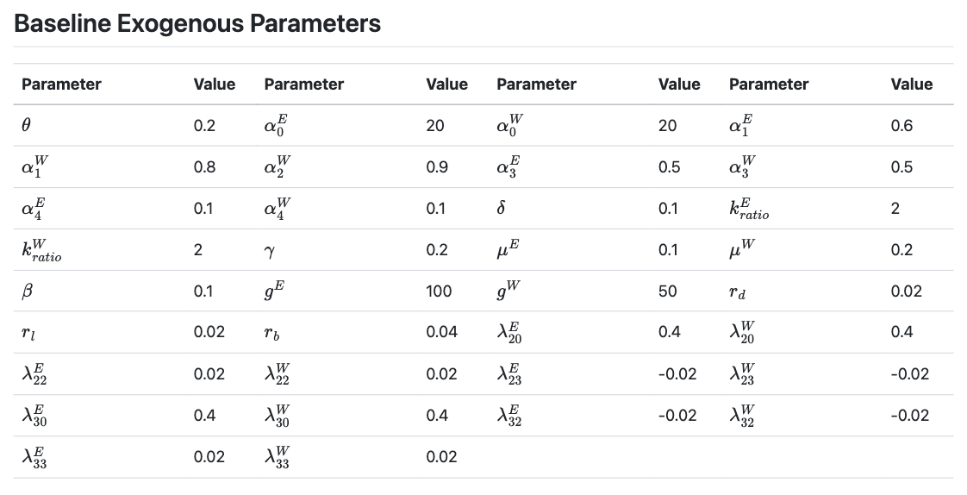
Parameters
Notes:
Autonomous spending amount is the same for two regions. The west has higher discretionary spending propensity for being poorer.
Developmental imbalance is achieved by different levels of government spending in the two regions.

Slide 7
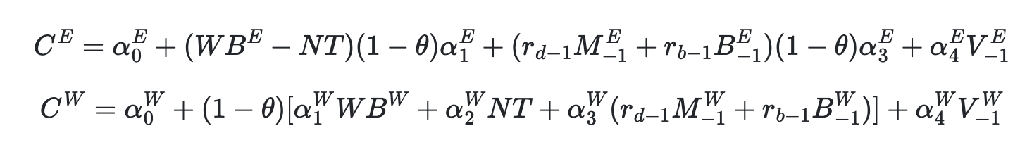
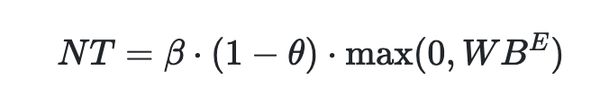
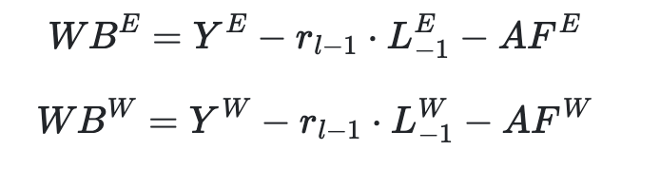
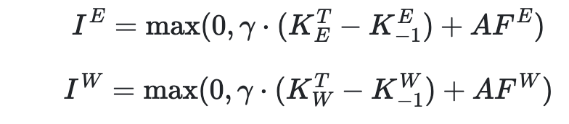

Key Behavioral Equations
True in every scenario

Slide 8
Scenario Analysis

