Slide 1
SFC Model Presentation
Chenning Xu
5/15/2025

Slide 2
Motivation
To understand the dynamics within an economy where there is regional development imbalance.
Examples: East/west disparity in China. North/south divide in Italy.
If there are inter-regional trade and remittance, how will policies and shocks affect the regional and aggregate economy? Will remittance moderate or amplify shocks in both short and long run?
SFC models allow us to simulate both the short-run disturbance and long-run impact.

Slide 3
Some Literature Review
Caliendo et al. (2018) Review of Economic Studies:
A Spatial GE model shows that propagation of regional shocks depends on the position of a region in the trade network. Shocks in well-connected region will significantly affect aggregate economy.
Snudden (2017) IMF:
A global DSGE model shows that remittance serve as a stabilizing force for recipient economies against external shocks, but the effect depends on the nature of labor market, shock and the economic linkages between countries.

Slide 4
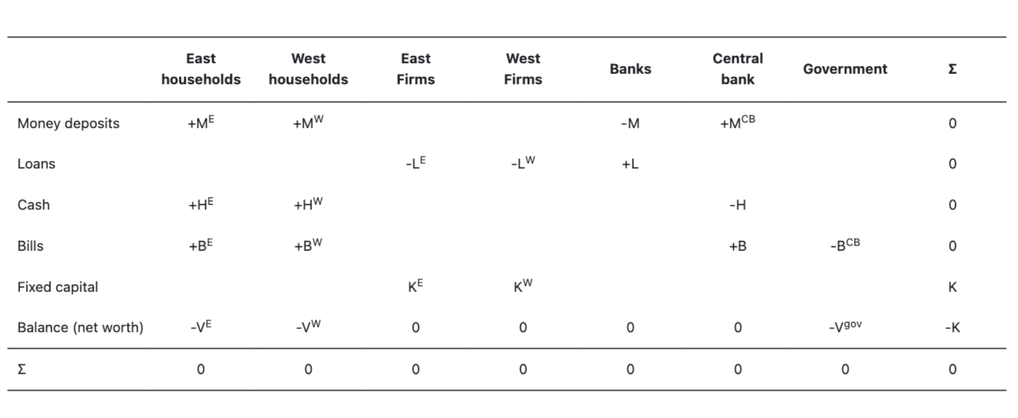
Model design – Balance Sheet Matrix

Slide 5
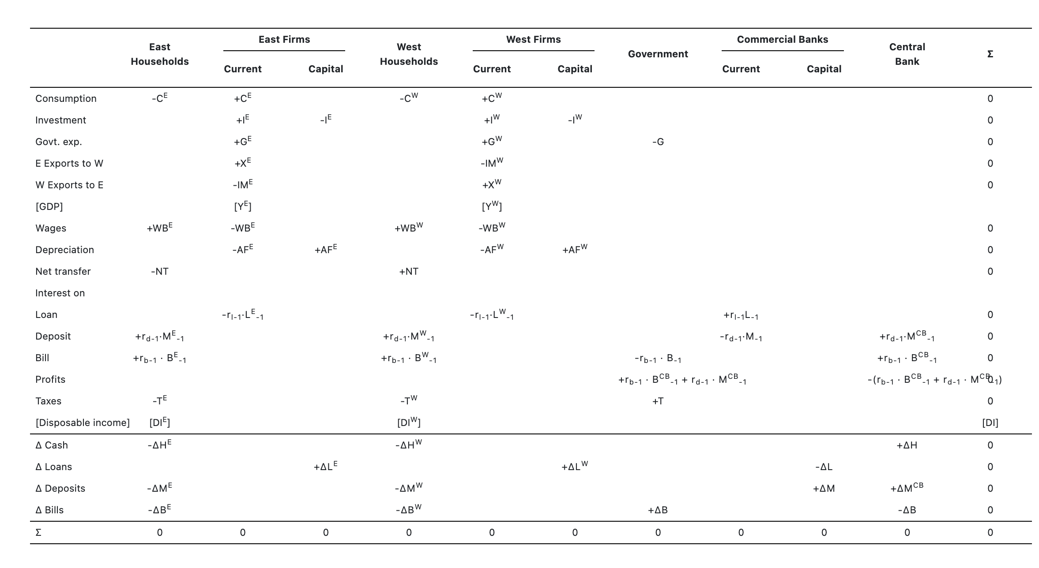
Model design – Transaction flow matrix

Slide 6
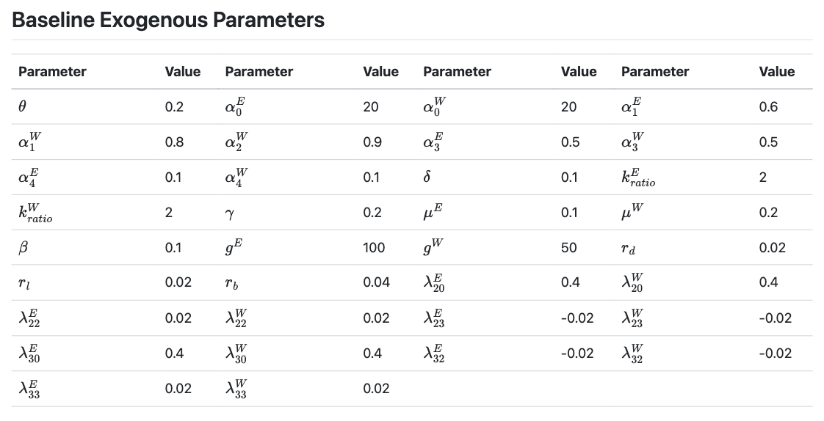
Parameters
Notes:
Autonomous spending amount is the same for two regions. The west has higher discretionary spending propensity for being poorer.
Developmental imbalance is achieved by different levels of government spending in the two regions.

Slide 7
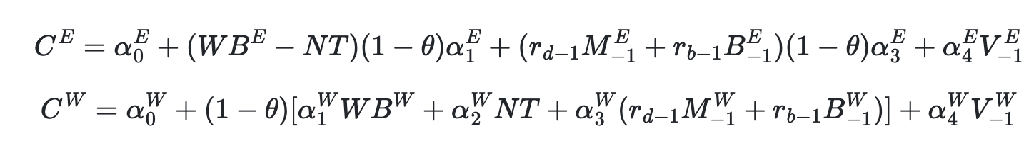
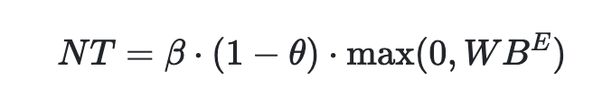
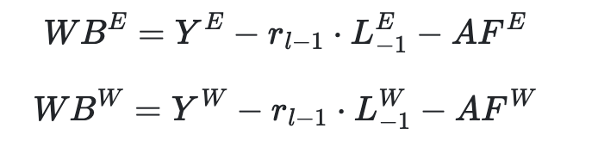
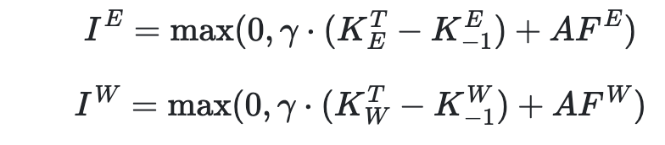

Key Behavioral Equations
True in every scenario

Slide 8
Scenario Analysis
How does systemic remittance alter the impact of a demand shock in the west? (lower gov spending in west)
How does systemic remittance alter the impact of a demand shock in the east? (lower gov spending in east)
How does systemic remittance alter the impact of an embargo? (propensity to import to 0)
Robustness check: relax the assumption that the west has a higher propensity to import. (mu_w = mu_e = 0.2)
Notes:
Afterwards I will call the model with remittance the remittance regime, and the one without remittance, non-remittance regime.

Slide 9
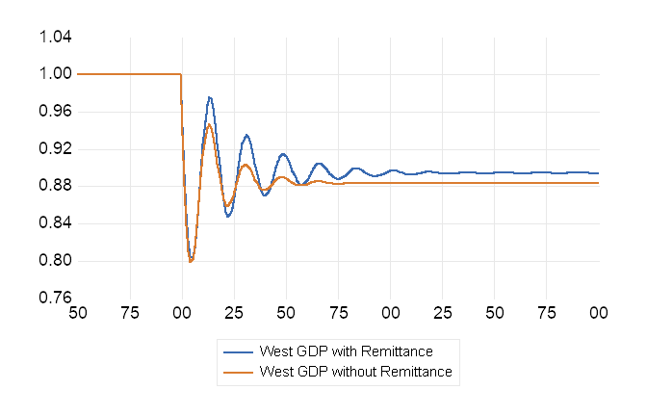
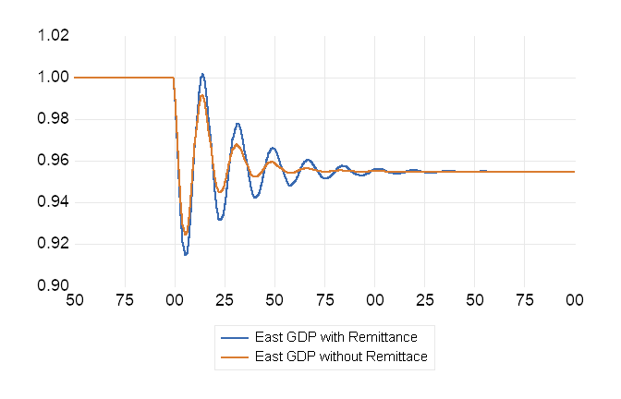
Demand Shock in West
Notes:
In the short run, the fluctuation after the shock is bigger under the remittance regime, for both the east and the west. In the long run, the shock has a smaller impact on the west under the remittance regime, while in the east, long-term GDP ends up the same in both regimes.
In the remittance regime, the adjustment also takes a longer time than the no-remittance regime.

Slide 10
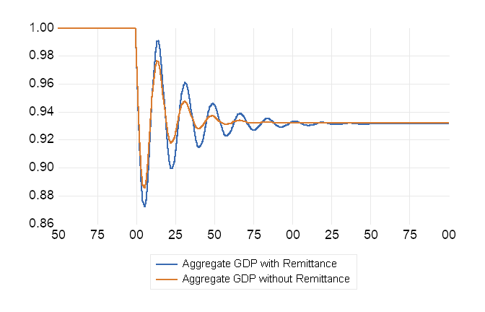
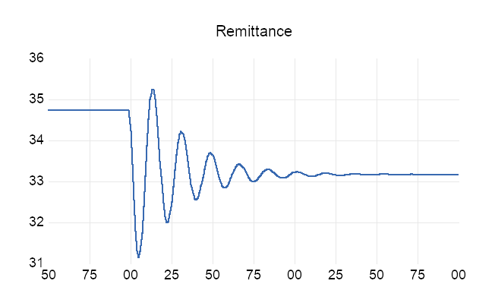
Demand Shock in West
Notes:
For aggregate GDP, the short-term fluctuation is still larger under the remittance regime compared to the non-remittance regime. In the long run, the overall impact is pretty similar across both regimes. It’s slightly smaller under the remittance regime, which makes sense since we’ve already seen that the long-term effect in the west is smaller with remittances.
On the right chart, we can see that remittances drop slightly after the demand shock. That’s because lower GDP in the west means the east earns less from exports, so its wage bill also shrinks.
To sum up: with remittances, the long-term impact of a demand shock on the recipient region is smaller. But the short-term fluctuation is larger in both regions, and the long-term effect on national GDP is minimal. Since volatility also comes with social costs, the remittance regime doesn’t necessarily lead to better outcomes overall.

Slide 11
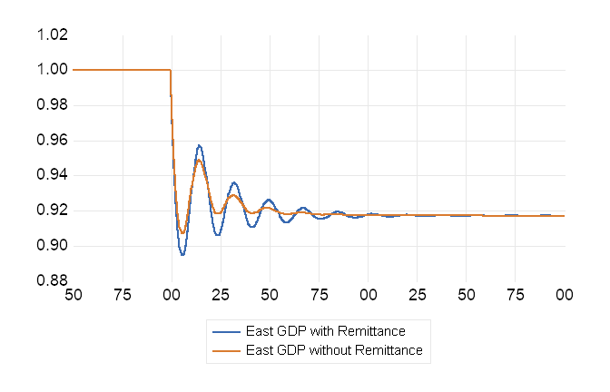
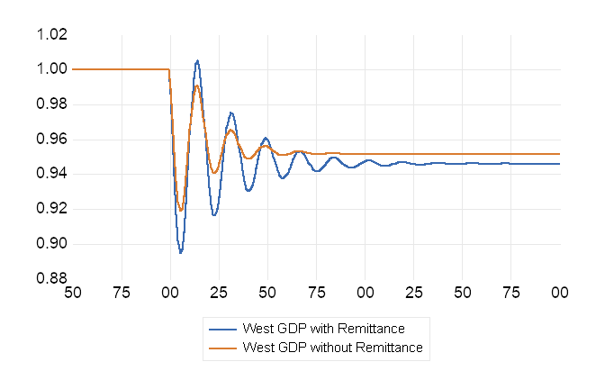
Demand Shock in East
Notes:
Now let’s look at how remittances affect a demand shock in the east.
On the left graph, we see that in the west, both the short-term fluctuation and the long-term impact are larger under the remittance regime. On the right chart, the short-term fluctuation is also larger, but remittances don’t change the long-term, permanent effect of the shock.

Slide 12
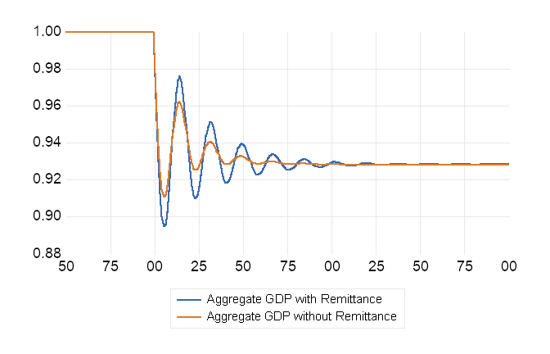
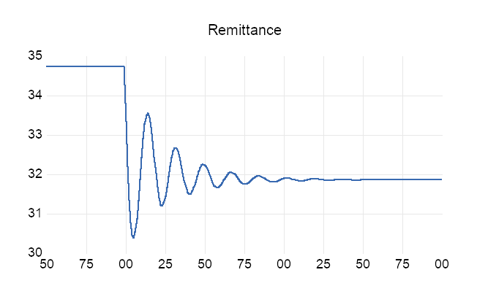
Demand Shock in East
Notes:
The impact of a demand shock in the east on aggregate GDP is similar to that of a shock in the west, but the overall fluctuation is smaller.
On the left graph, we can see that remittances still increase the size and duration of the fluctuation. However, they don’t significantly change the long-term impact.

Slide 13
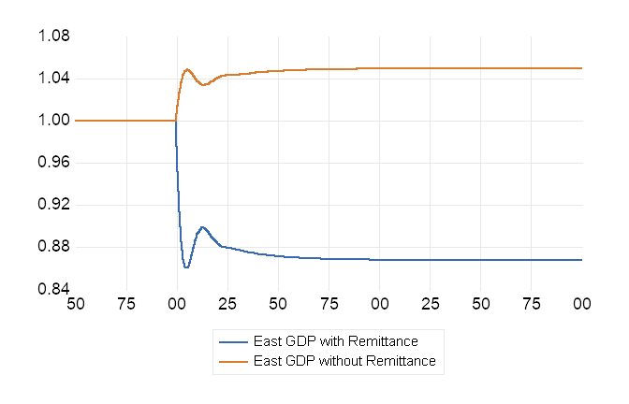
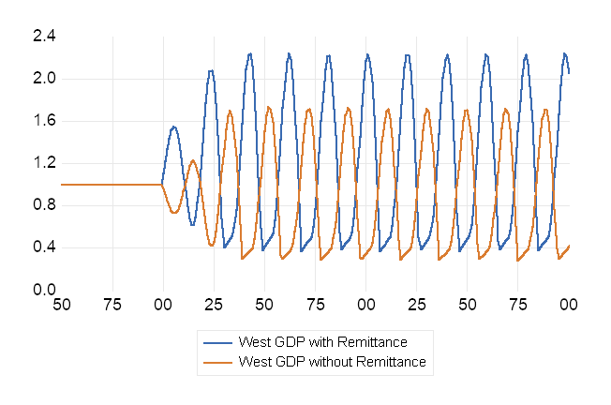
Embargo (no trade anymore)
Notes:
This case is both interesting and dramatic. After the embargo, the west falls into a cyclical economic pattern.
What stands out is that the cycles are much more pronounced with remittances—larger ups and downs—but the average GDP in the west is higher with remittances than without. You can see this if we draw a horizontal line showing the cycle average.
In contrast, the east sees a sharp drop in GDP under the remittance regime, while in the no-remittance regime, GDP actually rises slightly. So actually, there is a transfer effect between the two regions in the remittance regime. The East GDP is lower but the west GDP is higher, with remittance.
We’ll explore why that happens in the next slide.

Slide 14
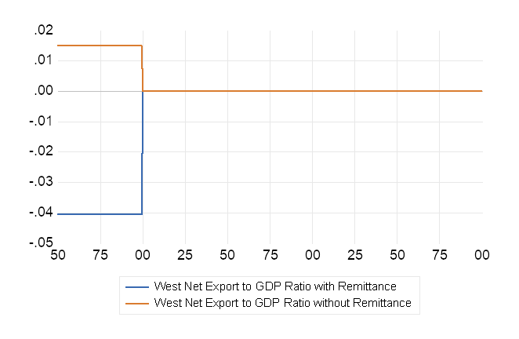
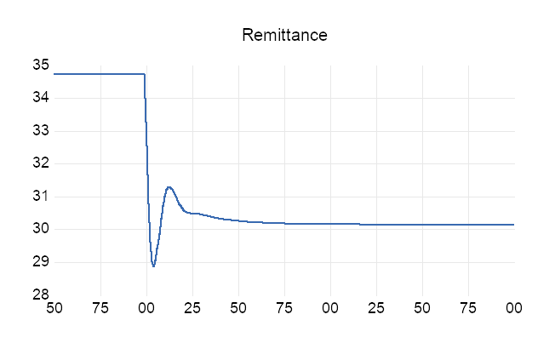
Embargo (no trade anymore)
Notes:
On the left graph, we see that remittances decline after the shock in the remittance regime. But I don’t think that’s the cause of the unusual pattern we saw on the last slide—it’s more likely a result of it.
On the right graph, you can see that before the embargo, the west is running a 4% GDP trade deficit under the remittance regime. Without remittances, it would be running a 2% trade surplus instead.
Why the difference? Because part of that deficit is being financed by remittances. Once trade is cut off, households in the west start spending remittances on local goods and services instead of import. That shift in spending boosts long-run average GDP in the west, while the east loses out—leading to a decline in east long-run GDP.

Slide 15
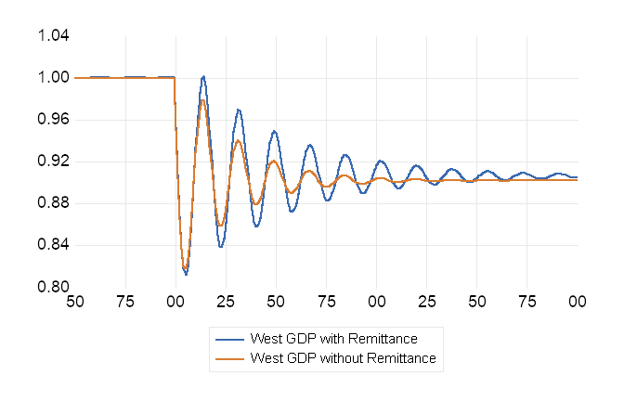
Robustness Check (relax import assumption)
Demand shock in west
Notes:
The original model is on the left and the new model with equal propensity to import is on the right.
Not much difference. The conclusion still holds. Short-run fluctuation is bigger, and the long-run impact is smaller in the west.

Slide 16
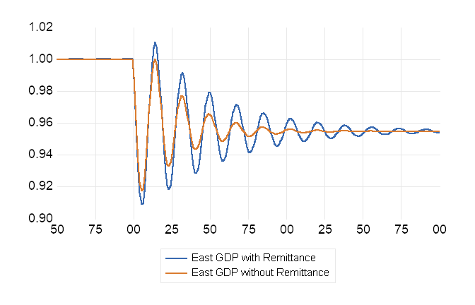
Demand shock in west
Notes:
Still not much difference. With equal propensity to import, the adjustment not takes a longer time. But clearly remittance increases the short-run fluctuation but does not much the long-run impact very much.

Slide 17
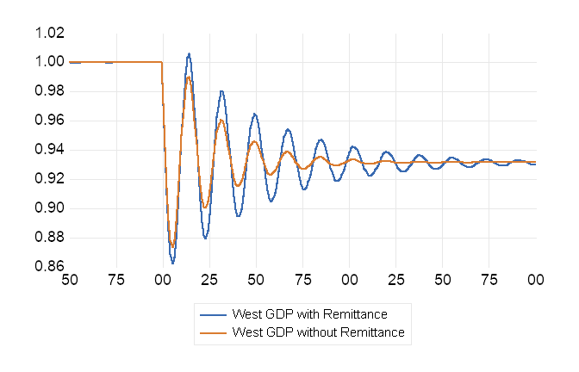
Demand shock in west
Notes:
Similar.

Slide 18
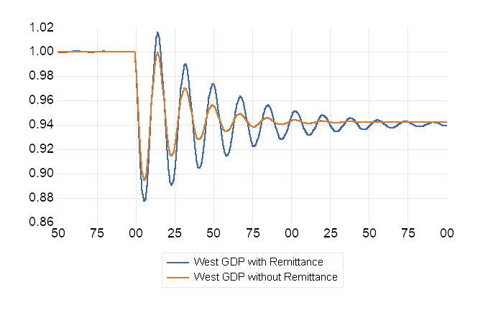
Demand Shock in east
Notes:
In both remittance and non-remittance regimes, the adjustment takes longer after the shock. But the impact of remittance on the adjustment follows the same pattern.

Slide 19
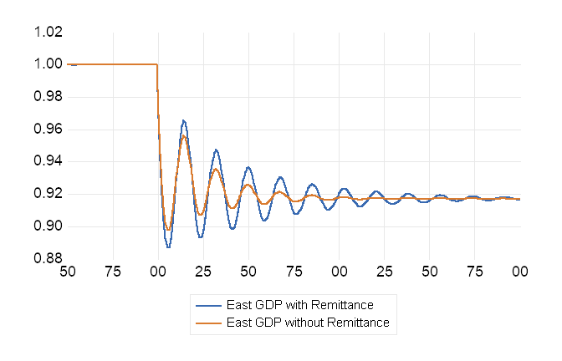
Demand Shock in east

Slide 20
Demand Shock in East

Slide 21
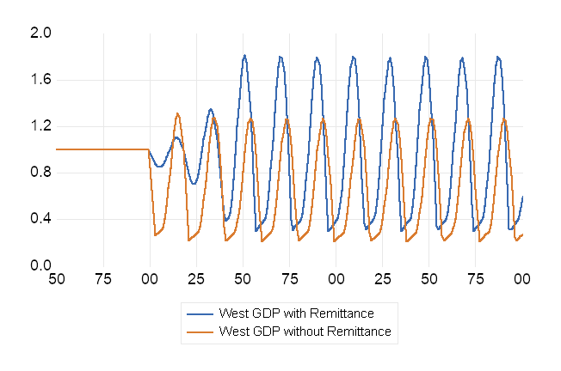
Embargo

Slide 22
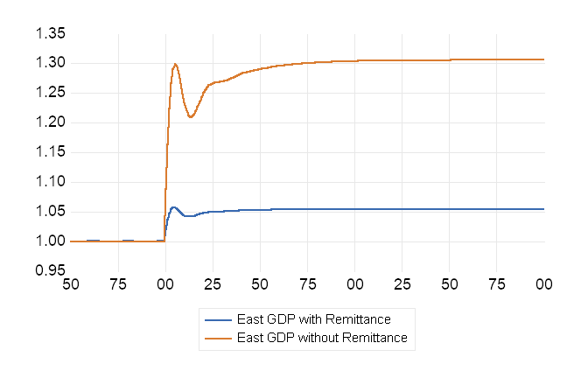
Embargo
Notes:
This one is quite different. The reason why after embargo, in both regimes, with or without remittance, the GDP in east rises, is because, in either regime, the east is running trade deficit before the shock.

Slide 23
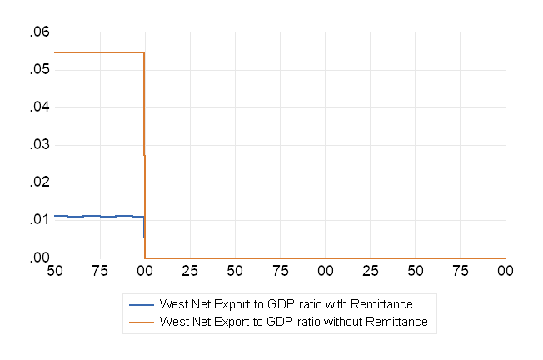
Embargo

Slide 24
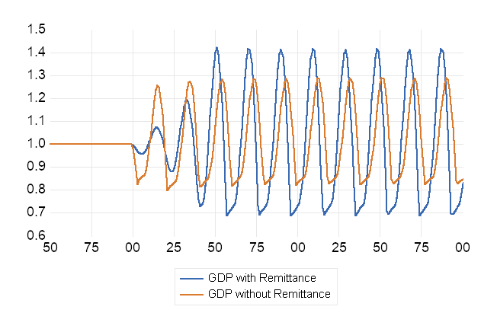
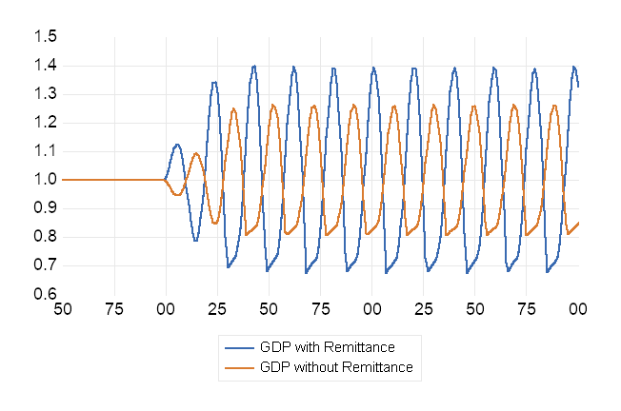
Embargo
Notes:
Whether the volatility is worth the rise in average income, it is up to regional preference.

Slide 25
Concluding remarks
In this regime where remittance depends on wage in east, the existence of remittance increases the fluctuation and period of adjustment after a shock
Whether remittance increase or decrease the long-term impact of a shock, it is up to the nature of the shock. In this study, for the west, demand shock in west is moderated in the long-term, but demand shock in east is amplified.
For the aggregate GDP, remittance only increases post-shock fluctuation but does not moderate long-term impact.
The institution of systemic remittance could make the economy more unstable and sensitive to shocks, to the contrary of our intuition.

Slide 26
Further research questions
If remittance does not depend on current wage or income, but on past income or future expectation, will it still amplify shocks in the short-run and increase adjustment period?

