Slide 1
Wealth Inequality in China: Evidence from the 2017 and 2019 CHFS
Chenning Xu
5/13/2025

Slide 2
Introduction
China has gone through incredible economic growth since 1978, with annual GDP growth averaging over 9%.
Growth slowed after 2010, with a GDP growth rate of 5.2% in 2023 (World Bank, 2025).
The growth has been quite unequal across urban/rural areas, regions, and sectors. Urban areas, coastal provinces, and investment/export sectors enjoyed more pronounced growth.
Economic inequality rose significantly along with output growth.
However, evidence shows that inequality peaked in 2010 and has moderated(Kanbur, Wang, and Zhang, 2021).

Slide 3
Motivation
Use the latest free data to confirm whether China’s inequality decreased after 2010 and continued from 2017 to 2019.
Investigate the intersection of household wealth inequality with urban/rural disparity and regional imbalance.
Study the heterogeneity of wealth inequality across subgroups.
get informed intuition on reducing wealth inequality in China by reducing both between-group imbalance and dealing with within-group heterogeneity.

Slide 4
Literature Survey
Piketty, Li, and Zucman (2019) used multiple data sources and documented that from 1978 to 2015, the top 10% household income rose from 27% to 41%, while the bottom 50% fell from 27% to 15%. The wealth share of the top 10% increased from 40% to 70%, while that of the bottom from 15% to 5%.
The urban-rural average income gap widened from 2:1 to 3.5:1.
They joked that China went from Nordic-level equality to the U.S. level of inequality during this reform period.

Slide 5
Literature Survey
Knight, Li, and Wan (2022) used the China Household Income Project data in 2002 and 2013, and found that the Gini coefficient for wealth per capita rose from 0.5 to 0.62.
A significant contributor to wealth inequality is housing, expanding from 53% of total household assets to 73%, with its contribution rising from 64% to 79%.
They argued that the source of wealth inequality is the different saving rates across the wealth rank and the uneven housing price inflation, which favors homeowners in major urban centers.

Slide 6
Literature Survey
Inequality is highly interwoven with persistent structural divides in China.
The urban-rural income ratio, despite some decline after peaking around 3.3 in 2009, remained high at 2.7 in 2019 (Zhang, 2021).
This gap is reinforced by the hukou (household registration) system, which limits rural migrants’ access to urban services and opportunities.
Regional inequality persists, with coastal areas much richer than inland regions (Liao and Wei 2016).

Slide 7
Literature Survey
The transition towards a market economy itself introduced multiple drivers of inequality.
In rural China, the rise was associated with unequal access to non-agricultural income sources, particularly family businesses, alongside periods of slow growth or falling prices in the agricultural sector (Benjamin et al. 2008; Ravallion and Chen 2009).
In urban areas, contributing factors included the phasing out of subsidies and entitlements, increasing wage dispersion driven by market forces and enterprise reforms, higher returns to education, and unemployment resulting from State-Owned Enterprise (SOE) restructuring (Benjamin et al. 2008).
Uneven regional development was further amplified by policies favoring coastal regions and the differential impacts of globalization and marketization (Liao and Wei 2016).
Housing is always a big driver of wealth inequality. And corruption and unequal network access.

Slide 8
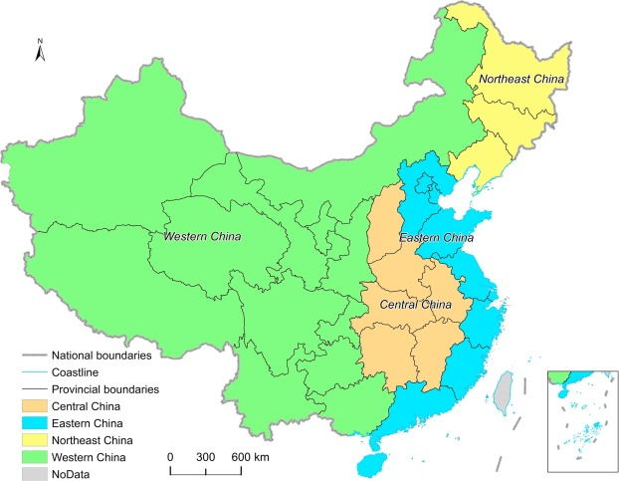
A view of China
40% rural population in 2019
35% today
Several % lower in the Eastern area
Notes:
In the later group decomposition for regions, non-east means the rest of China excluding the eastern area.

Slide 9
Data
China Household Finance Survey: 2017 and 2019.
38994 Households in 2017 and 34643 households in 2019 across 29 provinces.

Slide 10


Methodology
Factor decomposition of Gini (Lerman and Yitzhaki 1985):
Group decomposition (Bhattacharya and Mahalanobis, 1967):
Gb: Contribution to Gini from differences between the means of subgroups
Gk: Contribution to Gini from the Gini coefficient of subgroups
R: contribution from the overlapping between the between-group difference and within-group inequality
Notes:
Share of the source, Gini coefficient of a particular source of wealth, and correlation between the source and the rank of overall wealth.

Slide 11
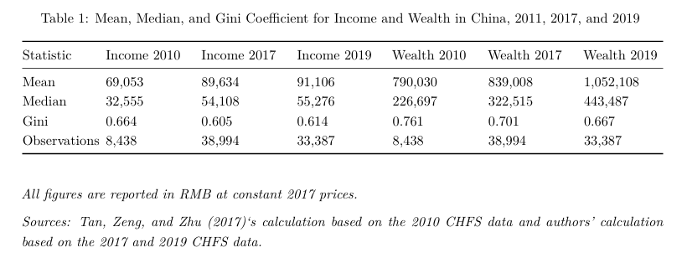
Summary statistics
Income and wealth inequality fell from 2010 to 2017. Income inequality rose slightly from 2017 to 2019, while wealth inequality continued to fall.
The results are consistent with the earlier claims that China’s income inequality peaked in 2010 and fell afterwards. Wealth inequality also peaked in 2010 and has continued to fall in recent years.
Notes:
To answer the first research question: whether China’s inequality has peaked around 2010 and moderated since then. The summary statistics here generally supports this earlier observation, especially for wealth inequality.
All the figures are in 2017 RMB.

Slide 12
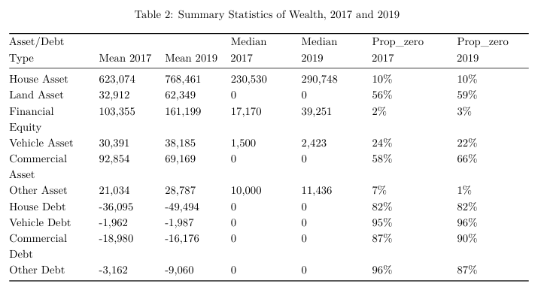
Summary statistics
Housing is over 70% of total wealth, consistent with earlier data. However, only 10% of the households do not have any housing assets. Meanwhile, only 18% of households have housing debt.
Notes:
Before we get into the decomposition, here is the summary statistics of the various sources of wealth.
This is contrary to some narratives that China’s economy completely depends on real estate. It’s actually not true right. In the rural area, the older generation simply built their own houses on their distributed land. In the city, a lot of people got free houses when the government took away their land.
The inequality of housing distribution is high, but the distribution is quite wide, just like rural land. We will see.

Slide 13
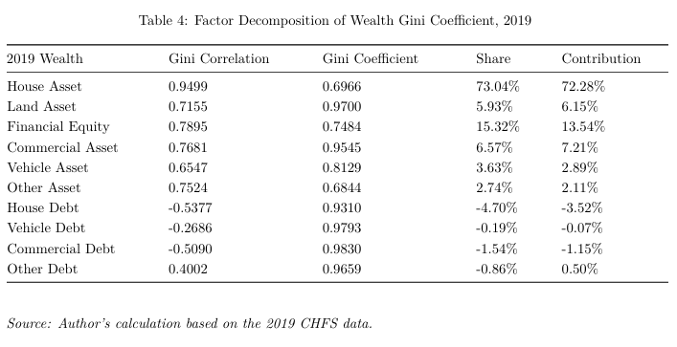
Factor decomposition of overall inequality
On the national level, housing clearly dominates wealth inequality. Financial assets, land, and commercial assets follow in importance.
Asset debts are negatively correlated with wealth rank, which means that rich people tend to have more debt for assets. The only exception is other debt, which includes various consumption debts, like medical and education, which appear to burden the poor more.
Notes:
I am just presenting the 2019 results. The 2017 one is similar and it’s in my paper.

Slide 14
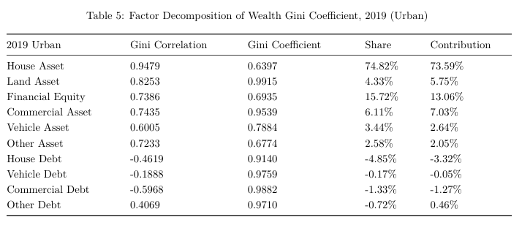
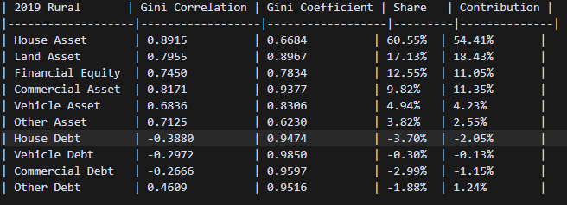
Factor decomposition for urban and rural
Housing is the main contributor to wealth inequality in both urban and rural areas. But its influence is much more pronounced in urban than rural areas.
Land is a minor contributor in urban areas, but it is highly important in rural areas.
The ownership of land in rural areas is widespread but highly unequal, with 81% of households owning land in 2019, but the Gini is as high as 0.9.
Financial assets are a more significant inequality driver in urban than rural areas.
The inequality of financial assets and cars is higher in rural areas, as obviously, fewer rural households can afford them.
Notes:
To understand the heterogeneity of wealth inequality between urban and rural areas, the factor decompositions are conducted on the urban and rural sample respectively.

Slide 15
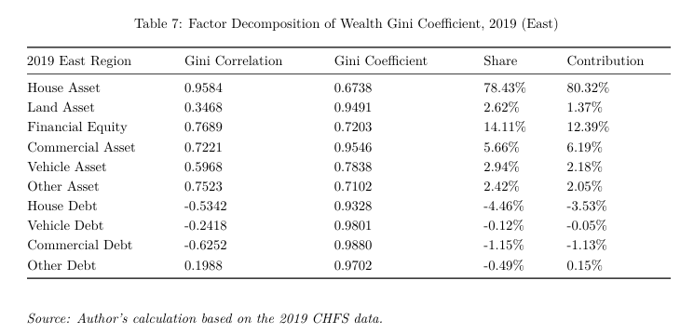
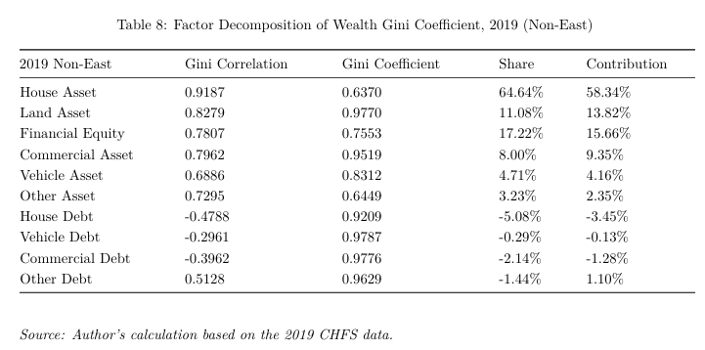
Factor decomposition for east and other regions
Housing contributes to an extremely high portion of wealth inequality in the East.
Land is trivial in the east but important in non-east regions.
Financial assets are a more significant contributor to wealth inequality in non-Eastern than in Eastern countries, to our surprise.
Financial assets and car distribution are more unequal in non-Eastern and Eastern.
In general, the pattern is similar to the urban/rural difference.
Notes:
In the estern costal area, we can safely claim that “ the housing inequality is really the wealth inequality”
Which could be because housing is more affordable and people accumulate more financial wealth in their portfolio.

Slide 16
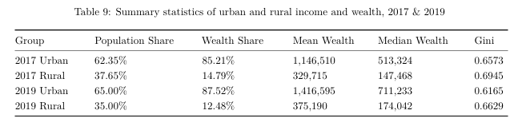
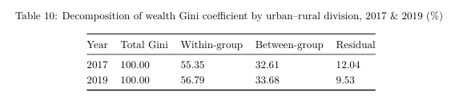
Group decomposition for urban and rural
Urban households own over 85% of total wealth in China, with 62.3% of the population.
In both urban and rural area, wealth inequality declined from 2017 to 2019.
Wealth inequality is higher in rural than urban areas.
Between-group inequality contributes to about 1/3rd of the total Gini coefficient.
Notes:
To understand the contribution of urban/rural and regional disparity to the national wealth inequality, group decompositions are performed on the respective subgroups.

Slide 17
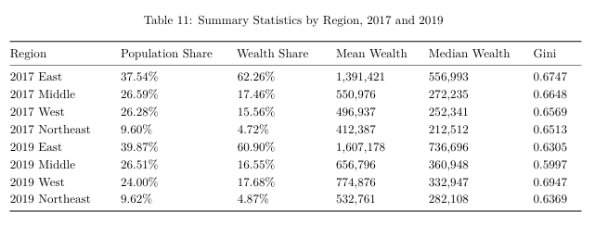
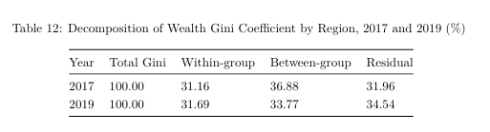
Group decomposition for regions
Less than 40% of the eastern population owns more than 60% of the total wealth. However, from 2017 to 2019, with a larger population, the East owned a smaller proportion of total wealth.
In 2017, wealth inequality was highest in the East, but in 2019, it was surpassed by the West and the Northeast.
Wealth in the West rose considerably, with the largest rise in inequality. It could be policy-related.
Between-region inequality contributes to more than 1/3rd of total inequality, and there is a higher residual term than the urban/rural decomposition.

Slide 18
Summary of findings
The CHFS 2017 and 2019 data support the claim that China’s inequality peaked in 2010 and fell moderately afterwards. Wealth inequality continued to decline from 2017 to 2019. This period happens to have a declining GDP growth rate.
There is considerable heterogeneity for wealth inequality across urban/rural and regional subgroups. Housing inequality contributes to a much higher proportion of wealth inequality in urban and eastern areas, while land plays a bigger role in rural and non-eastern areas.
Group decompositions show that the urban/rural divide and regional imbalance contribute to more than 1/3rd of total inequality, when measured separately.

Slide 19
Policy implications
To reduce the national wealth inequality in China, the government must deal with the urban/rural and regional imbalances but also deal with the within-group inequality.
Development policies should be established for rural areas and non-eastern regions. For the latter, we must recognize the heterogeneity of inequality across subgroups.
To reduce wealth inequality in cities and the East, cooling down the housing market and providing affordable homes would be necessary. Housing is still important in rural and western areas, but equitable land redistribution and higher compensation for land appropriation would be beneficial.

