Slide 1
TSDA: Topic Stability Driven Approach with Data
Flow Analysis and Hyperparameter Optimization
For Enhanced Topic Sentiment Summarization
MEMBERS:
AJAY KUMAR.T
RAJA ATHIBAN.P
VASANTH RAMM.P.K
GUIDE: Mrs.S.Aishwarya,
Assistant Professor,
Dept of Information Technology.
Department of IT

Slide 2
AIM
Our aim is to enhance the stability and reliability of topic extraction from documents by introducing a new method, TSDA, which employs LDA and LSA models optimized through techniques like Grid Search and Genetic Algorithm, ensuring coherent topics evaluated by coherence score, thus improving topic sentiment summarization.
Department of IT

Slide 3
OBJECTIVES
Utilizing LDA and LSA for the purpose of topic modeling.
To Ensure topic coherence within documents for consistent and meaningful topics.
Analyze sentiments across topics associated with sentences to understand people's feelings better.
Implement the data flow analysis in TSDA to perform topic sentiment summarization.
Fine-tune methods with hyperparameter optimization for effective topic sentiment summarization.
Department of IT

Slide 4
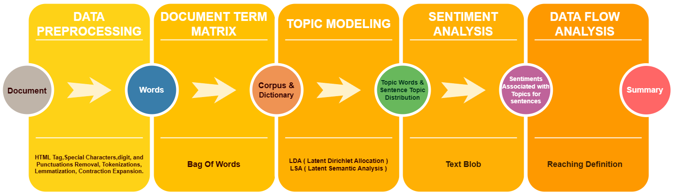
Basic Overall Work Flow
Department of IT

Slide 5
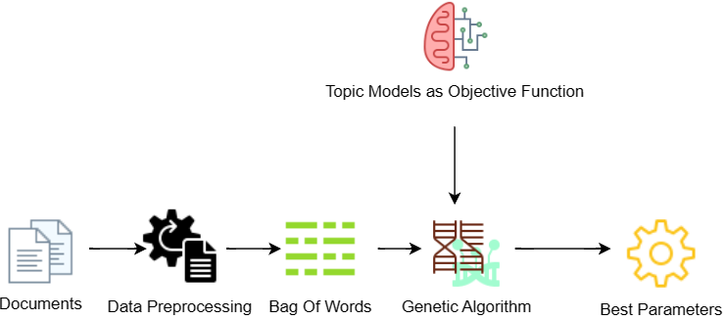
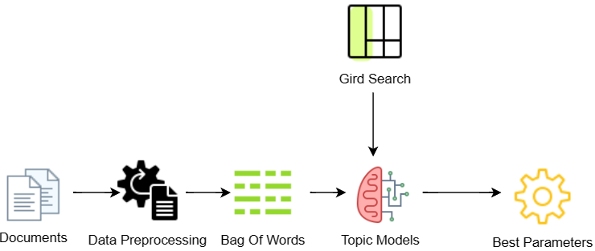
Optimizations
Department of IT

Slide 6
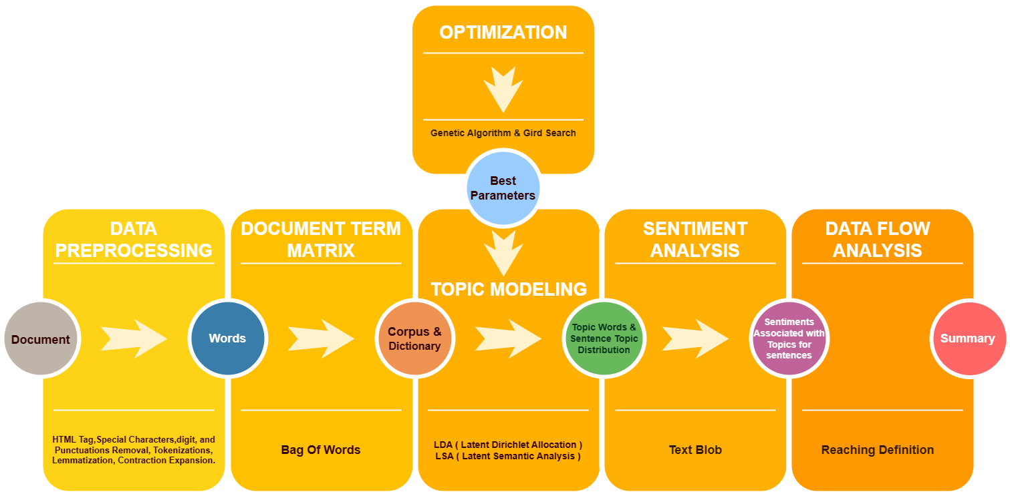
Overall Work Flow
Department of IT

Slide 7
Modules
Data Preprocessing
Bag Of Words
Topic Modelling
Topic Stability
Hyperparameter Optimization
Sentiment Calculation
Reaching Definition
Sentiment Classification
Evaluation
Department of IT

Slide 8
MODULE DESCRIPTION
Input Module
The TSSRD aims to summarize single-document texts.
It takes multiple text documents (.txt) with reviews as input.
And converts into single dataset as .csv file for further processing.
Data Preprocessing
The data collected may have noise.
So preprocessing is done to change the data collected into high quality and suitable for further process.
Preprocessing techniques used are
  Tokenization
  Stop Word Removal
  Removal of punctuations , HTML Tags and special characters
  Expanding Contractions
Department of IT

Slide 9
Bag Of Words
After preprocessing , the tokenized words are vectorized.
Because the machine learning model cannot understand text written in any natural language.
BOW converts data into numbers represented as sparse matrix.
Here BOW is used to create a corpus through a dictionary
helps to understand inputs and run code faster.
Dictionary: A mapping of unique words to integer IDs.
Corpus: Bag-of-words representation of documents, where each document is represented as a list of (word ID, word frequency) tuples.
For example : “The cat sat on the mat”
  Dictionary
Word | id
cat | 0
sat | 1
mat | 2
Corpus
[(0, 1), (1, 1), (2, 1)]
Department of IT

Slide 10
Topic Modeling
LDA Topic Model
LDA stands for Latent Dirichlet Allocation.
Used to extract topics from a corpus.
Latent means hidden or concealed.
Dirichlet Allocation nothing but Dirichlet process is a theory in probability which uses probability distribution.
Generates probabilities for the words using which topics are formed.
It is Iterative process.
Key assumptions of LDA are
  Documents are a mixture of topics,
  Topics are a mixture of tokens or words.
  Topics using probability distribution generate words.
  LDA model has two parameters that control the distributions
    Alpha controls sentence topic distribution.
    Beta controls topic word distribution.
Department of IT

Slide 11
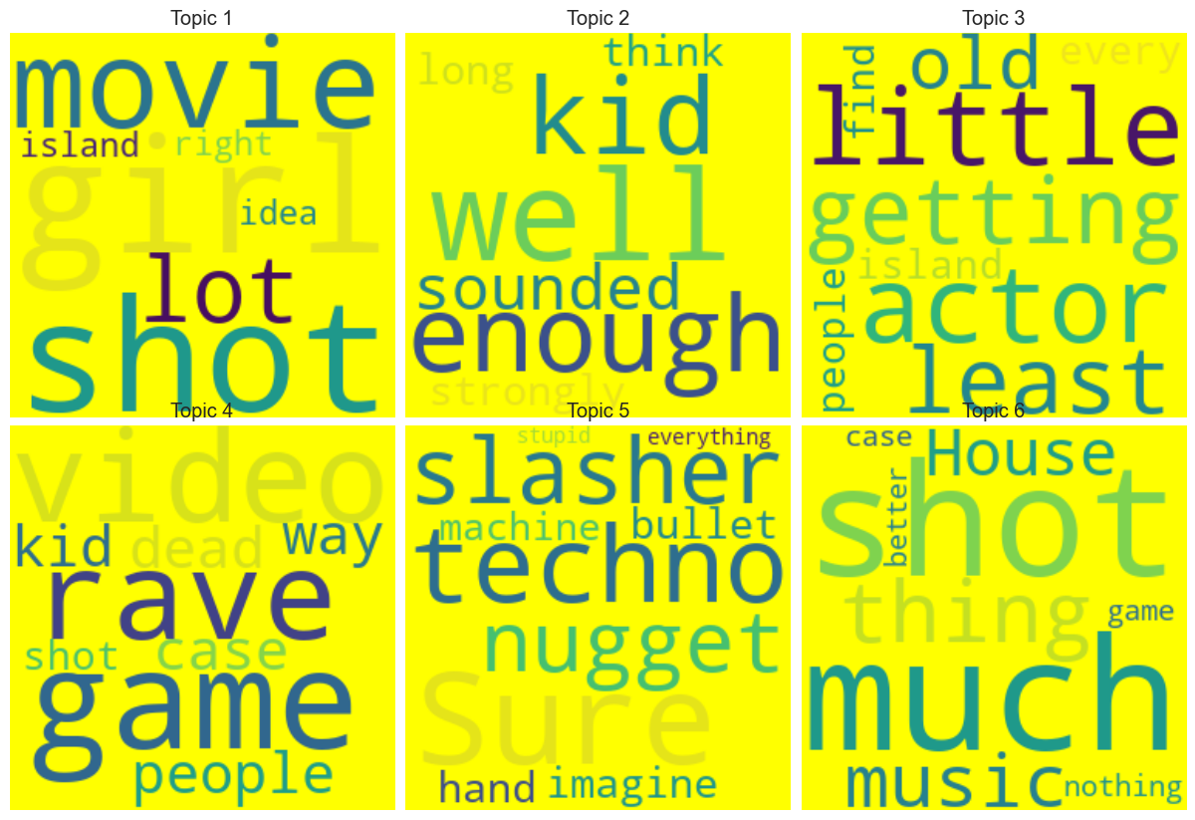
Sample Example For Topics
Department of IT

Slide 12
LSA Topic Model
LSA stands for Latent Semantic Analysis.
Takes a matrix of documents and terms and try to decompose it into separate two matrices.
  Topic-word matrix.
  Sentence-topic matrix
Learning of LSA for latent topics includes matrix decomposition on the document-term matrix using Singular value decomposition.
SVD is finding the most valuable information and using lower dimension to represent the same thing.
Department of IT

Slide 13
Topic Stability
To evaluate the stability of topics generated from topic models is evaluated using coherence score metric .
Coherence score is a quantitative measure used to evaluate the semantic coherence of topics generated by topic modeling algorithms.
Higher coherence scores indicate that the words within a topic are more closely related and that the topics are more distinct from each other.
Hyperparameter Optimization
It is the process of finding the best set of hyperparameters for a machine learning algorithm.
Genetic Algorithms (GA) and Grid Search are the techniques employed to find the optimal set of hyperparameters.
It uses log-likelihood-score to find best settings.
log likelihood score quantifies how well a statistical model fits observed data by comparing the likelihood of the data under the model to a baseline.
Department of IT

Slide 14
Topic Sentiment Calculation
Calculating sentiments of sentences with associated topics using a sentiment dictionary ie Text blob
Sentiment dictionary contains sentiment scores for many words and phrases
Reaching Definition (RD)
Technique used to analyze computer programs, particularly in compiler theory and program analysis.
It helps to understand how the values assigned to variables change as the program executes.
Like wise in TSDA the RD tracks the sentiment changes of topics with respect to sentences in a document.
The final topics associated with sentences live at the end of the reaching definition is taken as summary.
Department of IT

Slide 15
Sentiment Classification
Since have only documents . Created labels manually be classifying documents and summary to evaluate.
Documents and summary are classified in 3 categories they are positive , negative , neutral .
Sentiment Classification is done using Text Blob Sentiment dictionary.
Evaluation
The summary generated by our framework is evaluated for many case , they are,
  Readability [Fluency] of summary is evaluated using Parts of Speech (POS), it categorizes words in a sentence into their respective grammatical categories, such as nouns, verbs, adjectives, etc.
  Evaluation for the presence of topic words in the generated summary [Relevance].
  Comparing with popular summarization algorithm page rank by rouge score.
  Finally evaluated by cross-validation.
Department of IT

Slide 16
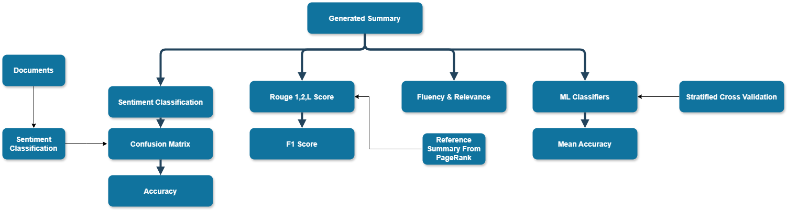
Frameworks
We implemented eight frameworks. they are,
Iterative LDA
Iterative LSA
Topic-Wise LDA
Topic-Wise LSA
GA - LDA
GA - LSA
Grid - LDA
Grid - LSA
The Performance of all methods we implemented are way better than our base paper
Department of IT

Slide 17
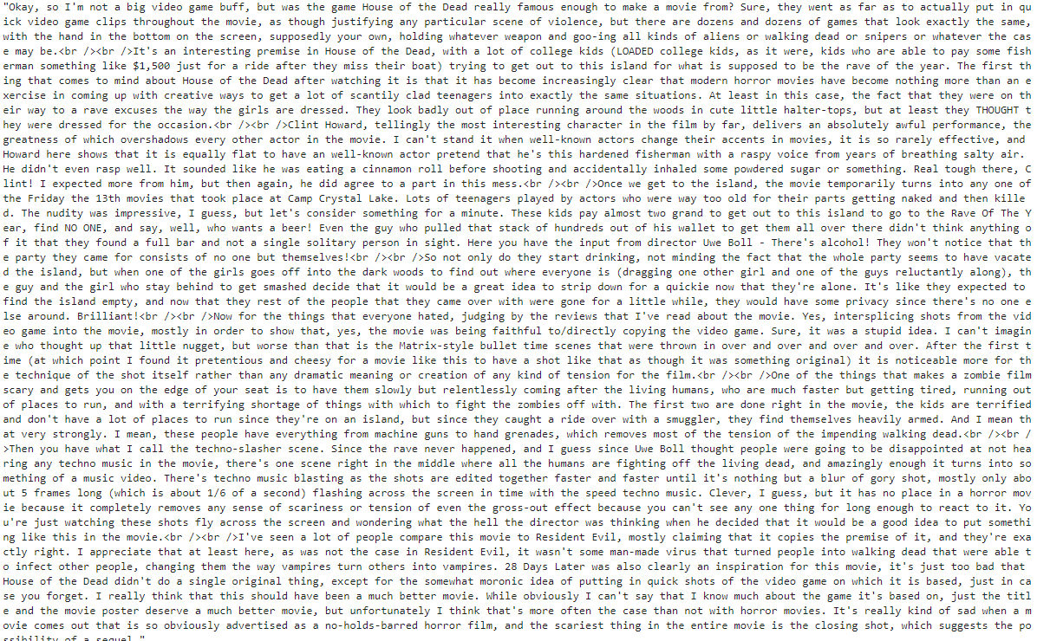
Results
Actual Document
Department of IT

Slide 18
Summary generated
Just until...Straight from the beginning of the film lots and lots of problems happen to them The premise of this movie has been tickling my imagination for quite some time now That alone is the main reason to why these two guys get so well along, because they simply only have each other to turn to when comforting is needed The amount of problems they face keeps increasing until that one day where they may have to face the inevitable and deal with it Dave is unsuccessful at his job and his colleagues don't treat him very well and with the respect he deserves Andrew is a nervous wreck to say the least and Dave is considered being one of the biggest losers of society Both of them get involved with crime, Andrew suffers from paranoia and simply doesn't dare going out of the house We've all heard or read about it in some kind of con-text This is just too much for them and they wish that everything would just go away.. What would you do if you were all alone in the world? What would you do if the entire world suddenly disappeared in front of your eyes? In fact, the last part is actually what happens to Dave and Andrew, two room-mates living in a run-down house in the middle of a freeway system
Department of IT

Slide 19
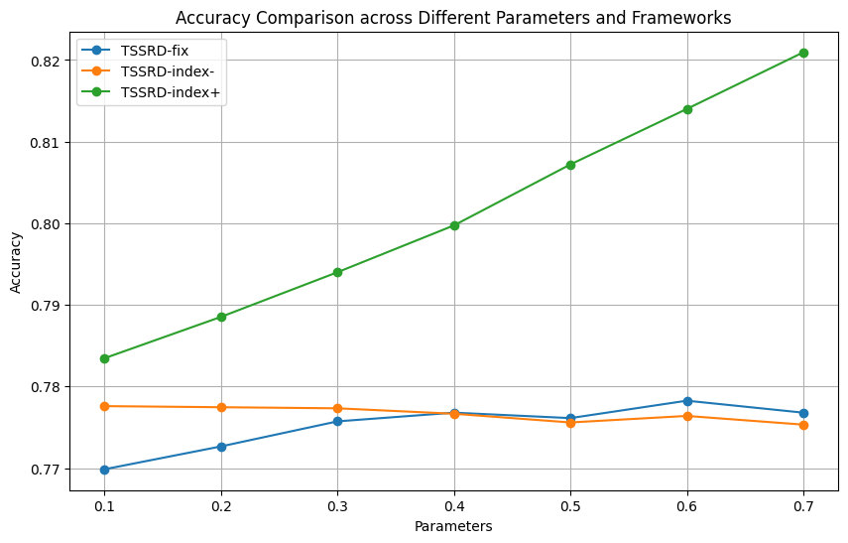
Results
Baseline Results
Department of IT

Slide 20
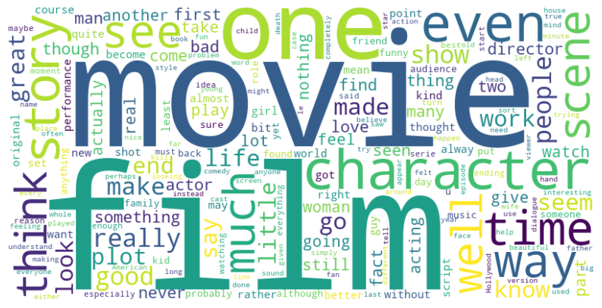
Department of IT

Slide 21
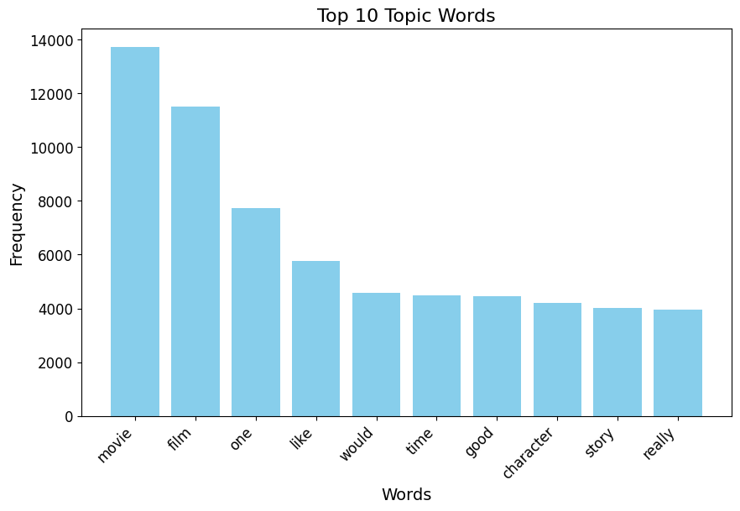
Department of IT

Slide 22
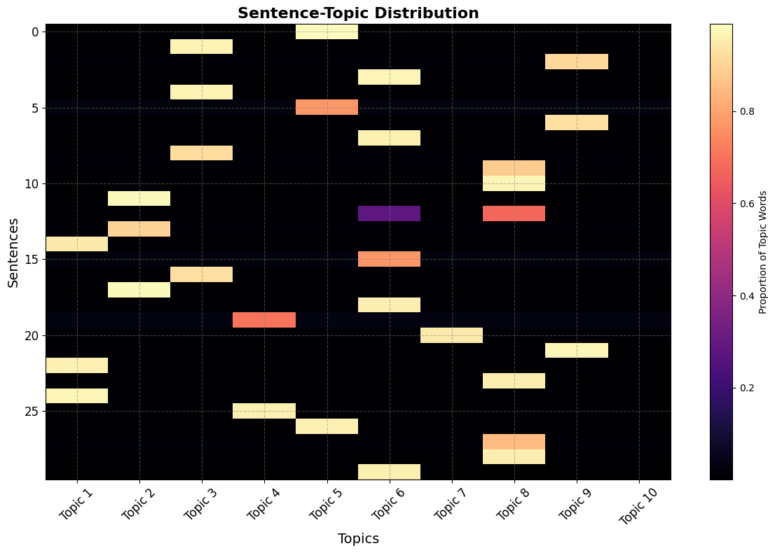
Department of IT

Slide 23
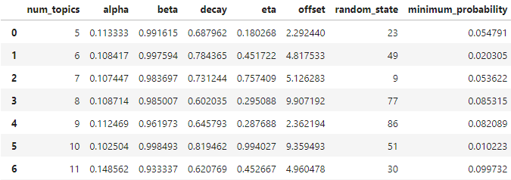
Novelty Results - Best Parameter Settings Using Genetic Algorithm (LDA model)
Department of IT

Slide 24
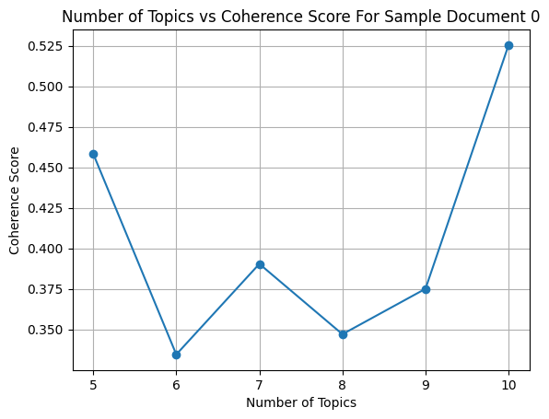
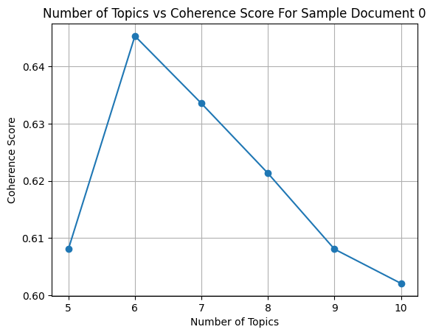
Iterative LDA vs Iterative LSA Topic Stability
Department of IT

Slide 25
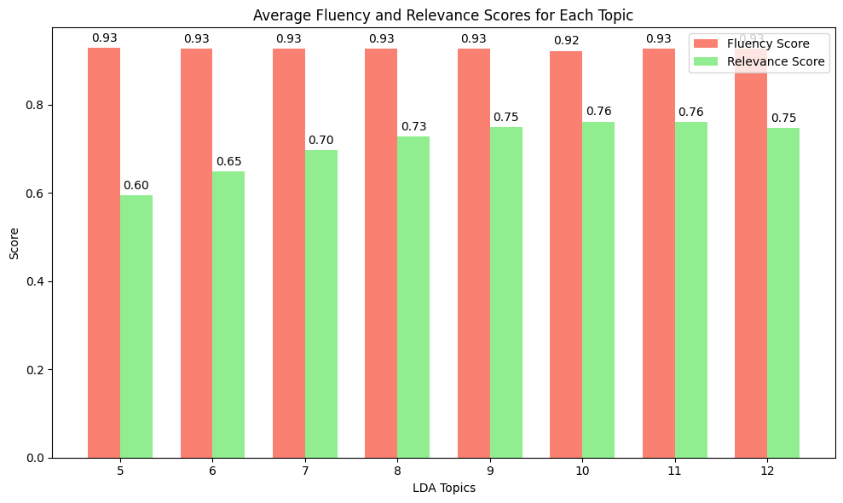
Topic-Wise LDA – Fluency And Relevance
Department of IT

Slide 26
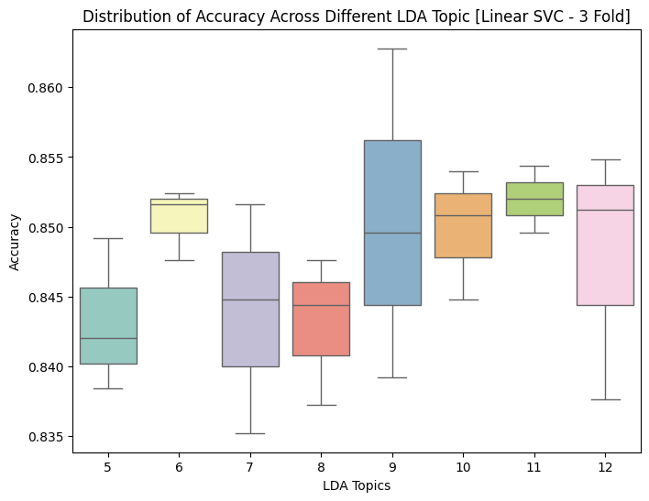
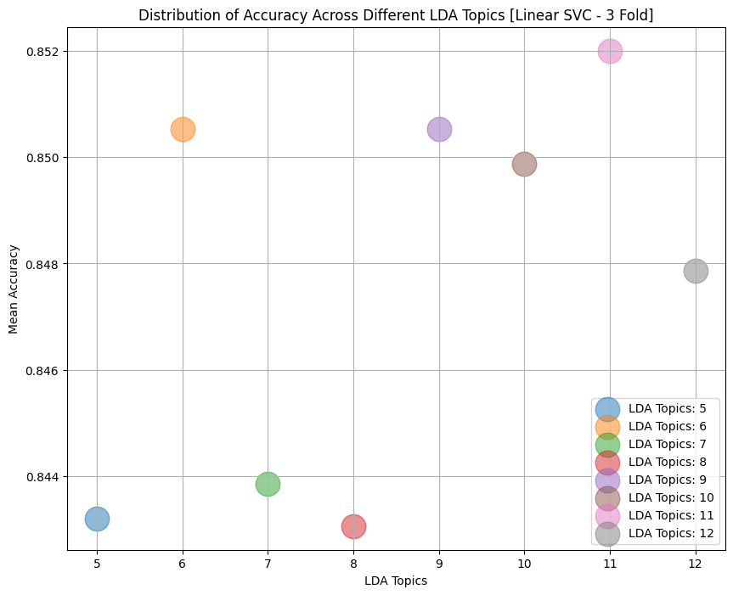
Topic-Wise LDA – Best Cross Validation
Department of IT

Slide 27
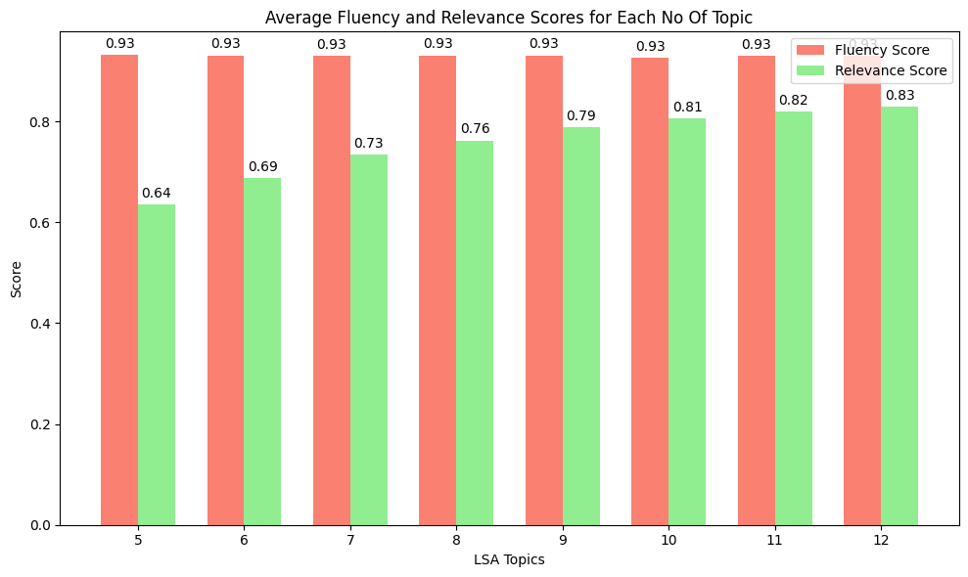
Topic-Wise LSA – Fluency And Relevance
Department of IT

Slide 28
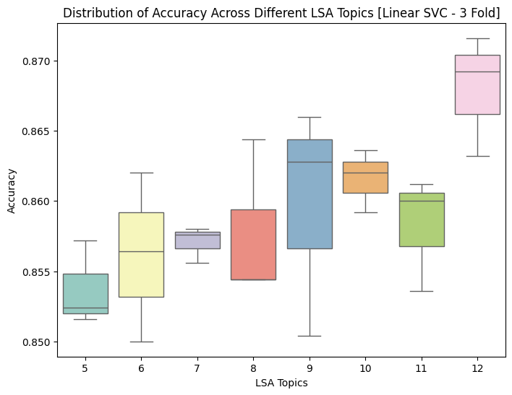
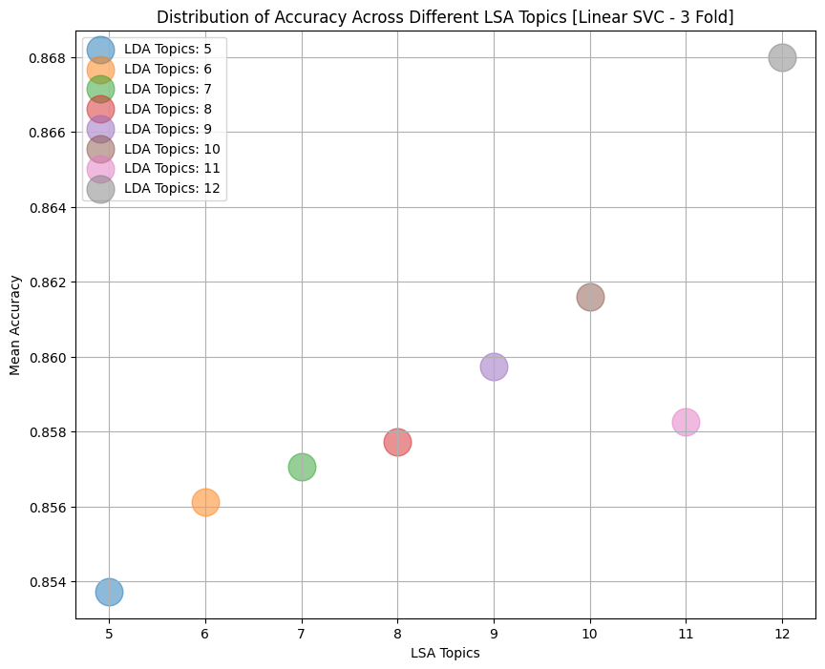
Topic-Wise LSA – Best Cross Validation
Department of IT

Slide 29
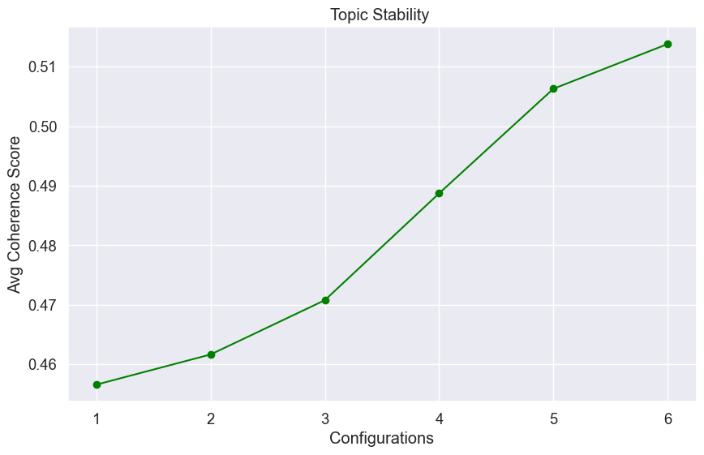
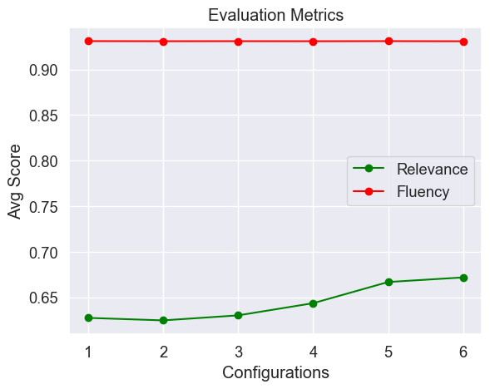
GA LDA
Department of IT

Slide 30
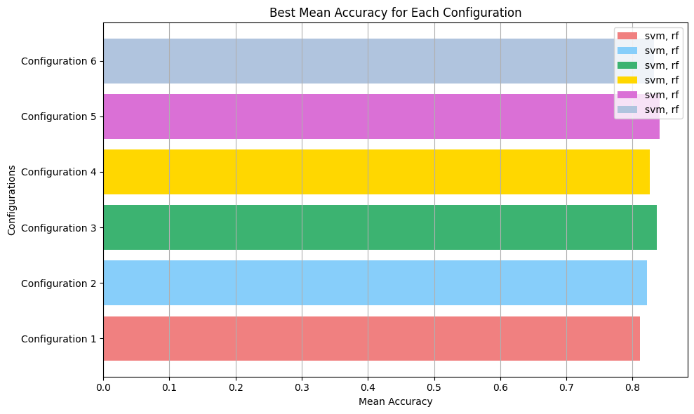
GA LDA
Department of IT

Slide 31
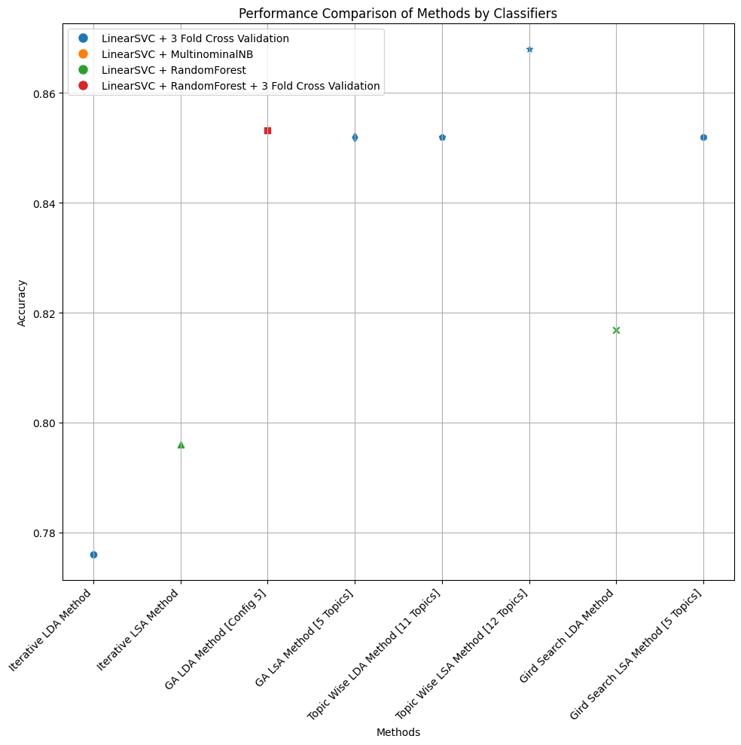
Overall Results
Cross Validation Results
Department of IT

Slide 32
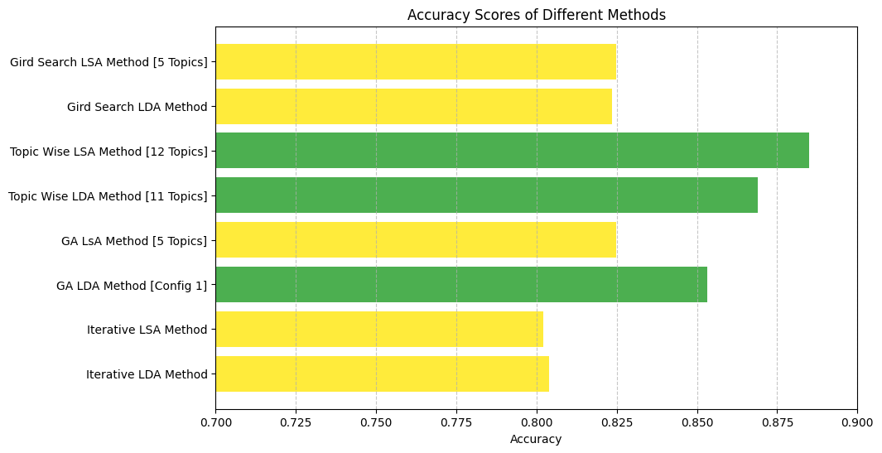
Confusion Matrix Results
Department of IT

Slide 33
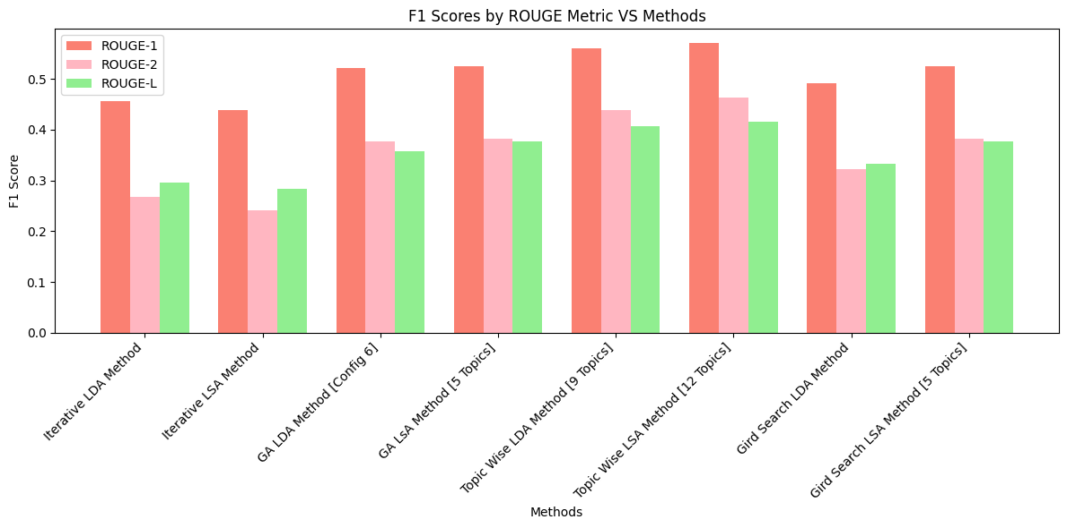
Rouge Scores vs Frameworks
Department of IT

Slide 34
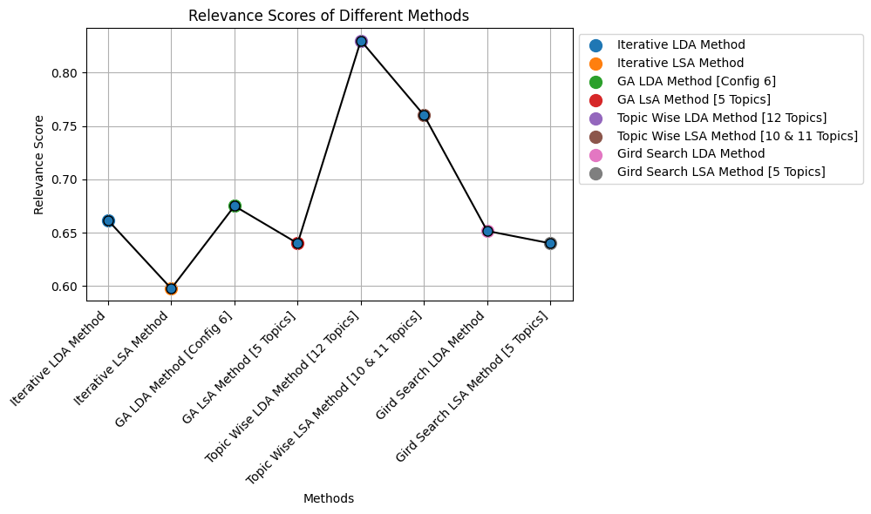
Relevance Scores vs Frameworks
Department of IT

Slide 35
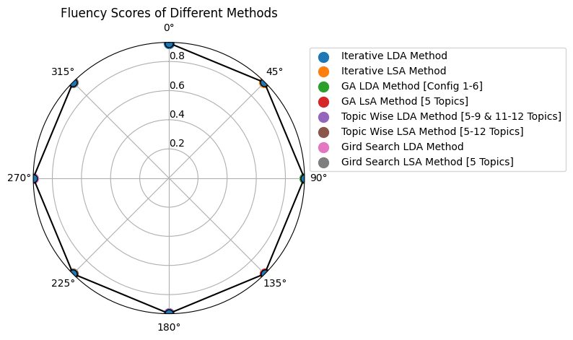
Fluency Scores vs Frameworks
Department of IT

Slide 36
Limitations
Execution Time
Dependency on Preprocessing.
Limited Scope of Summarization.
Merits
Enhanced topic models through topic stability measure.
Fine-tuned models to get better topics.
Versatility
Improved Summarization.
Department of IT

Slide 37
Implementation
Final Work\GA LDA
Final Work\GA LSA
Final Work\Gird LSA
Final Work\Grid LDA
Final Work\Iterative LDA
Final Work\Iterative LSA
Final Work\TopicWise LDA
Final Work\Final-Visualizations.ipynb

Slide 38
Thank You

