Slide 1
C++: performance matters (in a nutshell)
Janusz Majchrzak

Slide 2


Base problem: Get n Fibonacci numbers
Fibonacci numbers are the numbers in the following integer sequence, called the Fibonacci sequence, and characterized by the fact that every number after the first two is the sum of the two preceding ones:
The sequence F_{n} of Fibonacci numbers is defined by the recurrence relation: : with seed values:
These numbers are often used in finance or many types of simulations including biology, chemistry or physics.

Slide 3
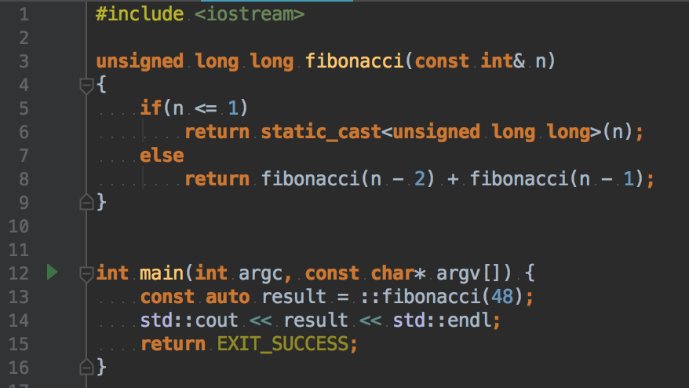
Common implementation 1: Recursive algorithm
In case of recursive Fibonacci implementation the algorithm complexity is O(2^{n}). Computer has to calculate the same numbers many times due to the recursive function call.
To get 48th Fibonacci sequence number (4807526976) it took 38 seconds on my machine.
Imagine if we need to get a lot of the numbers in the same time…

Slide 4
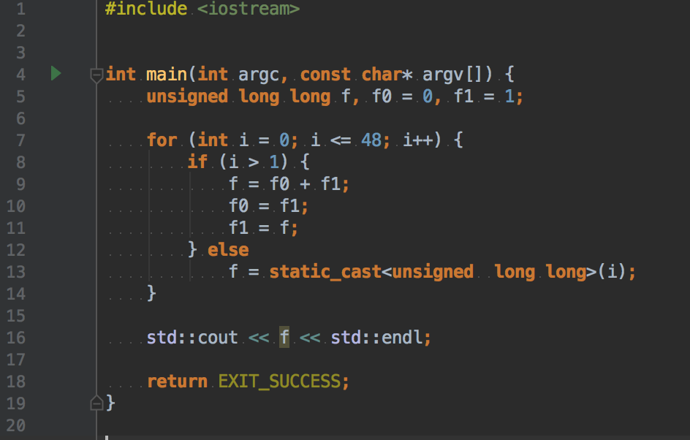
Common implementation 2: Iteration algorithm
The previous approach was very simple, but wasn’t optimal. We can easily designe better algorithm using an iterative approach.
This time calculation of 48th Fibonacci number took only about 0.09 second.
The algorithm complexity is O(n) now.
This method is clearly way better, but the question remains: What if we need to get a lot of big Fibonacci numbers in the same time?
Notes:
Modern CPUs can optimazie the code in example it can use SMID (-O3).
This can work in our case, but not every problem can be acceleraded using SMID for example.
Some operation can be excluded to GPU (again if the operation can be vectorized)
Change of the compiler can help in some cases (better HW instruction sets – not every task)
Intel math kernel is much faster on intel’s CPUs (e.g. fft)
libc++ (fatser compile time, new features) vs stdlibc++ (worth considering, but sometimes compatibilitys issues)

Slide 5
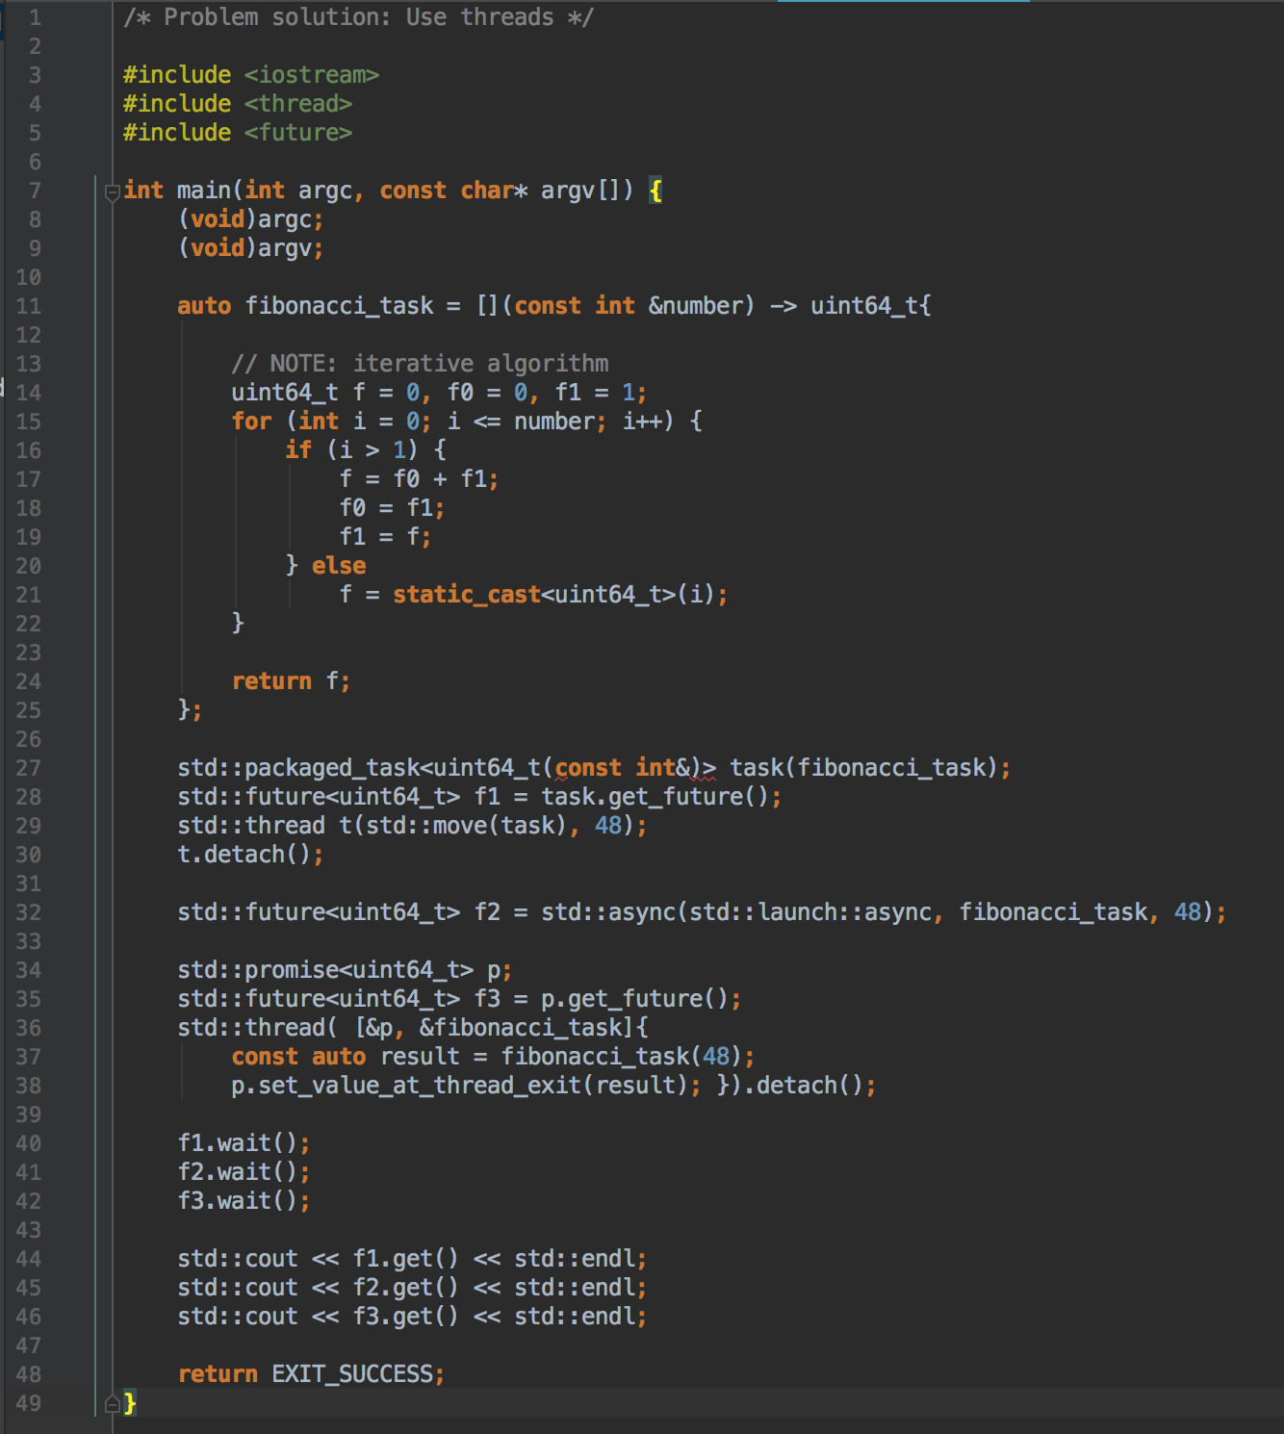
Problem solution: Use threads
The idea is to calculate values on a different thread. This approach may be useful in some cases, but also has it’s down sides.
In some systems adding new threads can be forbidden. (Real time applications for example).
If we can make a new thread, we have to remember that this is not a cheap operation.
It is also worth mention CPU thread pool.
Notes:
- New c++ 11 promise/future example – IDE
- Thread pool
- Inclusive cache and contecst switching – hiper threading
- OS denies to create a new thread – higher level c++ thread api and lunch policy
- MT designe problems: dead lock, live lock, sync overhead (avoid shared data between the threads)

Slide 6
Problem solution: Load pre computed numbers from external file
The idea is to pre calculate the Fibonacci numbers before the application yet started and load them form file. This method is commonly used for some data especially in the applications that requires computing a real big numbers.
The file could contain a list of numbers placed in very specific order. This requires us to take care if anybody hasn’t modified the file. The parser will expect only certain pattern, if this pattern has been changed our parser should also be modified.
But this is also not perfect in our use case. We want to get just a few Fibonacci numbers as quick as possible.
In some applications this method is also not possible. For example the application that I’ve been developing in previous company had very strict requirements and worked in very controlled environment which is common in case of real time applications. We as developers were not allowed for adding anything to the file system.
Please also remember that I/O operations are also not cheap (OS calls). The CPU has to make a lot of operations in order to gain access and read data form disk.
Notes:
Pos:
Can be lazy – if not needed don’t load
Useful when the program state has to remembered
Cons:
- Open file descryptor (OS call)
- I/O takes cpu c.
- Parser and parse errors

Slide 7
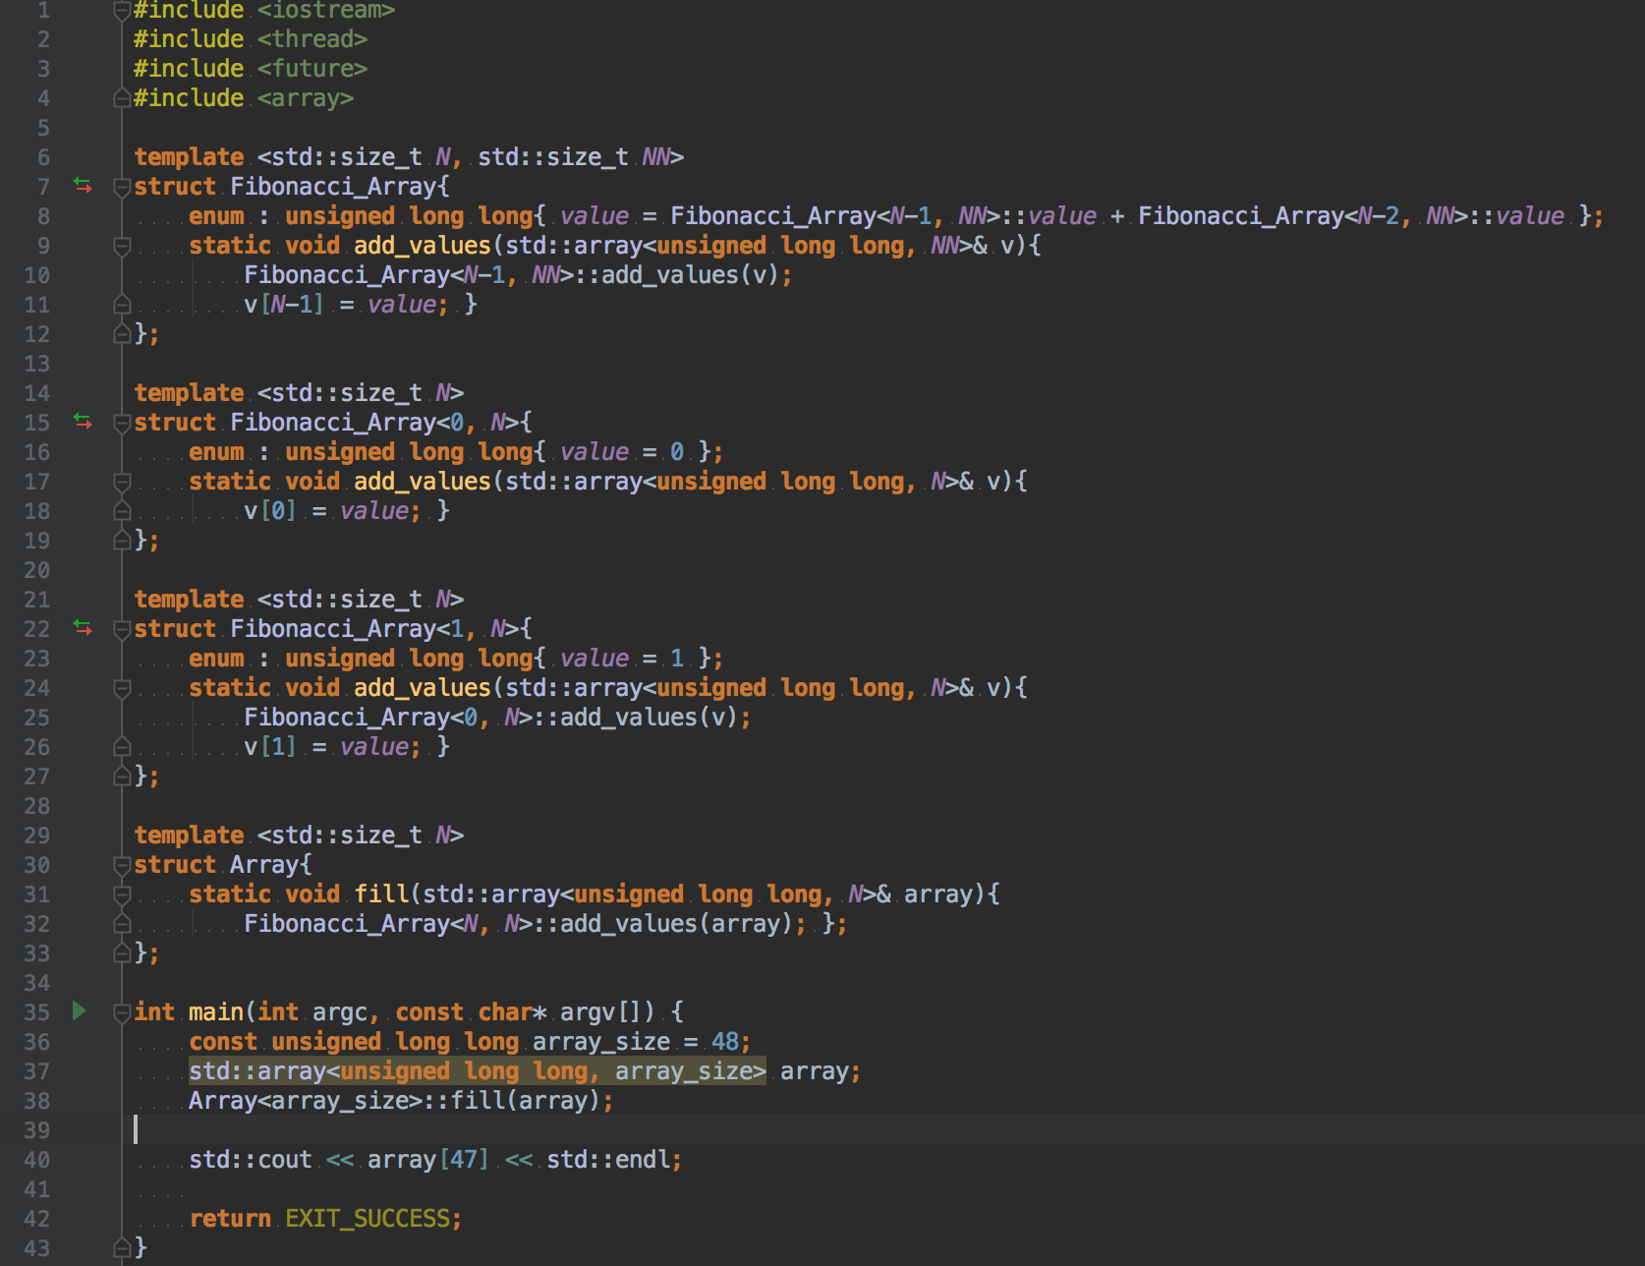
Problem solution: Use compile time
In this method we will also use already computed Fibonacci numbers, but unlike previous solution, we will not use external file. Instead we want these numbers combined with the program executable file.
This solution is very efficient and works very well for such a small data set.
For storing bigger amount of data using external file may be a better solution.
This method makes accessing the Fibonacci number very fast (the access time is immeasurable).
Notes:
GOLDBOT
– simpler `non-array`: https://godbolt.org/g/NptM7c / IDE
Alternative:
Copy and paste the pre-calculated values into the app source (std::array in example) – this could work in our case, but no in general (fib is only ilustration)
cons:
No float
Not lazy init – have to compiled every time (ccache – compiler cache to speed up compilation)
Compile time increase
- Compile Time limitation

Slide 8
Bibliography
https://en.wikipedia.org/wiki/Fibonacci_number
https://www.geeksforgeeks.org/time-complexity-recursive-fibonacci-program/
https://en.wikipedia.org/wiki/Automatic_vectorization
https://en.wikipedia.org/wiki/SIMD
https://www.it.uu.se/edu/course/homepage/hpb/vt12/lab4.pdf
https://ccache.samba.org
https://cppcon.org
https://isocpp.org
http://www.stroustrup.com/bs_faq2.html#char
https://www.rust-lang.org/en-US/
https://www.ponylang.org
https://youtu.be/zBkNBP00wJE?t=26m56s
Notes:
Play Jason Turner video:
- https://www.youtube.com/watch?v=zBkNBP00wJE&feature=youtu.be&t=26m56s
Other compile-time examples:
- OPTIONAL: SFINAE and compiler substitution/resolving: https://godbolt.org/g/f2ZNz5
Show books:
- „Effective modern c++” – Scott Mayers;
„C++ Concurecy in Action: Practical Multithreadin” – Anthony William;
„char” on Straustrup’s blog
RUST/PONY

Slide 9
Thank You

