Slide 1
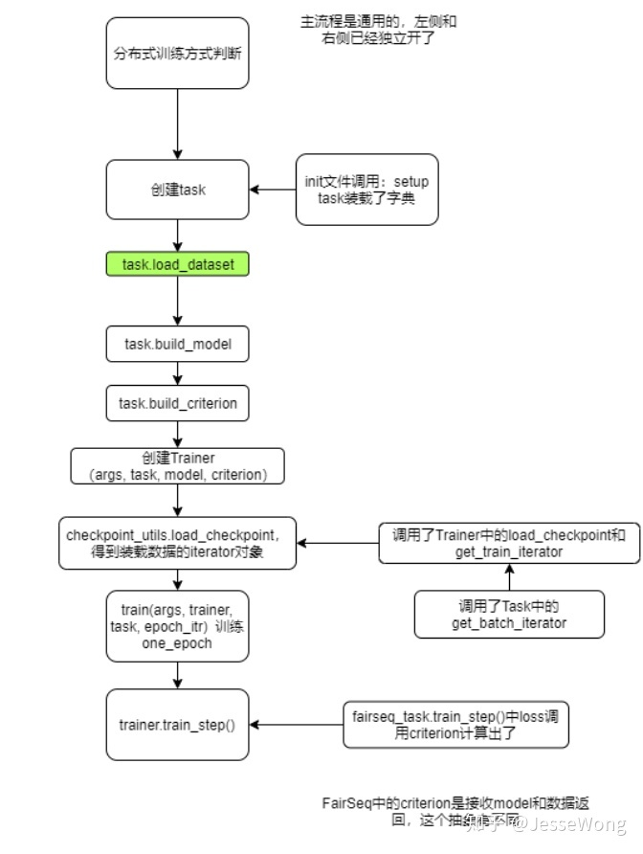
Notes:
https://zhuanlan.zhihu.com/p/100249351

Slide 2
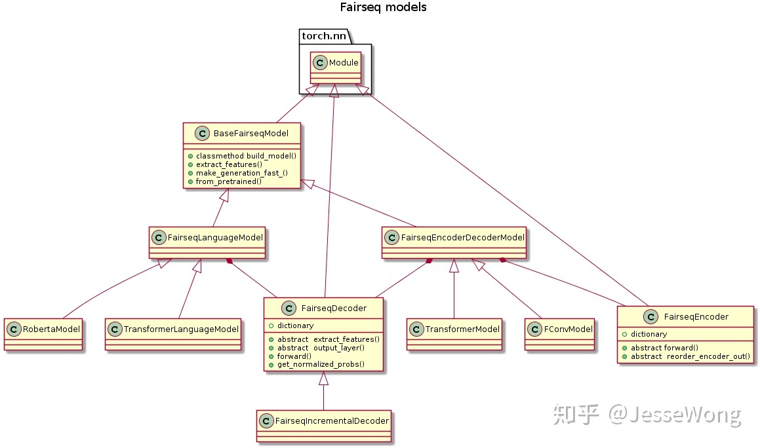

Slide 3
