Slide 1
Computer Vision
Vorlesung 1: Wie sehen Tiere?

Slide 2
Light
Light
Particles known as photons
Act as ‘waves’
Two fundamental properties
Amplitude
Wavelength
Frequency is the inverse of wavelength
Relationship between wavelength (lambda) and frequency (f)
Where c = speed of
light = 299,792,458 m / s

Slide 3
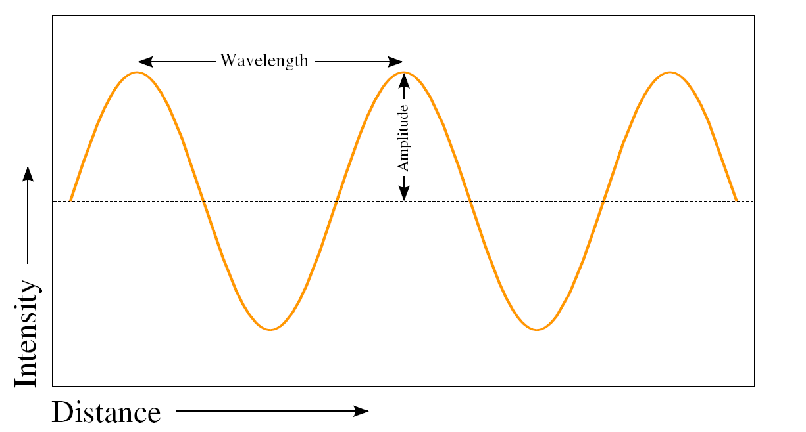
Light
Diagram of a light wave.

Slide 4
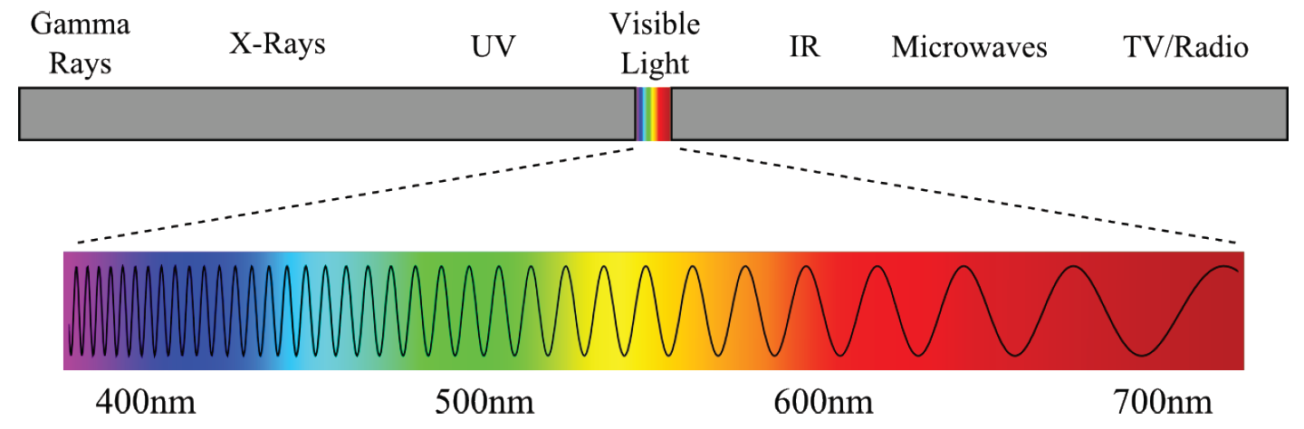
Light
Electromagnetic Spectrum

Slide 5
Human Visual System
Human vision
Cornea acts as a protective lens that roughly focuses incoming light
Iris controls the amount of light that enters the eye
The lens sharply focuses incoming light onto the retina
Absorbs both infra-red and ultra-violet light which can damage the lens
The retina is covered by photoreceptors (light sensors) which measure light

Slide 6
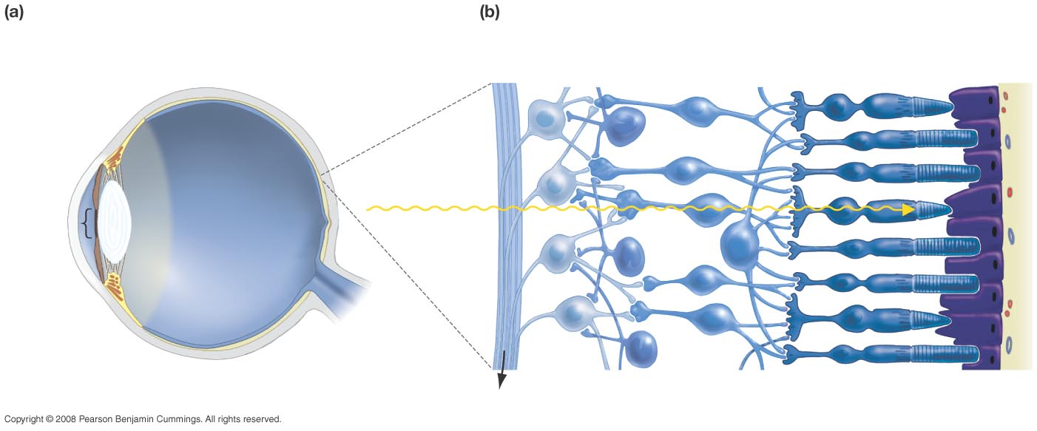
Figure 46-8
The structure of the vertebrate eye.
In the retina, cells are arranged in layers.
Pigmented epithelium
Ganglion cells
Connecting neurons
Photoreceptor cells
Sclera
Retina
Iris
Direction of light
Pupil
Cornea
Fovea
Lens
Optic nerve (to brain)
Axons to optic nerve
Notes:
6

Slide 7
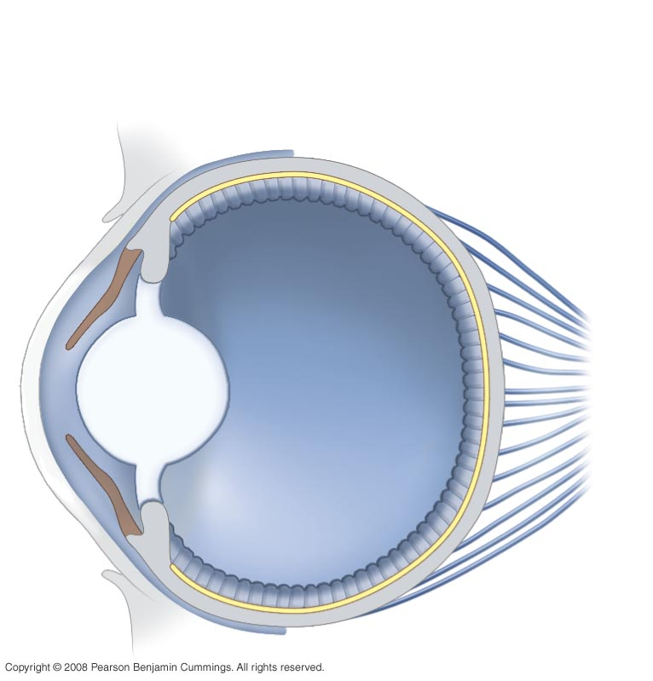
Figure 46-9
The Cephalopod Eye
Retina (photoreceptors are on the inside surface)
Cornea
Lens
Sensory nerves to brain
This “design” is “more intelligent” than that of mammals (humans) because it lacks the blind spot and maximizes light exposure to receptors
Notes:
7

Slide 8
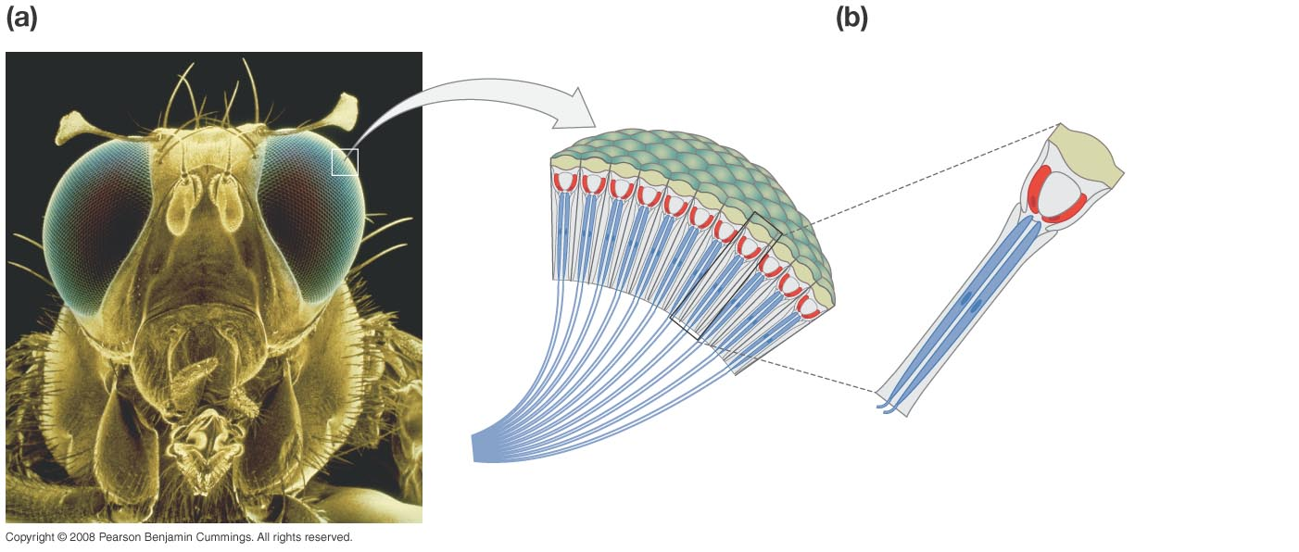
Figure 46-7
Insects appear to have two eyes also, but they are compound!
Each ommatidium sends separate information to their brain.
Ommatidia are the functional units of insect eyes.
Ommatidia contain receptor cells that send axons to the CNS.
Ommatidia
Lens
Receptor cells
Axons
Notes:
8

Slide 9
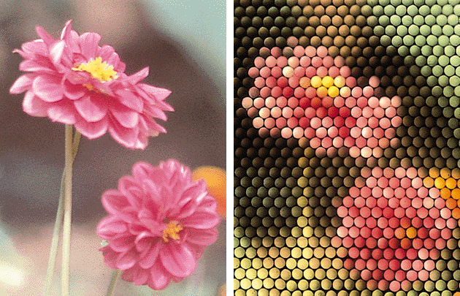
Human vs Insect Vision
Copyright Norton Presentation Manager

Slide 10
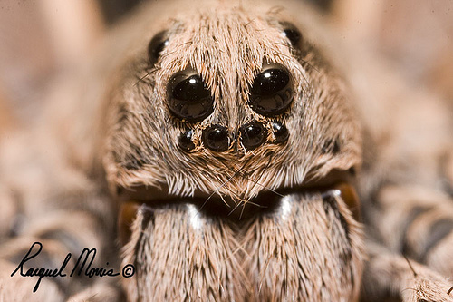
Spiders have up to 8 eyes looking in different directions!!
It makes you wonder what exactly they see!
http://farm5.static.flickr.com/4010/4682587135_b91e399914.jpg

Slide 11
Structure of the Eye: Cornea and Lens
Retina
Cornea
Eyelens
There are two lenses in your eye, the cornea and the eyelens.
The cornea, the front surface of the eye, does most of the focusing in your eye
The eyelens provides adjustable fine-tuning of the focus

Slide 12
Structure of the Eye: Cornea and Lens
Retina
cornea: n ≈ 1.4
eyelens: n ≈ 1.4
air: n = 1
humors: n ≈ 1.3
This is because the cornea-air surface has a large change in the index of refraction, so light bends a lot
The power of the cornea lens is ~43 diopters (focal length 2.3 cm)
The eyelens is surrounded by the humors, which have a very similar index of refraction as the lens itself.

Slide 13

How a Camera Lens Focuses
A camera is focused by changing the distance, x_{i}, from the lens to the image at the back on the film or CCD as the distance to the object, x_{o}, changes.
Focal length (fixed)
Object distance
(varies)
Image distance
(changes to satisfy equation when x_{o} changes)

Slide 14

How Your Eye Focuses
The eyelens is a fixed, unchanging distance, x_{i}, from the retina at the back of the eyeball where the image is created
Object distance
(varies)
Focal length (changed to satisfy the equation when x_{o} changes)
Image distance (fixed)

Slide 15
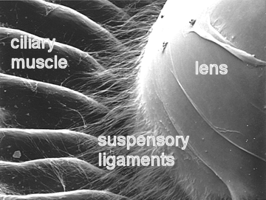
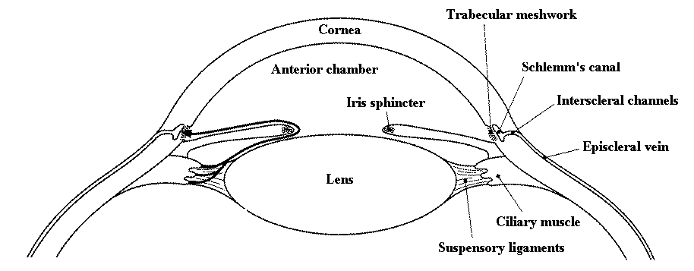
The Eyelens: Accommodation
The eyelens changes its focal length by changing its shape. Ligaments pull on the lens to change the amount of “bulge”

Slide 16
Eyelens: Accommodation
Muscles contract, ligaments relax, more bulge, more bending power, shorter focal length
Ligaments
Eyelens
Muscles relax, ligaments contract, less bulge, less bending power, longer focal length

Slide 17
How Your Eyelens Focuses
Your eyelens has a small depth of field
You can't see something close and far with both objects in focus at the same time
Hold out your thumb about a foot away from your eye
Then, alternately focus on thumb and me (right above your thumb)
Note that you cannot see both me and your thumb sharply (in focus) at the same time
You focus on one or the other by changing the bulge of your eyelens

Slide 18
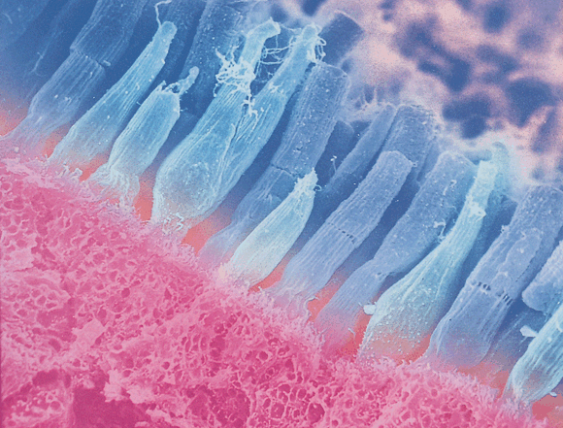
Vertebrate Retina
rod
cone
light

Slide 19
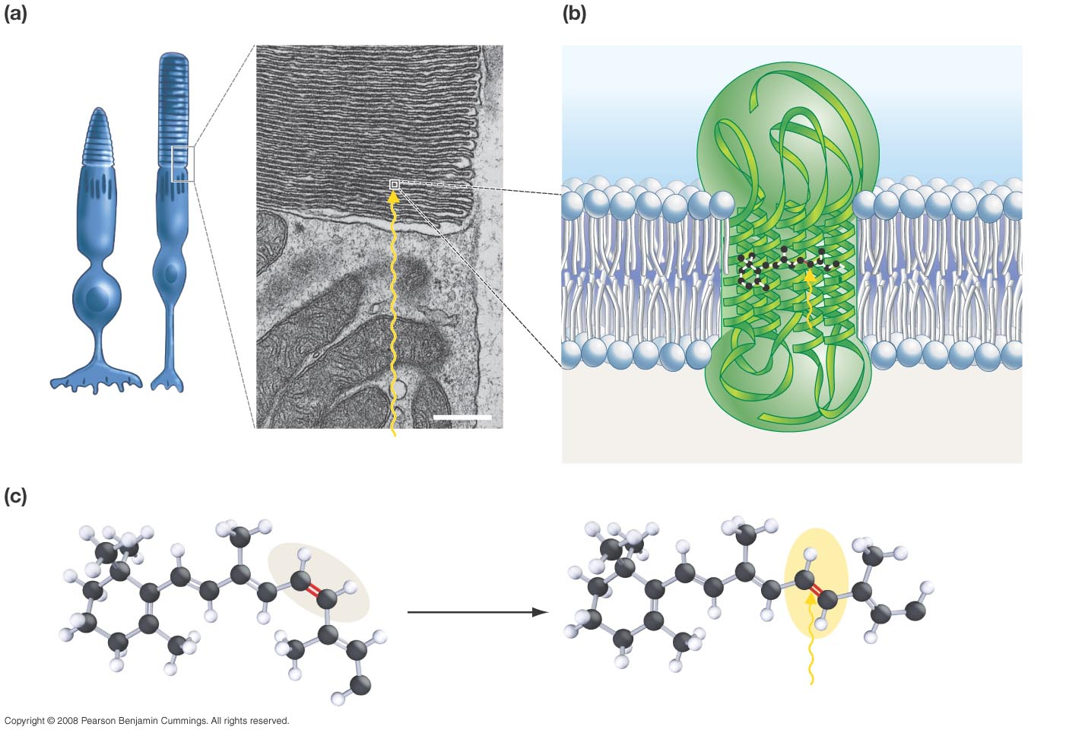
Figure 46-10
Rods and cones contain stacks of membranes.
Rhodopsin is a transmembrane protein complex.
Opsin (protein component)
Retinal (pigment)
Cone
Rod
0.5 µm
Rhodopsin
Light
Light
The retinal molecule inside rhodopsin changes shape when retinal absorbs light.
cis conformation (inactive)
trans conformation (activated)
Opsin
Opsin
Light
Notes:
19

Slide 20
Photoreceptors
Rods
Approximately 100-150 million rods
Non-uniform distribution across the retina
Sensitive to low-light levels (scotopic vision)
Lower resolution
Cones
Approximately 6-7 million cones
Sensitive to higher-light levels (photopic vision)
High resolution
Detect color by the use of 3 different kinds of cones each of which is sensitive to red, green, or blue frequencies
Red (L cone) : 564-580 nm wavelengths (65% of all cones)
Green (M cone) : 534-545 nm wavelengths (30% of all cones)
Blue (S cone) : 420-440 nm wavelengths (5% of all cones)

Slide 21
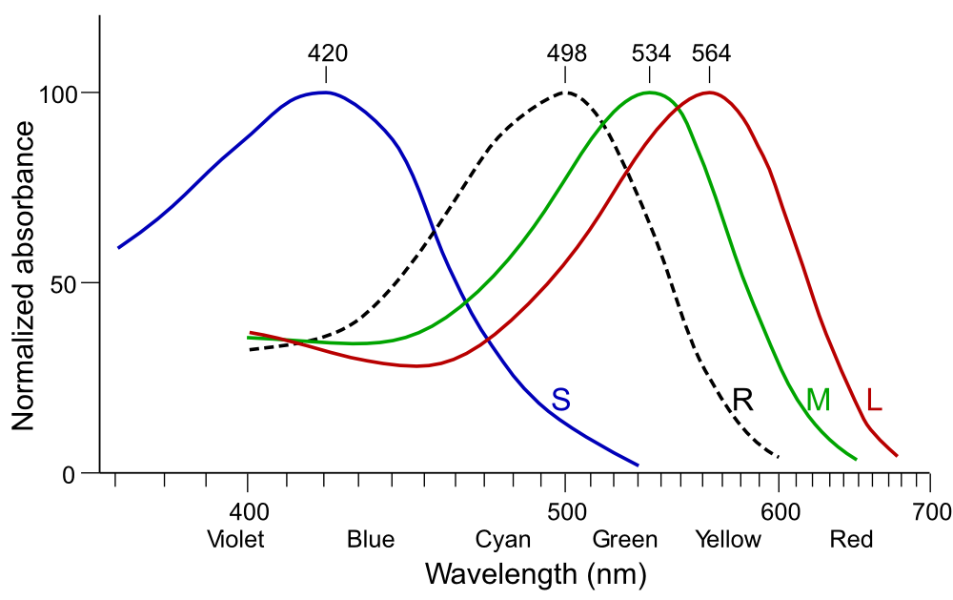
Cone (LMS) and Rod (R) responses
http://en.wikipedia.org/wiki/File:Cone-response.svg

Slide 22
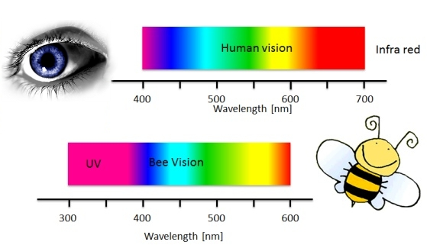

Slide 23
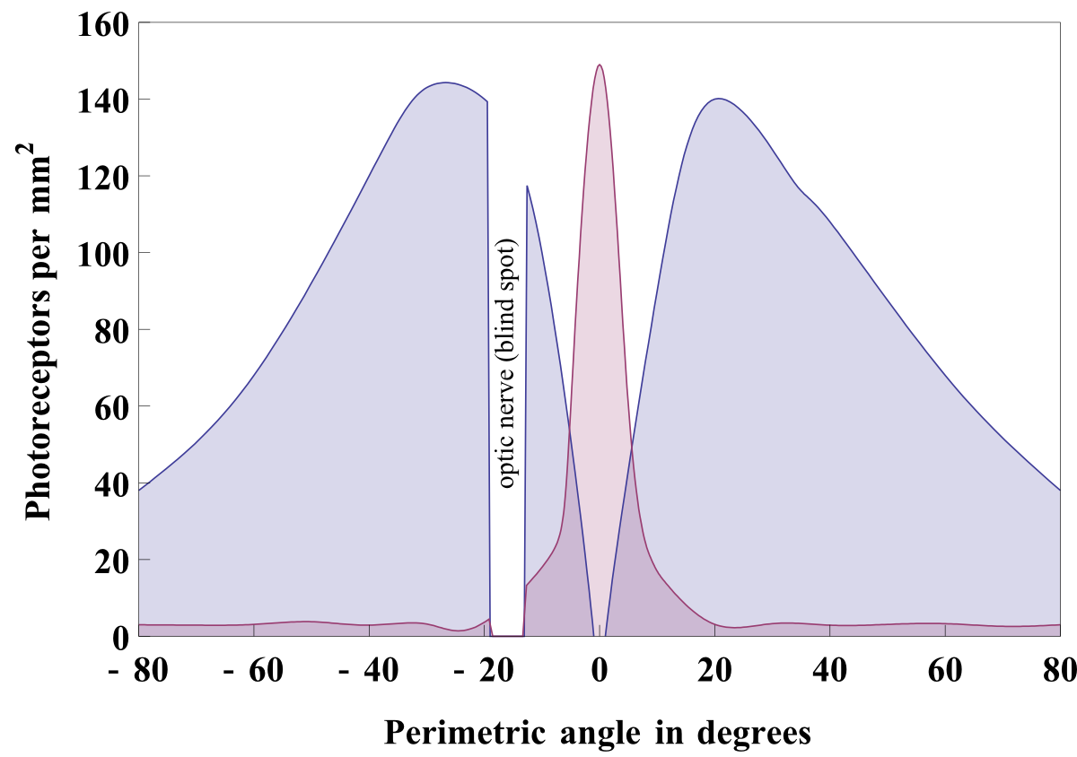
Photoreceptor density across retina

Slide 24
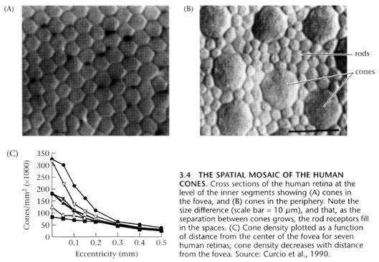

Slide 25
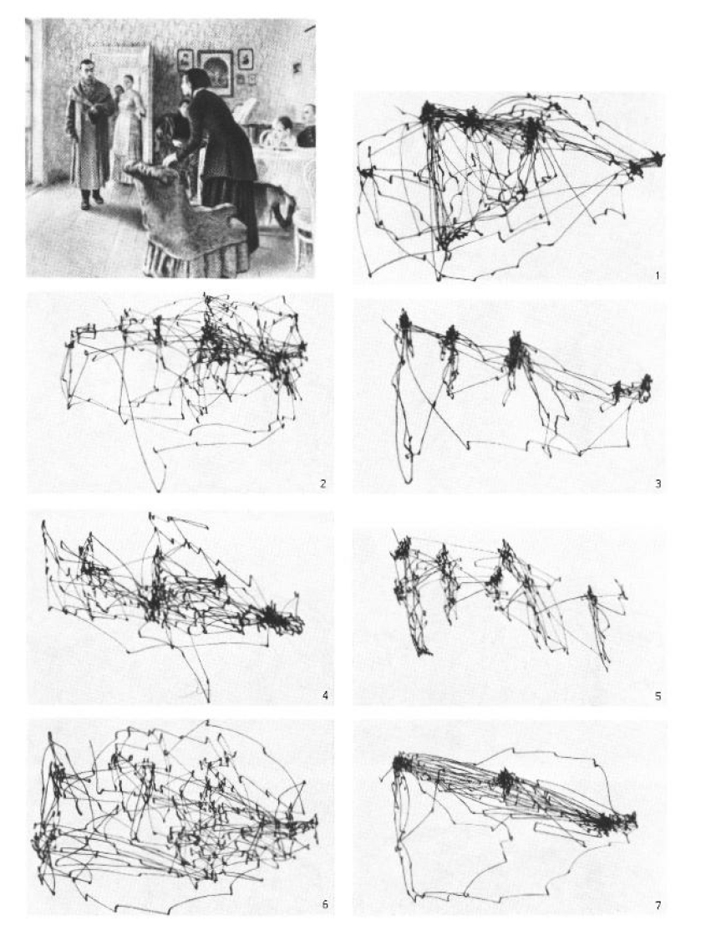

Slide 26
Comparison between rods and cones
Rods | Cones
Used for night vision | Used for day vision
Loss causes night blindness | Loss causes legal blindness
Low spatial resolution with higher noise | High spatial resolution with lower noise
Not present in fovea | Concentrated in fovea
Slower time response to light | Quicker time response to light
One type of photosensitive pigment | Three types of photosensitive pigment
Emphasis on motion detection | Emphasis on detecting fine detail

Slide 27
Human Visual Perception
Light intensity:
The lowest (darkest) perceptible intensity is the scotopic threshold
The highest (brightest) perceptible intensity is the glare limit
The difference between these two levels is on the order of 10¹⁰
We can’t discriminate all these intensities at the same time! We adjust to an average value of light intensities and then discriminate around the average.
Log compression.
Experimental results show that the relationship between the perceived amount of light and the actual amount of light in a scene are generally related logarithmically.
The human visual system perceives brightness as the logarithm of the actual light intensity and interprets the image accordingly.
Consider, for example, a bright light source that is approximately 6times brighter than another. The eye will perceive the brighter light as approximately twice the brightness of the darker.

Slide 28
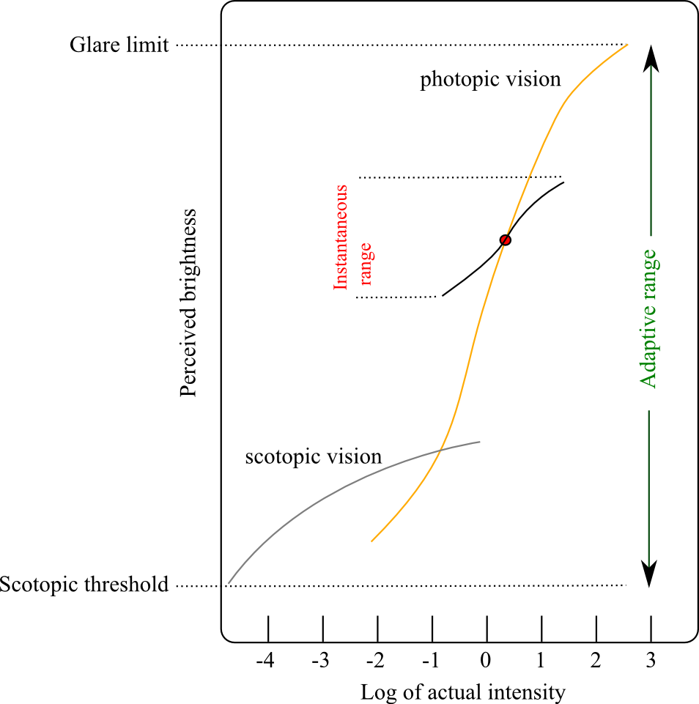
Brightness Adaptation
Actual light intensity is (basically) log-compressed for perception.
Human vision can see light between the glare limit and scotopic threshold but not all levels at the same time.
The eye adjusts to an average value (the red dot) and can simultaneously see all light in a smaller range surrounding the adaptation level.
Light appears black at the bottom of the instantaneous range and white at the top of that range.

Slide 29
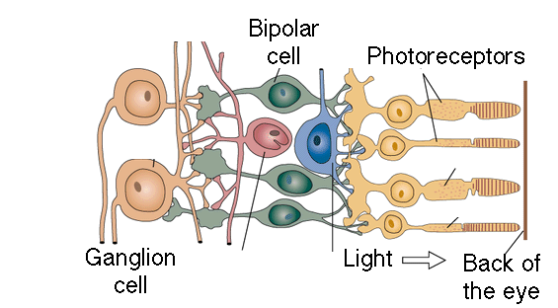
Retinal Processing
© Stephen E. Palmer, 2002

Slide 30
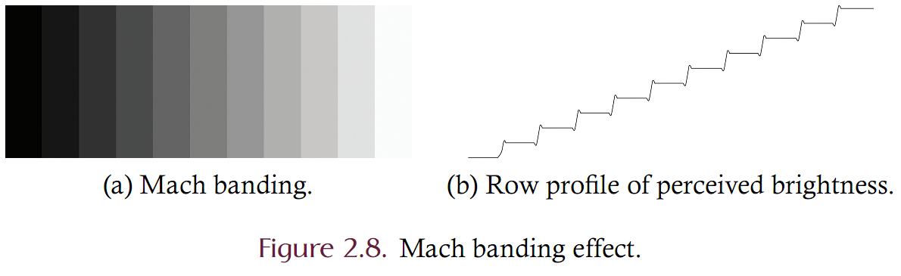
Brightness Adaptation and Mach Banding

Slide 31
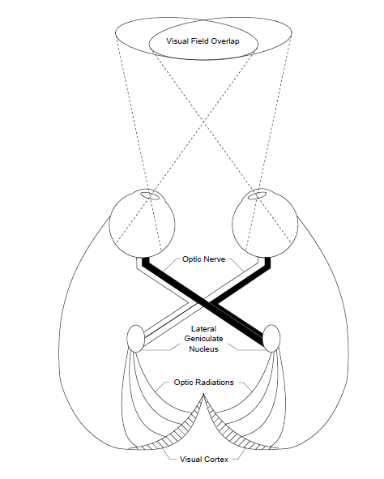

Slide 32
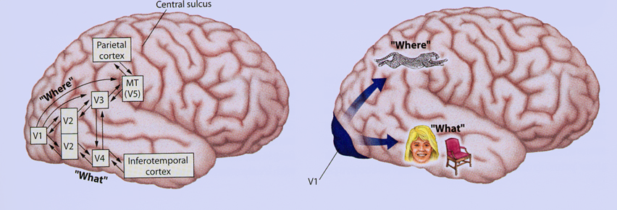

Slide 33
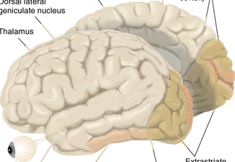
Single Cell Recording
Microelectrode
Amplifier
Electrical response
(action potentials)
mV
© Stephen E. Palmer, 2002

Slide 34
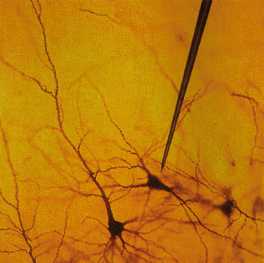
Single Cell Recording
© Stephen E. Palmer, 2002

Slide 35
Retinal Receptive Fields
Receptive field structure in ganglion cells:
On-center Off-surround
Stimulus condition
Electrical response
© Stephen E. Palmer, 2002

Slide 36
Retinal Receptive Fields
Receptive field structure in ganglion cells:
On-center Off-surround
Stimulus condition
Electrical response
© Stephen E. Palmer, 2002

Slide 37
Retinal Receptive Fields
Receptive field structure in ganglion cells:
On-center Off-surround
Stimulus condition
Electrical response
© Stephen E. Palmer, 2002

Slide 38
Retinal Receptive Fields
Receptive field structure in ganglion cells:
On-center Off-surround
Stimulus condition
Electrical response
© Stephen E. Palmer, 2002

Slide 39
Retinal Receptive Fields
Receptive field structure in ganglion cells:
On-center Off-surround
Stimulus condition
Electrical response
© Stephen E. Palmer, 2002

Slide 40
Retinal Receptive Fields
Receptive field structure in ganglion cells:
On-center Off-surround
Stimulus condition
Electrical response
© Stephen E. Palmer, 2002

Slide 41
Retinal Receptive Fields
RF of On-center Off-surround cells
© Stephen E. Palmer, 2002

Slide 42
Retinal Receptive Fields
RF of Off-center On-surround cells
Surround
Center
© Stephen E. Palmer, 2002

Slide 43
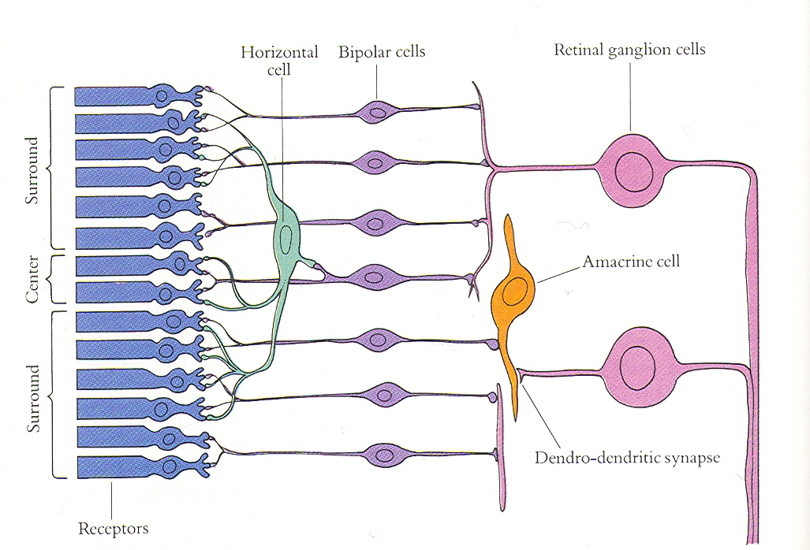
Retinal Receptive Fields

Slide 44
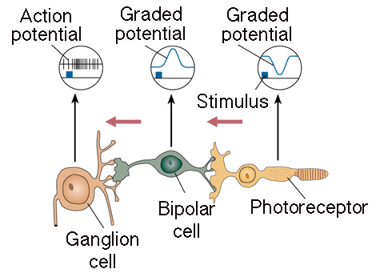
Retinal Receptive Fields
Receptive field structure in bipolar cells
Light
© Stephen E. Palmer, 2002

Slide 45
Retinal Receptive Fields
Receptive field structure in bipolar cells
© Stephen E. Palmer, 2002

Slide 46
Cortical Receptive Fields
Single-cell recording from visual cortex
© Stephen E. Palmer, 2002

Slide 47
Cortical Receptive Fields
Simple Cells: “Line Detectors”
© Stephen E. Palmer, 2002

Slide 48
Cortical Receptive Fields
Simple Cells: “Edge Detectors”
© Stephen E. Palmer, 2002

Slide 49
Cortical Receptive Fields
Constructing a line detector
© Stephen E. Palmer, 2002

Slide 50
Cortical Receptive Fields
Complex Cells
0º
© Stephen E. Palmer, 2002

Slide 51
Cortical Receptive Fields
Complex Cells
60º
© Stephen E. Palmer, 2002

Slide 52
Cortical Receptive Fields
Complex Cells
90º
© Stephen E. Palmer, 2002

Slide 53
Cortical Receptive Fields
Complex Cells
120º
© Stephen E. Palmer, 2002

Slide 54
Cortical Receptive Fields
Constructing a Complex Cell
© Stephen E. Palmer, 2002

Slide 55
Cortical Receptive Fields
Hypercomplex Cells
© Stephen E. Palmer, 2002

Slide 56
Cortical Receptive Fields
Hypercomplex Cells
© Stephen E. Palmer, 2002

Slide 57
Cortical Receptive Fields
Hypercomplex Cells
© Stephen E. Palmer, 2002

Slide 58
Cortical Receptive Fields
Hypercomplex Cells
“End-stopped” Cells
© Stephen E. Palmer, 2002

Slide 59
Cortical Receptive Fields
“End-stopped” Simple Cells
© Stephen E. Palmer, 2002

Slide 60
Cortical Receptive Fields
Constructing a Hypercomplex Cell
© Stephen E. Palmer, 2002

Slide 61
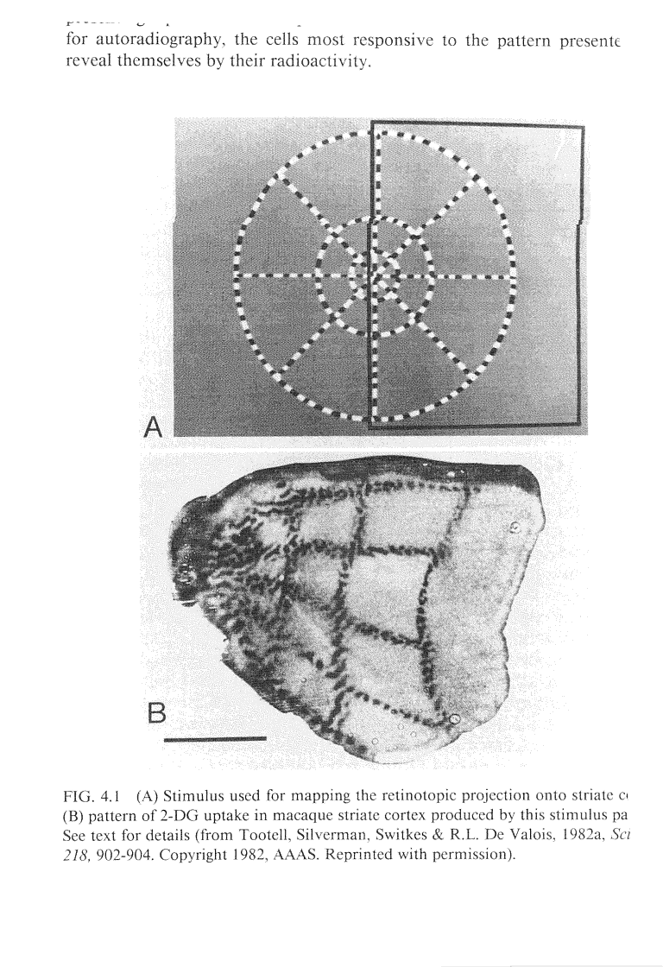
Mapping from Retina to V1

Slide 62
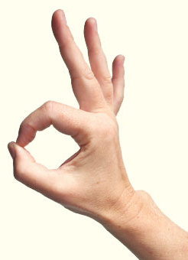
Use both eyes…at arm’s length, center target within finger OK sign
Lock hand in position…see which eye is still aligned by closing the other
The eye with good alignment is your dominant eye!
http://www.twohotpotatoes.com/wp-content/uploads/whose-plate-4-tips-table-manner-03-af.jpg

Slide 63

Use right eye only (close left eye)…focus only on the target for this test!
Lock head in position…hold one finger up at arm’s length to cover view of target
Move arm slowly outwards from target (to right for right eye)
Find your blind spot for that eye…is it only off to ONE side? try the other side!
Does the blind spot extend upwards or downwards?
http://us.123rf.com/400wm/400/400/rebirth3d/rebirth3d1103/rebirth3d110300047/9130190-woman-hand-with-index-finger-pointing-up-or-showing-number-one.jpg
Try with your left eye…is its blind spot on the same side or on the other?
Try with BOTH eyes open…do you have a blind spot now? Why not?

Slide 64
Use right eye only (close left eye)…our target is a row of numbers
1 2 3 4 5 6 7 8 9
Focus on each number in turn, until the break in the blue lines is in your blind spot. What is different when the blind spot holds a blank area?

Slide 65

Use both eyes, stare at area shown in blue for 15 seconds or so

Slide 66
What do you see on this blank white slide? Blink if needed!
This is called an “after image”
Does it move around as you move your gaze?

Slide 67
Use both eyes, stare at the parrot’s eye for 15 seconds or so

Slide 68
What color is the bird in the cage?
Blink if needed

Slide 69
Use both eyes, stare at the parrot’s eye for 15 seconds or so

Slide 70
What color is the bird in the cage?
Blink if needed

Slide 71
Use both eyes, stare at the parrot’s eye for 20 seconds or so

Slide 72
What color is the bird in the cage?
This color is a bit harder to visualize

Slide 73
Use both eyes, stare at the white dot for 20 seconds or so

