Slide 1

DeepCareX: AI based Healthcare System
Deepali Handgar, Sumon Singh
(40176) , (40351)

Slide 2

Table of content
Introduction
objectives
Methodology & implementation details
Experimentation setup and results
Future scope

Slide 3
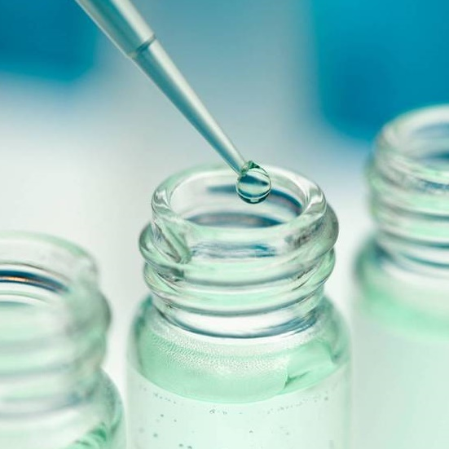
Introduction
Effective diagnosis of a disease is a significant need on a large scale. Some of these problems can be resolved by researchers, doctors, and patients thanks to machine learning (ML), a branch of artificial intelligence (AI).
Artificial intelligence (AI) in the medical field largely focuses on creating algorithms and methods to assess if a systems behaviour in diagnosing diseases is accurate. The sickness or disorders that account for a persons symptoms and indicators are identified by a medical diagnosis.

Slide 4
objectives
The objectives of this project are:
1. One of the primary objectives is to identify diseases by analyzing symptoms.
2. Output will be generated based on these parameters and a person can also choose whether they wish to save their data or not.
3. Deep learning and machine learning models are used to distinguish between symptoms that are similar but could be caused by different diseases. By taking into account a variety of symptoms and their combinations, this purpose is to give precise and targeted outcome.
4. Giving the user choice to save the data for further use.
5. Receive feedback from users if any. Provision of weekly newsletter and other healthcare information.

Slide 5
Methodology
Data collection: Data was collected from online resources. Mostly from Kaggle.com
Pre-processing: Pre-processing was done on datasets that required it. Various data cleaning and encoding techniques were used.

Slide 6
Methodology
Model development: Various machine learning models and ensemble models were used to predict the outcome for diseases. Some of the algorithms used in this project are XGBoost, Random Forest, Logistic Regression, CNN, etc. Transfer learning models like DenseNet201, ResNet152V2, and VGG19 were used.
Model Evaluation: Evaluation metrics like accuracy, precision, recall and f1-score were used to evaluate the model performance.

Slide 7
Experimental setup
Using HTML, Bootstrap and Flask, design 8 webpages were created for the diseases. Bootstrap offers a selection of JavaScript, CSS, and HTML building blocks that may be used to create web interfaces.
Also, a sqlite3 database is added to store the information of the user.

Slide 8
Tools used
IDE: Vscode, Jupyter Notebook
Platform: Anaconda
Browser: Microsoft Edge, Google browser (Tested On)
Languages: Python 3.9, HTML, CSS
Framework: Bootstrap v5.3.0-alpha, Tensorflow 2.9, Keras, Flask
Database: sqlite3
Libraries:
1. numpy
2. Pandas
3. scikit-learn
4. matplotlib
5. os
6. scipy
7. seaborn 9. joblib
8. Xgboost 10. pickle

Slide 9
Features of Project
1. Home page with Register/Log-in.
2. Individual pages for each of the 8 diseases. The user can input the symptoms and get the r result as required.
3. On these pages, there is option to save one’s data. This data will then be stored in database.
4. The result report will be displayed on the output page.
5. About Us page – where information in provided about this system.
6. Contact us page – To send queries.

Slide 10
Instructions to run
1. Create the databses :
Navigate to : DeepCareX/Website/database
Run : database.py
Syntax : python3 database.py
2. Run The Application :
Navigate to : DeepCareX/Website
Run : main.py
Syntax : python3 main.py

Slide 11
results
DISEASE | MODEL | TRAINING ACCURACY | TESTING ACCURACY
Breast Cancer | Random Forest | 1 | 0.94
Diabetes | XGBoost Classifier | 0.98 | 0.97
Hepatitis C | XGBoost Classifier | 1 | 0.97
Heart Disease | Random Forest | 1 | 0.99
Brain Tumor | VGG19 | 0.98 | 0.97
COVID-19 | ResNet152V2 | 0.98 | 0.95
Alzheimer’s | CNN | 0.97 | 0.98
Kidney Disorder | CNN | 0.99 | 0.97
Pneumonia | DenseNet201 | 0.98 | 0.83

Slide 12
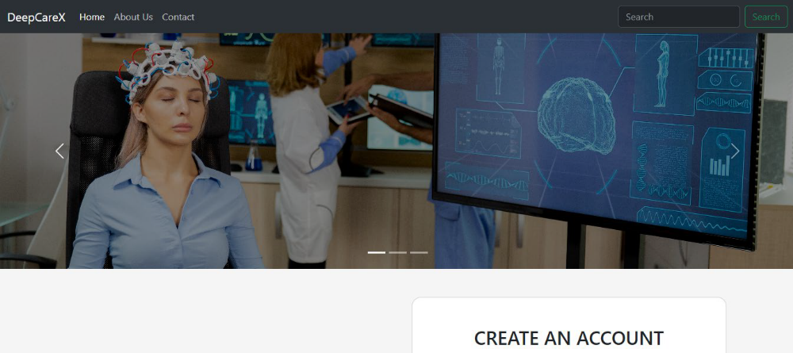
User interface of system
HOME PAGE

Slide 13
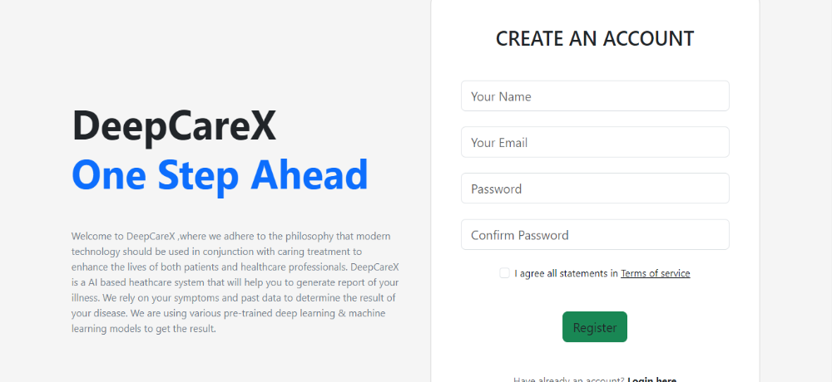

Slide 14
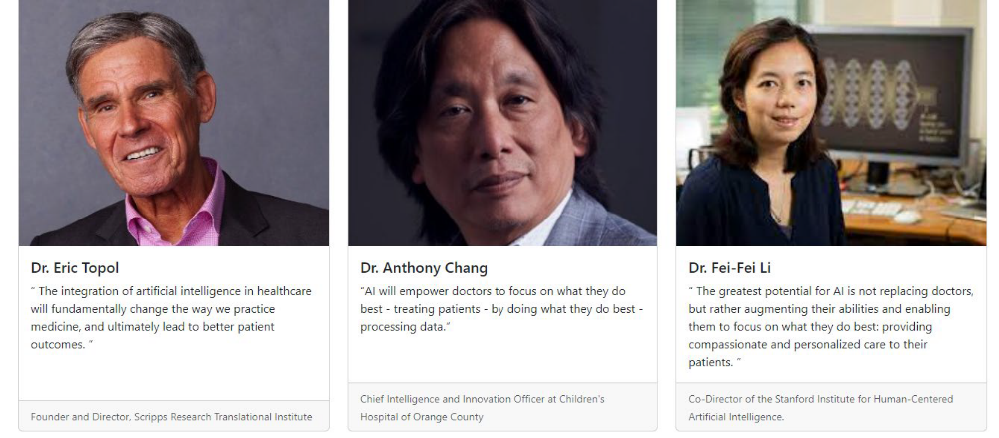

Slide 15
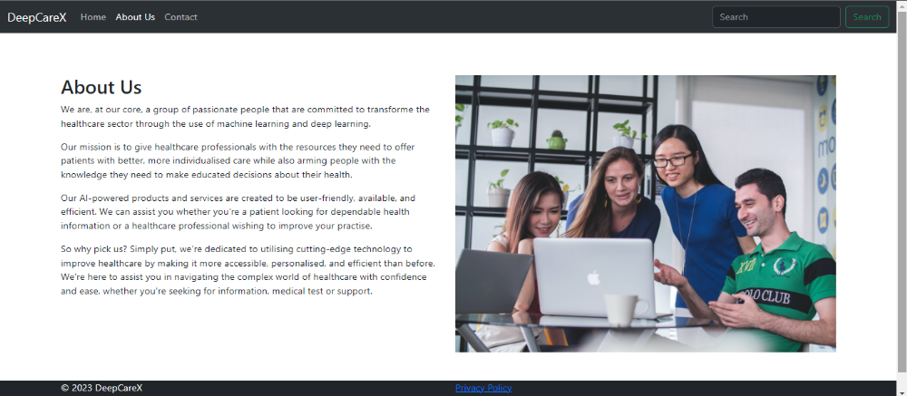
ABOUT US

Slide 16
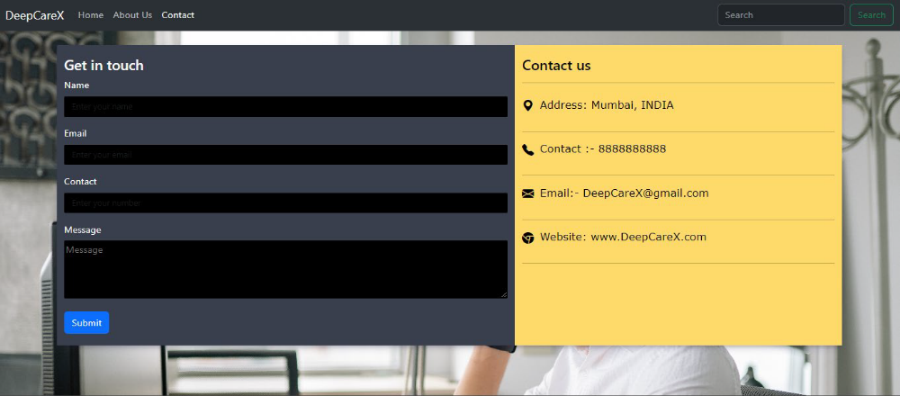
CONTACT US

Slide 17
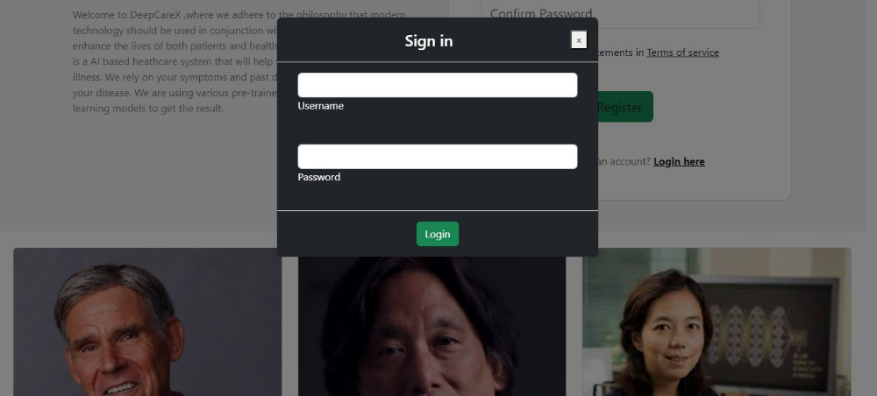
LOGIN

Slide 18
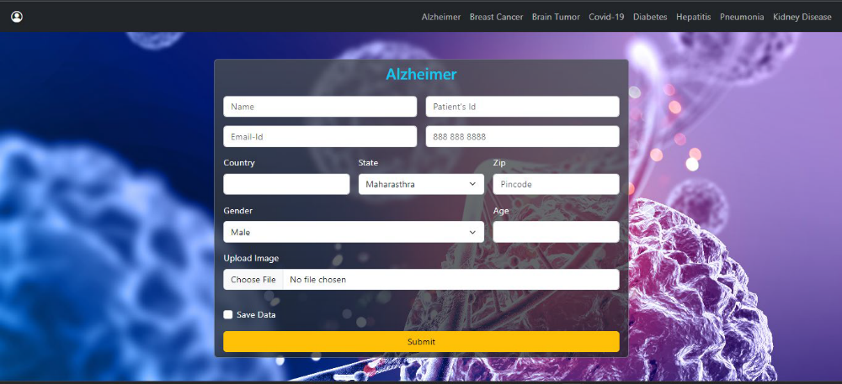
After Registration/Login
Alzheimer’s

Slide 19
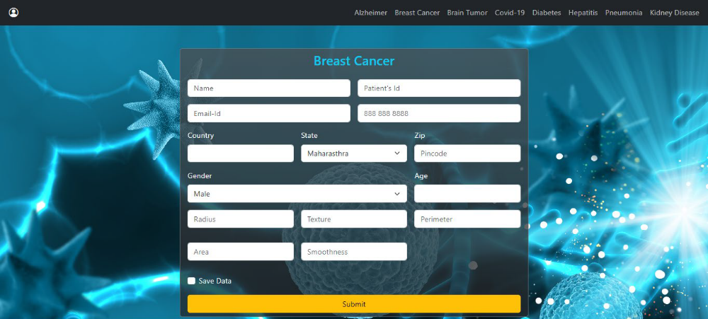
Breast Cancer

Slide 20
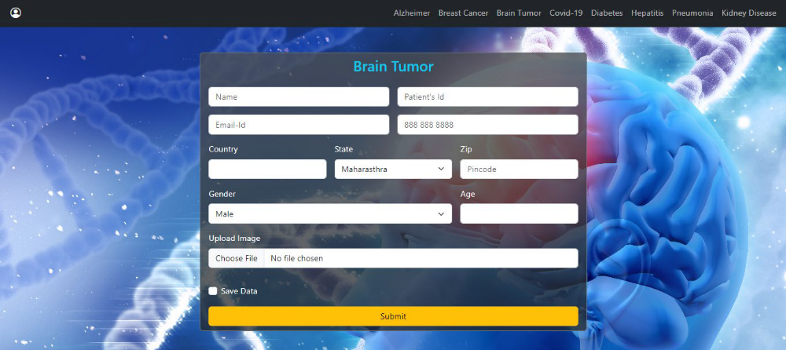
BRAIN TUMOR

Slide 21
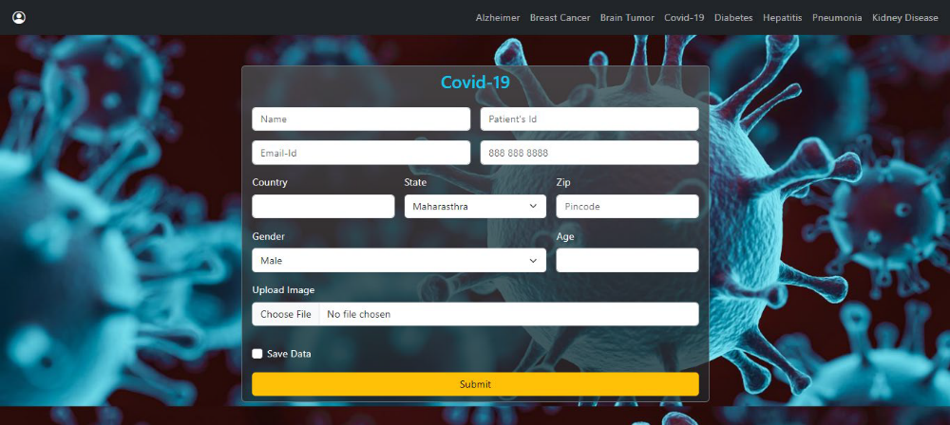
COVID-19

Slide 22
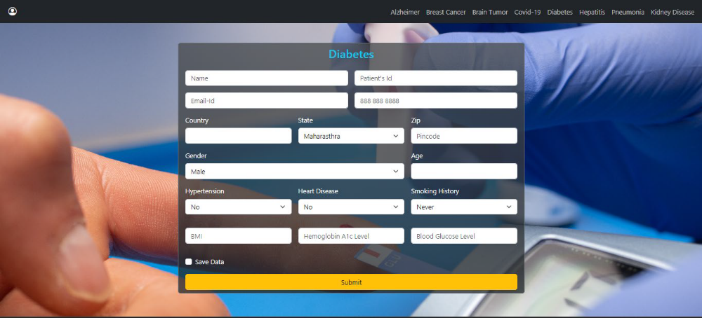
DIABETES

Slide 23
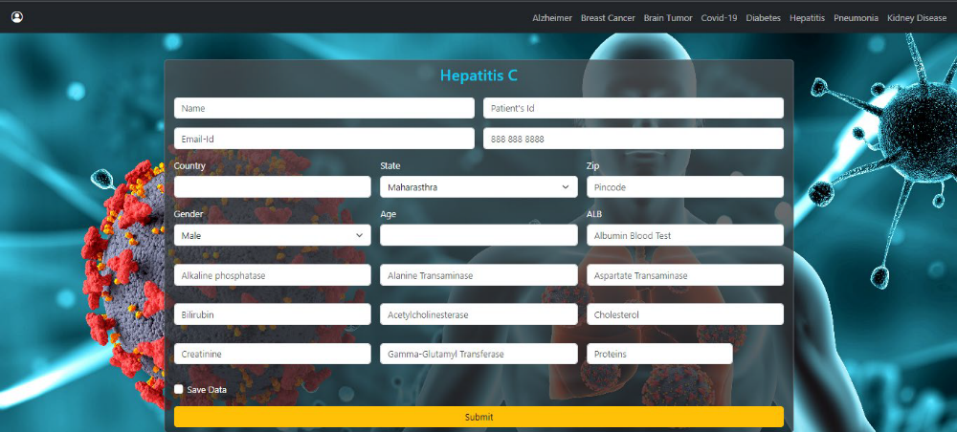
HEPATITIS C

Slide 24
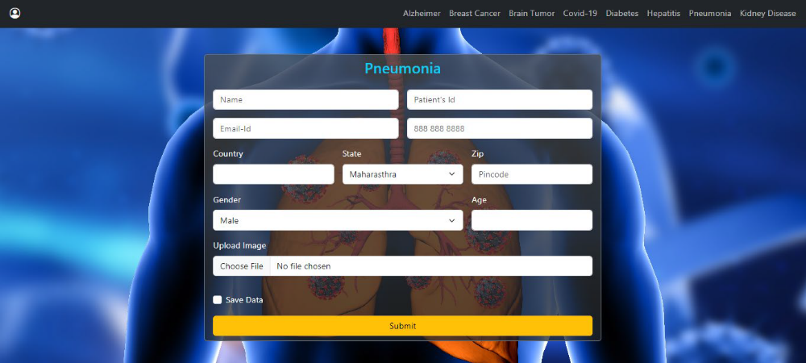
PNEUMONIA

Slide 25
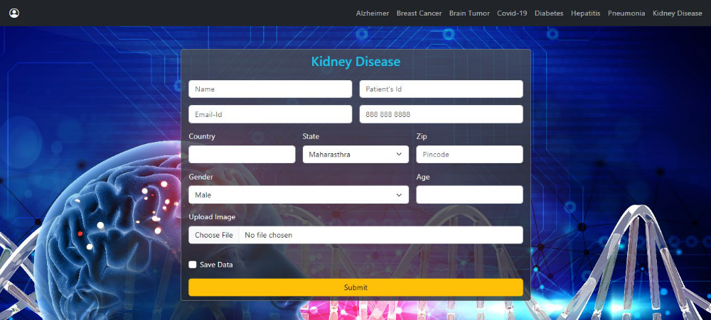
KIDNEY DISEASE

Slide 26
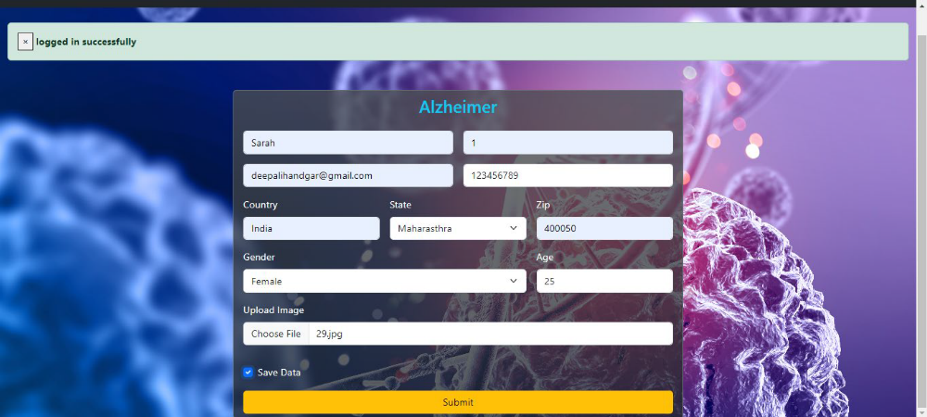
RESULT FOR ALZHEIMER’S

Slide 27
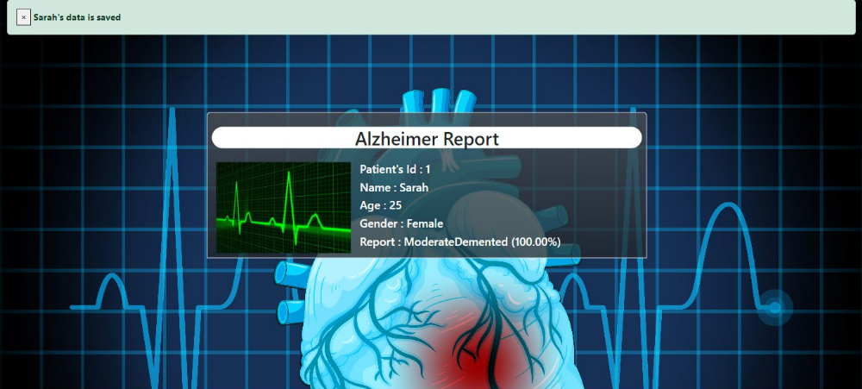

Slide 28
FUTURE SCOPE
There is a lot of room for improvement and growth with this project. The system may be made even more complete and beneficial for users by adding further functions. Here are some ideas about how to make the project better:
Expanded Disease Database
Integration with Healthcare Professionals
Advanced Predictive Models
Complete Diagnostic Reports
Accessibility and user-friendly design
Data Security and Privacy

Slide 29

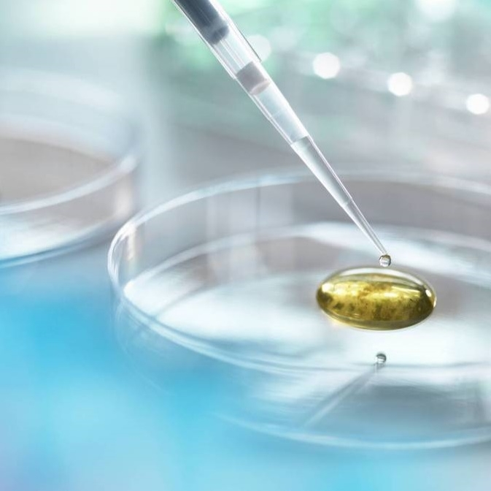
Thank you

