Slide 1
Edge NodeJS Bootcamp
NodeJS Integration with Edge

Slide 2
What is NodeJS?
Open source, cross platform runtime environment
For server-side networking applications
Written in JavaScript
For building fast, scalable network applications
Capable of handling a huge number of simultaneous connections with high throughput
Event-driven
Non-blocking

Slide 3
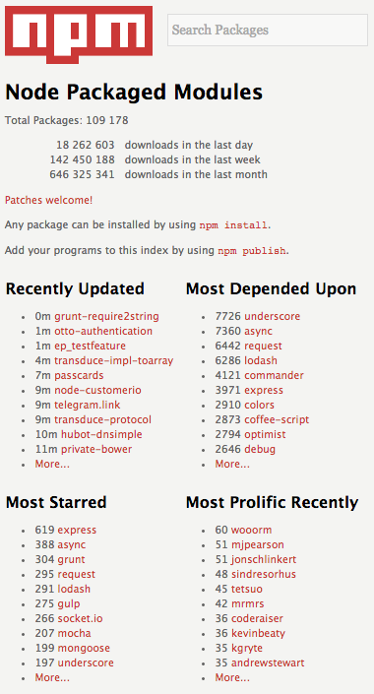
Node package management
NPM is the package manager for Node.js
It is bundled and installed automatically with Node.js
Comes with a command line tool to manage packages
There are A LOT of packages for Node.js – community is very active.
Here is how to install postgres node.js driver
$ npm install pg
$ npm install –g pg

Slide 4
Non-blocking JavaScript
var result = database.query('select * from hugetable');
console.log(result);
console.log('hello');
VS
database.query('select * from hugetable', function(result) {
console.log(result);
});
console.log('hello');

Slide 5
NodeJS runtime
NodeJS runtime on Edge is Trireme
http://github.com/apigee/trireme
Notes:
Understanding of Node.js runtime (Trireme) becomes very important when designing/architecting a Node.js project that will be running on Edge

Slide 6
What is Trireme
Edge open-source project
Set of libraries for running node.js scripts inside JVM
Specifically designed to be embeddable within any Java program
“HTTP Adapter” lets it run inside existing containers
“Sandbox” restricts file and network I/O access

Slide 7
NodeJS as a Target Endpoint
Target Endpoint
NodeJS
<HTTPTargetConnection>
<Properties>
<Property name="success.codes">2XX,3XX,4XX</Property>
</Properties>
<LoadBalancer>
<Algorithm>RoundRobin</Algorithm>
<Server name="server1"/>
<Server name="server2"/>
</LoadBalancer>
<Path>/resource</Path>
</HTTPTargetConnection>
<ScriptTarget>
<Properties>
<Property name="success.codes">2XX,3XX,4XX</Property>
</Properties>
<ResourceURL>node://app.js</ResourceURL>
</ScriptTarget>
Notes:
Comparison of implementation between “standard” node.js and Trireme

Slide 8

NodeJS as a Target Endpoint
Other languages are extension policies and placed on the flow as a step
Java
JavaScript
Python
Node.js implemented as a target not as a policy
Node.js
Target
JavaScript
Python
Java
Notes:
Compare Apigee Node.js implementation (i.e. it being a target) to other platforms supported (i.e. as a step)
Briefly mention the differences between steps and targets in Apigee Edge

Slide 9


NodeJS as a Target Endpoint
<ProxyEndpoint>
…
<RouteRule name="node">
<Condition>proxy.pathsuffix MatchesPath “/queue”</Condition>
<TargetEndpoint>node</TargetEndpoint>
</RouteRule>
<RouteRule name="directToBackend">
<TargetEndpoint>backend</TargetEndpoint>
</RouteRule>
</ProxyEndpoint>
Notes:
You can define multiple routes within the proxy definition and conditionally route traffic to either routes (you can’t route traffic to more than 1 target for the same request)

Slide 10
Apigee Access
apigee-access open source Node.js module
Provides Node.js applications running on the Edge platform a way to access Edge specific functionality. You can use this module to:
Access and modify "flow variables" within the Edge message context.
Retrieve sensitive data from the the secure store.
Use the built-in distributed cache.
Use the built-in distributed quota service.
Use the OAuth service.
http://apigee.com/docs/api-services/content/using-apigee-access
https://github.com/apigee/apigee-access
Notes:
Apigee places certain restrictions on various operations, processes and protocols to be executed on Edge platform. These are mostly for security purposes.

Slide 11
When to use NodeJS?
Try out of the box policies first
Configuration over code, aka policy over code
Speed / Agility
Let’s implement a distributed quota
Use an Edge policy implement from scratch
Quality
“Developed/Tested” once, “configured” everywhere
Maintained centrally
<Quota name="Quota.DailyPerApp">
<Interval>1</Interval>
<TimeUnit>day</TimeUnit>
<Distributed>true</Distributed>
<Synchronous>true</Synchronous>
<Identifier ref="request.queryparam.apikey" />
<Allow count="100" />
</Quota>

Slide 12
When to use NodeJS?
Then consider callout policies
Simple functionality which can be visualized as a step?
Get/set variable
Make custom/simple modifications to request/response?
Request/response data validations?
Edge supports Java, JavaScript, Python as callout policies
//offset parameter validation
var offset = context.getVariable('request.queryparam.offset');
if (offset != null) {
if (offset < 1) {
context.setVariable('errorCode', '400.02.001');
context.setVariable('errorMessage', 'offset query parameter value is invalid');
}
}

Slide 13
When to use NodeJS?
Non-http backend
Async execution
Complex mashups
Job scheduling
Bulk operations
Retry logic
Mockups
User interface
Quick demonstrations
PoC development
Consider Node.js if
Edge doesn’t have an existing policy to do the work
You need intelligent asynchronous processing logic
Implementation can be visualized as an API proxy target, rather than as a step
Legacy backend protocols (non HTTP)

Slide 14
When to use NodeJS?
Non-HTTP backend
POSTGRES
USERGRID
ZOOKEEPER
Edge
RABBITMQ
SMTP
.
.
.
WORLD OF NPM

Slide 15
When to use NodeJS?
Async operations
TARGET A
TARGET B
Edge

Slide 16
When to use NodeJS?
Module reuse
Notes:
There is a module already written for the functionality that you want to implement

Slide 17
When to use NodeJS?
Module reuse - async example
async.waterfall([
function(callback){
callback(null, 'one', 'two');
},
function(arg1, arg2, callback){
// arg1 now equals 'one' and arg2 now equals 'two'
callback(null, 'three');
},
function(arg1, callback){
// arg1 now equals 'three'
callback(null, 'done');
}
], function (err, result) {
// result now equals 'done'
});
async.parallel([
function(callback){
setTimeout(function(){
callback(null, 'one');
}, 200);
},
function(callback){
setTimeout(function(){
callback(null, 'two');
}, 100);
}
],
// optional callback
function(err, results){
// the results array will equal ['one','two'] even though
// the second function had a shorter timeout.
});
Notes:
async module (https://caolan.github.io/async/)

Slide 18
When NOT to use NodeJS?
There are existing Edge policies that can do the job
Cannot be visualized as an API proxy “target”
Node.js is implemented as a target, so
You cannot execute an Edge policy in the middle of your Node.js script
You cannot execute full Node.js script multiple times

Slide 19
Testing NodeJS
Testing Node.js applications
Grunt.js
Mocha
Chai
TDD
Notes:
Grunt, Mocha, Chai – TDD
TDD == Test Driven Development
http://code.tutsplus.com/tutorials/testing-in-nodejs--net-35018
TDD reduces development time and time to market
Increases accuracy

Slide 20
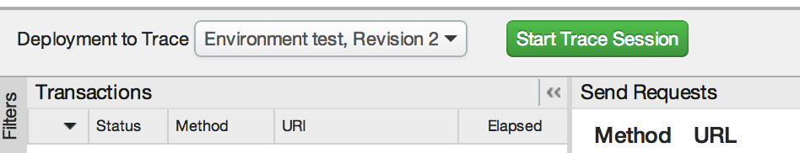
Troubleshooting NodeJS
Troubleshooting Node.js using the Edge Trace tool { hands on }
Inspecting requests, responses, and HTTP status codes
console.log()

Slide 21
Troubleshooting NodeJS
The node-inspector tool
Browser-based Node.js debugger
Navigate in your source files
Set breakpoints (and specify trigger conditions)
Step over, step in, step out, resume (continue)
Inspect scopes, variables, object properties
IntelliJ IDEA
A feature-rich GUI builder for Node.js
Notes:
Grunt, Mocha, Chai – TDD
TDD == Test Driven Development
http://code.tutsplus.com/tutorials/testing-in-nodejs--net-35018
TDD reduces development time and time to market
Increases accuracy

Slide 22
Troubleshooting NodeJS
Getting help
StackOverflow has an incredible wealth of Node.js knowledge
How to ask: http://stackoverflow.com/help/how-to-ask
Edge docs
http://apigee.com/docs/api-services/content/getting-started-nodejs-apigee-edge
Notes:
Grunt, Mocha, Chai – TDD
TDD == Test Driven Development
http://code.tutsplus.com/tutorials/testing-in-nodejs--net-35018
TDD reduces development time and time to market
Increases accuracy

Slide 23
THANK YOU

