Slide 1
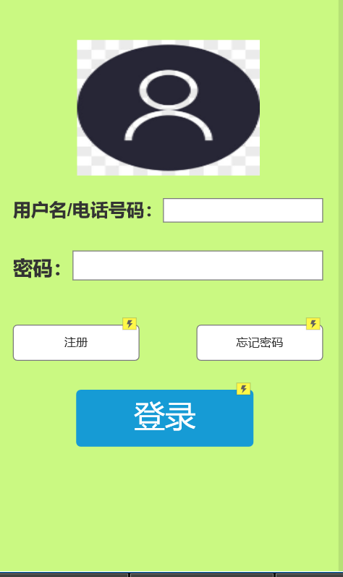
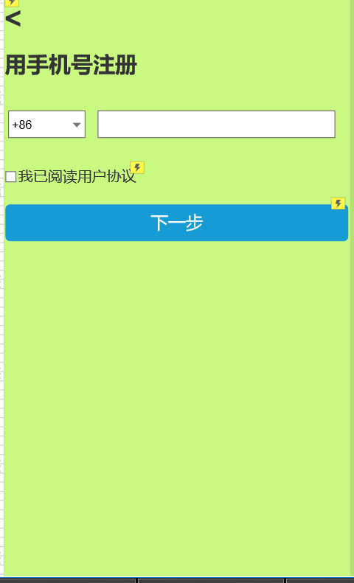
社区服务
UI

Slide 2
社区服务
背景
社区服务可以运用到各个居民的身边，让生活更便利，还可给服务人员
使用，这样可以让社区生活更丰富，更便捷

Slide 3
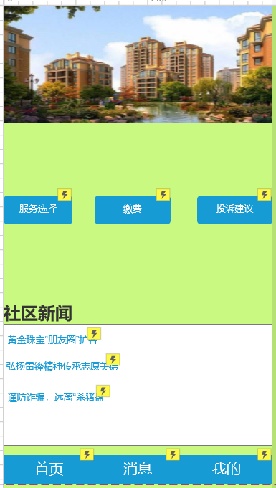
社区服务
UI
主页

Slide 4
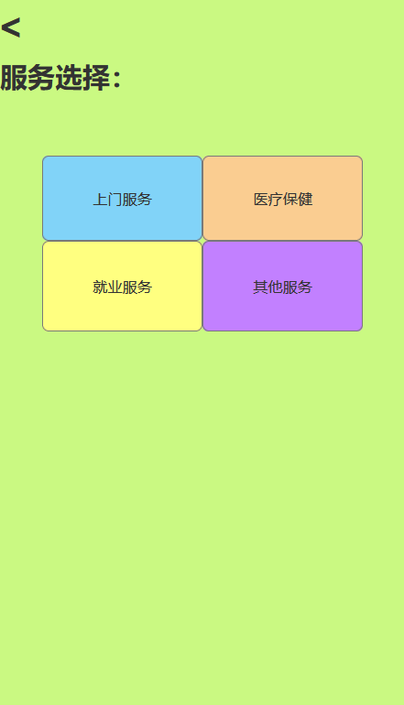
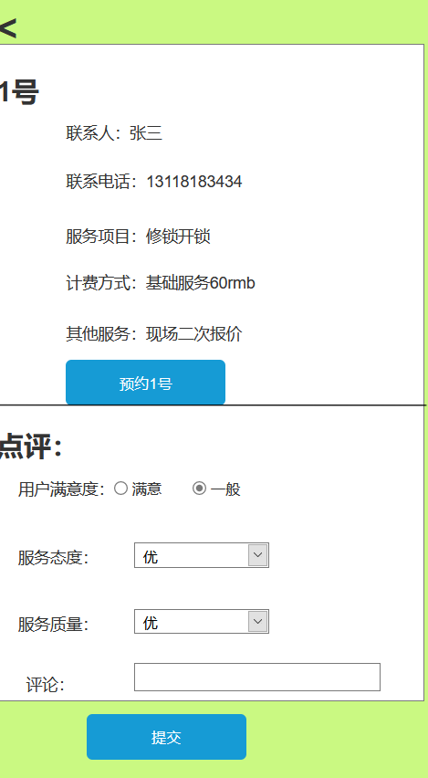
社区服务
UI

Slide 5
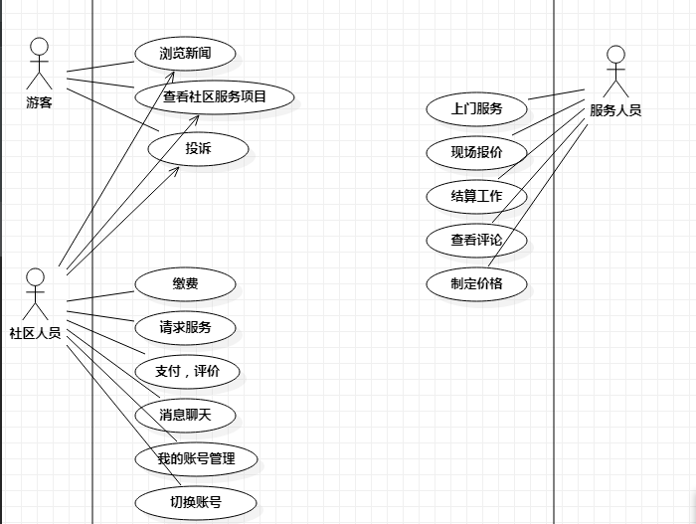
社区服务
UML用例图

Slide 6
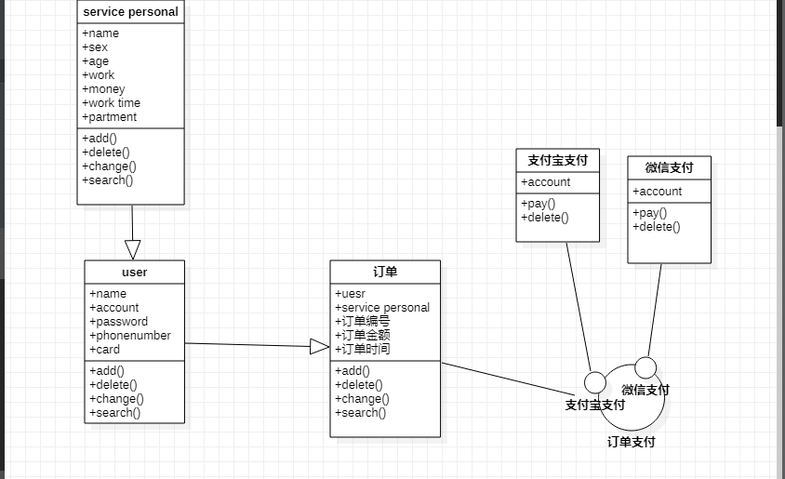
社区服务
UML类图

Slide 7
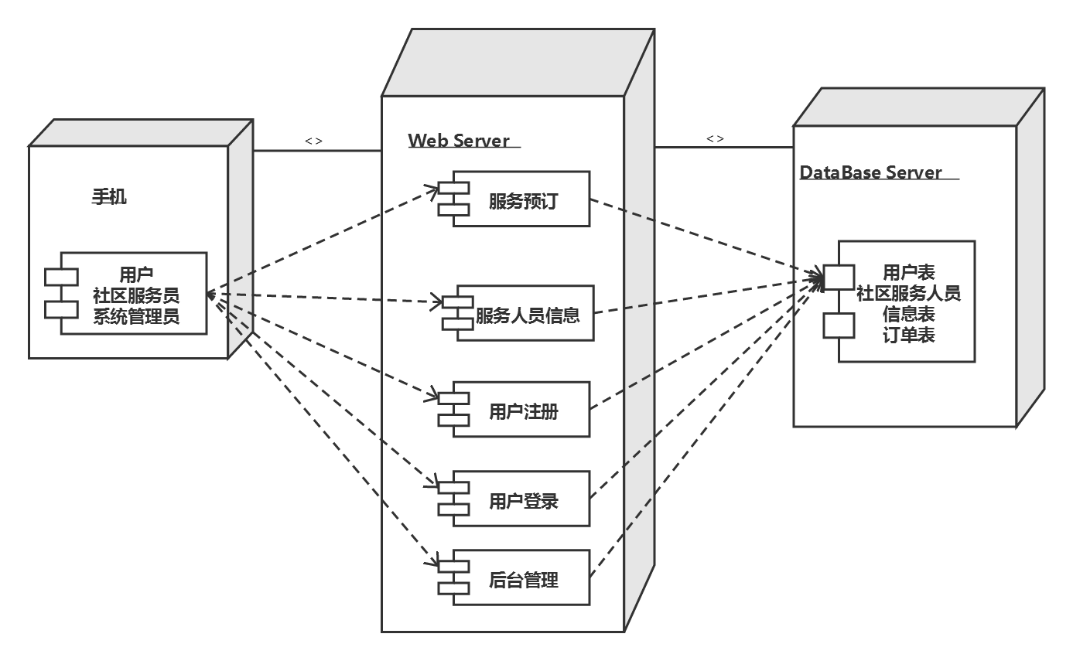
社区服务
UML部署图

Slide 8
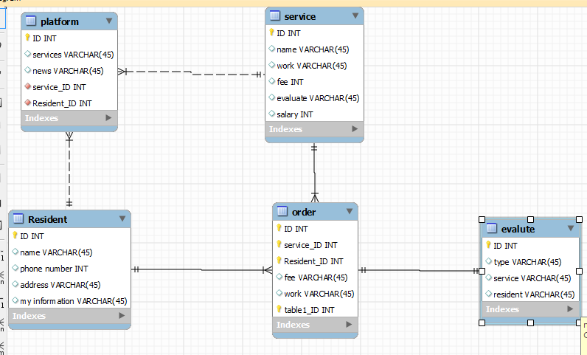
社区服务
ERD

Slide 9
社区服务
JSON-order
{
"RECORDS": [
{
"_id": "6080264bce230000a20012ff",
"id": "1001",
"resident_ID": "001",
"service_ID": "00001"
},
{
"_id": "60802656ce230000a2001300",
"id": "1002",
"resident_ID": "002",
"service_ID": "00001"
},
{
"_id": "60802661ce230000a2001301",
"id": "1003",
"resident_ID": "001",
"service_ID": "00002"
},
{
"_id": "6080266dce230000a2001302",
"id": "1004",
"resident_ID": "003",
"service_ID": "00003"
}
]

Slide 10
社区服务
JSON-resident
{
"RECORDS": [
{
"_id": "608025c8ce230000a20012fa",
"address": "101",
"id": "001",
"phone number": "123456"
},
{
"_id": "608025d5ce230000a20012fb",
"address": "102",
"id": "002",
"phone number": "254367"
},
{
"_id": "608025e3ce230000a20012fc",
"address": "103",
"id": "003",
"phone number": "312566"
},
{
"_id": "608025f7ce230000a20012fd",
"address": "104",
"id": "004",
"phone number": "446722"
},
{
"_id": "60802602ce230000a20012fe",
"address": "105",
"id": "005",
"phone number": "545773"
}
]
}

Slide 11
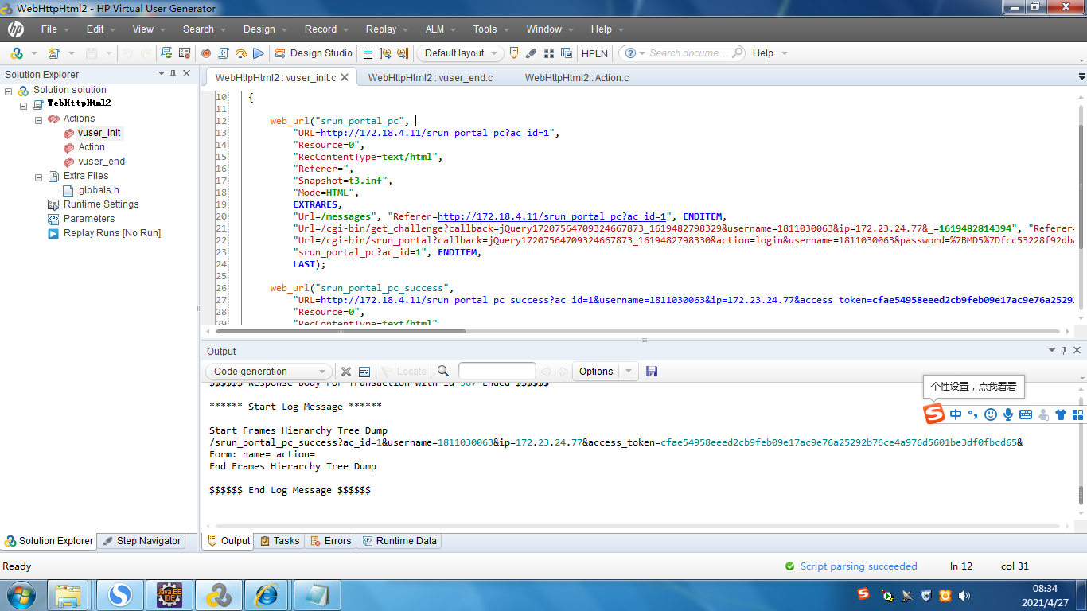
社区服务
loadrunner测试

Slide 12
社区服务
分工
项目经理 | 姜佳伶
产品经理 | 黄靖文，王诗雪
系统架构 | 覃鑫懿，陈紫悦
答辩 | 张莉

