Slide 1
Personalized Expedia Hotel Searches
Team: Madata

Slide 2
OUTLINE
Background
Problem Setting
Dataset Exploration
Feature Engineering
Data Preprocessing
Feature Generation
Target Generation
Models
Logistic Regression
Random Forest
Gradient Boosting
Results & Future work

Slide 3
BACKGROUND

Slide 4
BACKGROUND
Expedia, the world’s largest online travel agency (OTA), powers search results for millions of travel shoppers every day
Matching users to hotel inventory matters a lot since the best ranking of hotels gives an OTA the best chance of winning the sale
Best ranking results maximize the purchases as well as offer great user experiences

Slide 5
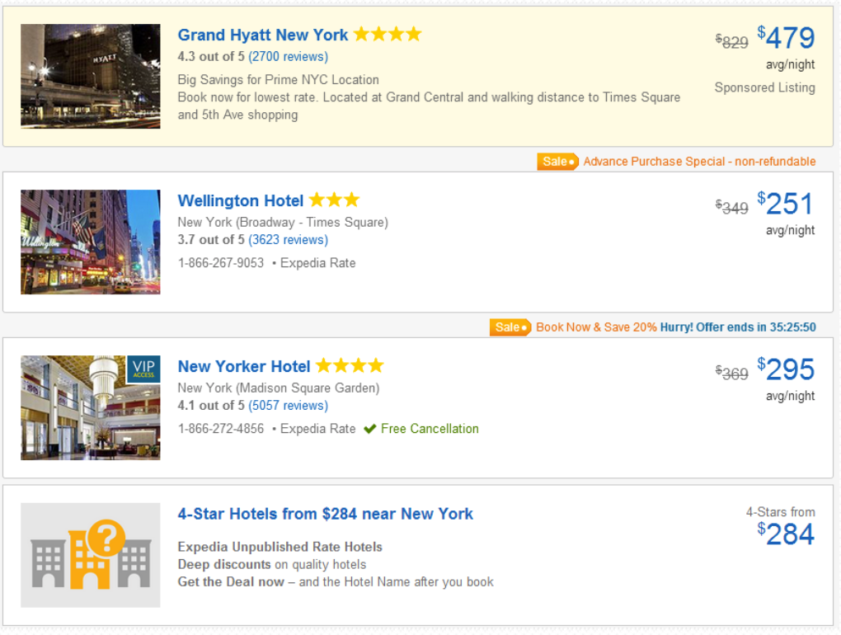
PROBLEM SETTING
Predict what hotel a user is most likely to book
Learning to rank hotels such that purchased and clicked hotels are ranked at top among all hotels associated with a search query
RANK:
hotels booked
hotels clicked
neither

Slide 6
PROBLEM SETTING
Given a dataset of search queries with associated hotel information and the clicking & booking results, train a model to rank the search results.
The results for the test set will be scored using a Normalized Discounted Cumulative Gain (NDCG) metric.
NDCG measures the performance of a recommendation system based on the graded relevance of the recommended entities. It varies from 0.0 to 1.0, with 1.0 representing the ideal ranking of the entities

Slide 7
DATASET
Training set : 399,344 unique search lists
9,917,530 points
Test set: 266,230 search lists
6,622,629 points
~50 features:
1.Hotel characteristics
2.Location attractions of hotels
3.Users aggregate purchase history
4.Competitor OTA information

Slide 8
FEATURE ENGINEERING

Slide 9
Data Preprocessing
Feature Generation
Target Generation

Slide 10
DATA PREPROCESSING
Missing Value Estimation
Data Balancing
Truncation
Normalization
Data Split By Country

Slide 11
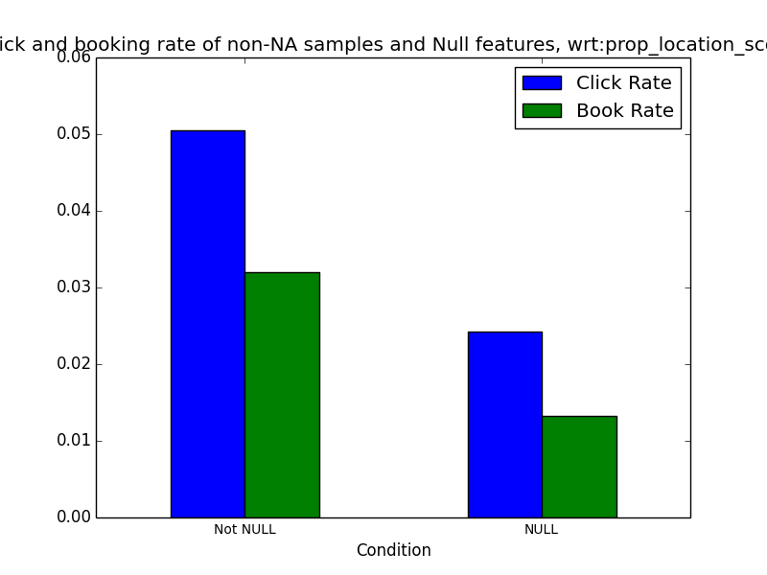
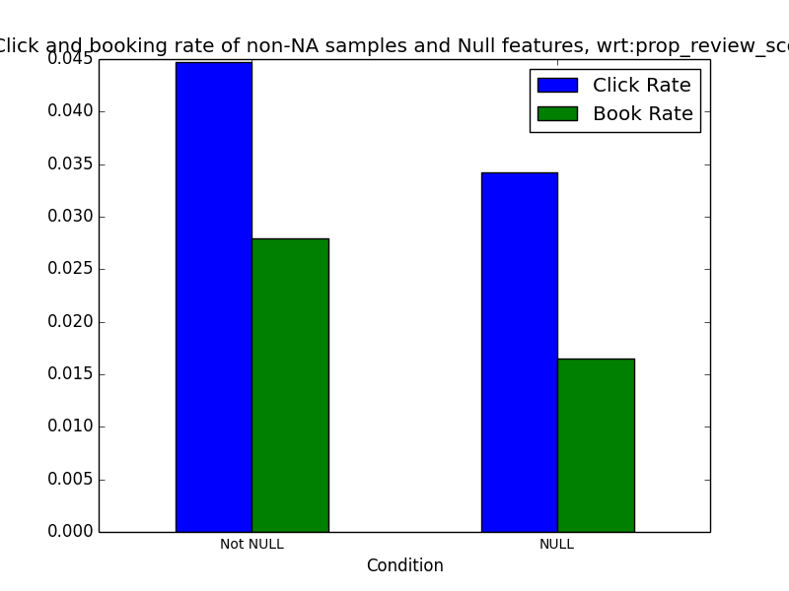
DATA PREPROCESSING
Filling missing data: missing data are filled with different values,
i.e. worst, mean, median values
Examples –’prop_location_score2’, ‘prop_review_score’

Slide 12
DATA PREPROCESSING
Data Balancing:
Problem: Only 4.4% positive data points among 9.9 million data points.
Solution: Choose all positive data and randomly sample the same amount of negative data points.

Slide 13
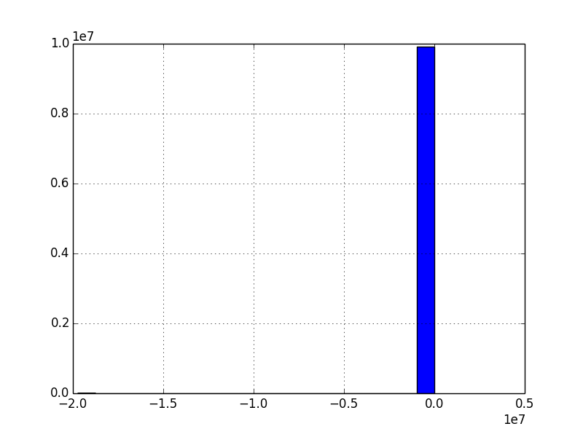
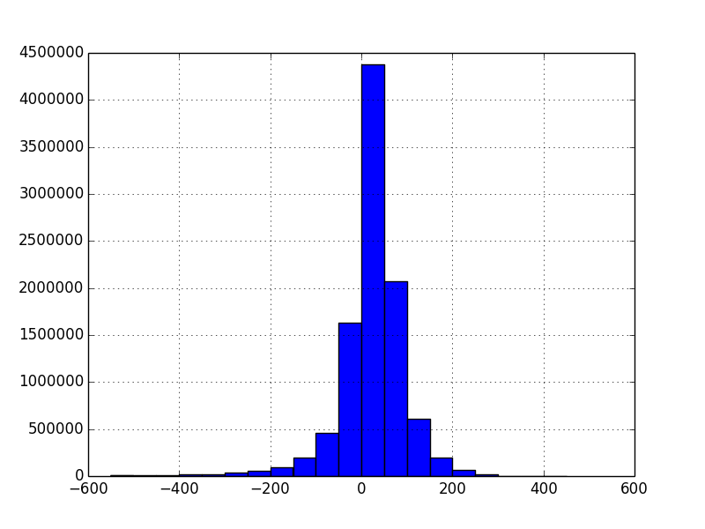
DATA PREPROCESSING
Truncation: Price related features: truncate outlier data and quantize data into bins
Examples - ‘price_usd’, ‘prop_price_diff’, ‘user_price_diff’, ‘per_fee’, ‘total_fee’

Slide 14
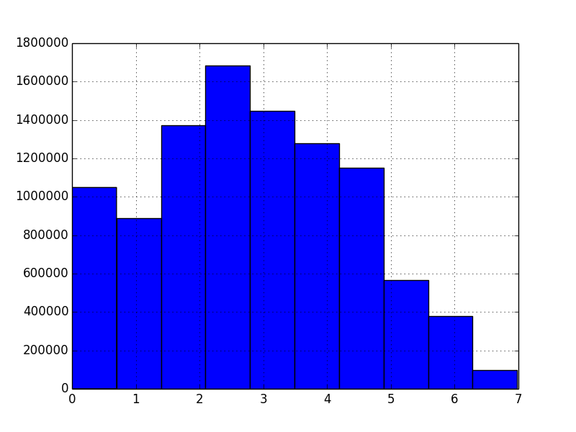
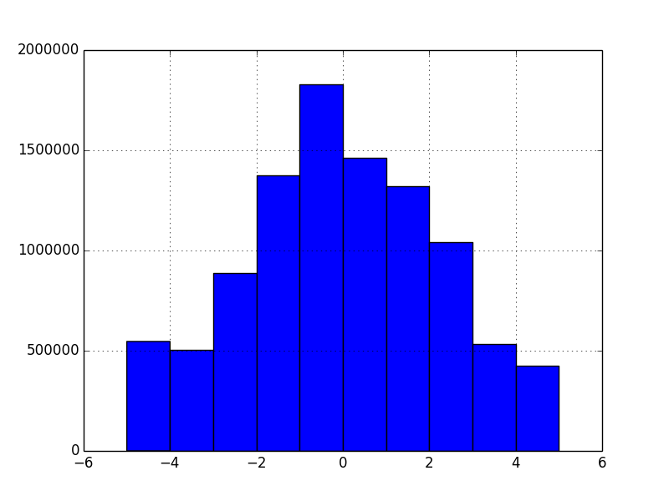
DATA PREPROCESSING
Normalization: some features are normalized to reflect the relative distribution
Examples - ‘prop_location_score1’, prop_location_score2’, ‘orig_destination_distance’,‘starrating_diff’, ‘prop_review_score’, ‘score2ma’, ‘score1d2’

Slide 15
DATA PREPROCESSING
Split data by country (prop_country_id):
1. NaN data for certain prop_coutry_id
2. Lower predict score

Slide 16
FEATURE GENERATION
USER-GENERATED FEATURES
We generated some meaningful features based on the existing features:
Price features
Score features
Competitor features
Hotel quality features

Slide 17
FEATURE GENERATION
price features

Slide 18
FEATURE GENERATION
score features

Slide 19
FEATURE GENERATION
competitor features

Slide 20
FEATURE GENERATION
hotel quality features

Slide 21
TARGET GENERATION

Slide 22
MODELS

Slide 23
LOGISTIC REGRESSION
Linear model for classification. Serve as benchmark in our model.
scikit-learn implementation can fit a multiclass (one-vs-rest) logistic regression with optional L2 or L1 regularization.

Slide 24
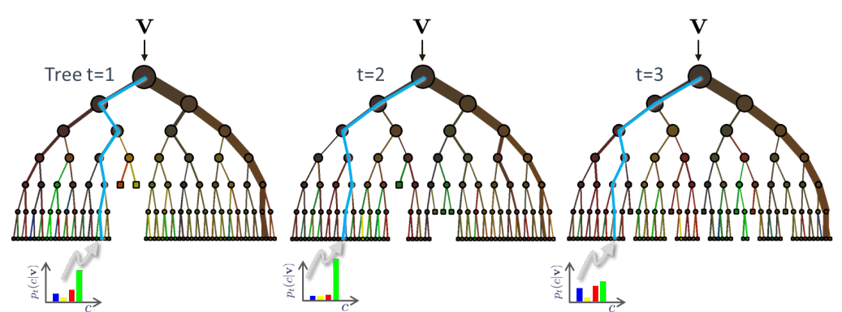
RANDOM FOREST
Random forests is an ensemble learning method, in which each tree in the ensemble is built from a sample drawn with replacement (i.e., a bootstrap sample) from the training set.
In addition, when splitting a node during the construction of the tree, the split that is chosen is no longer the best split among all features. Instead, the split that is picked is the best split among a random subset of the features.

Slide 25
GRADIENT BOOSTING
Ensemble of weak prediction models. (boosting)
Allowing optimization of an arbitrary differentiable loss function
The advantages of GB are:
Natural handling of data of mixed type (= heterogeneous features)
Predictive power
Robustness to outliers in output space (via robust loss functions)
The disadvantages of GB are:
Scalability, due to the sequential nature of boosting it can hardly be parallelized.

Slide 26
RESULTS
 | Logistic Regression | Random Forest | Gradient Boosting
Best NDCG score for now | 0.48334 | 0.48709 | 0.48491

Slide 27
FUTURE WORK
Data processing: missing value, normalization
Feature engineering: generate more useful features
Model: Extreme Randomized Trees, LambdaMART

Slide 28
REFERENCES
[1] Liu, Xudong, et al. "Combination of Diverse Ranking Models for Personalized Expedia Hotel Searches." arXiv preprint arXiv:1311.7679 (2013).
[2] Agarwal, Saurabh, Luke Styles, and Saurabh Verma. "Learn to Rank ICDM 2013 Challenge Ranking Hotel Search Queries." space 2: 3.
[3] Website: ”Personalize Expedia Hotel Searches - ICDM 2013”, Kaggle, Inc. URL: http://www.kaggle.com/c/expedia-personalized-sort

Slide 29
Thanks!
ANY QUESTIONS?

