Slide 1
Personalized Expedia Hotel Searches
Team: Madata

Slide 2
OUTLINE
Background
Problem setting
Dataset exploration
Feature Engineering
Data Preprocessing
Feature selection
Models
Logistic Regression
Random Forest
Gradient Boosting
Results & Future work

Slide 3
BACKGROUND

Slide 4
BACKGROUND
Expedia, the world’s largest online travel agency (OTA), powers search results for millions of travel shoppers every day
Matching users to hotel inventory matters a lot since the best ranking of hotels gives an OTA the best chance of winning the sale
Best ranking results maximize the purchases as well as offer great user experiences

Slide 5
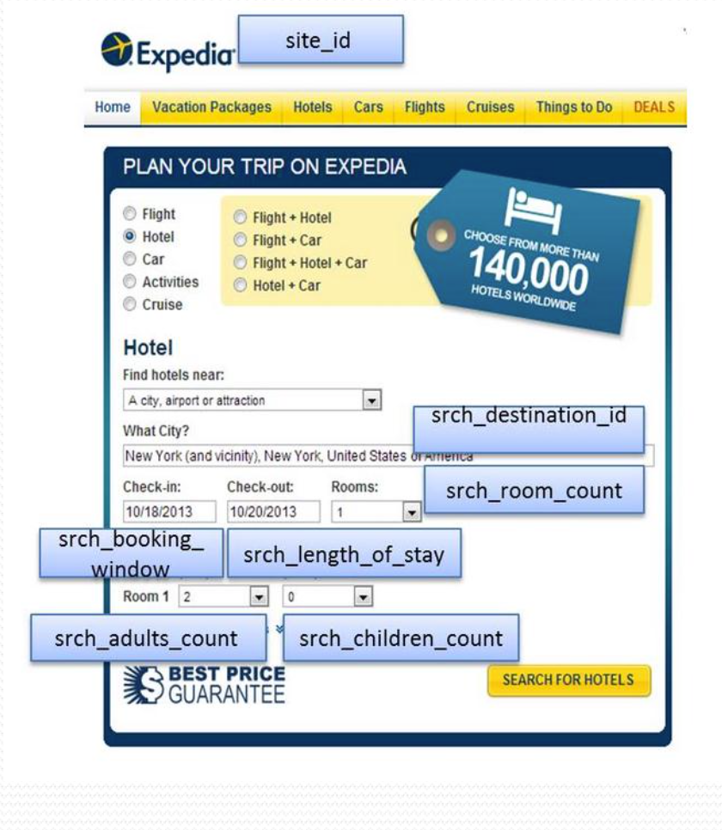
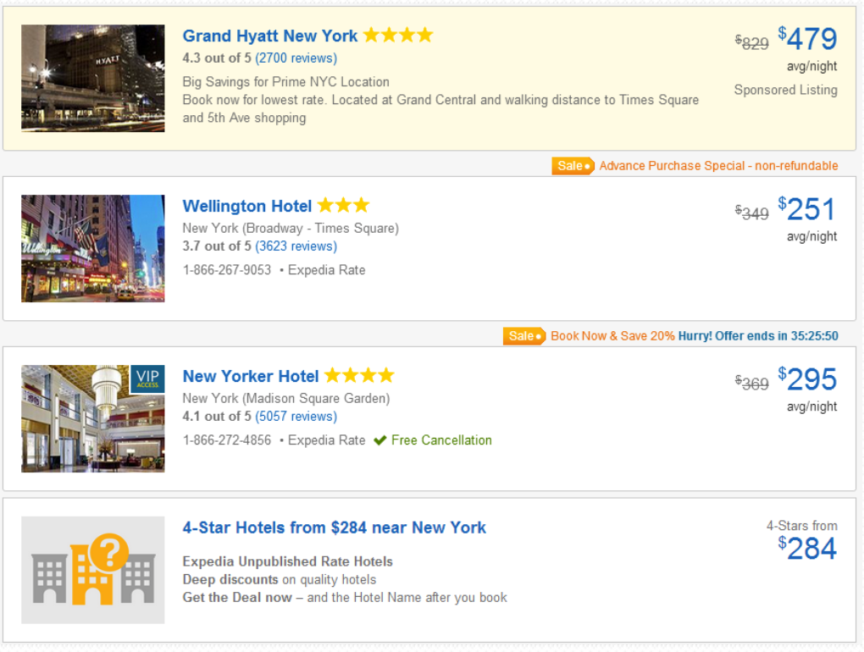
PROBLEM SETTING
Predict what hotel a user is most likely to book.
Learning to rank hotels such that purchased and clicked hotels are ranked at top among all hotels associated with a search query

Slide 6
PROBLEM SETTING
Given a dataset of search queries with associated hotel information and the clicking & booking results, train a model to rank the search results.
The results for the test set will be scored using a Normalized Discounted Cumulative Gain (NDCG) metric.
NDCG measures the performance of a recommendation system based on the graded relevance of the recommended entities. It varies from 0.0 to 1.0, with 1.0 representing the ideal ranking of the entities

Slide 7
DATA SET
Training set : 399,344 unique search lists
9,917,530 points
Test set: 266,230 search lists
6,622,629 points
~50 features:
1.Hotel characteristics
2.Location attractions of hotels
3.Users aggregate purchase history
4.Competitive OTA information

Slide 8
Training set features click_bool, booking_bool
Unbalanced data
Missing value
Only 4.4% of the data was clicked (positive)
Some features have missing values of 60% up to 98%

Slide 9
FEATURE ENGINEERING

Slide 10
FEATURE ENGINEERING
Missing Value Estimation
Data Balancing
Truncation
Normalization
Split Data By Country
Feature Extraction

Slide 11
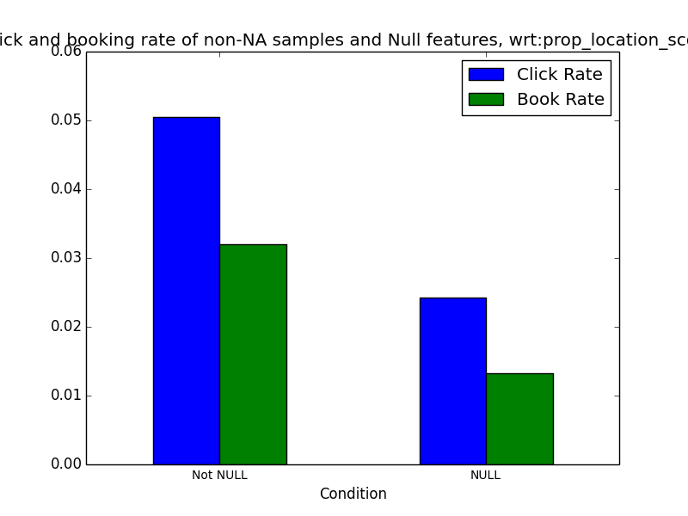
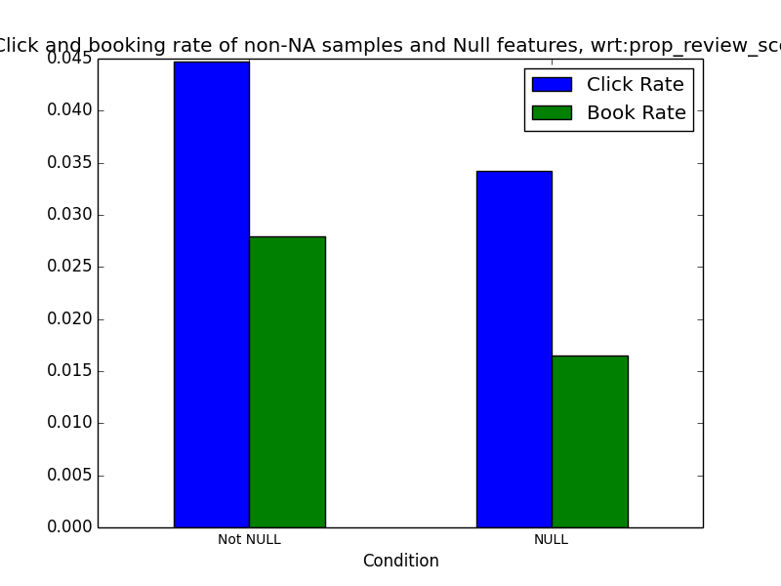
FEATURE ENGINEERING
Filling missing data: missing data are filled with different values
i.e. worst, mean, median values
Examples –’prop_location_score2’, ‘prop_review_score’

Slide 12
FEATURE ENGINEERING
Data Balancing:
Problem: Only 4.4% positive data points among 9.9 million data points.
Solution: Choose all positive data and randomly sample the same amount of negative data points.

Slide 13
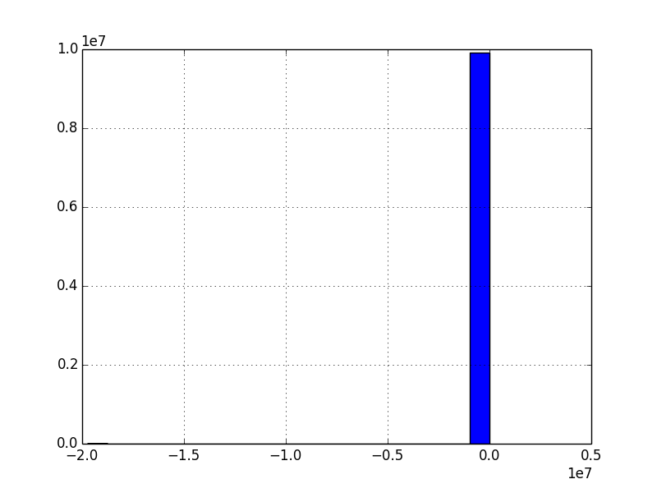
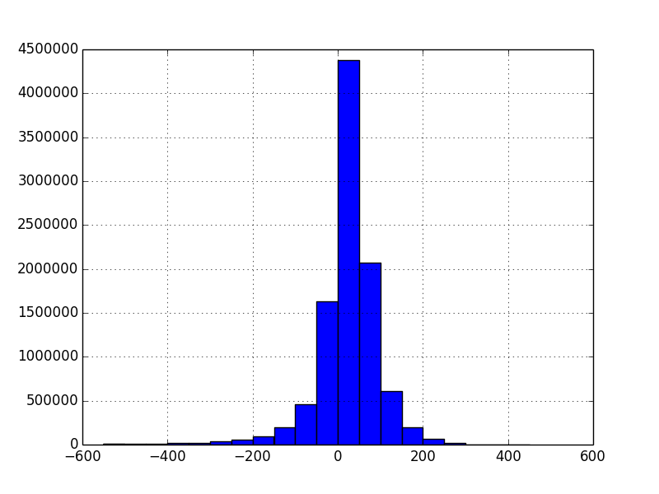
FEATURE ENGINEERING
Truncation: Price related features: truncate outlier data and quantize data into bins
Examples - ‘price_usd’, ‘prop_price_diff’, ‘user_price_diff’, ‘per_fee’, ‘total_fee’

Slide 14
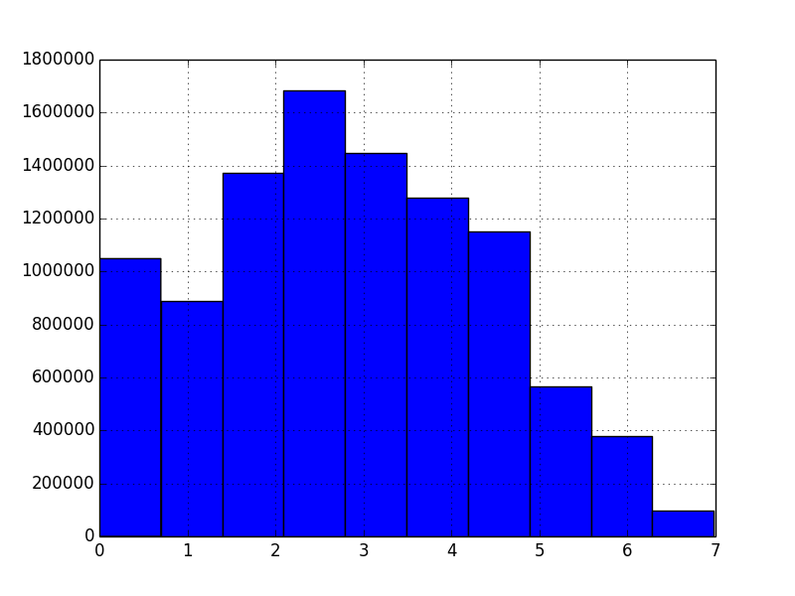
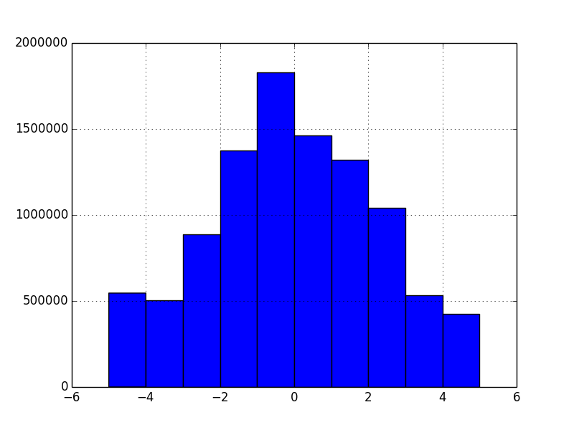
FEATURE ENGINEERING
Normalization: some features are normalized to reflect the relative distribution
Examples - ‘prop_location_score1’, prop_location_score2’, ‘orig_destination_distance’,‘starrating_diff’, ‘prop_review_score’, ‘score2ma’, ‘score1d2’

Slide 15
FEATURE ENGINEERING
Split data by country (prop_country_id)
NaN data for certain prop_country_id
Lower predict score

Slide 16
FEATURE ENGINEERING
USER-GENERATED FEATURES
We generated some meaningful features based on the existing features

Slide 17
FEATURE ENGINEERING
price features
Notes:
prop_log_historical_price = The logarithm of the mean price of the hotel over the last trading period. A 0 will occur if the hotel was not sold in that period.
price_usd = Displayed price of the hotel for the given search. Note that different countries have different conventions regarding displaying taxes and fees and the value may be per night or for the whole stay
visitor_hist_adr_usd = The mean price per night (in US$) of the hotels the customer has previously purchased; null signifies there is no purchase history on the customer

Slide 18
FEATURE ENGINEERING
score features
Notes:
srch_query_affinity_score = The log of the probability a hotel will be clicked on in Internet searches (hence the values are negative) A null signifies there are no data (i.e. hotel did not register in any searches)

Slide 19
FEATURE ENGINEERING
competitor features

Slide 20
FEATURE ENGINEERING
hotel quality features

Slide 21
MODELS

Slide 22
LOGISTIC REGRESSION
Linear model for classification. Serve as benchmark in our model.
scikit-learn implementation can fit a multiclass (one-vs-rest) logistic regression with optional L2 or L1 regularization.

Slide 23
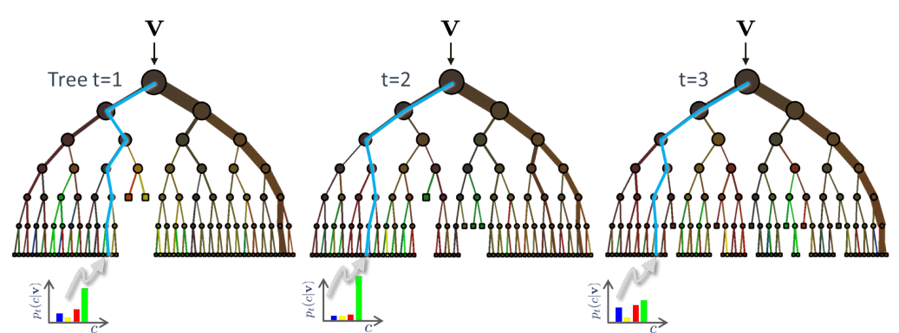
RANDOM FOREST
Random forests is an ensemble learning method, in which each tree in the ensemble is built from a sample drawn with replacement (i.e., a bootstrap sample) from the training set.
In addition, when splitting a node during the construction of the tree, the split that is chosen is no longer the best split among all features. Instead, the split that is picked is the best split among a random subset of the features.

Slide 24
GRADIENT BOOSTING
Ensemble of weak prediction models. (boosting)
Allowing optimization of an arbitrary differentiable loss function
The advantages of GB are:
Natural handling of data of mixed type (= heterogeneous features)
Predictive power
Robustness to outliers in output space (via robust loss functions)
The disadvantages of GB are:
Scalability, due to the sequential nature of boosting it can hardly be parallelized.

Slide 25
RESULTS
 | Logistic Regression | Random Forest | Gradient Boosting
Best NDCG score for now | 0.48334 | 0.48709 | 0.48491

Slide 26
REFERENCE
[1] Kaggle. Personalize Expedia Hotel Searches - ICDM 2013, 2013a. URL https://www.kaggle. com/c/expedia-personalized-sort.
[2] Liu, Xudong, et al. "Combination of Diverse Ranking Models for Personalized Expedia Hotel Searches." arXiv preprint arXiv:1311.7679 (2013).
[3] Logistic Regression, URL http://scikit-learn.org/stable/modules/linear_model.html#logistic-regression
[4] Random Forest, URL http://scikit-learn.org/stable/modules/ensemble.html#random-forests
[5] Gradient Boosting, URL http://scikit-learn.org/stable/modules/ensemble.html#gradient-tree-boosting

Slide 27
Thanks!
ANY QUESTIONS?

