Slide 1
COMP4433 Competition
Kaggle’s House Price Prediction
Group Name : Supernova
Group member : DENG Xindi 18081072d
HUANG Raoyi 18082421d
WANG Hewei 18081698d

Slide 2
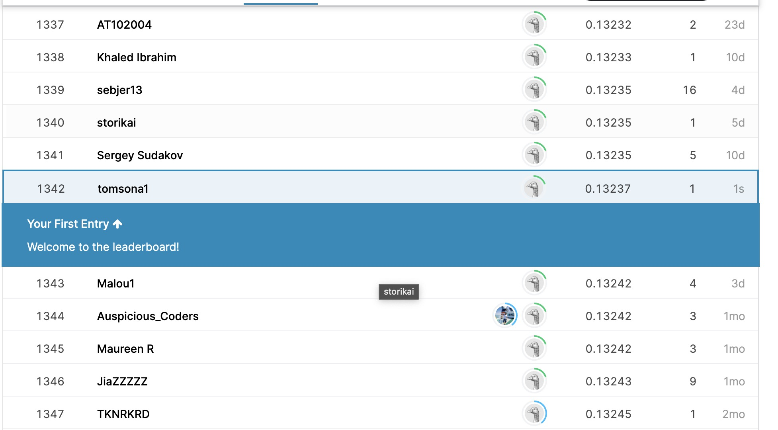
1.1 Competition result
1 Introduction
Rank: 1342
Score: 0.13237

Slide 3
1.2 Project overview
1 Introduction
data exploration
run a baseline model
data preprocessing
4 parts
3 stages
adjust the feature engineering
feature engineering
model selection
adjust the model selection

Slide 4
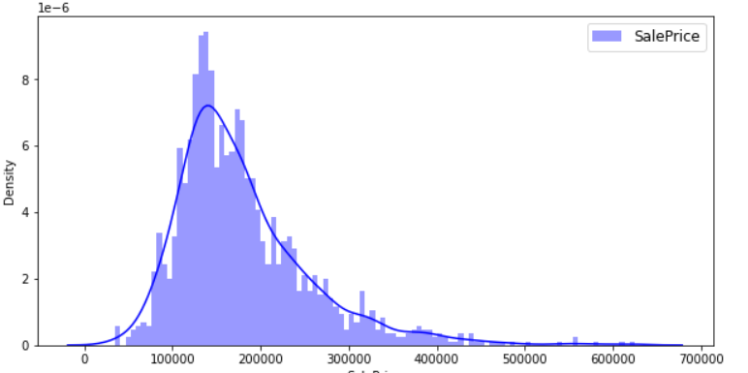
2.1 Data Overview
2 Data Exploration
Train dataset:
1460 lines, 81 features (including “SalePrice”)
Test dataset:
1459 lines, 80 features (excluding “SalePrice”)
use 80 features to predict sale prices
Skewness of sale prices
right skewness

Slide 5
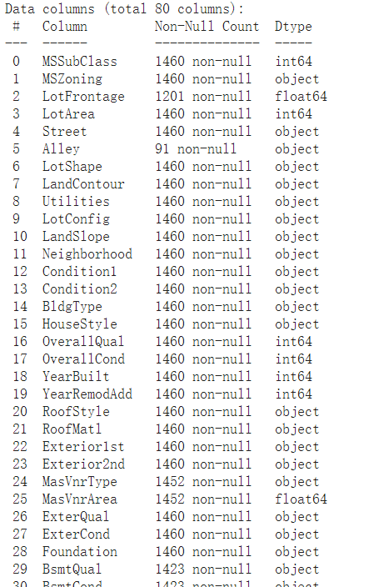
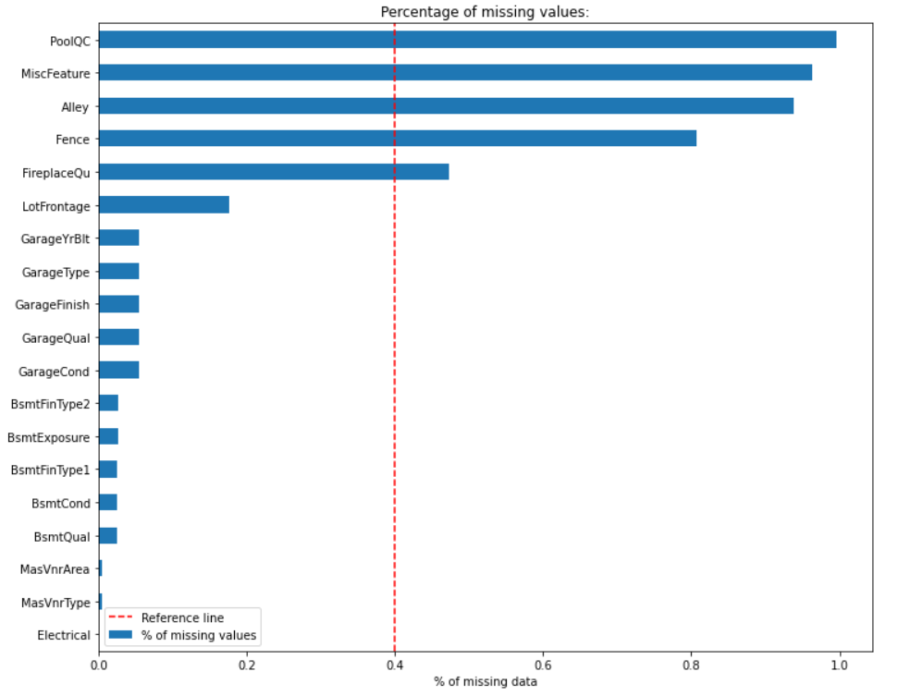
2.2 Observation by manual observation
Data type
categorical features + numerical features
Missing values
< 1460 non-null count
19 attributes with missing values (16 categorical + 3 numerical)
Attribute correlation
attribute name -> relation in meaning

Slide 6
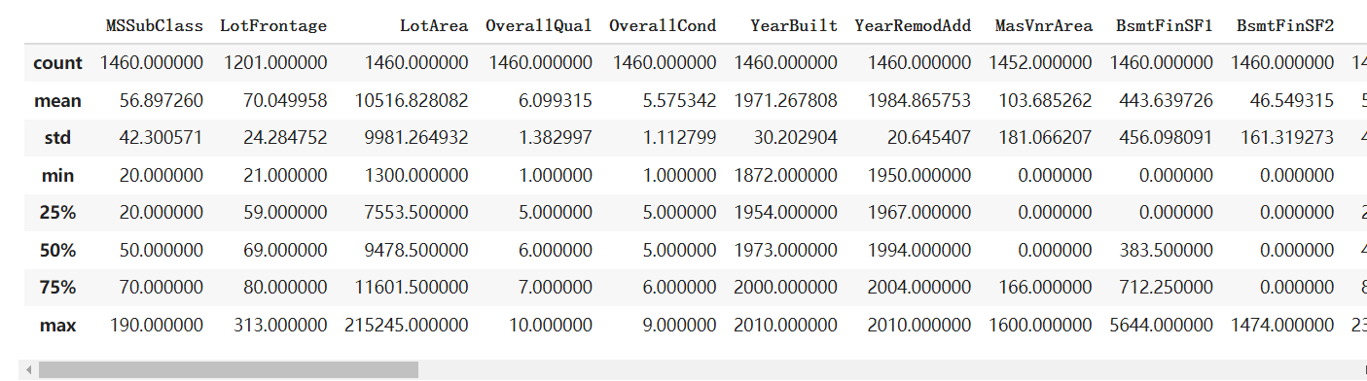
2.3 Exploration by computation
2.3.1 descriptive statistics
Observation: 1. mean -> values of some features are relatively large.
2. min & max -> within control
Suggestion: 1. do data normalization
2. min-max normalization may practicable

Slide 7
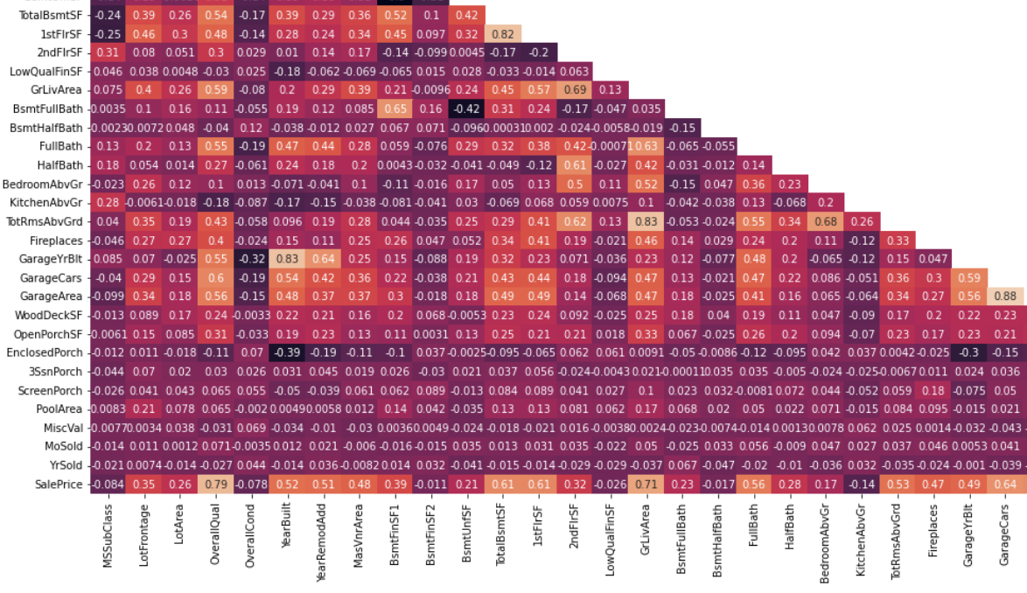
2.3 Exploration by computation
2.3.2 correlation

Slide 8
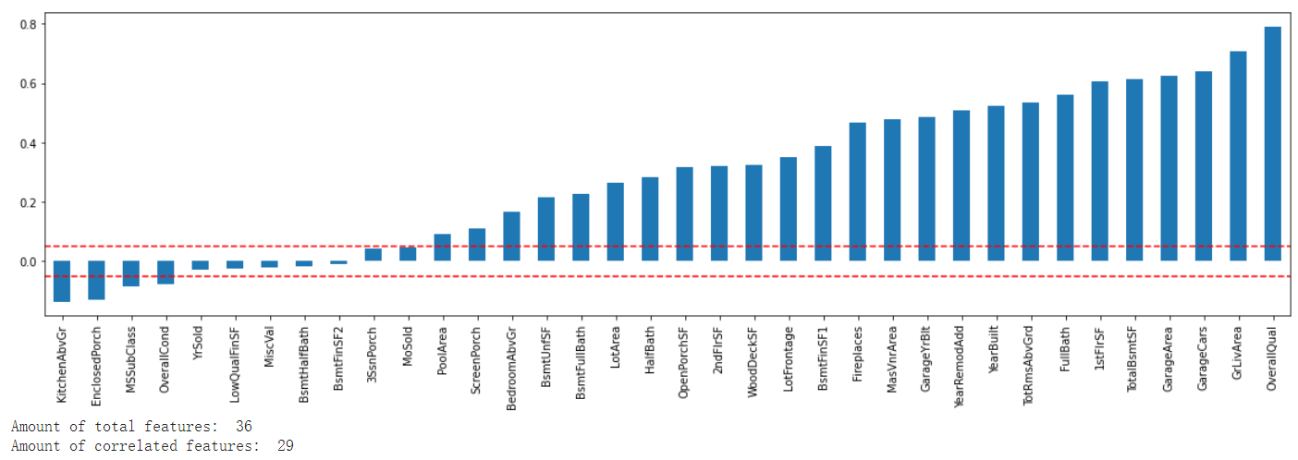
2.3 Exploration by computation
2.3.2 correlation
Threshold = 0.05
Operation: delete the features with < 0.05 correlation

Slide 9
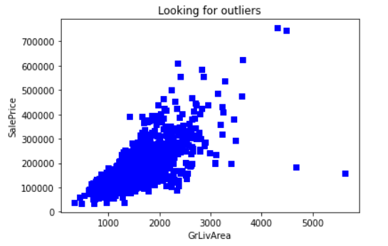
3.1 Data cleaning
3 Data Preprocessing
3.1.1 remove outliers
Features: “SalePrice” versus “GrLivArea”
Criteria: GriLivArea < 4000
Notes:
According to the author of the dataset, "there are five observations relating to the feature “GrlivArea” need to be removed before giving it to students. (thus, we draw a plot of SALE PRICE versus GR LIV AREA will quickly indicate these points).

Slide 10
3.1 Data cleaning
3.1.2 fill in missing values
NA
missing value
Notes:
We find that ‘NA’ can be used to represent missing value.

Slide 11
3.1 Data cleaning
3.1.2 fill in missing values
most ‘NA’ means the inexistence of corresponding object
(e.g., garage for “GarageArea”)
numerical features
missing value
0
NA
‘NA’ means “the object does not exist” rather than missing value
candidate of variable
fill in ‘NA’ in form of string
categorical features
choose simple way because of the small number of missing values
missing value
fill in mode
TODO: ARM, Decision Tree (Classification/Regression)
Notes:
However, according to our data exploration, we find that for categorical features, NA can also be a candidate of variable. Therefore, we deal with missing values for numerical features and categorical features, respectively.
For numerical features, we find that most of the ‘NA’ means the inexistence of object. For example, garage is the object of GarageArea. Most ‘NA’ for garage area is caused by the inexistence of garage. Therefore, we just assign 0 to the variable.
And for the categorical features that take NA as candidate, NA has meaning itself and we just fill in “NA” in form of string.
For the other categorical features, we use mode, the simplest way to fill in the missing values for the number of missing values for these features are small. In the future, we can also try association rule mining and decision tree to make such prediction more accurate.

Slide 12
3.1 Data cleaning
3.1.3 resolve inconsistence
Q
Is it possible that “GarageType” = NA and “GarageCond” != NA?
Garage does not exist
Garage exists
A
NO! Inconsistence!
Q
Is it possible that this inconsistence occurs in the dataset?
YES!
A
remove that line
Solution
Notes:
We manipulate the problem relating to “NA” in the former part. But there is still one question remains. Here we take an example.

Slide 13
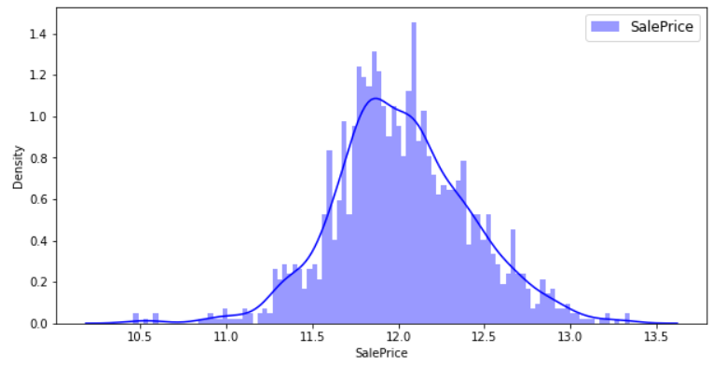


3.2 Data transformation
3.2.1 remove skewness
log transformation
3.2.2 categorical values -> numerical values
Labelencoder e.g., MsZoning: [C(all), FV, RH, RL, RM] -> [0, 1, 2, 3, 4]
One-hot
Notes:
In general, the model may make reliable predictions are made if the predictors and the target variable are normally distributed. According to the data exploration, we find that the sale price is right skewness. Thus, here we use log transformation to remove the skewness and the curve of the transformed data is now roughly symmetric.
Next step of transformation is to transform all categorical values to numerical values, because features with numerical representation is always more convinient for the model training. Here we consider two methods. First is Label encoder. For example, the candidates for MsZoning is C, FV, RH, RL, and RM, with label encoder, the values is transformed to 0 to 4. Another method we considered is ont-hot. However, we already have large number of features, while one-hot will make it more serious. Thus, we use labelencoder in our project.

Slide 14
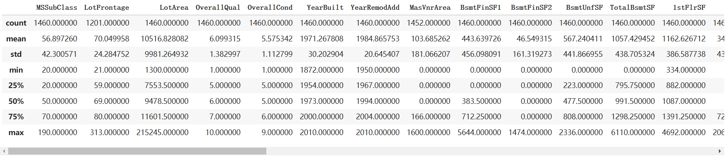
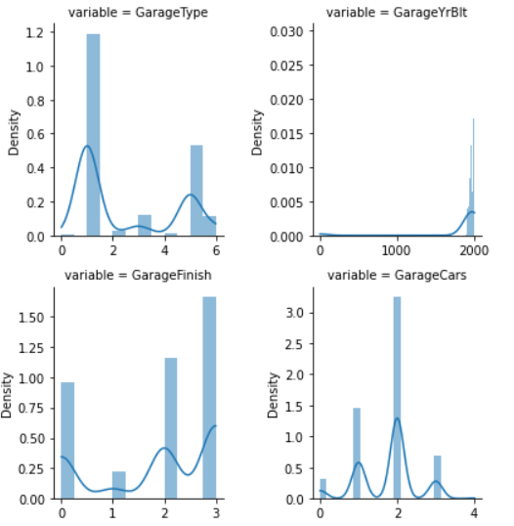
3.2 Data transformation
3.2.3 data normalization
min-max normalization (Assumption: min & max within control)
z-score normalization (Assumption: the distribution of data roughly symmetrical)
Notes:
We have several ways to do the data normalization.
According to the descriptive statistics, min and max for each features are within control. Thus, it meets the assumption to use min-max normalization.
And because we do remove the skewness of the sale price before and the sale price now is symmetric. Thus, we want to check whether z-score normalization can also be used in this work. However, the assumption of z-score normalization is the distribution of data should roughly symmetric. According to the visualization for each feature, here I just show some examples, we find that the assumption fails.
Therefore, we use min-max normalization.
Here is the end of data preprocessing, and with the preprocessed data, we can do feature selection to optimize our model.

Slide 15
4 Feature Engineering
4.1 Baseline Model Selection
Training data split (random_state = 42):
Training
Testing
75%
25%
Abbreviation | Models | Test RMSLE
DTR | DecisionTreeRegressor(random_state=1) | 0.015405
LR | LinearRegression() | 0.010319
Notes:
For feature engineering, we first split our training data into new training data and testing data. Based on the split, we select our baseline model from DecisionTreeRegressor and LinearRegression. From test RMSLE, we can see that LR out performs DTR, so we selected LR as our baseline model.

Slide 16
4.2 Eliminate features based on some metrics
4.2.1 Eliminate based on correlation
4 pairs of highly correlated features
Notes:
Then we eliminated some features based on some metrics. First metrics is correlation. We can see there’re four pairs of features which are highly correlatied in this graph.

Slide 17
4.2.1 Eliminate based on correlation
Pair no. | Feature 1 | Feature 2 | Correlation
1 | GarageArea (int) | GarageCars (int) | 0.88
 | Size of garage in square feet | Size of garage in car capacity
2 | TotRmsAbvGrd (int) | GrLivArea (int) | 0.83
 | Total rooms above grade (does not include bathrooms) | Above grade (ground) living area square feet
3 | GarageYrBlt (float) | YearBuilt (int) | 0.83
 | Year garage was built | Original construction date
4 | 1stFlrSF (int) | TotalBsmtSF (int) | 0.82
 | First Floor square feet | Total square feet of basement area
Notes:
Let’s take a deeper look at those pairs of highly correlated features. We can see that all pairs have similar meanings. Take the first pair as an example, it’s just about different units of measurement for the same attribute. Since they’re both integer, the latter is probably more accurate since 1 foot approximately = 30 cm.

Slide 18
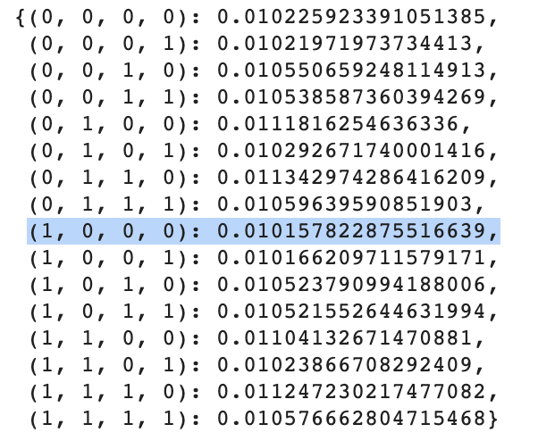
4.2.1 Eliminate based on correlation
similar_pairs = [['GarageArea', 'GarageCars’], ['TotRmsAbvGrd', 'GrLivArea’],
['GarageYrBlt', 'YearBuilt’], ['1stFlrSF', 'TotalBsmtSF']]
Test RMSLEs to find the best combination of eliminated features:
Features to eliminate:
'GarageCars’,
'TotRmsAbvGrd’,
'GarageYrBlt’,
'1stFlrSF
Current baseline test RMSLE: 0.010158
Notes:
However, it’s better to determine whichi feature to be eliminated by test RMSLEs calculated from the baseline model to avoid multi-collinearity. We can see that the feature combination represented by the tuple (1, 0, 0, 0) performs best. Let’s make it our new baseline test RMSLE.

Slide 19
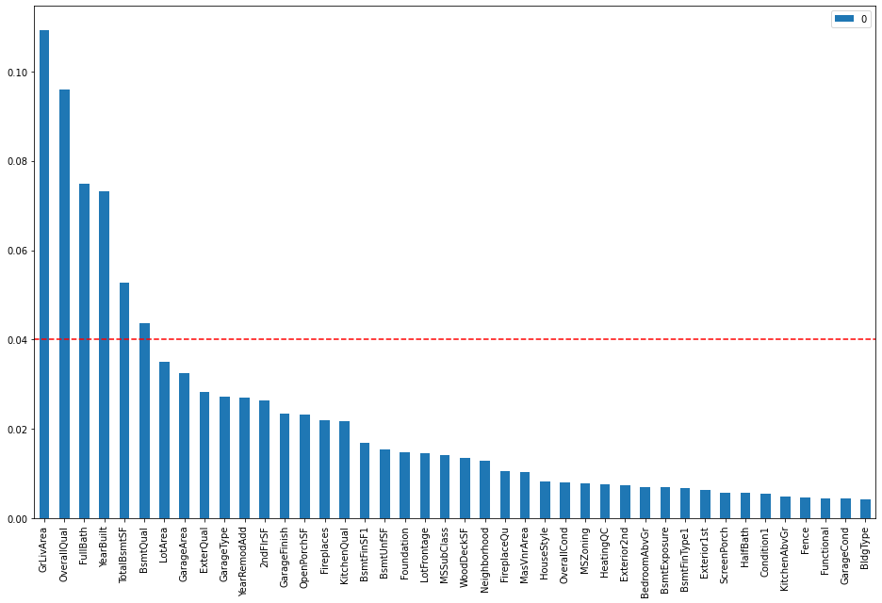
4.2.2 Eliminate based on RF feature_importance and LR coefficients
threshold = 0.04
rf_top6 = ['GrLivArea’,
'OverallQual’,
'FullBath’,
'YearBuilt’,
'TotalBsmtSF’,
'BsmtQual']
Notes:
Besides correlation, we can also understand the importance of features by feature_importance attribute from RandomForest and coefficients of linear regression. Let’s look at the RF feature_importance first. Since the top 6 feature importances decrease at a more drastic speed, we selected the top 6 features by a threshold 0.04. Then we get the array rf_top6.

Slide 20
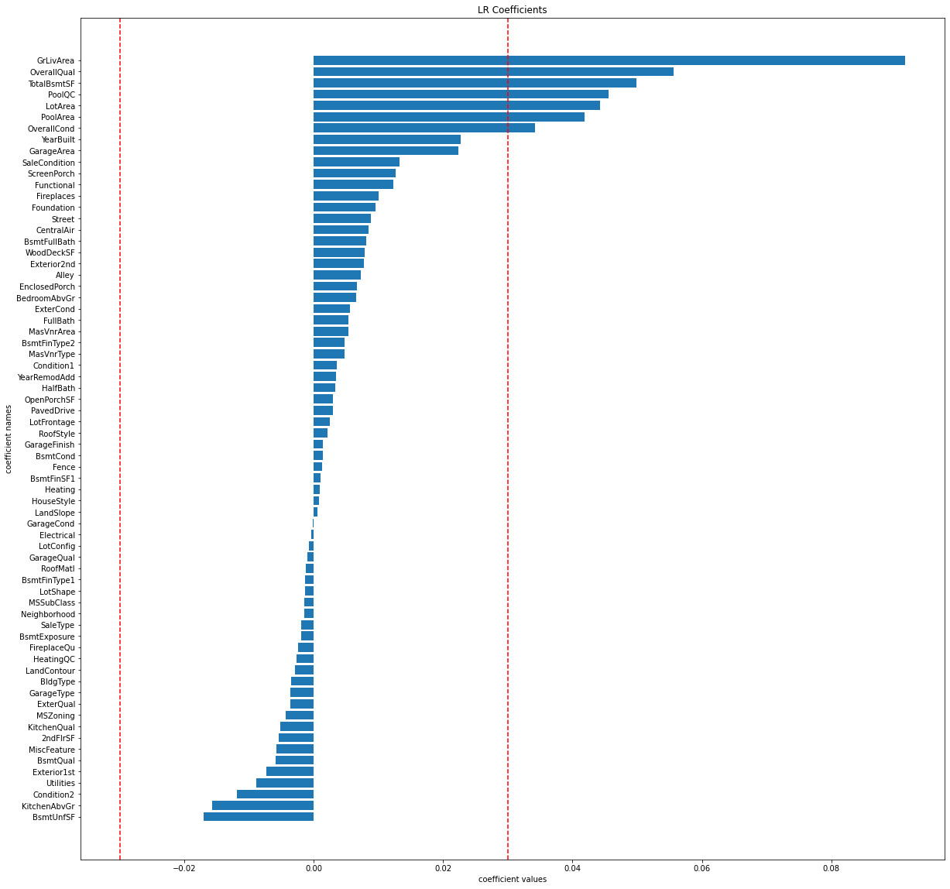
4.2.2 Eliminate based on RF feature_importance and LR coefficients
threshold = +/- 0.03
lr_top7 = ['GrLivArea’,
'OverallQual’,
'TotalBsmtSF’,
'PoolQC’,
'LotArea’,
'PoolArea’,
'OverallCond']
Notes:
Similarly for LR coefficients, we selected the top 7 features by setting threshold +/-0.03. Then we get the array lr_top7.

Slide 21
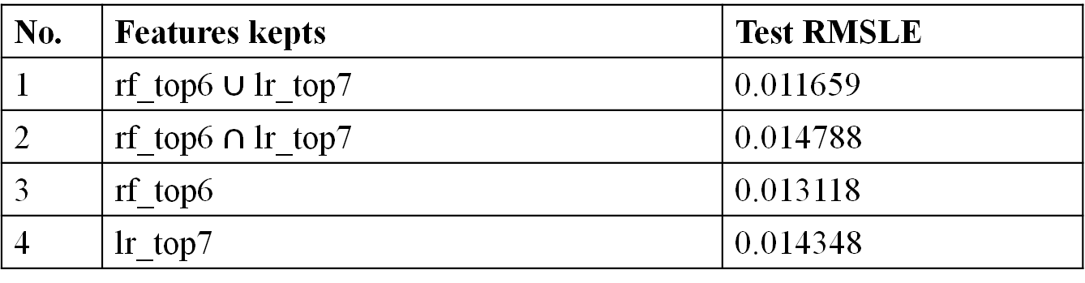
4.2.2 Eliminate based on RF feature_importance and LR coefficients
No. | Features kepts | Test RMSLE
1 | rf_top6 $∪$ lr_top7 | 0.011659
2 | rf_top6 $∩$ lr_top7 | 0.014788
3 | rf_top6 | 0.013118
4 | lr_top7 | 0.014348
Current baseline RMSLE: 0.010158
Thus, we won't eliminate any features.
Notes:
Let’s manipulate the two arrays rf_top6 and lr_top7 to see whether we can achieve better performance on our baseline model. However, after trial with intersection, union, and indepent sets, we found that none of them are better than our current baseline RMSLE, so we won’t eliminate any features here.

Slide 22
4.3 Dimensionality Reduction
4.3.1 feature extraction
Methods | Best hyperparameter combination | Test RMSLE
PCA (Principal Component Analysis) | PCA(n_components=67, random_state=1) | 0.010254
SVD (Singular Value Decomposition) | TruncatedSVD(n_components=67, random_state=1) | 0.010122
FA (Factor Analysis) | FactorAnalysis(n_components=67, random_state=42) | 0.010278
Current baseline RMSLE: 0.010158
4.3.2 feature selection (subset selection algorithms)
Methods | Best hyperparameter combination | Test RMSLE
Forward Search | k_features=15 | 0.010261
Backward Search | k_features=60 | 0.010326
Floating Search | k_features=51 | 0.010241
Notes:
After feature selection by some metrics, let’s see whether we can further get better features by dimensionality reduction. First is about feature extraction, we tried three methods PCA, SVD, and FA, and happily found that SVD outperforms our current baseline RMSLE. Then we tried feature selection by subset selection methods forward search, backward search, and floating search. However, we can’t find better features at this time. Thus, our current best feature combination should be from SVD.

Slide 23
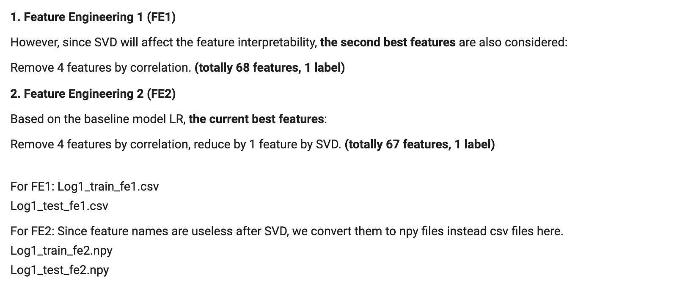
4.4 A summary on feature engineering
Notes:
Then it comes to our summary on feature engineering. Even though our current best features are obtained by first eliminating 4 highly correlated features and then applying SVD to reduce by 1 dimension. However, the difference of test RMSLEs is not that large, the impact of SVD is also not large by only reducing 1 dimension, and it’s detrimental to the data interpretability once we use SVD. Therefore, we also consider our second best features here which are obtained by only eliminating 4 highly correlated features. Then these two feature engineering results are written to csv and npy files separately.

Slide 24
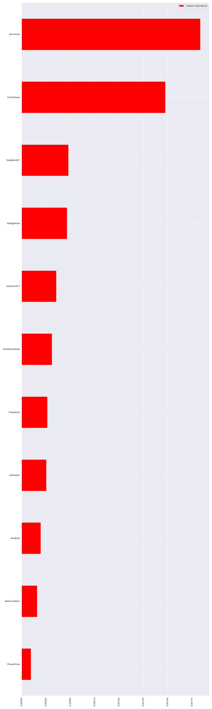
5 Model Selection
5.1 Lasso, BayesianRidge and GradientBoostingRegressor
Lasso:
improve the utilization of information
missing values ​​and outliers
BayesianRidge:
missing values ​​and outliers
realize the regularization
GradientBoostingRegressor:
Increase the weight of the instance that is predicted incorrectly
avoid overfitting
ridge, e-net, and svr …
Notes:
Since there are some missing values ​​and outliers in the data, this situation is very suitable for Lasso. The number of samples we have is limited, so we need to improve the utilization of information. Lasso can also determine what attribute has a greater impact on the result, and filter the variables in this part. The picture on the right shows some attributes that are calculated using Lasso and are highly correlated with the result. And this condition is also very suitable for a Bayesian linear regression model. BayesianRidge can realize the regularization of the data by manually adjusting the hyperparameters. Moreover, this model can be changed based on existing data.
GradientBoostingRegressor is a boosting method. In each step of the downward calculation, the weight of the instance that is predicted incorrectly is increased. In this way, we can focus on the wrong category and avoid overfitting very effectively.
In addition to these three models that fit the situation very well, I also tried regression models such as ridge, e-net, and svr. But their performance is not as good as the above three models.

Slide 25
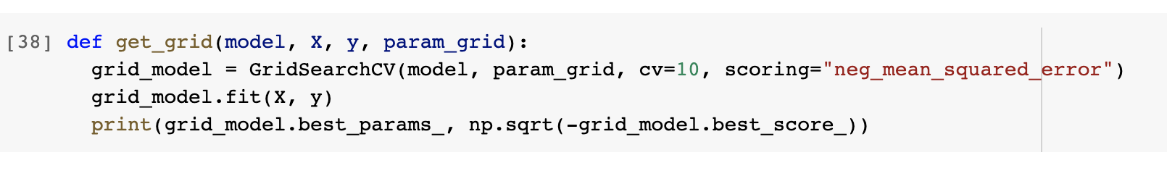
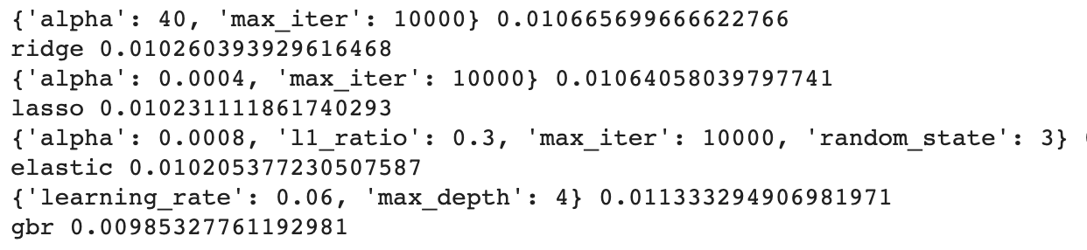
5.2 Data segmentation and hyperparameter selection
Two ways to build the test dataset and train dataset
Use the grid function to find the best hyperparameters
Notes:
There are two ways to build the test dataset and train dataset.
I can split the dataset into four parts. I can also divide the whole dataset into ten parts by using KFolds.
Then I used the grid function to find the best hyperparameters.

Slide 26
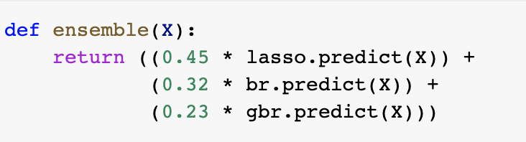

5.2 ensemble the best basic models
combined the three best-performing models to form the final model
the RMSE value of this model is better than the performance of any model
Notes:
After choosing the best hyperparameters, I combined the three best-performing models to form the final model. After adjusting each weight, the RMSE value of this model is better than the performance of any model alone.

Slide 27
6 Future Work & Conclusion
Future Work:
1. For data exploration:
-- other possible values set for the threshold to eliminate the features which are less correlated with the label can also be tried
2. For data preprocessing:
For outliers:
-- Different visualisation methods can be tried to figure out more outliers
For missing value filling:
-- Other methods to fill the null values such as Decision Tree, Associative Rule Mining, and Clustering
For normalisation:
-- Different min-max normalised intervals can be tried (not just [0, 1] and [0, 10])
-- Other data transformation methods can be tried such as decimal scaling, feature cross, or polynoimal features
3. For feature engineering
-- Different splitting methods for training data can be tried
-- Different hyperparameters for the baseline model can be tried
-- Different thresholds set for correlation, RF feature_importance, and LR coefficients can be tried
-- More systematic methods for hyperparameter tuning for Dimensionality Reduction methods can be tried

Slide 28
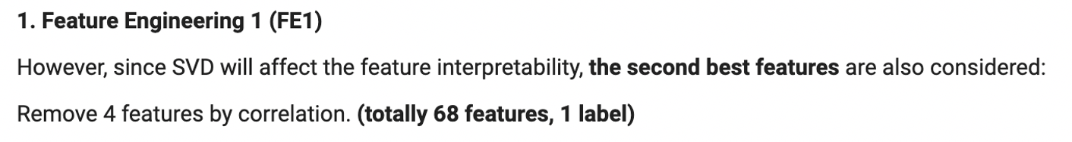
6 Future Work & Conclusion
4. For model selection
-- Neural Networks can also be tried as a basic model
-- Faster hyperparameter tunning method such as Baysian Optimization and Randomized GridSearch can be tried
-- After selecting the best model, further tune features according to it
Conclusion:
Best model
Best features

