Slide 1
Corporate Presentation
Mahanagar Gas Limited
05th Oct 2026

Slide 2
MGL Overview

Slide 3





Our History
Mumbai High
GAIL Partnered British Gas
Mahanagar Gas Limited (MGL) sowed the seeds of success in city gas distribution in India and today stands as a leader in the CGD sector, known for its excellence in operations and safety.
Natural Gas Flared off
To leverage on their technical Know-how and robust safety practices of BG
1976
Early 1990’s
MGL Today
Late 1980’s
8th May 1995
GOI
MGL
Planned to utilize the gas instead of flaring and nominated GAIL to implement CGD project in Mumbai
Was incorporated as a JV between GAIL and BG

Slide 4




Company Overview
Mahanagar Gas Limited (MGL) was incorporated on 8th May 1995 with GAIL and British Gas as its promoters.
Shareholding
In August 2019, BGAPH completely divested its equity.
MGL got listed on 1st July 2016; Government of Maharashtra (GoM) increased its shareholding to 10%.
Corporate Vision
GAIL owns 32.5% , GoM owns 10% stake in the company, with the remaining stake distributed amongst FPIs/NRIs (~24.25%), DI/ Investors (~23.82%), Others (9.4%).
To be world class, consumer and environment-friendly company, an employer of choice
Committed to provide safe, efficient, and reliable energy
While creating value for all our stakeholders

Slide 5

MGL Business Verticals
Mahanagar Gas Limited
Merger & Acquisition
Strategic Investment
Joint Ventures
Unison Enviro(UEPL)
3ev Industries Pvt. Ltd.
Mahanagar LNG Pvt. Ltd. (MLPL)
IBC India (IBCIPL)

Slide 6



Company Overview
4.54 MMSCMD
5.34 MMSCMD
Gas Sourcing
Average Sales¹
Peak Sales · September 2026
Mix of Domestic, Term and Spot gas
Financial Metrics FY 26* (in INR Cr.)
8,240²
7,135²
847
10,882³
Revenue
Fixed Asset
PAT
Market Cap
(1) Sales Volume is April to August FY 2026-27 annual average (2) Fixed Assets is as on 31st March 2025 and Revenue from operations (Net) excluding Other Income (3) Market Cap as on September 09, 2026

Slide 7
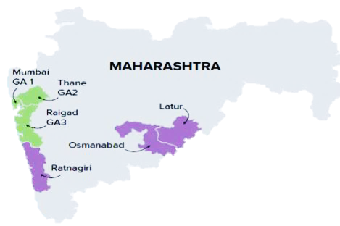



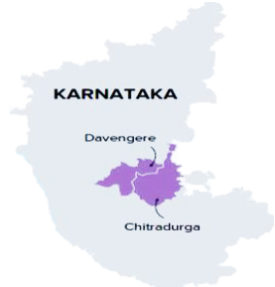


Area of Operation & Infrastructure
45,691
47,96,180
Area (sq Km)
Urban Households
10
522
759
7,757
CGS & LNG Station (No)
CNG Stations (No)
Steel Pipeline Length (Km)
PE Pipeline Length (Km)
MGL’s existing Geographical Areas (GA)
13,30,819
32,61,514
6,307
GAs of erstwhile UEPL
CNG Vehicles (No)
PNG Household Connections
Industrial Commercial Customers
Note: Data till 31st March 2026

Slide 8

From network expansion to integrated operations
10
522
759
7,757
13,30,819
32,61,514
6,307
CGS & LNG Station (No)
CNG Stations (No)
Steel Pipeline Length (Km)
PE Pipeline Length (Km)
CNG Vehicles (No)
PNG Household Connections
Industrial Commercial Customers
Integrated Command & Control Centre - Mahape
MGL moved from individual systems to an integrated operational view.
CNG station network scaled from 290 in FY 22 to 500+ in FY 26
~3.2 Mn DPNG connections, accounting for ~20% of India’s ~16 Mn customer base
Adoption of MLC1 piping (~25-30% cheaper) and upgradation in metering technologies
Projects
SCADA
GIS
IVMS
CNG Transport Software
Forecourt Automation
AMR
ICCC enables
GIS mapping for asset visibility, maintenance and emergency handling
In-house SCADA + IVMS2 tool to cut dry-outs at daughter booster stations
Powering COCO CNG stations through renewable energy
Centralised monitoring
Faster emergency response
Resource mobilisation
Outage management
Nearest emergency response team identification
Operational dashboards and analytics
Future SAP integration for maintenance planning and expenditure management
O&M
Integrated ISO 45001, 14001 & 9001 framework; zero LTIFR3, 96% employees trained in FY25
“No STC4 No Work”, Dial-before-Dig and near-miss reporting embedded
Digital safety audits and HIRA / QRA / HAZOP reviews across projects and operations
HSE
1. Multi Layer Composite | 2. In Vehicle Monitoring System | 3. Lost Time Injury Frequency Rate | 4. Safety and Technical Competency

Slide 9

The digital platform is now ready for the next phase of MGL
Project Utkarsh - RISE with SAP
Project PRISM
Digital HSE
First CGD company in India to implement RISE with SAP on private cloud - SAP ECC 6.0 to SAP S/4HANA.
New digital customer/operations architecture with Salesforce and Appstrail. Phase 1:
1
Digital safety audits
2
Real-time compliance
Modern enterprise backbone
Reduced IT complexity
Cloud-based scalability
Improved integration
Platform for future expansion and innovation
CRM
Collect360
3
Incident tracking
Meter Reading App
Five O&M apps
4
Root-cause analysis
Single customer view
Breaking data silos
5
Corrective-action monitoring
First AI-enabled use case
Supports virtual audits, photographic evidence and centralised HSE monitoring.
Digital O&M
SCADA + GIS + AMR + IVMS
+ ICCC + SAP + PRISM
Predictive maintenance
Asset optimisation
Demand forecasting
Automated workflows
AI-enabled operations
FROM CAPABILITY BUILDING TO CAPABILITY LEVERAGE Over the last 5-6 years, MGL has built more than physical infrastructure - it has built an execution platform combining network scale, asset integrity, HSE, project execution, digital systems and operational data.

Slide 10
Financial performance over past 5 years
Values in INR Crores
Revenue
PAT
EBITDA
Gross Margin

Slide 11
Infrastructure and volumes
CNG Customers (end users) Growth (in '000s)
PNG Customers (end users) Growth (in '000s)
Sales Volume
YoY Volume Growth
FY 25
09%

Slide 12
Growth- Infrastructure and Volume
CNG Customers (end users) Growth (in '000s)
PNG Customers (end users) Growth (in '000s)
Sales Volume
YoY Volume Growth
FY 25
09%

Slide 13
CAPEX Outlay Plan
Rs. 9,300 Crore*
Total Capex (Rs. Cr)
Total capex till 31st March 2026
~Rs.6,850 Crore
Plan to Invest ~Rs.6,850 Crore in next 5 years
Reinvesting Profits to enhance CGD network for benefit of Consumers primarily PNG Customers.
Targeting addition of about 1 million and 500K DPNG customers in next 5 years in MGL and UEPL GAs, respectively.
*The figures include MGL and UEPL Capex

Slide 14
5-year Business Plan
Connect ~12.5 lakhs additional households
New LNG stations at multiple locations to cater to the long-haul segment
250+ additional CNG stations for meeting rising demand of CNG
Sales Volume upto ~ 6.80 mmscmd (CAGR 10%)
Expansion of pipeline network of more than~1,000 kms
Invest about Rs.6,000 crore to meet the expansion plan

Slide 15
O&M Infrastructure

Slide 16
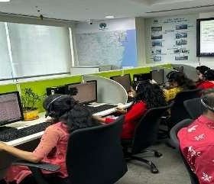
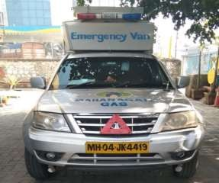
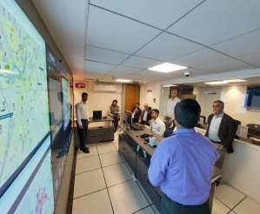
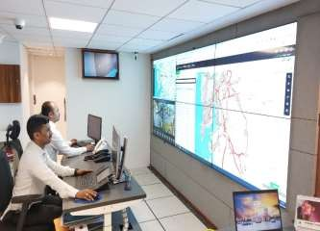
O&M infrastructure
Emergency Control Stations
Security Control Room
MGL has divided its authorized GAs into 16 districts
24 x 7 Control room
29 Emergency Van
CCTV SURVEILLANCE
IN VEHICLE MONITORING SYSTEM
VEHICLE TRACKING SYSTEM
To receive complaints of damages and stoppage of gas
Fully Equipped and operational round the clock
-Monitoring through cameras installed at strategic locations
-Establishing two-way communication through D3D cameras
-Vehicle & trip monitoring of CTV
-Driver behavior monitoring
-Live information streams
-Monitor pipeline patrolling activity
-Real time tracking & alerts

Slide 17
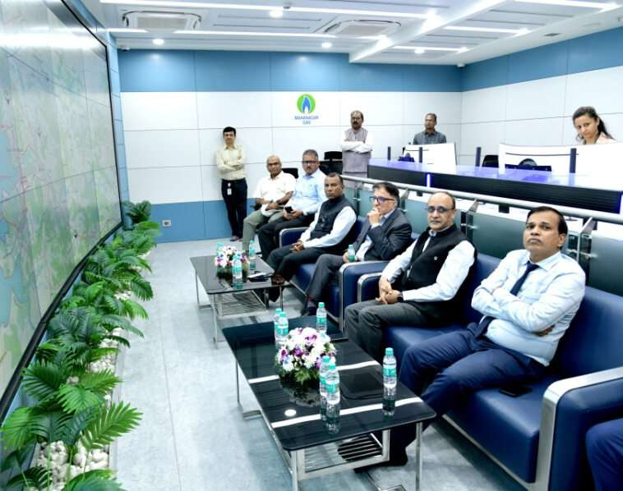
O&M infrastructure
Integrated Command and Control Centre

Slide 18
MGL’s Vision and Long-term Strategy
LAKSHYA
Vision 2027
A diversified energy utility:
1st
quartile in employee engagement
Be a diversified Clean Energy company
Be a Digital Leader
Among India's top energy companies to work for
2x
volume growth
Diversify into new energy areas (e-mobility, biofuels)
Digitize across the value chain (network planning to operations & maintenance to customer service)
Create and sustain an Employee friendly workplace
3x
margins
1/4th
revenue from new businesses
in 5
years

Slide 19
Business Expansion & Diversification
New business opportunity | Description | Adjacency with MGL's core | Status
CGD acquisition | Augment Growth in the core sector | Leveraging core competencies of MGL in the CGD sector | MGL auqired 100% stake in UEPL. Merger completed.
Long Haul/ Circular movement | Cluster-based approach Replace existing diesel fleet with LNG for closed loop logistics | Extension of MGL‘s business through participation in long haul logistics | Rolling out LNG stations. Savroli (started in Aug-23) Launched Aurangabad in Oct-24. target to add 3 more LNG stations within 1 year period.
Compressed Bio Gas | Set up Asia‘s biggest CBG plant at Mumbai, having capacity to process 1,000 TPD MSW BMC to provide land and feedstock | Similar composition and energy potential to CNG; green renewable alternative for MGL | Concession agreement to be signed with BMC. JV agreement with the partner to be signed after CA
Green Hydrogen | Develop use cases for Hydrogen for the mobility and Industrial segments through pilot projects | Hydrogen to be blended in the CGD network. Hydrogen to be dispensed in FCEV‘s deployed as part of project. | Land for pilot project has been acquired at Rasayani, Patalganga. A pilot project of 0.5 MW for blending application has been planned to be implemented.
1
2
3
4

Slide 20
Business Expansion & Diversification
New business opportunity | Description | Adjacency with MGL's core | Initiative Taken
EV | Exploring opportunities in the rapidly expanding e-mobility space | Aligns with MGL‘s objective of being a diversified clean energy company. | Invested in 3W EV manufacturing company
Lithium Ion Battery | Setting up a Joint Venture to manufacture Li-Ion battery cells | Complements MGL‘s interest in the mobility sector. Will immensely help India indigenize the core of EV value chain. | Land has been acquired from KIADB in Bangalore. MEP & CSE Design in final stages.
Renewable | Exploring opportunities in the renewable energy space – Captive use as well as solar/ wind assets/ platforms. | Aligns with MGL‘s objective of being a diversified clean energy company | Invested in group captive Solar Power generation to meet demand at MGL‘s COCO CNG stations.
5
6
7
By 2040, MGL aims to be a diversified clean energy company and is actively working towards developing capabilities in new energy segments viz. Hydrogen, CBG and Renewable Energy.

Slide 21
CBG

Slide 22


Strategic CBG Initiatives & Project Updates – Mumbai Region
1. Municipal Solid Waste (MSW) Project – Mankhurd & Deonar
2. Cow Dung-Based Project – Aarey Colony
3. Municipal Solid Waste (MSW) Project – Davangere, Karnataka
MOU signed with BMC on 08th June 2023 for setting up CBG plant
Government Support: GR issued (28th May 2025) for land allocation at concessional rates to MGL.
Project Scope: Total 1000 TPD capacity plant, to be executed in two phases (500 TPD each).
Plot at Phase-1 Mankhurd: Dismantling of the existing Mumbai Compost Structure is 95% complete by BMC.
Key Milestone: The structure of the Mumbai compost plant has been removed by BMC from the Mankhurd Bulldozer Garage site.
Key Milestone: Changes proposed in draft CA by BMC, under review. Concession Agreement (CA) with BMC expected to be signed in March 2026.
Proposal Status: Submitted to Secretary (Animal Husbandry), GoM, for allotment of 6 acres of land.
Stakeholder Engagement: Multiple rounds of discussions held with the Commissioner (Dairy Dev.) and CEO (Aarey) to expedite the process.
The CEO of Aarey Colony has informed MGL to have discussions with NDDB, which will be one of the partners for executing the CBG Project at Aarey Colony.
Subsequently, MGL officials have met with NDDB officials for further action on the proposal.
Government of Karnataka(GoK) has allotted 10 acres of land to MGL for the establishment of CBG Plant at Avaragolla, Davangere, on 10th December 2025 for a period of 25 years, subject to a lease at the rate of ₹72,000 per acre per annum.
MGL has requested City Corporation of Davangere (CCD), Karnataka, for reconsideration of the lease rent. Matter is being followed up.

