Slide 1


Psychological problem solving
Project

Slide 2
Psychological Problem Solving
Children are exposed to psychological problems due to being away from school resulting from certain conditions such as:
Poverty
Coronavirus
Other difficult circumstances.

Slide 3
The method of solving and treating these psychological problems
Communicate with a counselor to admit the status of child.
child have to doing various activities.

Slide 4
Context Diagram
<< System >>
Treating problems psychological for children far school
child's guardian
psychological counselor
Child
Notes:
AbuDayeh

Slide 5
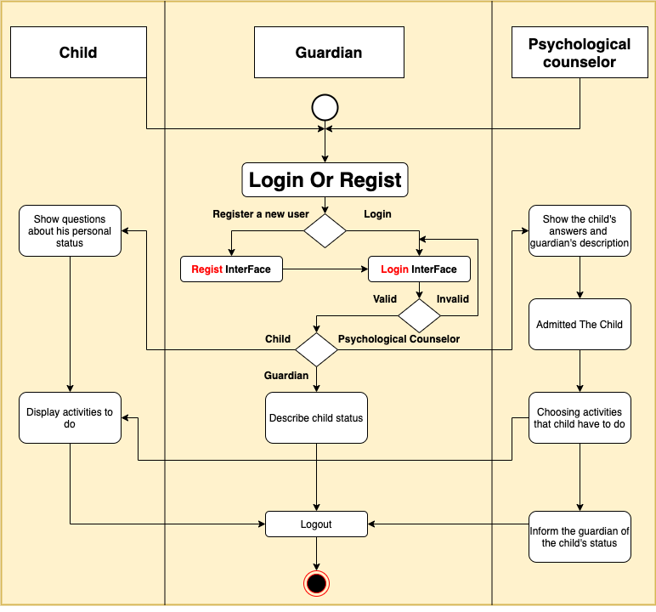
Activity Diagram
Notes:
Mustfa

Slide 6
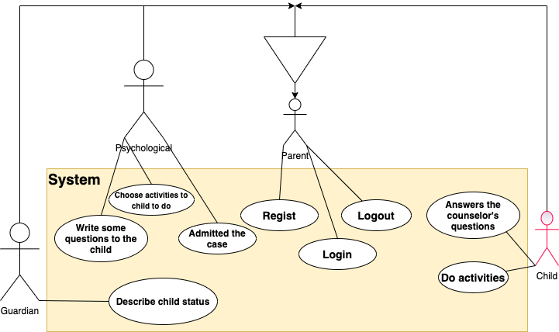
Use Case Diagram
Notes:
Allaham

Slide 7
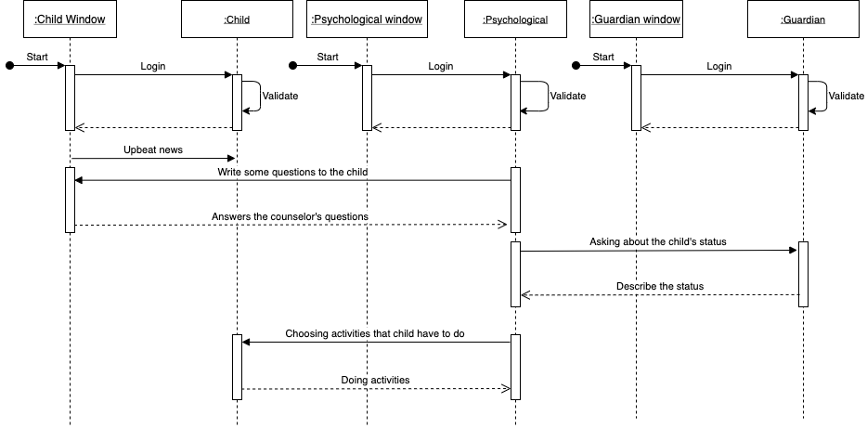
Sequence diagram
Notes:
Batool

Slide 8
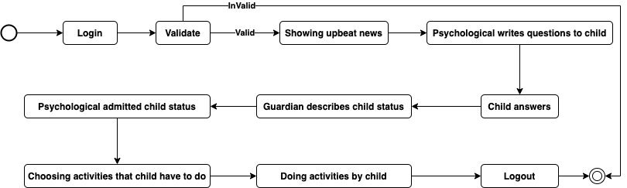
State Diagram
Notes:
Diaa

Slide 9
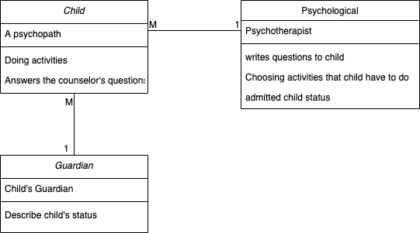
Class Diagram
Notes:
Batool

Slide 10


Thank You
Teams participates:
Mohammad AbuDayeh
Mohammad Allahham
Batool Hodrob
Diaa Khasawneh
Mustafa abdo

