Slide 1
1. 篩選特定股票

Slide 2

輸入輸入網頁

Slide 3
輸入篩選條件
不輸入股票號
英文 | 中文 | 條件 | 數值 | 注意
HK Stock Code | 香港股票代碼 | 等於 (equal to) |  | 可以直接輸入代碼 , 若空置代表全部股票
Trade date | 交易日期 | 等於 (equal to) | 20210105 | 有日曆選擇, 今天至過去一年
Vol | 成交量(股) | 大於或等於 (greater than or equal to) | 180000 | i.e. 200000
10SMA>20SMA>50SMA (Y/N) | 10天線>20天線>50天線 (Y/N) | 等於 (equal to) | Y | i.e. Y/N
10SMA-20SMA= | 10天線-20天線= | 大於或等於 (greater than or equal to) | 10% | i.e. 10%
10SMA-20SMA= | 10天線-20天線= | 少於或等於 (less than or equal to ) | 1% | i.e. 10%
20SMA-50SMA= | 20天線-50天線= | 少於或等於 (less than or equal to ) | 10% | i.e. 10%
20SMA-50SMA= | 20天線-50天線= | 大於或等於 (greater than or equal to) | 1% | i.e. 10%
No. of days of 10SMA>20SMA>50SMA | 最近連續 : 10天線>20天線>50天線 (天) | 等於 (equal to) / 少於或等於 (less than or equal to ) / 大於或等於 (greater than or equal to) | 4 | i.e. 5
14RSI | 14天相對強弱指數 | 等於 (equal to) / 少於或等於 (less than or equal to ) / 大於或等於 (greater than or equal to) | 46.2 | i.e. 45.553
9SMA (14 RSI) | 過去9天相對強弱指數移動平均線 | 少於或等於 (less than or equal to ) / 大於或等於 (greater than or equal to) | 50 | i.e. 45.553
14RSI÷9SMA-1 (%) | (14天相對強弱指數÷9天相對強弱指數)-1 (%) | 大於或等於 (greater than or equal to) | -5% | 雙重條件, 以找出範圍內股票 | 少於或等於 (less than or equal to ) | 15%
MACD (12, 26) | 指數平滑異同移動平均線 (12, 26) [快線] | 少於或等於 (less than or equal to ) / 大於或等於 (greater than or equal to) | -0.009 | i.e. -0.009
9-EMA of MACD | 指數平滑異同移動平均線 (9) [慢線] | 少於或等於 (less than or equal to ) / 大於或等於 (greater than or equal to) | 0.02 | i.e. 0.023
Diff | 指數平滑異同移動平均線 (12, 26) - 指數平滑異同移動平均線 (9) | 少於或等於 (less than or equal to ) / 大於或等於 (greater than or equal to) | 0.001 | i.e. 0.023
MOM or MTM (interval 10) | 動力指標 (預設值:10) | 少於或等於 (less than or equal to ) / 大於或等於 (greater than or equal to) | -0.3 | i.e. -0.500
Avg changing percentage of last 4 days | 過去4天平均漲跌幅(%) | 少於或等於 (less than or equal to ) / 大於或等於 (greater than or equal to) | 0.4 | i.e. +0.345%
ROC (interval 10) | 變動速度指標 (預設值:10) | 少於或等於 (less than or equal to ) / 大於或等於 (greater than or equal to) | 1 | i.e. 1
+DI - (-DI) | 正動向指數 - 負動向指數 | 少於或等於 (less than or equal to ) / 大於或等於 (greater than or equal to) | -20 | i.e. -40
"+DI - (-DI)" - ADX | 正動向指數 - 負動向指數 - 平均動向指數 | 少於或等於 (less than or equal to ) / 大於或等於 (greater than or equal to) | -15 | i.e. -25
Close > BB upper (+-%) | 收盤價大於保歷加通道上限 (+-%) | 少於或等於 (less than or equal to ) / 大於或等於 (greater than or equal to) | -5% | i.e. -5.554%
Close > BB middle (+-%) | 收盤價大於保歷加通道中位數 (+-%) | 少於或等於 (less than or equal to ) / 大於或等於 (greater than or equal to) | 25% | i.e. +20.453%
Close > BB lower (+-%) | 收盤價大於保歷加通道下限 (+-%) | 少於或等於 (less than or equal to ) / 大於或等於 (greater than or equal to) | 5% | i.e. +9.444%

Slide 4
設置好篩選條件後, run report
Avg changing percentage of last 4 days | 過去4天平均漲跌幅(%) | 少於或等於 (less than or equal to ) / 大於或等於 (greater than or equal to) | 0.4 | i.e. +0.345%
ROC (interval 10) | 變動速度指標 (預設值:10) | 少於或等於 (less than or equal to ) / 大於或等於 (greater than or equal to) | 1 | i.e. 1
+DI - (-DI) | 正動向指數 - 負動向指數 | 少於或等於 (less than or equal to ) / 大於或等於 (greater than or equal to) | -20 | i.e. -40
"+DI - (-DI)" - ADX | 正動向指數 - 負動向指數 - 平均動向指數 | 少於或等於 (less than or equal to ) / 大於或等於 (greater than or equal to) | -15 | i.e. -25
Close > BB upper (+-%) | 收盤價大於保歷加通道上限 (+-%) | 少於或等於 (less than or equal to ) / 大於或等於 (greater than or equal to) | -5% | i.e. -5.554%
Close > BB middle (+-%) | 收盤價大於保歷加通道中位數 (+-%) | 少於或等於 (less than or equal to ) / 大於或等於 (greater than or equal to) | 25% | i.e. +20.453%
Close > BB lower (+-%) | 收盤價大於保歷加通道下限 (+-%) | 少於或等於 (less than or equal to ) / 大於或等於 (greater than or equal to) | 5% | i.e. +9.444%
Run Report
按掣
Run Report

Slide 5
得出結果
符合條件之股票
股票代號 | 股票代號 | 檔案下載
00001.hk | 長和 | 下載
01234.hk | XXXX | 下載
03444.hk | XXXX | 下載
05864.hk | XXXX | 下載
08888.hk | XXXX | 下載
 |  | 全部下載
Run Report

Slide 6
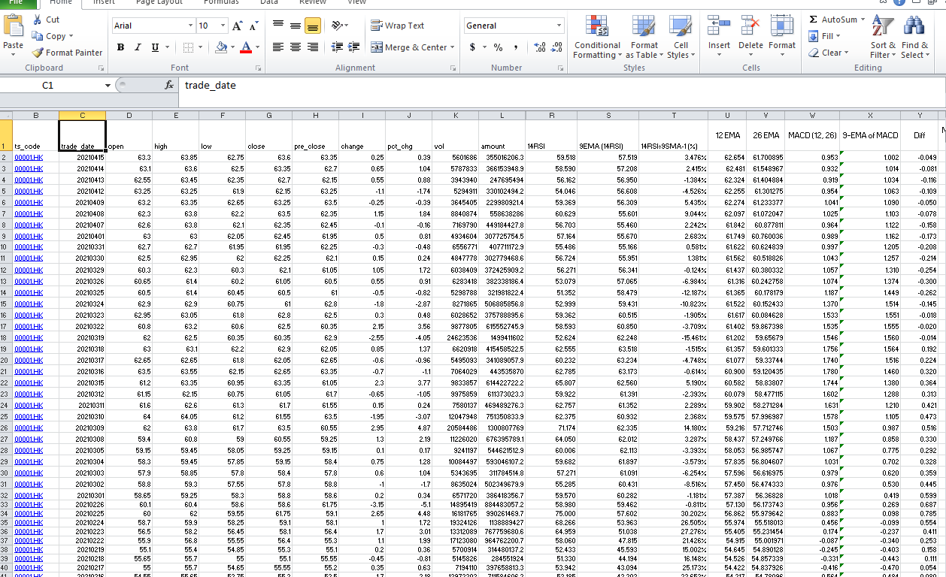
下載檔案樣本
Run Report

Slide 7
2. 選擇指定股票

Slide 8
輸入篩選條件
英文 | 中文 | 條件 | 數值 | 注意
HK Stock Code | 香港股票代碼 | 等於 (equal to) | 00001.hk | 可以直接輸入代碼 , 若空置代表全部股票
Trade date | 交易日期 | 等於 (equal to) | 20210105 | 有日曆選擇, 今天至過去一年
Vol | 成交量(股) | 少於或等於 (less than or equal to ) / 大於或等於 (greater than or equal to) |  | i.e. 200000
10SMA>20SMA>50SMA (Y/N) | 10天線>20天線>50天線 (Y/N) | 等於 (equal to) |  | i.e. Y/N
10SMA-20SMA= | 10天線-20天線= | 大於或等於 (greater than or equal to) |  | i.e. 10%
10SMA-20SMA= | 10天線-20天線= | 少於或等於 (less than or equal to ) |  | i.e. 10%
Run Report
其餘留白
按掣
Run Report

Slide 9
得出結果
符合條件之股票
股票代號 | 股票代號 | 檔案下載
00001.hk | 長和 | 下載
 |  | 全部下載
Run Report

Slide 10
下載檔案樣本
Run Report

Slide 11
3. 選擇當天全部股票

Slide 12
輸入篩選條件
英文 | 中文 | 條件 | 數值 | 注意
HK Stock Code | 香港股票代碼 | 等於 (equal to) |  | 可以直接輸入代碼 , 若空置代表全部股票
Trade date | 交易日期 | 等於 (equal to) | 20210105 | 有日曆選擇, 今天至過去一年
Vol | 成交量(股) | 少於或等於 (less than or equal to ) / 大於或等於 (greater than or equal to) |  | i.e. 200000
10SMA>20SMA>50SMA (Y/N) | 10天線>20天線>50天線 (Y/N) | 等於 (equal to) |  | i.e. Y/N
10SMA-20SMA= | 10天線-20天線= | 大於或等於 (greater than or equal to) |  | i.e. 10%
10SMA-20SMA= | 10天線-20天線= | 少於或等於 (less than or equal to ) |  | i.e. 10%
Run Report
只入日期
按掣
Run Report

Slide 13
得出結果
符合條件之股票
股票代號 | 股票代號 | 檔案下載
ALL | ALL | 下載
Run Report

Slide 14
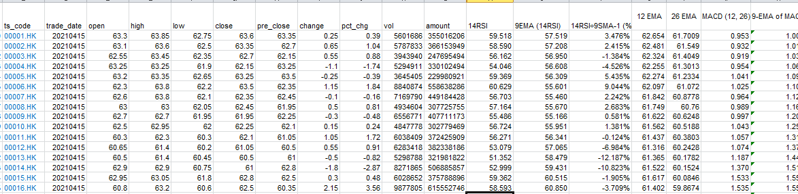
下載檔案樣本
Run Report

