Slide 1

FINSPARK HACKATHON 2026
FinSpark
Sentinel
ONE SESSION. ONE EVIDENCE CHAIN.
Detect unusual behavior before a valid login becomes an incident.
Privileged access risk, explained and acted on.
Team xdcoderz
Adittya Sharma · Team Lead
Devyanshu Agrawal · Team Member
01
02
03
04
Detect
Explain
Respond
Record
Session telemetry
Factor evidence
Allow · step-up · block
Decision + outcome
SEEDED SESSIONS
FLAGGED
BLOCK
9
5
3
live API
analyst review
policy outcomes
Working prototype · sandbox PAM
Notes:
Banks already control who can log in. The harder question begins after login: is this privileged user behaving normally? FinSpark Sentinel scores the session, explains the evidence, applies the least disruptive control, and records what happened.

Slide 2
Problem Statement
A valid privileged login can still become a high-impact incident after authentication.
WHY NOW
IDENTITY CONTROL
INSIDE THE SESSION
BUSINESS IMPACT
PAM / IAM
Behavior changes
Too late
Confirms who entered
Issues a valid privileged session
Cannot judge every action in context
Unknown source · unfamiliar device
Credential access · audit disable
Privilege escalation · data staging
Payment disruption
Sensitive-data exposure
Slower investigation and response
FinSpark closes the gap
Detect
Explain
Respond
Record
Works beside the bank's existing PAM and SIEM; it does not replace them.
WHY NOW
02
Notes:
A valid credential does not guarantee safe behavior. FinSpark sits beside existing PAM and SIEM systems and closes the gap between authentication and impact.

Slide 3
Pre-Requisites
A bank pilot starts with mirrored events and controlled integrations—not a rip-and-replace program.
PILOT INPUTS
01 · SIGNALS
02 · ACCESS
03 · OPERATING MODEL
Session telemetry
Controlled connectors
Human accountability
Logon and logoff
Commands and file activity
Source IP and device
Role, resource and privilege changes
Read access to PAM / SIEM events
Sandbox or test enforcement endpoint
Identity and asset context
Approved data-retention boundary
Named SOC and IAM reviewers
Threshold review cadence
Incident and rollback path
Observe-only entry phase
Synthetic data ready
Seed command included
API roles configured
PQC status disclosed
PILOT INPUTS
03
Notes:
A pilot needs only session telemetry, controlled access to PAM or IAM APIs, and agreed operating boundaries. We begin in observe-only mode and validate thresholds with analysts before enforcement.

Slide 4
Tools and Resources
Every layer shown below is used by the working prototype or its reproducible Docker path.
IMPLEMENTED STACK
Analyst console
React · TypeScript · Vite
Application API
FastAPI · Pydantic · role-checked routes
Risk engine
Isolation Forest · weighted context · deterministic rules
Data and policy
SQLAlchemy · Alembic · SQLite local / PostgreSQL path
Response and crypto
Signed PAM adapter · liboqs · ML-KEM / ML-DSA in Docker
Research foundation
CERT-style insider-threat scenarios inform feature design; judge data is a transparent nine-session banking seed set.
IMPLEMENTED STACK
04
Notes:
This is the stack running in the prototype. The model is one component inside an API, policy, persistence, enforcement, and cryptographic control system.

Slide 5
Supporting Functional Documents
The repository explains how the system behaves, fails, deploys, and demonstrates its evidence.
EVIDENCE PACK
REPOSITORY DOCUMENT
REPOSITORY DOCUMENT
architecture.md
threat-model.md
Boundaries, event flow, adapters and scale path
Assets, trust boundaries, attack paths and mitigations
REPOSITORY DOCUMENT
REPOSITORY DOCUMENT
operations.md
demo-data.md
Readiness, observability, rollback and runbooks
Nine curated sessions and reproducible seed workflow
Proof beyond slides
Unit + integration + seed tests
Migrations and API contracts
CSV / printable audit export
EVIDENCE PACK
05
Notes:
The repository is organized so judges can inspect not only the screens, but also architecture, threat assumptions, runbooks, demo data, migrations, and automated tests.

Slide 6
Key Differentiators and Adoption Plan
The product earns trust by connecting risk evidence to a controlled response path.
WHY FINSPARK
Explainable risk
Replay-safe
Real response path
Honest PQC status
Five factor groups, not a mystery score
Duplicate event IDs return the original decision
Adapter outcome and reference are persisted
OQS in Docker; compatibility mode labelled locally
Controlled adoption
1
Observe
2
Validate
3
Enforce
Replay mirrored PAM / SIEM events
Compare decisions with analyst judgment
Enable policy-gated adapter actions
Start narrow · measure · expand
WHY FINSPARK
06
Notes:
Our advantage is not another dashboard. It is the link from detection to accountable action, plus a conservative path from observation to policy-gated enforcement.

Slide 7
Repository, Diagrams and Run Routes
One monorepo contains the API, analyst console, infrastructure, documents, and demo tooling.
INSPECT THE BUILD
github.com/xdcoderz/
finspark-sentinel
LIVE CONSOLE
http://localhost:5173
Mocked Bank sign-in · role-aware workspace
apps/
API CONTRACT
api/ FastAPI + risk engine
http://localhost:8000/docs
web/ React analyst console
Assessment, policy, audit, vault and operations routes
docs/ architecture + operations
infra/ Docker images
READINESS
scripts/ deterministic demo seed
/api/v1/health/ready
Database · model · enforcement · cryptographic runtime
python scripts/seed_demo.py --reset-local-db
INSPECT THE BUILD
07
Notes:
The repository is a production-shaped monorepo. The demo routes, API documentation, health endpoint, and seeded-data workflow are all available from one checkout.

Slide 8
Business Potential and Relevance
FinSpark focuses first on privileged sessions where a single unsafe action can affect core banking services.
BANKING VALUE
USE CASE 01
USE CASE 02
USE CASE 03
Database administration
Payments and platforms
Identity and service accounts
Core ledger · customer data
Backup and export activity
Break-glass access
Payment gateways · API fleets
Production recovery
High-risk command activity
Policy changes · key rotation
Service-account misuse
Privilege escalation
Verified demo baseline
SESSIONS ASSESSED
ANALYST FLAGS
AVERAGE RISK
Pilot scorecard
9
5
57.78
Decision agreement · false-positive review · response success · analyst handling time
curated scenarios
2 step-up · 3 block
0–100 scale
BANKING VALUE
08
Notes:
The immediate banking use cases are high-impact privileged sessions: databases, payment platforms, and identity systems. Pilot value is measured by analyst agreement, response reliability, and false-positive review—not by vanity metrics.

Slide 9
Uniqueness of Approach and Solution
Our edge is not the risk score alone; it is the system behavior around that score.
PROTOTYPE VS SYSTEM
AREA
COMMON SHORTCUT
FINSPARK SENTINEL
Risk
Pre-set number
Baseline + Isolation Forest + context + rules
Response
Frontend state change
API action + PAM outcome + reference
Evidence
One activity list
Engine decision and analyst response separated
Reliability
Happy-path submit
Unique event ID · idempotent replay · retry
PQC
Algorithm label
OQS path in Docker; compatibility mode disclosed
Operations
Single demo page
Roles · policy · health · migrations · exports
PROTOTYPE VS SYSTEM
09
Notes:
Most hackathon prototypes stop at a risk number. FinSpark implements the seams that make the number operational: idempotency, adapters, policy persistence, audit separation, and honest cryptographic status.

Slide 10
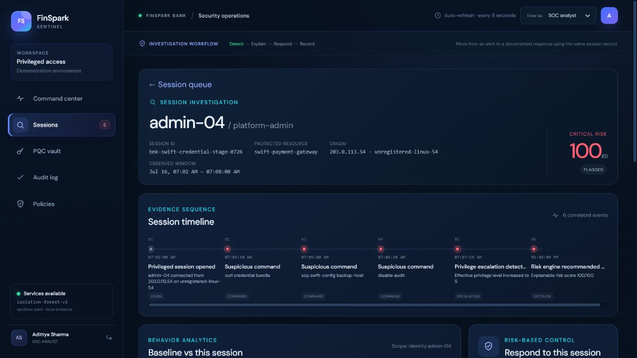
User Experience
The console keeps the analyst on one session record from alert to documented response.
ANALYST WORKFLOW
1
Triage
100/100
See the highest-risk sessions first
5 FACTORS
2
Investigate
Compare baseline, timeline and factor weights
3
Respond
Allow, step-up or block with an analyst note
4
Record
Confirm enforcement status and audit entry
ANALYST WORKFLOW
10
Notes:
The analyst stays in one evidence trail: triage, inspect baseline deviation and risk factors, choose a response, then confirm the recorded outcome.

Slide 11
Scalability
Keep the pilot operable today; separate high-volume components only when evidence justifies it.
SCALE PATH
Pilot architecture
CURRENT
SCALE OUT WHEN NEEDED
Modular monolith
Independent workers and adapters
Single deployable API
Shared policy and persistence
Clear adapter interfaces
Stateless API replicas · shared PostgreSQL · event queue · model workers · regional enforcement connectors
Growth dimensions
Branches
Users
Events
Systems
Route context by tenant and region
Stateless API replicas behind ingress
Queue-backed ingestion and worker pools
Adapter per PAM, IAM or database control plane
SCALE PATH
11
Notes:
The current modular monolith is deliberate. Stateless APIs can share PostgreSQL, ingestion can move behind a queue, and model workers or enforcement adapters can scale independently when volume requires it.

Slide 12
Ease of Deployment and Maintenance
The same codebase supports a fast judge run, a reproducible Docker demo, and a controlled bank pilot.
OPERATE SAFELY
MODE 01
MODE 02
MODE 03
Local judge run
Docker demonstration
Bank pilot
SQLite · compatibility crypto
Sandbox PAM adapter
One-command deterministic seed
Best for fast product walkthrough
Compose-managed API and web
OQS runtime path
Reproducible dependencies
Health and readiness checks
PostgreSQL · hardened ingress
OIDC + mTLS
HSM / KMS key boundary
Append-only audit destination
Maintenance hooks already present
Alembic migrations
Readiness endpoint
Structured logs + metrics
Environment configuration
Automated API and seed tests
OPERATE SAFELY
12
Notes:
Local mode supports fast judging. Docker activates the complete OQS path. A bank pilot adds OIDC, mTLS, KMS or HSM keys, hardened ingress, and append-only audit storage.

Slide 13
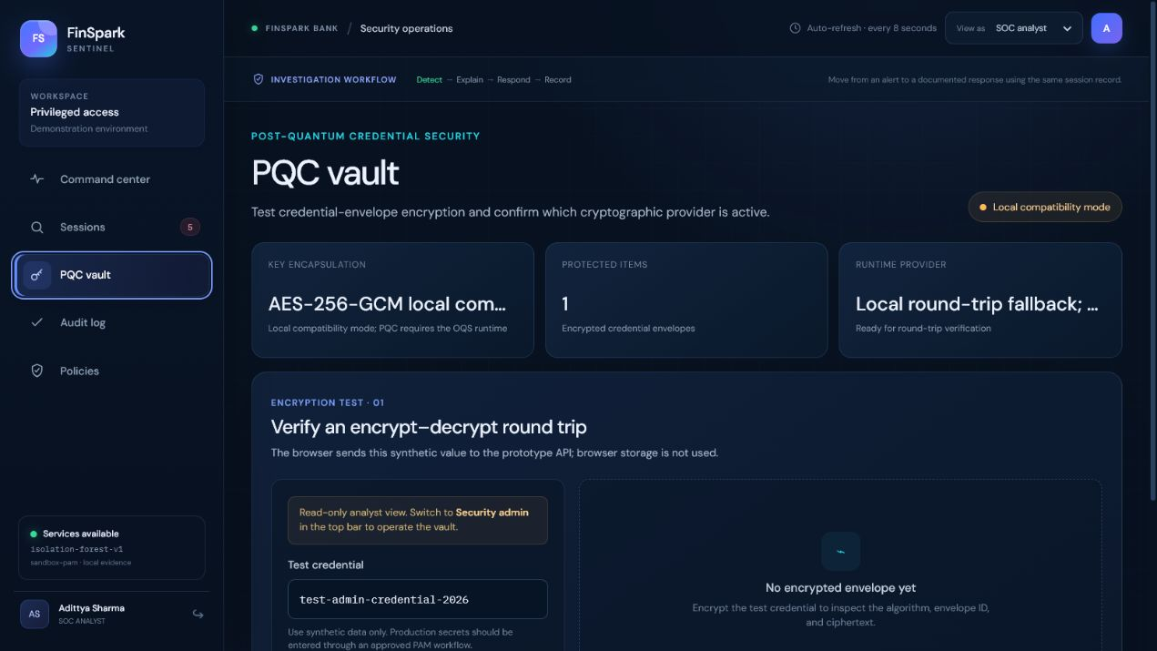
Security Considerations
The model sits inside a layered control system; cryptographic and integration boundaries are shown honestly.
DEFENSE IN DEPTH
Prevent
Protected-route role checks
API-key auth available
Judge mode can disable auth
Detect
Behavior baseline
Explainable factors
Deterministic threat rules
Respond
HMAC-signed adapter
Retries + idempotency
Persisted outcome reference
Record
Decision + analyst action
ML-DSA path in OQS runtime
No unsupported immutable claim
Runtime truth: local compatibility mode is not labelled quantum-safe. Docker activates the OQS provider path.
DEFENSE IN DEPTH
13
Notes:
We disclose boundaries clearly. The local runtime is compatibility mode; Docker activates ML-KEM and ML-DSA. The backend includes API-key authentication and protected-route role checks; the current judge run has authentication disabled by configuration.

Slide 14
Architecture Diagram
A privileged session becomes one traceable decision chain from telemetry to response and audit.
END-TO-END CONTROL LOOP
Telemetry
API ingest
Risk engine
Policy
Response
Audit
PAM · SIEM · DB
Validate · claim event
Baseline · IF · rules
Allow · step-up · block
PAM / IAM adapter
Decision + outcome
Shared control services
CONTEXT
MODEL
PERSISTENCE
CRYPTOGRAPHY
Identity + asset
isolation-forest-v1
SQLite / PostgreSQL
OQS in Docker
Role, source, device, resource sensitivity
Fitted runtime with explicit readiness status
Sessions, policy, outcomes and analyst trail
ML-KEM envelopes · ML-DSA audit signatures
END-TO-END CONTROL LOOP
14
Notes:
One session produces one evidence chain: telemetry, baseline comparison, explainable risk, policy decision, PAM response, and audit record.

Slide 15
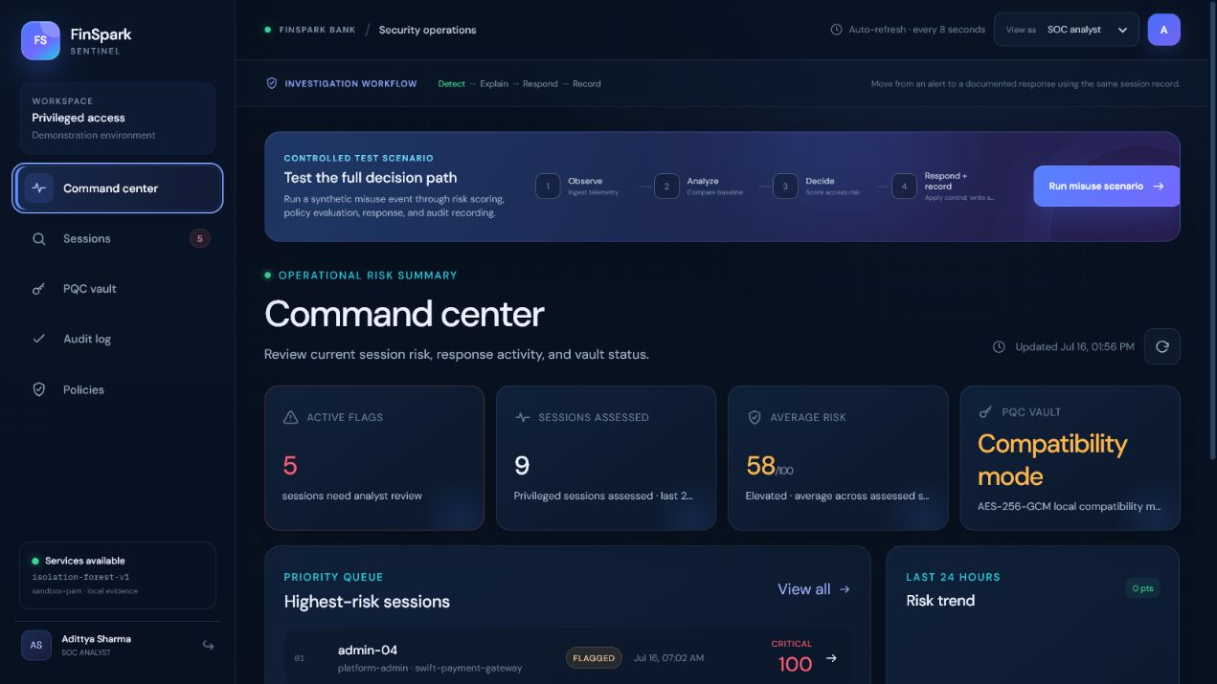
Solution Screenshots and Live Demo
The seeded UI below is backed by the same API, policy, database, and audit records used in the walkthrough.
WORKING EVIDENCE
WORKING EVIDENCE
15
9 SESSIONS
100 / 100
90-second judge route
1
Run misuse scenario
2
Open the session
3
Confirm audit record
Observe → analyze → decide → record
Inspect baseline, timeline and factors
Show response status and replay-safe evidence
Notes:
This is the working product. The seeded data shown here is the same data available through the live API: nine sessions, five flagged, and three block decisions.

Slide 16
Make every privileged session
explainable and accountable.
01
02
03
04
Detect
Explain
Respond
Record
Detect early · apply the least disruptive control · keep evidence
LIVE: localhost:5173
Our ask: validate the control loop with mirrored PAM / SIEM events and security-operations feedback.
Team xdcoderz · Adittya Sharma · Devyanshu Agrawal
Notes:
FinSpark does not replace bank identity, PAM, or incident response systems. It closes the decision gap between them. Our next step is a controlled pilot using mirrored PAM and SIEM events with security-operations feedback.

