Slide 1
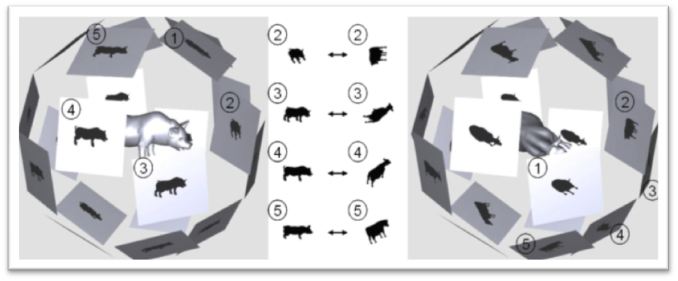
On Visual Similarity Based 3D Model Retrieval
Boyan Endrovski
Stefan Hospes

Slide 2
Overview
Method Overview
  Lightfield descriptors
  Image Processing
  Comparing
Proof of Correctness
Program Demonstration
Implementation
Conclusion

Slide 3
Method Overview
Statement:
“If two 3D models are similar, they also look similar from all viewing angles.”
Goal:
Comparing similarity of 3d models using lightfield descriptors.

Slide 4

Method – Lightfield Descriptors
In short a lightfield descriptor is:
  4D Representation of a
  3D Object using a set of
  2D Images
3D Model rendered
  Multiple camera’s
  Camera’s distributed uniformly
2D Images are extracted

Slide 5
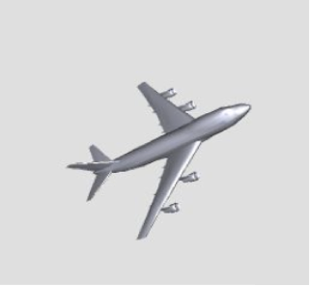
Method – Lightfield Descriptors

Slide 6
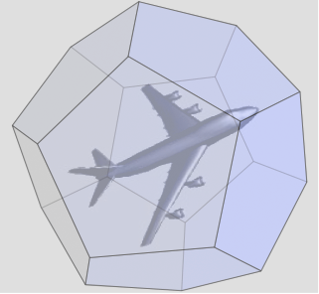
Method – Lightfield Descriptors
Dodecahedron (20 points)

Slide 7
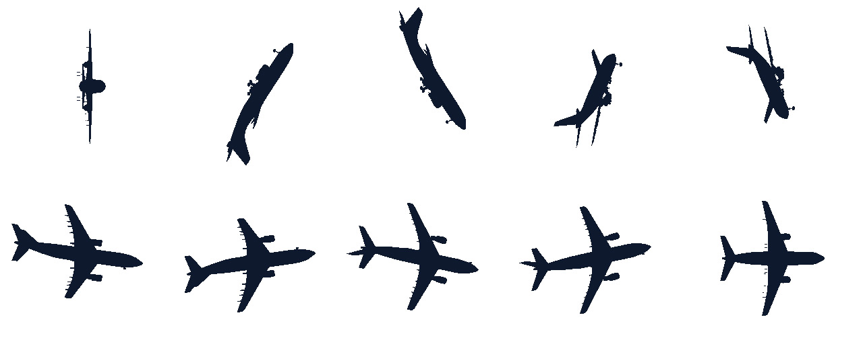
Method – Lightfield Descriptors

Slide 8
Method – Lightfield Descriptors
A set of Lightfield descriptors is used
  Different orientations
  Robustness against rotations
Feature vectors extracted from images
  Contour / Region based methods
  Fourier
  Zernike
These are used to compare images
Notes:
In the paper, they use 10 Lightfield descriptors, we as well.

Slide 9

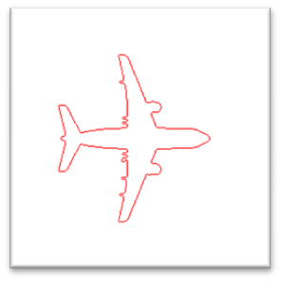
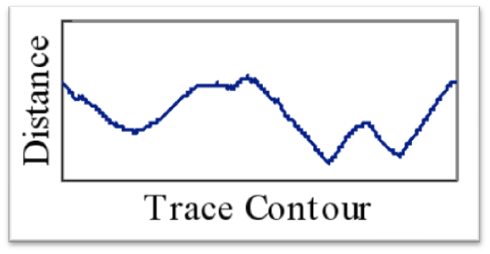
Method – Fourier Descriptors
Contour based descriptor
  Boundary traced
  Centroid distance computed
  1D signal extracted
Fourier
  Signal described as combined frequencies

Slide 10
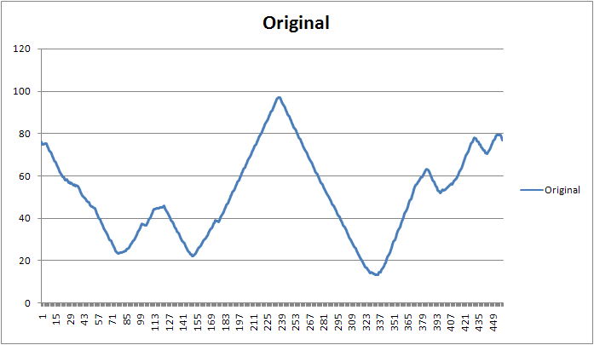
Method – Proof of Correctness
Fourier results

Slide 11
Method – Proof of Correctness
Fourier results
<double>50.859683207908304</double>
<double>1.9924127134385032</double>
<double>12.509206556102793</double>
<double>5.2503052377636994</double>
<double>3.8635064590383537</double>
<double>1.7149455948809431</double>
<double>1.233363744106678</double>
<double>2.3046485989726238</double>
<double>0.542737497561154</double>
<double>0.52505654953251657</double>
<double>0.48796749689123547</double>
<double>0.44239059908830047</double>
<double>0.59497865566300556</double>
<double>0.38957044475978114</double>
<double>0.30550987848332251</double>
<double>0.08958360393490479</double>

Slide 12
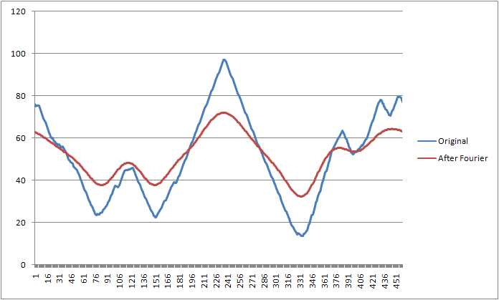
Method – Proof of Correctness
Fourier results

Slide 13
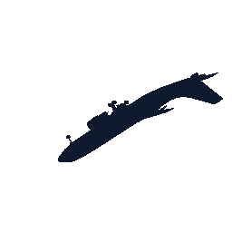





Method – Proof of Correctness
Fourier = Rotation/Scale invariant
<double>0.00909101292477597</double>
<double>0.33377416726489373</double>
<double>0.033445556292064492</double>
<double>0.045493341409796793</double>
<double>0.012047234881232405</double>
<double>0.00909101292477591</double>
<double>0.33377416726489384</double>
<double>0.033445556292064374</double>
<double>0.04549334140979687</double>
<double>0.012047234881232183</double>
<double>0.0090515607462757271</double>
<double>0.33186307947323773</double>
<double>0.032583782370948521</double>
<double>0.045375113543610478</double>
<double>0.012971825485817138</double>

Slide 14

Method – Proof of Correctness
Fourier = Rotation/Scale invariant
<double>0.00909101292477597</double>
<double>0.33377416726489373</double>
<double>0.033445556292064492</double>
<double>0.045493341409796793</double>
<double>0.012047234881232405</double>
<double>0.14760912860262174</double>
<double>0.054299788608528632</double>
<double>0.2459447191191097</double>
<double>0.1068753353845613</double>
<double>0.077408586674172539</double>

Slide 15
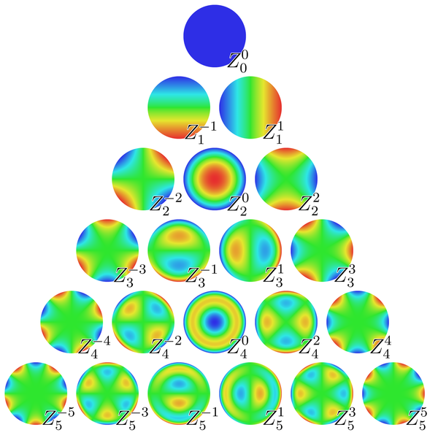
Method – Zernike Descriptors
Region based descriptor
  Based on Zernike polynomials, orthogonal complex polynomials over the unit circle
  Rotation invariant
  Z_{n,-m}= Z*_{n,m}
  Only the modulus is being used

Slide 16
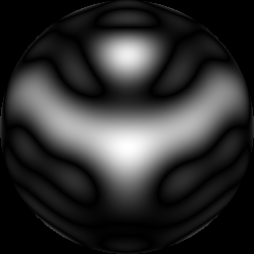
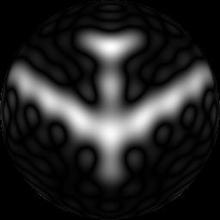

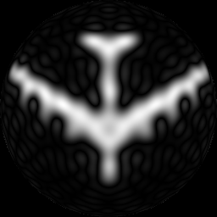


Method – Proof of Correctness
Zernike proof
  By Image Reconstruction
Order 10
Order 20
<double>0.11041978553845756</double>
<double>0.28669038237158623</double>
<double>1.9485392343684422</double>
<double>0.17137337451985807</double>
<double>0.08786023288070037</double>
<double>0.0511079113421742</double>
…
Order 30

Slide 17


Method – Proof of Correctness
Rotation invariance
<double>0.13801994359165026</double>
<double>0.23142015396153173</double>
<double>1.488189179167015</double>
<double>0.21304617617974997</double>
<double>0.03847727066391067</double>
<double>0.23715623304652408</double>
<double>0.13801994359165026</double>
<double>0.23142015396153173</double>
<double>1.488189179167015</double>
<double>0.21304617617974997</double>
<double>0.03847727066391067</double>
<double>0.23715623304652408</double>

Slide 18
Method – Comparing Images
Fourier and Zernike combined
  Weighting factor
fz={α·FD₁, α·FD₂, ... , α·FD_{m}, β·z₁, β·z₂, ... ,β·z_{n} }
Euclidian distance computed

Slide 19
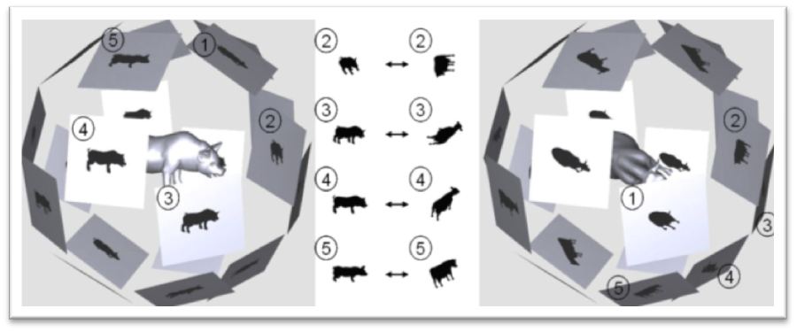
Method – Comparing Lightfields
Each 3d Model has 10 lightfields (random orientations)
Each lightfield consists of 10 images for the 20 views
  Lightfields distance = Sum distance images
Compare each pair of lightfields
Use the smallest distance found
Notes:
- Distance images is computed of images with same viewing angles
- “Repeat until” will be explained in last section (problems encountered)_x0013_

Slide 20
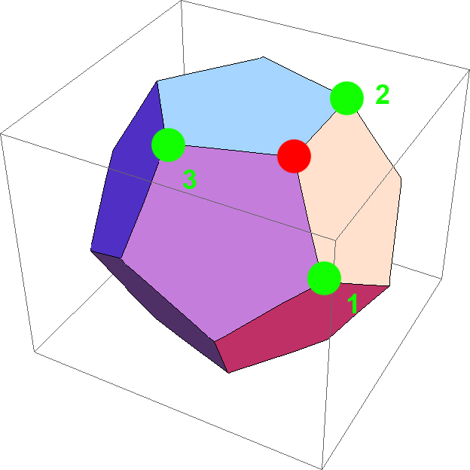

Measuring similarity
Each lightfield can be used to represent 60 rotations, one is optimal
Combinatorial problem, solved by doing a breadth-first search on the dodecahedron graph

Slide 21

Program demonstration

Slide 22
Implementation
.NET based (and couple of shell scripts)
3 Step process
  Rendering
  Extracting features from the images
  Measuring similarity

Slide 23
Rendering
Done in hardware with DirectX (XNA)
Pseudo random orientations
  First one is the original orientation
Framing into the unit circle

Slide 24
Extracting features from the images
Fourier coefficients
  Can extract any number of coefficients
  Lower order coefficients describe overall shape
  Higher order coefficients describe small features
Zernike coefficients
  Up to order 10 (36)
  Multiple passes through the image (performance issues)
    Image access API and Multithreading
    Early outs
    Caching the Zernike polynomials

Slide 25
Conclusion
Method can correctly compute distance between 3D models using lightfield descriptors
Prime candidate for GPGPU CUDA

