Slide 1
Virtualization and Concurrency
Zhengwei QI
Shanghai Jiao Tong University
2008-11-12

Slide 2
Agenda
Virtualization based security
Model checking for concurrency bugs

Slide 3
Security vs. Hardware Virtualization
1st Generation – SVM, VT-X
  VMM no longer need to run the VM kernel under binary translation
  Security Trade off – Code Breakpoint, Guest code patching (while translating), Control flow visibility
2nd Generation – NPT, EPT
  VMM no longer need to have software based MMU
  Security Trade off – Tracking LA->PA mapping is becoming expensive, resulting with inability to operate on linear addresses.
3rd Generation – IO MMU, VT-D
  VMM can assign physical devices to VMs without worry of VM escape or hypervisor corruption
  Security Trade off – Interposition on the pass-thru device is eliminated

Slide 4
Hardware vs. Software virtualization
S/W based (x86)
Requires ‘emulation’ of guest’s privileged code
  can be implemented very efficiently: Binary Translation (BT)
Does not allow full virtualization
  sensitive unprivileged instructions (SxDT)
Widely used today
  VMWare, VirtualPC
H/W virtualization
VT-x (Intel IA32)
SVM/Pacifica (AMD64)
Does not require guest’s priv code emulation
Should allow for full virtualization of x86/x64 guests
Still not popular in commercial VMMs

Slide 5
Full VMMs vs. “Thin” hypervisors
Full VMMs
Create full system abstraction and isolation for guest,
Emulation of I/O devices
  Disks, network cards, graphics cards, BIOS…
Trivial to detect,
Usage:
  server virtualization,
  malware analysis,
  Development systems
“Thins hypervisors”
Transparently control the target machine
Based on hardware virtualization (SVM, VT-x)
Isolation not a goal!
  native I/O access
  Shared address space with guest (sometimes)
Very hard to detect
Usage:
  stealth malware

Slide 6
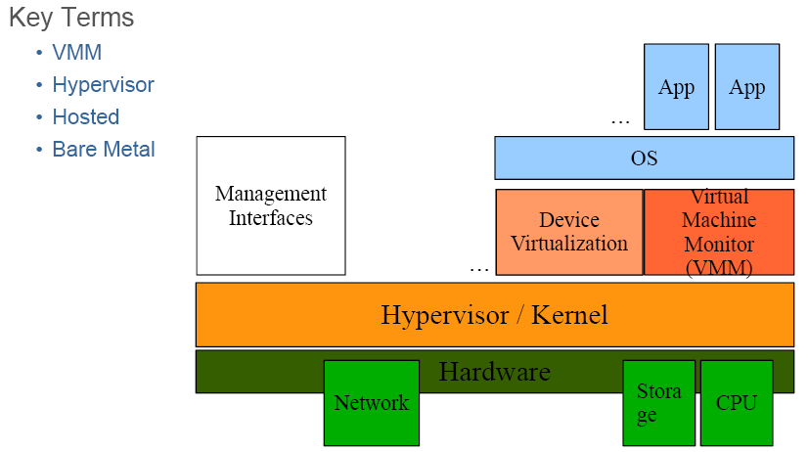
Thin hypervisors

Slide 7
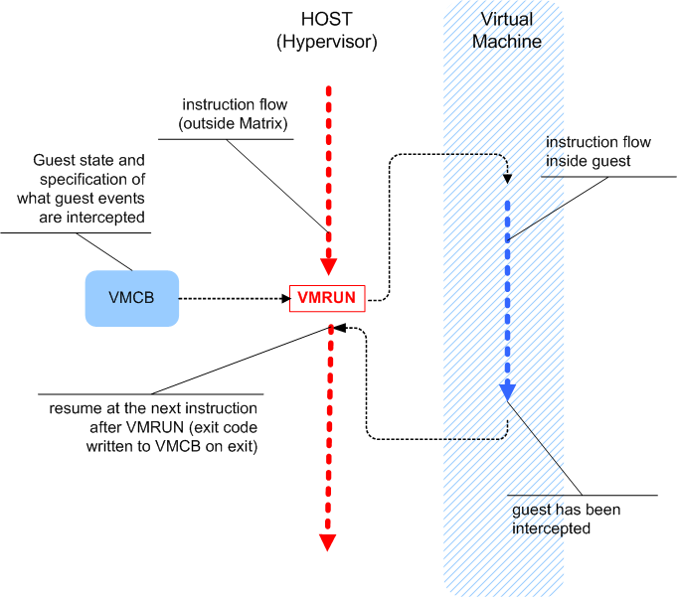
The heart of SVM: VMRUN instruction

Slide 8
Control target OS
If we manage to run the target OS inside a hardware hypervisor controlled by ourselves…
we can bypass all the OS-provided prevention technologies
  kernel prevention
  anti-debugging
It does not matter what OS is running inside
  we control the guest’s memory
  we control the guest’s I/O
  we can set hardware breakpoints

Slide 9
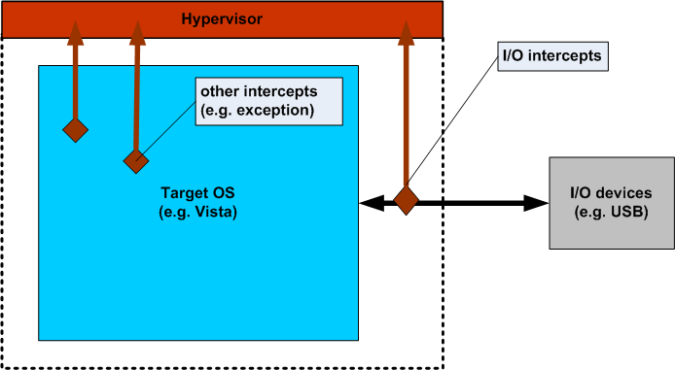
Controlling the target OS

Slide 10
Idea: Protecting Special Process
Problem: In Cloud Computing, if the server’s OS was attacked, how to guarantee the security of Application like Bank Transaction.
Using VM to protect process’s data [ASPLOS’08]
Our Solution: Using VM to protect memory and IO
  Hypervisor uses Root model, Windows uses Non-root model(kernel in Ring 0, App. In Ring 3)
  Monitor target process’s memory by System Call/EPT
  Monitor target process’s IO by VT-d

Slide 11
Agenda
Virtualization based security
Model checking for concurrency bugs

Slide 12
Three types of non-deadlock concurrency bugs
Atomicity Violation
  Since programmers think sequentially, they tend to assume that
Order Bugs
  It is also common for programmers to assume an order between two operations from different threads, but programmers may forget to enforce such an order.
Performance Bugs
  In one version of MySQL, programmers use a timeout threshold fatal timeout to detect deadlock. The server will crash, if any thread waits for a lock for more than fatal timeout amount of time.

Slide 13
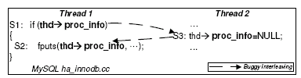
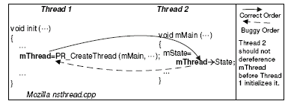


Slide 14
Findings about concurrent bugs[ASPLOS’08]
A significant number (24 out of 74) of the examined non-deadlock concurrency bugs are order bugs, which are not addressed by previous bug detection work.
  New bug detection techniques are desired to address order bugs.
A non-negligible number (34%) of non-deadlock concurrency bugs involve more than one variable.
  We need new concurrency bug detection tools to address multiple variable concurrency bugs.

Slide 15
Existing Works
Lockset algorithm.
  The lockset algorithm checks whether each shared variable in a program is consistently guarded by at least one lock.
  A recent work reports that a lockset algorithm resulted in thousands of false positives for scientic applications.
Happens-before algorithm.
  The happens-before algorithm checks whether accesses to shared variables in a program are ordered by an explicit synchronization operation or not.
  it can detect the data races with no false positives because the analysis is based on whether there are two unordered memory operations or not.
  However, the resulting coverage can be less than the lockset algorithm.

Slide 16
Existing Works (Cont.)
Atomicity Violation Detection
  Determining the atomic regions in itself is a significant challenge. Many techniques require the programmer to explicitly specify the atomic regions through annotations
  SVD and AVIO , the authors used heuristics to infer the atomic regions automatically. They report a high number of false.
Dynamic analysis mechanism on top of iDNA [PLDI2007]
  record and replay a program's execution.
  If the two replays for the two orders produce the same result, then the checker classifies the data race as potentially benign.
MUVI [SOSP2007]
  automatically infers commonly existing multi-variable access correlations through static code analysis
  (1) inconsistent updates
  (2) multi-variable concurrency bugs

Slide 17
Motivation: How to balance?
Less False positive
Static
Dynamic
More path coverage
Happen-before
iDNA
AVIO
Atomicity Violation
LockSet
MUVI
Atomicity Violation
How to combine?
Model Checking

Slide 18
Idea: Specialized model checking
Observation: The multi-thread concurrency bugs are related to the order of access ( Atomicity violation, order bugs, multiple variable bugs,…).
Solution: Only model check the interleaving of access of share variables.
  Only when accessing share variables, it triggers the schedule of model checking.

Slide 19
Walkthrough
Identify the access of share variables.
  io_pending (S1,S2,S3)
Add scheduling points (static or dynamic instrumentation)
  S1: Schedule();io_pending = TRUE;
Model check the scheduling
  S1-> S2->S3
  S1->S3->S2 (error)
  S3->S1->S2
Thread 1: Mozilla macio.c
int ReadWriteProc (…)
{
…
PBReadAsync ( &p);
S1: io_pending = TRUE;
…
S2: while ( io_pending ) {...};
…
}
Thread 2: Mozilla macthr.c
void DoneWaiting (…)
{
...
S3: io_pending = FALSE;
...
}

Slide 20
Challenges -1
Problem: How to identify the share-variables
  Single global and static variables is easy
  Local variables are ignored
  The difficulty are heap variables and complex structures
Possible Solution:
  Static analysis of memory access by Phoenix IR tags
  Dynamic trace and compare the addresses (like some previous methods)
  Combine Both, but how to ?

Slide 21
Challenges -2
Problem: How to reduce the state explosion
  Although we model check the real code, we focus on Scheduling level(not on instruction, block, or function )
  Only interleaving the access of share variables.
  Difficulty: Partial order reduction
Possible Solution:
  Access of two different share variables is independent
  Access of two different locks (required by variables) is independent
  Symbolic scheduling of interleaving

Slide 22
Challenges -3
Problem: How to identify a concurrency bug
  If fail stop, then it will crash or deadlock, which is easy to detect
  otherwise, need some constraints or rules to detect.
  Difficulty: what’s the reasonable constraint
Possible Solution:
  Assertions or Invariants Violation
  Some heuristics (AVIO, MUVI)
  High level LTL properties.

Slide 23
Benefits
Systemically explore the interleaving of share variables and add more code coverage as possible (compare to dynamical analysis)
Real execution of code to avoid false-alarms (compare to static analysis)
Complete to many today’s analysis tech.

Slide 24
Limitations
Only interleaving of share access on scheduling level (may sound, but not complete).
Hard to deal with complex share variables.
Scalability (too many states)

Slide 25
For scalability: Symbolic Scheduling ?
The static analysis can not deal with inter-thread interleaving.
In order to introduce inter-thread analysis, need a symbolic scheduling model.
In a nutshell, scheduling is similar to branch. The former is jumping between threads, while later is jumping in a thread.
Difficulty: How to build a symbolic scheduling model?
  We have known the building of symbolic time scheduling
  Can we extend this to other scheduling problem?

Slide 26
Next steps
Survey static analysis tools
  How to know the access of share variables
  How to deal with heap variables
Survey partial order model checking
  Identify the independent relationship
  partial order reduction
Survey symbolic scheduling
  Follow the symbolic time scheduling

Slide 27
Reference
Shan Lu, Soyeon Park, Eunsoo Seo, Yuanyuan Zhou: Learning from mistakes: a comprehensive study on real world concurrency bug characteristics. ASPLOS 2008: 329-339
Shan Lu, Soyeon Park, Chongfeng Hu, Xiao Ma, Weihang Jiang, Zhenmin Li, Raluca A. Popa, Yuanyuan Zhou: MUVI: automatically inferring multi-variable access correlations and detecting related semantic and concurrency bugs. SOSP 2007: 103-116
Shan Lu, Joseph Tucek, Feng Qin, Yuanyuan Zhou: AVIO: Detecting Atomicity Violations via Access-Interleaving Invariants. IEEE Micro 27(1): 26-35 (2007)
Satish Narayanasamy, Zhenghao Wang, Jordan Tigani, Andrew Edwards, Brad Calder: Automatically classifying benign and harmful data racesallusing replay analysis. PLDI 2007: 22-31
Min Xu, Rastislav Bodík, Mark D. Hill: A serializability violation detector for shared-memory server programs. PLDI 2005: 1-14

Slide 28
Thanks!

