Slide 1
Multi-Token Prediction with Consistency Methods
Selective Distribution Consistency + Latent Consistency Matching
Presenter: 陳九龍

Slide 2
CONTENTS
01
04
Introduction
Experiment Results
Pages 4–7
Pages 18–25
05
02
Related Work
Conclusion & Future Work
Pages 9–12
Pages 27–28
03
Proposed Method
Pages 14–16

Slide 3
Introduction

Slide 4
Part 1: Introduction
Background — Multi-Token Prediction for Faster Generation
The goal of Multi-token prediction (MTP)[1] is to predict not only the next token in a single forward pass, but also future tokens at farther positions using multiple prediction heads.
Input: t₀
Model
(Head 1–k)
Output: t₁… t_{k}
If the next-token prediction head (Head 1) produces predictions consistent with the other prediction heads, multiple tokens can be accepted at once, reducing inference cost and accelerating decoding.

Slide 5
Part 1: Introduction
Motivation — Future-Token Prediction Heads Are Harder to Optimize
Standard MTP trains each prediction head independently using only CE loss, but it lacks an explicit consistency constraint across heads.
Problem
The farther the position predicted by a prediction head, the lower its prediction accuracy.
The farther the position predicted by a prediction head, the more difficult the optimization becomes.
During pre-training, this study adds consistency regularization to the loss function without changing the MTP model architecture, aiming to improve model performance.

Slide 6
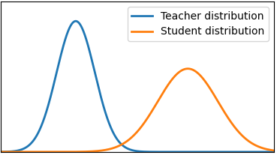
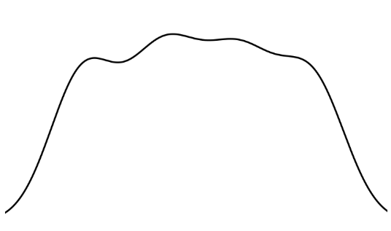
Part 1: Introduction
Research Methods
This experiment uses two consistency methods: Selective Distribution Consistency (SDC) and Latent Consistency Matching (LCM)[2].
SDC
SDC is proposed in this study to align the output probability distributions of the student heads (Heads 2–K) with the teacher head (Head 1).
LCM [2]
Besides probability distribution alignment, LCM reduces the distance between student heads and the teacher head at the latent representation level.
The figure below projects high-dimensional latent representations into 2D to visualize teacher–student distances.
Distribution Alignment
In addition, SDC masks low-confidence tokens from the teacher head (as shown below) and ignores these positions when computing the SDC loss.
Latent Alignment

Slide 7
Part 1: Introduction
Contributions
01
Selective Distribution Consistency
During pre-training, this study introduces SDC as a consistency regularization term. The teacher head's prediction distribution is used to supervise the student heads, improving consistency between their predictions.
02
Improved Head PPL and Draft Acceptance
This study evaluates the proposed method against the baseline using metrics such as Oracle PPL, Average Draft Tokens Accepted, and Generative PPL. Among them, Generative PPL is reduced by about 52%, showing the largest improvement.
03
Joint Training of SDC and LCM
The experimental results show that SDC and LCM can be jointly trained, and no negative effects caused by conflicts between the two methods were observed.

Slide 8
Related Work

Slide 9
Part 2: Related Work
Multi-Token Prediction Architecture
2
3
4
5
outputs:
3
4
5
6
4
5
5
6
6
7
7
8
Head 1
2
3
4
Shared
Inputs:
1
2
3
4
Head 1 corresponds to standard next-token prediction.
The computational cost mainly comes from the shared trunk, while the additional cost of multiple prediction heads is relatively limited. Therefore, decoding can be accelerated by predicting multiple future tokens in a single pass.

Slide 10
Part 2: Related Work
Baseline Training
Without consistency, each head independently computes CE loss only against its corresponding ground-truth token.
Forward
Backward
CE Loss 1
CE Loss 2
… …
CE Loss K
z = model.shared(x)
d = z.detach()
d.requires_grad = True
for i in range(n):
p = model.head[i](d)
loss(p, y[i]).backward()
z.backward(gradient=d.grad)
Head 1
Head 2
… …
Head K
Shared
Advantage: Simple architecture and compatible with the standard LM training workflow.
Limitation: The prediction distributions of Heads 2–K may be inconsistent with the more reliable Head 1.

Slide 11
Part 2: Related Work
Different Forms of MTP
01
Pre-training MTP — Gloeckle et al. [1] Shared trunk + multiple prediction heads → predict multiple future tokens during pre-training
02
Post-training MTP — Samragh et al. [2] Introduce MTP into pretrained LLMs through SFT and consistency objectives → adapting existing models for multi-token prediction
03
Large-scale MTP — DeepSeek-V3 [11] MTP integrated into large-scale pre-training → practical deployment in large-scale LLM training

Slide 12
Part 2: Related Work
MTP Speculative Decoding — From Parallel Prediction to Draft Acceptance
Input: t_{0,} t_{1, …,} t_{n}
Stern et al. [3] proposed blockwise parallel decoding, where multiple future tokens are predicted in parallel and the longest valid prefix is accepted after verification.
MTP model
Head 1
Head 2
Head 3
Tn+1
Tn+2
Tn+3
Connection to This Work
Following this verification principle, we evaluate MTP heads using a self-speculative decoding setting.
Heads 2–K → Draft tokens
Head 1 → Verification reference
Metric → Average Draft Tokens Accepted
Verification
(Head 1 as reference)
Accept longest valid prefix

Slide 13
Proposed Method

Slide 14
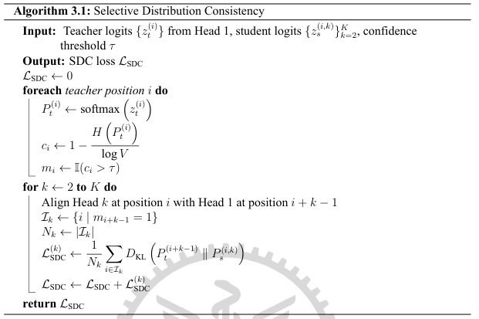
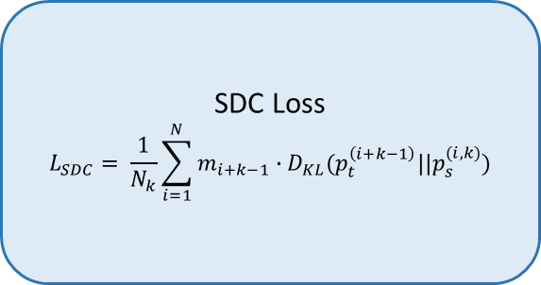
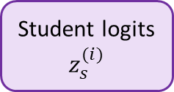
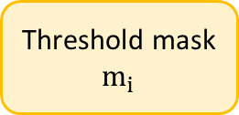
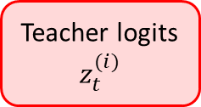
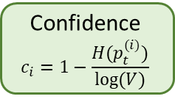
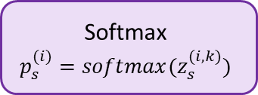
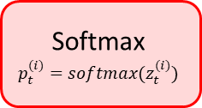
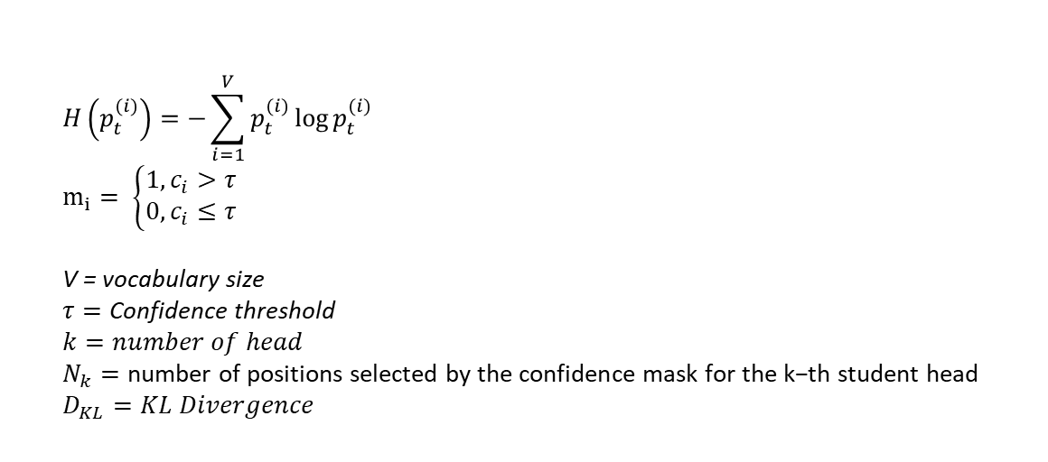
Part 3: Proposed Method
Selective Distribution Consistency
Teacher logits
$$z_{t}^{(i)}$$
Softmax
$$p_{t}^{(i)}=softmax(z_{t}^{(i)})$$
Confidence
$$c_{i}=1−\frac{H(p_{t}^{(i)})}{log⁡(V)}$$
Threshold mask
$$m_{i}$$
Position alignment
SDC Loss
$$L_{SDC}= \frac{1}{N_{k}}\sum_{i=1}^{N}{m_{i+k−1}∙D_{KL}(p_{t}^{\left(i+k−1\right)}||p_{s}^{(i,k)})}$$
Student logits
$$z_{s}^{(i)}$$
Softmax
$$p_{s}^{(i)}=softmax(z_{s}^{(i,k)})$$
$$H\left(p_{t}^{(i)}\right)=−\sum_{i=1}^{V}{p_{t}^{(i)}}\log{p_{t}^{(i)}}$$
$$m_{i}= \left\{\begin{aligned}1,c_{i}>τ \\ 0,c_{i}≤τ\end{aligned}\right.$$
V = vocabulary size
$$τ=\text{Confidence} \text{threshold}$$
$$k=number of head$$
$$N_{k}=\text{number} \text{of} \text{positions} \text{selected} \text{by} \text{the} \text{confidence} \text{mask} \text{for} \text{the} \text{k}\text{−}\text{th} \text{student} \text{head}$$
$$D_{KL}=KL Divergence$$
τ controls low-confidence masking. Too high τ can exclude many positions, hurting Oracle PPL / draft acceptance and increasing repetition.

Slide 15
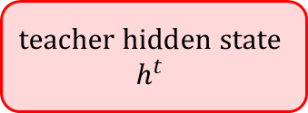
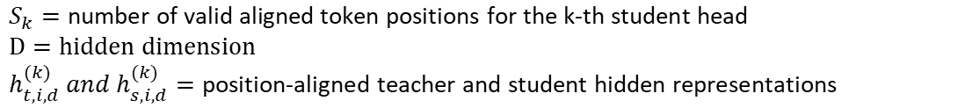
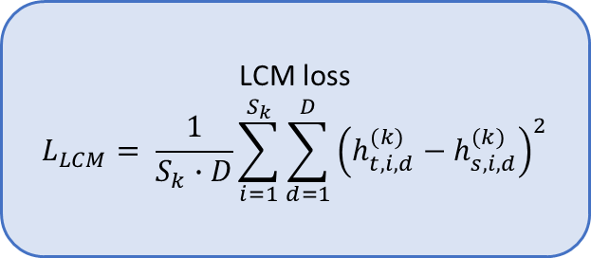
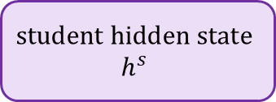
Part 3: Proposed Method
Latent Consistency Matching
LCM aligns the teacher and student heads at the latent / hidden representation level rather than directly aligning probability distributions.
$$\text{teacher} \text{hidden} \text{state}$$
$$h^{t}$$
LCM loss
$$L_{LCM}= \frac{1}{S_{k}∙D}\sum_{i=1}^{S_{k}}{\sum_{d=1}^{D}{{\left(h_{t,i,d}^{(k)}−h_{s,i,d}^{(k)}\right)}^{2}}}$$
$$\text{student} \text{hidden} \text{state}$$
$$h^{s}$$
$$S_{k}=\text{number} \text{of} \text{valid} \text{aligned} \text{token} \text{positions} \text{for} \text{the} \text{k}\text{−}\text{th} \text{student} \text{head}$$
$$D=\text{hidden} \text{dimension}$$
$$h_{t,i,d}^{(k)} and h_{s,i,d}^{(k)}=\text{position}\text{−}\text{aligned} \text{teacher} \text{and} \text{student} \text{hidden} \text{representations}$$

Slide 16
Part 3: Proposed method
Method Overview
This study combines MTP CE loss, SDC loss, and LCM loss, keeping the teacher head and student heads consistent at both the probability distribution and latent representation levels.
… …
Forward
Backward
Teacher Probability / Latent Representation
Student Latent Representation
Student Probability Distribution
Add
Add
CE Loss 1
CE Loss 2
LCM Loss 2
SDC Loss 2
… …
CE Loss K
LCM Loss K
SDC Loss K
Head 1
Head 2
… …
Head K
Shared
$$L_{total}=L_{CE}+{{\text{S}}_{W}∙L}_{SDC}+{L_{W}∙L}_{LCM}$$
${\text{S}}_{W}$,$L_{W}$: loss weights

Slide 17
Experimental Results

Slide 18
Part 4: Experimental Results
Experimental Configuration
Configuration | Value
Model Size | 1.3B
Number of Prediction Heads | 4
Main Training Tokens | 10B
Ablation Training Tokens | 1B
Sequence Length | 1024
Batch Size | 8
Optimizer | AdamW
Peak LR | 3 × 10⁻⁴
Weight Decay | 0.1
Warm-up Steps | 15000
S_{W}=1.0 | 1.0
Confidence Threshold τ=0.0 | 0.3
L_{W}=0.0 | 0.5
Top-p | 0.9
Temperature | 0.8
For optimization, AdamW [9] was used with β1 = 0.9, β2 = 0.95, and a decoupled weight decay coefficient of 0.1. The learning rate was linearly warmed up, followed by a cosine decay schedule [10]. In addition, gradients were clipped to a maximum Euclidean norm of 1.0 throughout training.

Slide 19
Part 4: Experimental Results
Main 1.3B Comparison — SDC+LCM vs. Baseline: Oracle PPL
Oracle PPL was computed independently for each prediction head using its corresponding ground-truth future token, where lower PPL indicates better prediction quality.
Metric | SDC+LCM | Baseline | Improvement
PPL head 1 | 19.1695 | 19.4293 | 1.34%
PPL head 2 | 83.7266 | 87.2351 | 4.02%
PPL head 3 | 189.2825 | 200.0813 | 5.40%
PPL head 4 | 299.5625 | 318.3247 | 5.89%
Observation
Larger gains are observed for farther prediction heads.
Head 4 achieves the largest PPL reduction (5.89%).
Head 1 remains comparable to the baseline.

Slide 20
Part 4: Experimental Results
Main 1.3B Comparison — SDC+LCM vs. baseline: Average Draft Tokens Accepted
Draft-token acceptance was evaluated using greedy predictions from the MTP heads. Head 1 was used as the verification reference, while predictions from Heads 2–K were treated as draft tokens. Draft tokens were accepted sequentially when they matched the corresponding Head 1 predictions, and verification stopped at the first mismatch. Head 1 itself was not included in the accepted draft-token count.
Metric | SDC+LCM | Baseline | Improvement
Average Draft Tokens Accepted | 0.7302 ± 0.0000 | 0.7010 ± 0.0000 | 4.17%
Prefix 128 | 0.9653 ± 0.0401 | 0.9117 ± 0.0205 | 5.88%
Prefix 256 | 0.9873 ± 0.0063 | 0.9458 ± 0.0068 | 4.39%
Prefix 512 | 1.0158 ± 0.0309 | 0.9689 ± 0.0221 | 4.84%
Prefix 768 | 1.0272 ± 0.0250 | 0.9760 ± 0.0222 | 5.25%
Observation
SDC+LCM consistently improves draft-token acceptance across all prefix lengths.
The average accepted draft tokens increase by 4.17%.

Slide 21
Part 4: Experimental Results
Main 1.3B Comparison — SDC+LCM vs. Baseline: Generative Quality
Generation quality was evaluated using Generative PPL, entropy, and 4-gram repetition. A total of 200 samples were generated using the first 128 tokens of each evaluation sequence as the prompt. Generation was performed using top-p and temperature sampling with p = 0.9 and a temperature of 0.8. Generative PPL was computed using GPT-2 Large as an external language model, where only the generated continuation was included in the perplexity calculation. Entropy was used to characterize the diversity of generated tokens, while 4-gram repetition was used to measure repetitive generation patterns.
Metric | SDC+LCM | Baseline | SDC+LCM vs. baseline
Generative PPL | 18.7180 ± 0.8276 | 39.5580 ± 0.9425 | -52.68%
Entropy | 6.8620 ± 0.0202 | 7.3223 ± 0.0351 | -6.29%
4-gram repetition | 0.0526 ± 0.0147 | 0.0229 ± 0.0084 | +130.17%
Observation
Generative PPL decreases substantially: 39.56 → 18.72.
Lower entropy suggests reduced generation diversity.
4-gram repetition increases, revealing a quality–diversity trade-off.

Slide 22
Part 4: Experimental Results
Main 1.3B Comparison — SDC+LCM vs. Baseline: Zero-Shot PPL Improvement By Head
To evaluate the generalization ability of the proposed method across different domains, zero-shot evaluation was conducted on WikiText[5], PennTreebank(PTB)[6], LAMBADA[7], and the arXiv and PubMed subsets of the Scientific Papers dataset[8].
Dataset | Head 1 | Head 2 | Head 3 | Head 4
WikiText | 0.32% | 7.57% | 7.19% | 5.62%
PTB | 13.82% | 9.90% | 10.53% | 5.63%
LAMBADA | 38.53% | 10.43% | 4.44% | 3.27%
arXiv | 1.48% | 3.94% | 3.71% | 0.27%
PubMed | 7.04% | 7.76% | 8.33% | 8.26%
Observation
PPL improvements generalize to multiple unseen datasets.
Heads 2–4 show relatively consistent gains on WikiText and PubMed.
Head 1 shows the largest gain on LAMBADA (38.53%).
The benefit varies across datasets but generalizes beyond the training domain.

Slide 23
Part 4: Experimental Results
Ablation Study — Oracle PPL
Let S_{W}, τ, and L_{W} denote the SDC term weight, confidence threshold, and LCM term weight, respectively.
Setting | Head 1 PPL | Head 2 PPL | Head 3 PPL | Head 4 PPL
baseline | 26.2356 ± 0.0000 | 121.8033 ± 0.0000 | 269.2450 ± 0.0000 | 406.6959 ± 0.0000
S_{W}=1.0, τ=0.0, L_{W}=0.0 | 26.7541 ± 0.0000 | 120.6687 ± 0.0000 | 261.6664 ± 0.0000 | 394.6503 ± 0.0000
S_{W}=1.0, τ=0.3, L_{W}=0.0 | 26.8150 ± 0.0000 | 120.5276 ± 0.0000 | 261.9479 ± 0.0000 | 394.7055 ± 0.0000
S_{W}=1.0, τ=0.6, L_{W}=0.0 | 27.7396 ± 0.0000 | 129.2922 ± 0.0001 | 278.8881 ± 0.0000 | 417.5874 ± 0.0000
S_{W}=1.5, τ=0.3, L_{W}=0.0 | 27.2684 ± 0.0000 | 122.5244 ± 0.0000 | 264.6119 ± 0.0000 | 397.3106 ± 0.0000
S_{W}=0.5, τ=0.3, L_{W}=0.0 | 26.4587 ± 0.0000 | 120.7186 ± 0.0000 | 265.0660 ± 0.0000 | 402.0413 ± 0.0000
S_{W}=0.0, τ=0.0, L_{W}=0.5 | 25.7096 ± 0.0000 | 118.9247 ± 0.0000 | 262.1637 ± 0.0000 | 397.9911 ± 0.0000
S_{W}=0.0, τ=0.0, L_{W}=1.0 | 25.5312 ± 0.0000 | 118.5823 ± 0.0000 | 261.1872 ± 0.0000 | 395.1838 ± 0.0000
S_{W}=0.0, τ=0.0, L_{W}=1.5 | 25.4583 ± 0.0000 | 119.1595 ± 0.0000 | 263.2083 ± 0.0000 | 398.8679 ± 0.0000
S_{W}=1.0, τ=0.3, L_{W}=0.5 | 26.2402 ± 0.0000 | 118.2168 ± 0.0000 | 257.0344 ± 0.0000 | 387.7455 ± 0.0000
S_{W}=1.0, τ=0.3, L_{W}=1.0 | 26.4553 ± 0.0000 | 119.2975 ± 0.0000 | 258.4100 ± 0.0000 | 390.7829 ± 0.0000
S_{W}=1.5, τ=0.3, L_{W}=1.0 | 26.5485 ± 0.0000 | 118.4341 ± 0.0000 | 254.9612 ± 0.0000 | 383.7626 ± 0.0000
Observation
Moderate SDC settings improve Heads 2–4, while Head 1 may slightly degrade.
Moderate LCM weights improve future-head PPL.
A high confidence threshold (τ = 0.6) consistently hurts PPL.
Joint SDC+LCM achieves the best overall future-head performance.

Slide 24
Part 4: Experimental Results
Ablation Study — Average Draft Tokens Accepted
Let S_{W}, τ, and L_{W} denote the SDC term weight, confidence threshold, and LCM term weight, respectively.
Setting | Average Draft Tokens Accepted | Prefix 128 | Prefix 256 | Prefix 512 | Prefix 768
baseline | 0.6238 ± 0.0000 | 0.8251 ± 0.0140 | 0.8205 ± 0.0062 | 0.8519 ± 0.0195 | 0.8552 ± 0.0233
S_{W}=1.0, τ=0.0, L_{W}=0.0 | 0.6388 ± 0.0000 | 0.8374 ± 0.0165 | 0.8746 ± 0.0108 | 0.8736 ± 0.0158 | 0.8802 ± 0.0029
S_{W}=1.0, τ=0.3, L_{W}=0.0 | 0.6400 ± 0.0000 | 0.8406 ± 0.0131 | 0.8602 ± 0.0232 | 0.8720 ± 0.0233 | 0.8772 ± 0.0015
S_{W}=1.0, τ=0.6, L_{W}=0.0 | 0.6113 ± 0.0000 | 0.7908 ± 0.0074 | 0.7919 ± 0.0086 | 0.8009 ± 0.0035 | 0.8174 ± 0.0130
S_{W}=1.5, τ=0.3, L_{W}=0.0 | 0.6414 ± 0.0000 | 0.8522 ± 0.0098 | 0.8581 ± 0.0139 | 0.8897 ± 0.0043 | 0.9082 ± 0.0204
S_{W}=0.5, τ=0.3, L_{W}=0.0 | 0.6345 ± 0.0000 | 0.8195 ± 0.0122 | 0.8416 ± 0.0115 | 0.8601 ± 0.0065 | 0.8644 ± 0.0304
S_{W}=0.0, τ=0.0, L_{W}=0.5 | 0.6398 ± 0.0000 | 0.8517 ± 0.0156 | 0.8589 ± 0.0096 | 0.8794 ± 0.0050 | 0.8895 ± 0.0257
S_{W}=0.0, τ=0.0, L_{W}=1.0 | 0.6442 ± 0.0000 | 0.8491 ± 0.0130 | 0.8698 ± 0.0154 | 0.8919 ± 0.0168 | 0.8943 ± 0.0012
S_{W}=0.0, τ=0.0, L_{W}=1.5 | 0.6467 ± 0.0000 | 0.8510 ± 0.0112 | 0.8862 ± 0.0054 | 0.8951 ± 0.0129 | 0.9028 ± 0.0327
S_{W}=1.0, τ=0.3, L_{W}=0.5 | 0.6507 ± 0.0000 | 0.8498 ± 0.0339 | 0.8615 ± 0.0179 | 0.8987 ± 0.0103 | 0.8862 ± 0.0151
S_{W}=1.0, τ=0.3, L_{W}=1.0 | 0.6495 ± 0.0000 | 0.8402 ± 0.0209 | 0.8612 ± 0.0043 | 0.8879 ± 0.0157 | 0.8950 ± 0.0071
S_{W}=1.5, τ=0.3, L_{W}=1.0 | 0.6525 ± 0.0000 | 0.8590 ± 0.0101 | 0.8656 ± 0.0214 | 0.9023 ± 0.0277 | 0.9044 ± 0.0140
Observation
Most consistency-loss settings outperform the baseline.
Increasing SDC/LCM weights generally improves draft-token acceptance.
τ = 0.6 reduces acceptance noticeably.
Joint SDC+LCM achieves the highest average acceptance: 0.6525.

Slide 25
Part 4: Experimental Results
Ablation Study — Generative Quality
Let S_{W}, τ, and L_{W} denote the SDC term weight, confidence threshold, and LCM term weight, respectively.
Setting | Generative PPL | Entropy | 4-gram repetition
baseline | 83.8285 ± 5.1409 | 7.4068 ± 0.0461 | 0.0119 ± 0.0097
S_{W}=1.0, τ=0.0, L_{W}=0.0 | 68.0596 ± 4.5760 | 7.3141 ± 0.0519 | 0.0193 ± 0.0154
S_{W}=1.0, τ=0.3, L_{W}=0.0 | 48.4875 ± 1.2280 | 7.1184 ± 0.0336 | 0.0183 ± 0.0055
S_{W}=1.0, τ=0.6, L_{W}=0.0 | 28.2332 ± 1.2754 | 6.7789 ± 0.0178 | 0.0393 ± 0.0080
S_{W}=1.5, τ=0.3, L_{W}=0.0 | 31.8082 ± 0.4503 | 6.8248 ± 0.0353 | 0.0485 ± 0.0159
S_{W}=0.5, τ=0.3, L_{W}=0.0 | 52.7654 ± 2.2732 | 7.1490 ± 0.0335 | 0.0323 ± 0.0169
S_{W}=0.0, τ=0.0, L_{W}=0.5 | 26.2091 ± 1.5675 | 6.8576 ± 0.0374 | 0.0555 ± 0.0204
S_{W}=0.0, τ=0.0, L_{W}=1.0 | 24.0955 ± 3.2440 | 6.7935 ± 0.0828 | 0.0657 ± 0.0388
S_{W}=0.0, τ=0.0, L_{W}=1.5 | 29.9033 ± 0.5373 | 6.8644 ± 0.0249 | 0.0215 ± 0.0049
S_{W}=1.0, τ=0.3, L_{W}=0.5 | 21.4788 ± 0.0773 | 6.6876 ± 0.0421 | 0.0720 ± 0.0062
S_{W}=1.0, τ=0.3, L_{W}=1.0 | 26.3414 ± 0.3656 | 6.7567 ± 0.0016 | 0.0460 ± 0.0160
S_{W}=1.5, τ=0.3, L_{W}=1.0 | 25.7832 ± 1.6338 | 6.7177 ± 0.0455 | 0.0453 ± 0.0197
Observation
All consistency settings reduce Generative PPL compared with the baseline.
Lower Generative PPL is often accompanied by lower entropy and higher repetition.
S_{W}=1.0, τ=0.3, L_{W}=0.5 achieves the lowest Generative PPL (21.48), but also the highest 4-gram repetition (0.072).
Generation quality shows a clear PPL–diversity trade-off.

Slide 26
Conclusion

Slide 27
Part 5: Conclusion
Conclusion
This study adds SDC and LCM to the MTP architecture and improves the prediction quality of prediction heads without changing the model architecture.
In the main 1.3B model experiment, SDC+LCM reduces the PPL of Heads 1–4 across the board, with Head 4 showing the largest reduction at 5.89%.
Average Draft Tokens Accepted increases from 0.7010 to 0.7302, indicating that self-speculative decoding can accept more draft tokens.
Generative PPL decreases substantially from 39.5580 to 18.7180, representing the largest improvement among the main positive evaluation metrics.
SDC+LCM mainly improves Heads 2–4 and increases draft-token acceptance, suggesting better consistency among MTP heads.

Slide 28
Part 5: Conclusion
Future Work
Further test different model sizes, larger training data volumes, and more diverse datasets.
Conduct follow-up training, including continued pre-training and supervised fine-tuning (SFT).
After scaling up the training data, further implement a complete greedy self-speculative decoding pipeline and compare the actual speed-up with the oracle upper bound.

Slide 29
Thanks for listening

Slide 30
Reference
[1] F. Gloeckle, B. Youbi Idrissi, B. Roziere, D. Lopez-Paz, and G. Synnaeve, “Better & faster large language models via Multi-token Prediction,”
[2] M. Samraghetal., “Your LLM knows the future: Uncovering its Multi-Token Prediction potential,”
[3] M. Stern, N. Shazeer, and J. Uszkoreit, “Blockwise parallel decoding for deep autoregressive models,”
[4] A. Gokaslan and V. Cohen, OpenWebText corpus
[5] S. Merity, C. Xiong, J. Bradbury, and R. Socher, “Pointer sentinel mixture models,”
[6] M. P. Marcus, B. Santorini, and M. A. Marcinkiewicz, “Building a large annotated corpus of English: The Penn Treebank,”
[7] D. Papernoetal., “The LAMBADA dataset: Word prediction requiring a broad discourse context,”
[8] A. Cohan et al., “A discourse-aware attention model for abstractive summarization of long documents,”
[9] I. Loshchilov and F. Hutter, “Decoupled weight decay regularization,”
[10] I. Loshchilov and F. Hutter, “SGDR: Stochastic gradient descent with warm restarts,”
[11]DeepSeek-AI, “DeepSeek-V3 technical report,”

