Slide 1
Introduction to programming in R, part 1
Daniel Reuman
Slides adapted from slides of Lawrence Hudson

Slide 2
Introduction to programming in R
Starts as a very basic introduction to R
Will get more complicated as we go
We will cover simple programming concepts
No statistics, just coding!
You will use R a lot
You should construct your own expertise in it, starting here!
2

Slide 3
What is R?
A statistical modelling language
Runs on Windows, Mac and Linux
Free :-)
Developed and scrutinised by top level academic statisticians
Has a huge number of libraries covering a wide range of areas
Produces publication-quality graphs
Very powerful but can be hard to master
3

Slide 4
Starting R - precursor
Create a new folder for yourself, for this bootcamp
Make subdirectories as appropriate – keep organized!
Put all materials for a given exercise in a sensible place
This will be called the “working directory”

Slide 5
Starting R (on your own laptop)
A good choice is R studio
Install and make it work with R
You ought to be an administrator on your own machine
Save a new R script as TechnicalLecture1Intro.R to the working directory and change R to that directory using Tools, Set working directory, To source file location
Have to make sure R is “in” the working directory
You should do something like this at the start of all new projects or exercises

Slide 6
Starting R – what next?
You should have the R window and the R script window
Type getwd() into the R window, press return
You should see that R’s current working directory is the directory you created – saved output will go here
There are other working setups possible, but these are some that can work
Type getwd() into your script file and use the appropriate button to send it to R. Or control-return to send current line or selection
Most code should go in the script, and be sent in in this way, except throwaway commands that are not part of a larger task and you’ll not want to repeat or edit
Don’t do “fire and forget” analyses
6
Notes:
6

Slide 7
The R Console
The ‘R Console’ window lets you use R interactively:
> is called the command prompt
The command prompt is waiting for us to enter an expression and hit return, or send expressions from a script
You can enter one command at a time into the R (very limited applications)
Or you can make a whole script worth of commands in R studio (R text editor) and then send them to R a line at a time or all at once (much better, you will see)
>
7

Slide 8
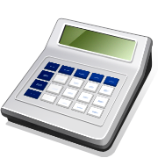
R as a calculator
Type the following in the R script window and then send to the R console window:
You should see:
Black text with a dashed border, you should type into your R script, then from there into R console
Text with a solid border is what R shows you:
That in red is what you typed in
That in blue is the answer from R
It is possible for answers to contain many values
The [1] means that 4 is the first answer; this will become clearer in a little while
2 * 2
> 2 * 2
[1] 4
8

Slide 9
Another calculator example
Type the following in the R script window and then send it to the R console:
^ (called hat) means ‘to the power of’
To enter the ^ hold SHIFT and press 6
You should see:
3 ^ 2
> 3 ^ 2
[1] 9
9

Slide 10
Operators
Some useful operators:
Addition +
Subtraction –
Multiplication *
Division /
To the power of ^
10

Slide 11
Brackets
Enter the following two lines into your script and then R:
R gives:
The multiply operator has a higher precedence than the addition operator
Due to its higher precedence, the multiplication in the first calculation is done before the addition
The brackets in the second calculation tell R to perform the addition first
1 + 2 * 2
(1 + 2) * 2
> 1 + 2 * 2
[1] 5
> (1 + 2) * 2
[1] 6
11

Slide 12
More brackets
Enter this example:
R gives:
‘To the power of’ has a higher precedence than addition
If in doubt, always use brackets
1 + 2 ^ 2
(1 + 2) ^ 2
> 1 + 2 ^ 2
[1] 5
> (1 + 2) ^ 2
[1] 9
12

Slide 13
Operator precedence
You can remember the order of evaluation with the following rhyme:
Please Excuse My Dear Aunt Sally
Which stands for:
Parentheses
Exponents
Multiplication & Division
Addition & Subtraction
But...
...if in doubt, always use brackets!
13

Slide 14
Large numbers
Enter the following into script, then R:
When you enter large numbers, don’t include a comma:
The correct way:
2 * 10,000
2 * 10000
> 2 * 10,000
Error: unexpected ',' in "2 * 10,"
> 2 * 10000
[1] 20000
14

Slide 15
E Notation
R supports ‘E Notation’
This is just like scientific notation / standard form
Enter:
R gives:
1E4
1e4
5e-2
> 1E4
[1] 10000
> 1e4
[1] 10000
> 5e-2
[1] 0.05
15

Slide 16
E Notation
R uses E notation to print very large or small numbers
Type in:
R gives:
1E4 ^2
1 / 3 / 1e8
> 1E4 ^ 2
[1] 1e+08
> 1 / 3 / 1e8
[1] 3.333333e-09
16

Slide 17
Mistakes in calculations
You may make mistakes in calculations and it is useful to know how R behaves
For example, division by 0
R gives:
1/0
> 1/0
[1] Inf
17

Slide 18
Mistakes in calculations
NaN – not number
R gives:
If you ever see Inf or NaN in a result, you have probably made a mistake
0/0
> 0/0
[1] NaN
18

Slide 19
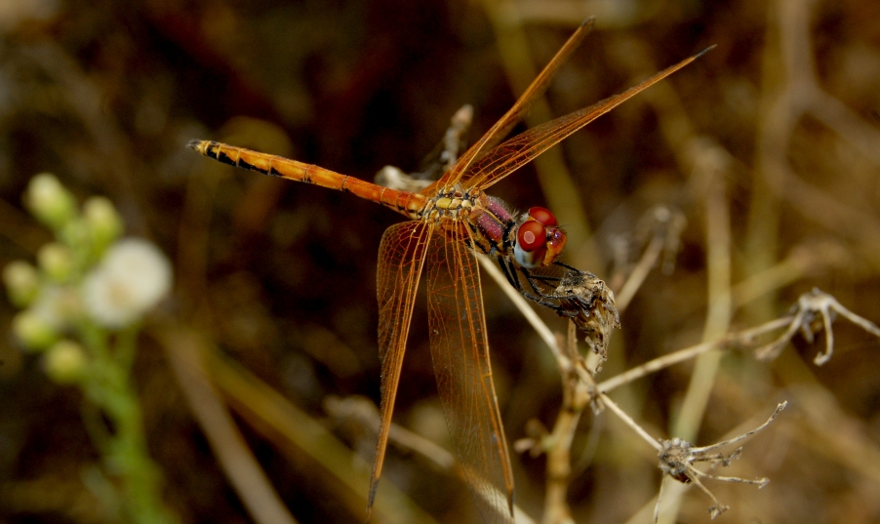
Variables
Let’s say we want to record the maximum width of an insects’s wing in cm:
wing.width.cm <- 1.2
This line is read ‘the variable wing.width.cm gets the value 1.2’
A variable is a name that is a container for one or more values
1.2
R doesn’t keep track of units; we do this by including the units in the variable name
wing.width.cm
19

Slide 20
Variables
You can examine the contents of a variable by typing its name and hitting return:
As expected, wing.width.cm contains 1.2
Let’s check the number of values in the variable:
Just the one value, which is nice
wing.width.cm
1.2
> wing.width.cm
[1] 1.2
wingWidthCm
length(wing.width.cm)
> length(wing.width.cm)
[1] 1
20

Slide 21
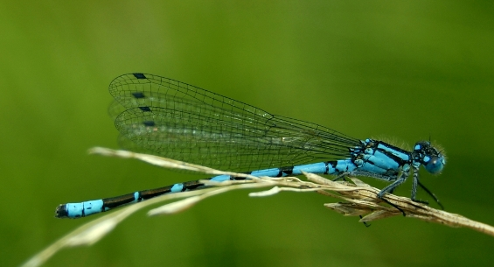
Vectors
Say we had three insect wing lengths in cm:
wing.length.cm <- c(4.7, 5.2, 4.8)
This line is read ‘the variable wing.length.cm gets the vector of values 4.7, 5.2 and 4.8’
c() concatenates items into a vector
A vector is a collection of similar data
4.7
5.2
4.8
wing.length.cm
21

Slide 22
Concatenation
c() is one of the most commonly used functions
Don’t forget it!
Remember if you want to use it to bind numbers together in a vector, you use it
There are other uses we will see later

Slide 23
Vectors
Let’s create the variable:
And check its contents:
wing.lengths.cm is therefore a vector containing three elements
> wing.length.cm <- c(4.7, 5.2, 4.8)
wing.length.cm
length(wing.length.cm)
> wing.length.cm
[1] 4.7 5.2 4.8
> length(wing.length.cm)
[1] 3
23

Slide 24
Vector elements
We can examine individual elements:
We can also set the value of an element:
Set it back to its original value:
wing.length.cm[3]
> wing.length.cm[3]
[1] 4.8
wing.length.cm[3] <- 12.1
wing.length.cm
> wing.length.cm[3] <- 12.1
> wing.length.cm
[1] 4.7 5.2 12.1
wing.length.cm[3] <- 4.8
24

Slide 25
Vectors and operators
We entered the three wing lengths in cm
Say we need them in mm:
R gives:
The multiply operator therefore works on individual elements of vectors
Vectors in R are different from Matlab, so if you know Matlab, watch out!
wing.length.cm * 10
> wing.length.cm * 10
[1] 47 52 48
25

Slide 26
Exercise 0: vectors
In your script, create a vector for storing 4 body masses in kg, 10, 1.2, 2.12, and 1001. Name it sensibly.
Display the whole thing
Display the 3rd entry
Change the 3rd entry to 2.13
Augment the vector with the additional values 101.2, 233.4

Slide 27
The workspace
All the objects currently in memory are in what’s called the workspace
You can get a list of all these by typing ls()
You can tell R to forget the object x, for instance, from the workspace by typing rm(x)
Try creating some variables and using ls() and then removing them and then using ls() again to see they are gone
You can clear the whole workspace with rm(list=ls())
This last command is useful but be careful with it!
27
Notes:
27

Slide 28
Object names
Not all computer code that works (or appears to work) is good code (far from it!)
Aspects of style such as choosing descriptive names for your objects are VERY IMPORTANT
If you don’t follow this and other stylistic guidelines you’ll write bad code that is
Hard for anyone else to use
Hard for you to find the “bugs” (a big pain, and can cause wrong results)
Hard for you to remember how it works or adapt it to a new application
Good style is more than just appropriate variable names – we will return to this
28
Notes:
28

Slide 29
Tab
We have created two variables that start with ‘wing’: wing.width.cm and wing.lengths.cm
Enter directly into the R console:
Press the TAB key
R shows all the names that start with ‘wing.’
If we wanted to see wing.length.cm, we’d hit the L key and hit TAB again
wing.
> wing.
wing.length.cm wing.width.cm
29

Slide 30
Case
Variables are case sensitive
The following will not work:
Using the TAB key helps you to get the correct spellings and case for variables and functions
TAB can save you a lot of typing pain
Wing.width.cm
WING.WIDTH.CM
Wing.Width.cm
1.2
30

Slide 31
Arrow keys
The up and down arrow keys (at the bottom right of the keyboard) go backwards and forwards through what you have entered into the R console
This is really useful if you make a mistake or want to repeat a previous command
Hit the up arrow a few times to go backwards
Now hit the down arrow to go forwards
The arrow keys can save you a lot of time
31

Slide 32
Exercise 1: temperature
You have some temperature data in °Fahrenheit:
Convert these temperatures into °C
Use the internet to find the conversion if you don’t already know it
Do this in a new script, saved as TempConvert.R in your working directory – save your old script first
Remember to use good style!
What are some advantages of doing it in a script?
Temperature (°F)
50.5
60.0
62.5
33.0
32

Slide 33

Exercise 2: tree height
We are performing a study of a woodland ecosystem and need to know the heights of trees
We walked a distance of 40 m from a tree
We measured an angle, θ, of 37° to the top
How tall is it?
Save your current script and make a new one to do this, call it TreeHeight.R
height = distance * tan(ѳ)
height
ѳ
distance
33
Notes:
33

Slide 34
Exercise 2: tree height
Now modify your script so it also does these trees along with the one you already did
Distance | Theta | Height
20m | 15 °
30m | 50 °
34
Notes:
34

Slide 35

Functions
To keep the slides shorter from here on, I won’t always show boxes with dashed borders
You should type in everything that is in red text
Suppose we need to know the mean wing length:
> mean(wing.length.cm)
[1] 4.9
mean() is a function
Functions process data and typically return a result
4.7
5.2
4.8
mean
4.9
wing.length.cm
35

Slide 36
Functions
Some more useful functions:
The minimum, maximum and total
The brackets here have a different meaning to brackets used in calculator arithmetic
A name followed by brackets means a function call
> min(wing.length.cm)
[1] 4.7
> max(wing.length.cm)
[1] 5.2
> sum(wing.length.cm)
[1] 14.7
36

Slide 37
Functions
c() and length() are also functions
Much of the work you will do will use functions and vectors
The functions you use can be:
Built in to R
From one of the many R libraries
Those you write yourself – we will learn this
We will come back to functions again later
37

Slide 38
Sequences
We often create vectors that are number sequences
For example, the years 1990 to 2009:
The : operator creates vectors of values, in this case starting at 1990 and ending at 2009
years <- 1990:2009
38

Slide 39

Sequences
Let’s have a look:
The [11] on the second line means that 2000 is the 11th element in the vector
You might see another number in place of 11 – it depends upon the width of the ‘R Console’ window
> years <- 1990:2009
> years
[1] 1990 1991 1992 1993 1994 1995 1996 1997 1998 1999
[11] 2000 2001 2002 2003 2004 2005 2006 2007 2008 2009
39

Slide 40
Sequences
You can also create sequences that count down:
> years <- 2009:1990
> years
[1] 2009 2008 2007 2006 2005 2004 2003 2002 2001 2000
[11] 1999 1998 1997 1996 1995 1994 1993 1992 1991 1990
40

Slide 41
More sequences
Using the : operator is great for sequences of whole numbers
You will often need to work with sequences of fractional numbers
The seq() function is great for this
A sequence between 0 and 5 in 0.1 steps:
> seq(1, 5, 0.1)
[1] 1.0 1.1 1.2 1.3 1.4 1.5 1.6 1.7 1.8 1.9 2.0 2.1
[13] 2.2 2.3 2.4 2.5 2.6 2.7 2.8 2.9 3.0 3.1 3.2 3.3
[25] 3.4 3.5 3.6 3.7 3.8 3.9 4.0 4.1 4.2 4.3 4.4 4.5
[37] 4.6 4.7 4.8 4.9 5.0
41

Slide 42
Named arguments
R is very good at “argument matching” if you name the arguments
seq(1, 5, 0.1) is fine, but you have to remember to put the start number first, the end number next, and the increment last
What if you forget the order?
You can write seq(from=1,to=5, by=0.1) OR seq(from=1, by=0.1, to=5), with the same effect (try it)
You can use any order of the arguments if you NAME the arguments so R can work out which is which
To see what names to use, use help files
Type ?seq into the R window
more on this later
42
Notes:
42

Slide 43
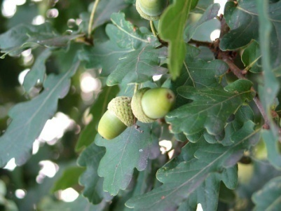

Strings
We often want to record textual information
This is done using strings
Anything within single quotes (') or double quotes (") is a string:
You can’t do arithmetic with strings:
> species.name <- "Quercus robur"
> species.name
[1] "Quercus robur"
> species.name <- 'Fraxinus excelsior'
> species.name
[1] "Fraxinus excelsior"
> species.name * 10
Error in species.name * 10 : non-numeric argument to binary operator
43

Slide 44
Joining items together to make strings
The paste function joins together items into a string:
As many R functions do, it works well with vectors:
This last example creates 11 strings which are kept together in a vector of strings
> answer <- 42
> paste('The answer is', answer)
[1] "The answer is 42"
> paste('The year is', 1990:2000)
[1] "The year is 1990" "The year is 1991" "The year is 1992"
[4] "The year is 1993" "The year is 1994" "The year is 1995"
[7] "The year is 1996" "The year is 1997" "The year is 1998"
[10] "The year is 1999" "The year is 2000"
44

Slide 45
Plotting graphs
The plot() function creates a new graph
The first parameter gives x values
The second parameter gives y values
The main= part tells plot() that we want “A simple graph” to be the title
plot(1:25, (1:25)^2, main="A simple graph")
45

Slide 46
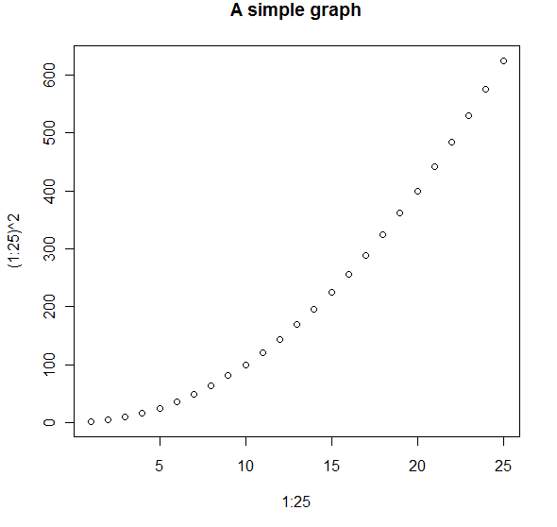
Plotting graphs
You should see:
46

Slide 47
Named arguments
plot() is very flexible and takes many parameters
The ‘main=‘ parts tell R which of these we want to use as the title (argument matching)
We are providing plot() with the named argument main (same idea as before with seq)
You will do this with many of the R functions that you use
You don’t need to prefix the x and y parameters, but you can, with x= and y=
Named arguments mean that you can put the arguments in in any order
47

Slide 48
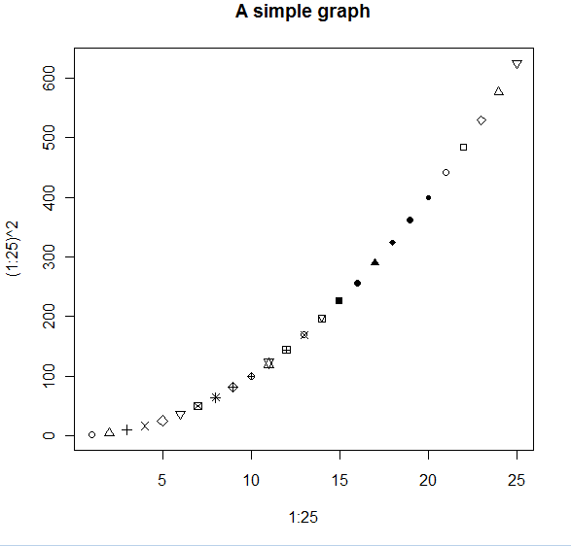
Exploring graph plotting
Plotting symbols
plot(1:25, (1:25)^2, main="A simple graph", pch=1:25)
48

Slide 49
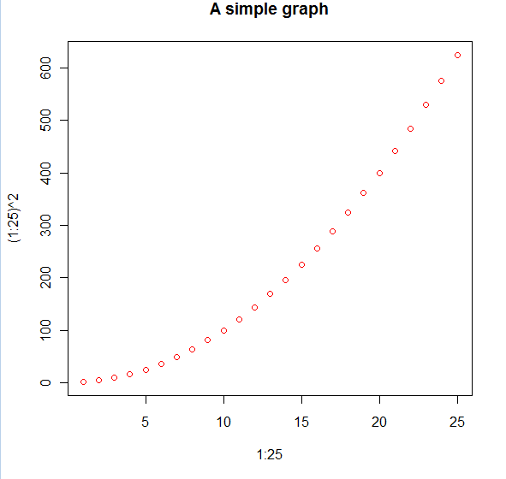
Exploring graph plotting
Color
The colors() function returns a list of all the colors that R knows about
plot(1:25, (1:25)^2, main="A simple graph", col="red")
49

Slide 50
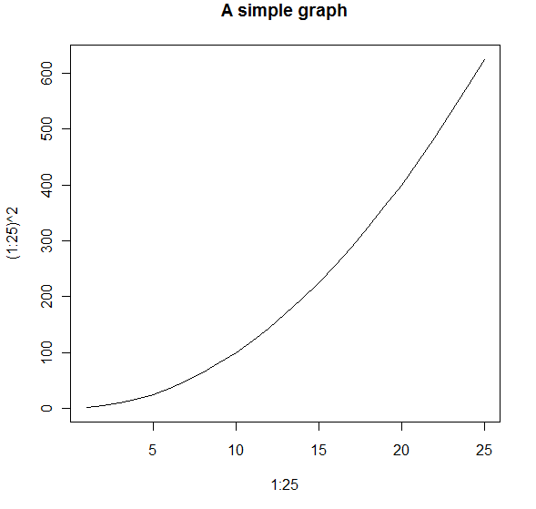
Exploring graph plotting
Lines rather than points
plot(1:25, (1:25)^2, main="A simple graph", type="l")
50

Slide 51
Exploring graph plotting
plot() creates a new graph
You will often need to have several sets of data on the same graph
lines(1:25, (25:1)^2, col="green")
points(2:26, (25:1)^2, col="blue")
51

Slide 52
Exercise 3: plotting and sequences
In a new script called FirstPlot.R …
Plot the numbers 1,1,2,3,5,8,13 against the sequence 1,2,3,4,5,6,7
Make the title “Fibonacci”
Make the x axis say “Sequence”
Make the y-axis say “Fibonacci”
Use a small upward pointing triangle as your plotting symbol, use the colour blue
Connect the dots with lines
The help file might help (type ?plot)

Slide 53
Getting data into R
Getting data in and out of R is part of most analyses
It is common to enter data into Excel (or similar), save it as a CSV file and load it into R
CSV – Comma Separated Values
We will look at a CSV file of data from the study of Nagy et al. 1999. Energetics of free-ranging mammals, reptiles and birds.
Each data point is an estimate of mean body mass and mean field metabolic rate of a single species
53

Slide 54
Getting data into R
Copy the file NagyEtAl1999.csv to your working directory
Open the file with Excel and check it out
To read a csv file:
f is new type of object called a data frame
Data frames are a bit like spreadsheets
Type f by itself into the R window to see what your data frame looks like – what’s the problem?
f <- read.csv('NagyEtAl1999.csv')
54

Slide 55
Data frames
How much data is there in this file?
Numbers of columns and rows:
To see the names of the columns:
ncol(f)
nrow(f)
> ncol(f)
[1] 5
> nrow(f)
[1] 229
colnames(f)
> colnames(f)
[1] "Species" "Common.name" "Class" "M.g" "FMR.kJ.day.1"
55

Slide 56
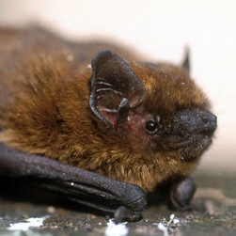
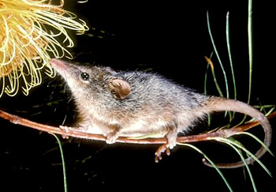
Data frames
To see the first 5 rows:
Each column in the data frame is a vector
The Species, Common.name and Class columns are vectors of strings
The M.g and FMR.kJ.day.1 columns are vectors of numbers
head(f, 5)
> head(f)
Species Common.name Class M.g FMR.kJ.day.1
1 Pipistrellus pipistrellus Pipistrelle Mammalia 7.3 29.3
2 Plecotus auritus Brown long-eared bat Mammalia 8.5 27.6
3 Myotis lucifugus Little brown bat Mammalia 9.0 29.9
4 Gerbillus henleyi Northern pygmy gerbil Mammalia 9.3 26.5
5 Tarsipes rostratus Honey possum Mammalia 9.9 34.4
56

Slide 57
Data frames
To get the vector of values in a column use $
You can do everything that you can with any other vector. E.g. To get mass in kg:
> f$M.g
[1] 7.3 8.5 9.0 9.3 9.9 11.5 13.0
[8] 13.4 15.1 16.0 16.6 17.9 17.9 19.2
...
> f$M.g / 1e3
[1] 0.0073 0.0085 0.0090 0.0093 0.0099 0.0115 0.0130
[8] 0.0134 0.0151 0.0160 0.0166 0.0179 0.0179 0.0192
...
57

Slide 58
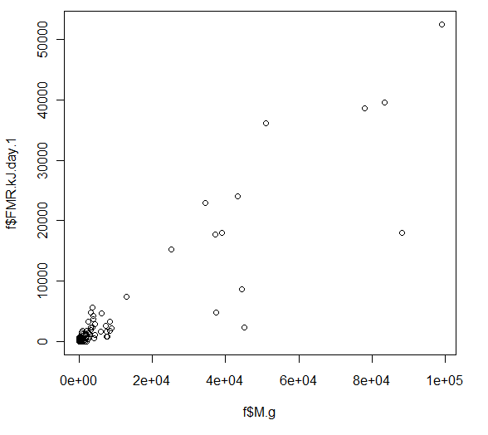
Plotting graphs
Field metabolic rate varies with body mass
Let’s look at the data graphically:
plot(f$M.g, f$FMR.kJ.day.1)
58

Slide 59
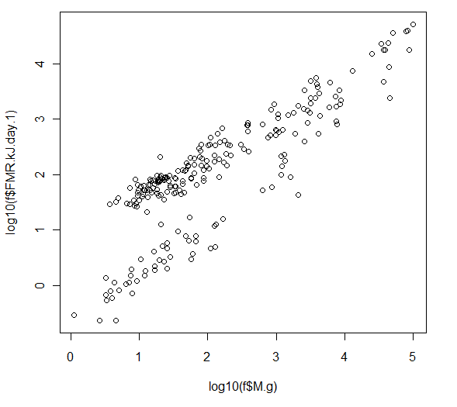
Data frames
Most of the data points are squashed into the corner - let’s log-transform the data
plot(log10(f$M.g), log10(f$FMR.kJ.day.1),type=‘p’)
59

Slide 60
Data frames
The data frame has data for three classes of animals: birds, mammals and reptiles
If we wanted to examine just the data for reptiles we can use the subset() function
How many rows for reptiles are there?
reptiles <- subset(f, 'Reptilia'==Class)
nrow(reptiles)
> nrow(reptiles)
[1] 55
60

Slide 61
Data frames
If we wanted to examine just the data for reptiles that are less than 100g:
Mammals over 500g:
small.reptiles <- subset(f, 'Reptilia'==Class & M.g<100)
large.mammals <- subset(f, 'Mammalia'==Class & M.g>500)
61

Slide 62
Exercise 4: plotting, data import
Do the below in a new script called MetRate.R
Plot the field metabolic rate data on one graph using a different colour for each class: birds, mammals and reptiles
Use this to create an empty graph of the correct size:
Use the points(x, y) function to add to the graph
We have covered everything else you need
There are many ways to do it
What does the graph say about the biology of each class of animals?
plot(log10(f$M.g), log10(f$FMR.kJ.day.1), type="n")
62

Slide 63
Exercise 4: plotting, data import
What are the mean, min and max body masses, overall and for each class? Calculate in your script.
Check the max and min against the graph of log(FMR) against log(M) – do the values look correct?
What are the mean, min and max field metabolic rates? Do it in the script.
Again, check these against the graph – do they look correct?
63

Slide 64
Your data into R
If you need to get your own data into R during your project work:
Enter the data into Excel (or similar)
Save to a CSV file
In Excel press the Office button at the top left, select Save as, Other formats
In ‘Save as type’ choose ‘CSV (Comma delimited) (*.csv)’
Bring the data into R using read.csv()
Just use Excel for data entry and storage!
64

Slide 65
Graphics in R
R is fantastic at creating graphs
Run these to see some examples:
You need to click on the graph to get R to move to the next example in each demo
demo(graphics)
demo(persp)
demo(image)
65

Slide 66
Summary
We covered a lot of stuff!
Additional exercises below – do them!
Starting R
Operators
Brackets
Variables
Vectors
Functions
Sequences
Strings
Creating graphs
Getting data into R
66

Slide 67
On your own, and soon (tonight)
Finish the exercises introduced today, if you have not already finished (QB, BIG – write up!)
Revise the material delivered today
Really try to internalize both the concepts and the technical R bits – you’ll need to build on these more and more as you go, so they need to become second nature!
Additional exercises to follow – do them!

Slide 68
Additional exercises
Make a sequence that goes from 1 to 5 in increments of .5 and then goes from 5 to 10 in increments of 1/3
Make a sequence whose square root goes from 0 to 4 in increments of .25
Make a sequence whose base 10 log goes from 0 to 3 in increments of 0.1
Load the Nagy FMR data and plot log10 FMR versus log10 body mass for passerine birds and non-passerine birds in separate colours – is there a difference? Why? Explore a few differences among other major taxonomic grouping and biologically interpret them if you can.
QB and BIG must write these ones up, too! Label them additional exercises 1-4, please!

