Slide 1
Introduction to programming in R, part 2
Daniel Reuman
Slides adapted from slides of Lawrence Hudson

Slide 2
Scripts
Last time we used both the interactive, command line interface and the script interface, though I tried to emphasize scripts
Working interactively (command line) is great for experimentation but makes it hard to perform tasks again, or to perform complex tasks
So we will increasingly be using scripts for almost everything
2

Slide 3

The height of a tree
We are performing a study of a woodland ecosystem and need to know the heights of trees
We walked a distance of 40 m from a tree
We measured an angle, θ, of 37° to the top
How tall is it?
height = distance * tan(ѳ)
height
ѳ
distance
3

Slide 4
The height of a tree
We are performing a study of a woodland ecosystem and need to know the heights of trees
We walked a distance of 40 m from a tree
We measured an angle, θ, of 37° to the top
How tall is it?
height = distance * tan(ѳ)
height
ѳ
distance
4

Slide 5
Writing your own functions
Up until now we have used functions that are built into R
We will create our own function that performs the tree height calculation
Splitting work into functions has advantages:
Functions can be reused
It is easier to read and understand many small functions than it is a single large script
Functions make it easier to diagnose problems because you can test them independently
5

Slide 6
Our first self-made R function
Create a new script
Call it TreeHeightFunction.R
Save it
6

Slide 7
The height of a tree
Enter into your script
TreeHeight gets a function
degrees and distance are the parameters of the function, a.k.a., arguments
Lines inside {} (called curly braces) make up the function body
The tan() function works in radians, not degrees
TreeHeight <- function(degrees, distance)
{
radians <- degrees * pi / 180
height <- distance * tan(radians)
return (height)
}
TreeHeight(37, 40)
7

Slide 8
Let’s run it!
From the script
Highlight the function and send it to R with the appropriate button
Then send the call line to R with the “send line” button
In R
Use the up arrow to retrieve the old call
Re-call it, modified, in several different ways
8

Slide 9
The height of a tree
You should see:
The distance was measured in meters so the tree is 30.14 m tall
The TreeHeight function can now be used whenever you want, just like the built in functions mean(), max(), min() etc
> TreeHeight <- function(degrees, distance)
+ {
+ radians <- degrees * pi / 180
+ height <- distance * tan(radians)
+ return (height)
+ }
>
> TreeHeight(37, 40)
[1] 30.14216
9

Slide 10
More tree heights
Say we need to know the height of two more trees for which the angles at 40m are 25° and 31°
We can combine all three angles into a single vector
Append the following line to your script:
The degrees parameter is a vector of 3 values
The distance parameter is still a single value
TreeHeight(c(37, 25, 31), 40)
10

Slide 11
More tree heights
Send just the new line into R:
Our function works just as well with vectors as with individual values
Many R functions also work very well with vectors of values
> TreeHeight(c(37, 25, 31), 40)
[1] 30.14216 18.65231 24.03442
11

Slide 12
The anatomy (syntax) of a function
The name of the function – how you call it
The “arguments” or “parameters” of the function (the inputs) – also needed to call it
TreeHeight <- function(degrees, distance)
{
radians <- degrees * pi / 180
height <- distance * tan(radians)
return (height)
}
The body of the function – what gets done
Red: same for all functions
Black: differs from function to function
The return statement (output) – what you get back
12
Notes:
12

Slide 13
Important function philosophy
The function should be thought of as a separate universe
Inside the function, you should ONLY use
Variables that were passed in the arguments
Variables you create in the function
You should generally not use other variables
It may work, or appear to work, if you use other variables, but it’s asking for trouble, for complex technical reasons
Just don’t do it, really
13
Notes:
13

Slide 14
Functions and comments
Almost every function should have a header comment above it
I use these components of the header
Brief description
Args (for arguments), each described
Output
Add these comments to your file

Slide 15
Exercise 5: writing a function
Create and save a new script, call it MyFirstFunction.R
Write a function that takes these arguments
p₀, the initial population size
Lambda, the factor by which the population increases each time step (exponential growth)
The function should create a plot showing how the population changes over five time steps
The function should return the whole history of the population in a vector
15
Notes:
15

Slide 16
Outputs and side effects
Functions will return output (this is what “return” is for)
Function calls can be assigned to variables to capture this
E.g., res<-mean(c(1,2,3)) captures the value returned by the mean function
Functions also have what are commonly called “side effects”, though this is a bad name
E.g., your function returned something, but ALSO…
…created a plot – this was its “side effect”
Sometimes side effects are the main thing you are after, e.g., with the plot() function!

Slide 17
What’s missing?
What do you wish you had in the last exercise?
What if instead of doing five time steps, you were asked to do 100 time steps?
Or n time steps, where n was another argument that different users might submit different values for?
Now what do you wish you had?
17
Notes:
17

Slide 18
Loops
Loops are a way to do the same thing many times
For example, print the same message ten times (put this into your original script and then send it to R):
Remember: 1:10 creates a vector
The code within the braces {} is executed once for every element in the vector 1:10
for(counter in 1:10)
{
print("Hello world!")
}
> for(counter in 1:10)
+ {
+ print("Hello world!")
+ }
[1] "Hello world!"
[1] "Hello world!"
....
18

Slide 19
Loops
Another loop
This prints a message 5 times
for(counter in 1:5)
{
print("We love R!")
}
> for(counter in 1:5)
+ {
+ print("We love R!")
+ }
[1] "We love R!"
[1] "We love R!"
....
19

Slide 20
Loops
We can use the counter variable within the loop
Each time round the loop, the counter variable contains the next element in the vector 1:10
for(counter in 1:10)
{
print("Hello world!")
print(counter)
}
> for(counter in 1:5)
+ {
+ print("Hello world!")
+ print(counter)
+ }
[1] "We love R!"
[1] 1
[1] "We love R!"
[1] 2
....
20

Slide 21
Loops
The vector after ‘in’ doesn’t need to start at 1
For example, the years 2009 to 2001:
for(year in 2009:2001)
{
print(paste('The year is', year))
}
> for(counter in 1:5)
+ {
+ print(paste('The year is', year))
+ }
[1] "We year is 2009"
[1] "We year is 2008"
[1] "We year is 2007"
....
21

Slide 22

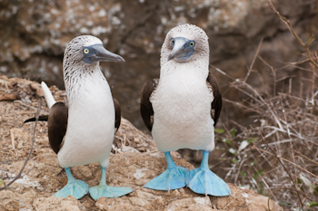

Loops
The vector after ‘in’ doesn’t need to contain numbers
It could be a vector of strings
For example, species names:
for(species in c('Heliodoxa rubinoides',
'Boissonneaua jardini',
'Sula nebouxii'))
{
print(paste('The species is', species))
}
> for(species in c('Heliodoxa rubinoides',
+ 'Boissonneaua jardini',
+ 'Sula nebouxii'))
+ {
+ print(paste('The species is', species))
+ }
[1] "The species is Heliodoxa rubinoides"
[1] "The species is Boissonneaua jardini"
[1] "The species is Sula nebouxii"
22

Slide 23
Loops
R has a built-in variable called LETTERS - a vector of capital letters
Have a look at it:
This loop prints out each letter in turn:
LETTERS
for(l in LETTERS)
{
print(l)
}
> for(l in LETTERS)
+ {
+ print(l)
+ }
[1] "A"
[1] "B"
...
23

Slide 24
Loops
All the loops so far have used print()
We can do more interesting things within the body of the loop
Let’s calculate 1 * 2 * 3 * 4 * 5 * 6 * 7 * 8 * 9 * 10
ten.factorial <- 1
for(counter in 1:10)
{
ten.factorial <- ten.factorial * counter
print(ten.factorial)
}
ten.factorial
Why start with 1?
Why not start with 0?
This is call initialization
> ten.factorial <- 1
> for(counter in 1:10)
+ {
+ ten.factorial <- ten.factorial * counter
+ print(ten.factorial)
+ }
[1] 1
[1] 2
[1] 6
...
> ten.factorial
[1] 3628800
24

Slide 25
Exercise 6: write some for loops
Write a loop that prints a message 5 times
The message could be your name, the name of your favourite species or a message of love for R
Write a loop that prints the numbers 50 to 40 in reverse order
Write a loop that calculates 2*4*6*…*24
Write a loop that pastes all the letters A to Z into a single string, in reverse order
25
Notes:
Discuss behaviour for model for different values of r

Slide 26
Exercise 6: write a for loop
6. Write a loop that fills this vector of zeros with the values 10, 10², 10³ etc up to 10¹⁰
If you need to, look back through the slides to find out:
how to calculate powers
how to set an element of a vector
X <- rep(0, 10)
26

Slide 27
Exercise 6: write a for loop
7. Write a loop that displays exponential growth in output like this:
[1] "At week 1 population size is 2"
[1] "At week 2 population size is 4"
[1] "At week 3 population size is 8"
[1] "At week 4 population size is 16"
[1] "At week 5 population size is 32"
[1] "At week 6 population size is 64"
[1] "At week 7 population size is 128"
[1] "At week 8 population size is 256"
[1] "At week 9 population size is 512"
[1] "At week 10 population size is 1024"
27
Notes:
27

Slide 28
Exercise 6: write a for loop
8. Write a loop that displays dates like this:
[1] “Year 1980, Month 1"
[1] “Year 1980, Month 2"
[1] "Year 1980, Month 3"
[1] “Year 1980, Month 4"
[1] "Year 1980, Month 5"
[1] "Year 1980, Month 6"
[1] "Year 1980, Month 7"
…
But make it go through all months in all years 1980 to 1990. Hint: you will need two for loops, one inside the other.
Challenge: make it display the month names instead of numbers.
28
Notes:
28

Slide 29
Some ways of using for loops
Doing the exact same thing a bunch of times
Print “We love R” several times
Print “Hello world” several times
Doing variants on a theme
Print “The year is 1990, The year is 1991, …”
Updating a variable that was initialized beforehand so that in the end it has the desired value
The factorial example
You can also update two or more variables each time through
Filling up a vector with values, perhaps with each depending somehow on the previous one
Double for loops (or triple, quadruple, etc., but watch out for speed!)

Slide 30
Brackets
You may have noticed, R uses three different types of brackets
Parentheses () – for function calls and in maths expressions:
Hard brackets / square brackets [] – vector elements:
Braces / curly brackets {} – functions, loops etc:
All differ from each other, and also these conventions differ from those of some other languages – confusing, but you get used to it
TreeHeight(c(37, 25, 31), 40) OR (2+3)*4
LETTERS[2]
for(l in LETTERS)
{
print(l)
}
30

Slide 31
Modelling
We will look at some simple models of population dynamics
31

Slide 32
Exponential growth
A model of exponential population growth:
N_{t+1} = N_{t} λ
What all the bits mean
N_{t} - the population size at time t
N_{t+1} - the population size at time t+1
λ - the intrinsic growth rate
If λ is 2 the population will double in size at every generation
If λ is 0.5 then population will halve in size at every generation
32

Slide 33
Exponential growth
There are two ways to model exponential growth:
N_{t+1} = N_{t} λ
N_{t+1} = N_{t} e^{r}
In which case
λ = e^{r}
log(λ) = r
λ -intrinsic growth rate
r - intrinsic rate of increase
e - Euler’s number ≈ 2.71828
33

Slide 34
Loops and functions together!
We’ll now create a script that simulates the exponential growth model
Save your old script
Create a new script called “Exponential.R”
34

Slide 35
Exponential growth
N_{t+1} = N_{t} e^{r}
Enter the following into your script:
Exponential <- function(N0=1, r=1, generations=10)
{
# Runs a simulation of exponential growth
# Returns a vector of length generations
N <- rep(NA, generations) # Creates a vector of NA
N[1] <- N0
for (t in 2:generations)
{
N[t] <- N[t-1] * exp(r)
}
return (N)
}
plot(Exponential(), type="l", main="Exponential growth")
35

Slide 36
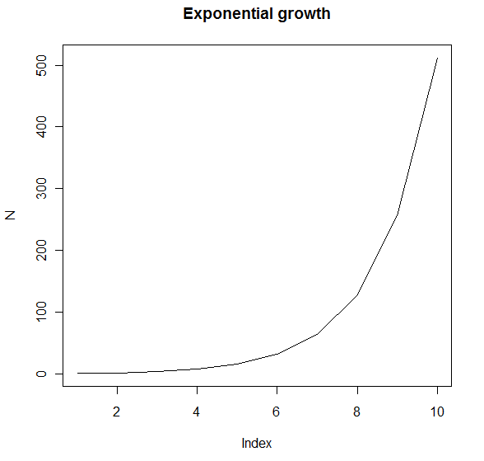
Exponential growth
You should see a graph:
36

Slide 37
Comments
Anything after a # is a comment:
Comments are not looked at by R – they are for humans only
You can put comments anywhere in a script
You can also put comments on the same line as code that is executed
# Runs a simulation of exponential growth
# Returns a vector of length generations
N <- rep(NA, generations) # Creates a vector of NA
This is run by R
This is ignored by R
37

Slide 38
Comments
It is a good idea to put short comments in your scripts:
At the top of your scripts, explaining what they do
At the top of functions you write, explaining what the function does
Next to any variable names whose names are not self-explanatory
Together with any sections of code whose purpose is not obvious
Misleading, unclear or contradictory comments are worse that no comments at all!
38

Slide 39
Default parameter values
We have provided default parameter values:
N0=1 means that if the function caller doesn’t provide a value for N0, it will have a value of 1
Similarly for r=1 and generations=10
Exponential <- function(N0=1, r=1, generations=10)
39

Slide 40
Default parameter values
If we wanted to simulate the model for 50 generations:
N0 and r would be as given in the function definition
Many R functions such as plot() work similarly
For example, to plot a black graph:
To plot a red graph:
Exponential(generations=50)
plot(1:10)
plot(1:10, col="red")
40

Slide 41

Not Applicable and rep()
NA – Not Applicable
Indicates missing values
If you have a variable that will contain a result, set it to NA to begin with
If you see NA at the end, something has gone wrong
rep() creates a new vector of a value that is repeated many times
So the line:
Creates a vector of length 10, each value is NA
rep(NA, 10)
41

Slide 42
Density dependent growth
The Ricker model of population growth:
N_{t+1} = N_{t} e^{r (1-Nt/K)}
Unlike the exponential growth model, the Ricker exhibits density dependence
N_{t} - the population size at time t
N_{t+1} - the population size at time t+1
r - the intrinsic rate of increase
K - carrying capacity
e - Euler’s number (2.71828...)
42

Slide 43
Density dependent growth
N_{t+1} = N_{t} e^{r (1-Nt/K)}
The equation might look complicated but let’s analyse it bit by bit
A good way to get a feel for a model is to think about how it behaves at limits
Let’s see what happens for different values of N_{t}
43

Slide 44
N_{t} is small
N_{t+1} = N_{t} e^{r (1-Nt/K)}
When N_{t} is close to 0, the model behaves like
N_{t+1} = N_{t} e^{r (1-0/K)}
The 0/K bit is 0, so we are left with
N_{t+1} = N_{t} e^{r}
Which is the exponential growth model
So when N_{t} is small, we expect to see exponential growth, or close to it
44

Slide 45
N_{t} is K
N_{t+1} = N_{t} e^{r (1-Nt/K)}
When N_{t} is close to K, the model behaves like:
N_{t+1} = N_{t} e^{r (1-K/K)}
K/K is 1
1-1 is 0
r x 0 is 0
Any number to the power 0 is 1 so the e^{r (1-K/K)} part becomes 1
When N_{t} is close to K, the model behaves like:
N_{t+1} = N_{t}
45

Slide 46
N_{t} is large
N_{t+1} = N_{t} e^{r (1-Nt/K)}
When N_{t} is very large, the model behaves like:
N_{t+1} = N_{t} e^{r (1-∞/K)}
∞/K is ∞
1- ∞ is -∞
r * -∞ is -∞
Negative powers mean “1 over”
So when N_{t} is large, the model behaves like:
N_{t+1} = N_{t}/e∞ = 0
46

Slide 47
Expected behaviour
N_{t+1} = N_{t} e^{r (1-Nt/K)}
The behaviour we expected if we simulate the model starting with these values of N:
N | Model
Small | Exponential growth
K | No change
Large | Population crash
47

Slide 48
The Ricker model in R
We’ll now create a script that uses our own functions together with loops
Start a new script, save it, call it Ricker.R
DON’T LOOK AT THE NEXT SLIDE
Write a function that implements the Ricker model
Try it out, test it
THEN you can look at the next slide
48

Slide 49
The Ricker model in R
N_{t+1} = N_{t} e^{r (1-Nt/K)}
A function to run Ricker models:
Ricker <- function(N0=1, r=1, K=10, generations=50)
{
# Runs a simulation of the ricker model
# Returns a vector of length generations
N <- rep(NA, generations) # Creates a vector of NA
N[1] <- N0
for (t in 2:generations)
{
N[t] <- N[t-1] * exp(r*(1.0-(N[t-1]/K)))
}
return (N)
}
plot(Ricker(generations=10), type="l")
49

Slide 50
The Ricker model
N_{t+1} = N_{t} e^{r (1-Nt/K)}
How does the Ricker behave over 10 generations?
Save the script and copy/paste the code into R
50

Slide 51
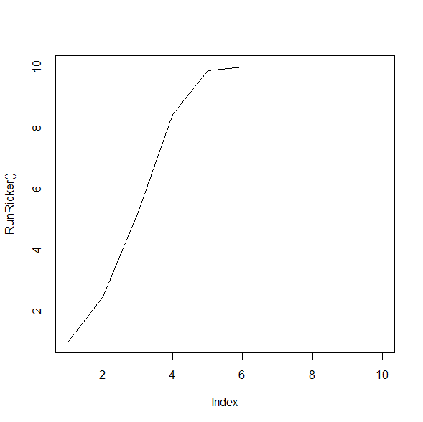
The Ricker model
You should see a graph:
51

Slide 52
Exercises 7: Ricker
How does the Ricker behave for different values of N0?
Using the defaults for r, K and generations, plot graphs using different values of N0
Try setting N0 to each of the cases we identified - small, K and large
Does it behave as we predicted?
Note that once you have a function in hand, these questions are much easier to explore
52

Slide 53
Exercises 7: Ricker
How does the Ricker behave for different values of r?
Produce a single graph containing 5 lines
Line should be the results of the Ricker for r=0.2, r=0.5, r=1, r=1.5 and r=1.9
Use the Ricker() function together with plot() and lines()
If you can, plot each trace in a different colour
53

Slide 54
Exercises 7: Ricker
Expand your script to examine how sensitive the Ricker model is to the initial value of N
With r=2.5 and K=20,000 try these values for N0:
10,000
10,001
Put both lines on the same graph
Do the lines for each N0 look the same?
Try the same values of N0 with r=2.75
Try the same values of N0 with r=3
What happens?
54

Slide 55
Exercises 7: Ricker
If you made it this far and want to do more, investigate the logistic growth model
N_{t+1} = rN_{t} (K-N_{t})
Write a new script with a function for this model
Pick values of N0 and K and see how the model behaves for different values of r
If you are really keen, investigate the models in Table 1. of Cohen. 1995. Unexpected dominance of high frequencies in chaotic nonlinear population models.
55

Slide 56
If statements, if-else statements
These are straightforward
The body can be as many lines of code as you like
if (x==1) #note you must use ==, not =
{
print(‘x was 1’)
}
condition
body
if (x>=1)
{
print(‘x was >= 1’)
} else
{
print(‘x was < 1’)
}
56
Notes:
56

Slide 57
If statements, if-else statements
You can put if or if-else statements inside for loops
You can put for loops inside if and if-else statements
You can put function calls inside if and if-else statements
You can put if and if-else statements inside function bodies
Like all coding constructs, the power comes by combining constructs
You’ll get practice on if and if-else in the practical
57
Notes:
57

Slide 58
Exercise: if statements, other stuff
Write a function that
Accepts a single integer argument
Returns “even” if it is even, “odd” if it is odd
Write a function that
Accepts a single integer argument
Returns “power” if it is a power of 2
Returns “not power” otherwise
You may need the command log2 and the operator %%
Write a function that
Accepts a single integer argument
Returns “prime” if it is prime, “unit” if it is 1, “zero” if “0”, “composite” otherwise

Slide 59
Getting help with R
You can get help on an R function by using ?
A help window will open
The help assumes a large degree of knowledge and can seem cryptic
To get help on mean()
?mean
59

Slide 60
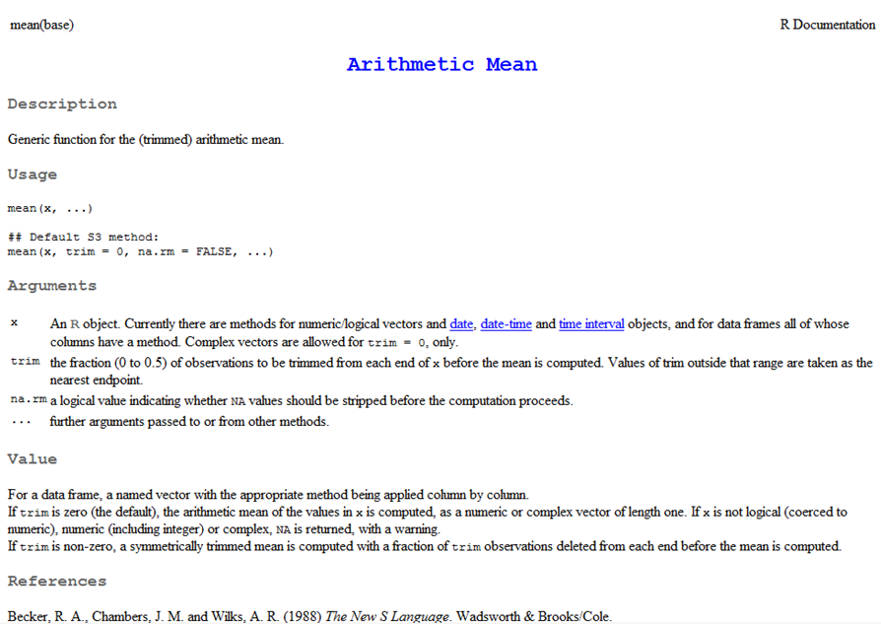
R help pages
Description
A short overview of what the function does
Arguments
A description of each argument that the function takes
Values
What the function returns
60

Slide 61
Getting help with R
I usually search google, prefixing the search with “R project”
You can search the R website from R itself:
> RSiteSearch("vector outer product")
A search query has been submitted to http://search.r-project.org
The results page should open in your browser shortly
61

Slide 62
Summary
We covered
Writing your own functions
Creating and using R scripts
For loops
Comments
Running modelling simulations
Getting help with R
Default parameter values, named parameters
If else statements
62

Slide 63
On your own, and soon (tonight)
Finish the exercises introduced today, if you have not already finished
Revise the material delivered today
Really try to internalize both the concepts and the technical R bits – you’ll need to build on these more and more as you go, so they need to become second nature!
Additional exercises to follow – do them!

Slide 64
Homework exercise
Suppose a sheep population consists of juveniles and adults
Suppose each year the average female adult births 1.1 juveniles, juveniles have a 30% chance of death, and adults have a 50% chance of death
Write a function that
accepts the arguments J0 and A0, which are populations of juveniles and adults in year 0; and n, the year to which to simulate
Make it print to the screen the populations for juveniles and adults in each year from 0 up to n; also make it plot
It returns the final populations in a length-2 vector
What does the population trajectory look like after a transient period, regardless of initial densities?

Slide 65
Homework exercises
Write a function that accepts as argument a single positive integer, and it tells you whether it is a prime number or not
Write a script that accepts a single positive integer and it tells you whether it is another integer raised to the third power
Write a script that accepts a vector, x, consisting of repetitions of the symbols ‘A’, ‘C’, ‘G’, ‘T’ in random orders and another such vector, y, written in to the top lines, and tells you whether y occurs anywhere as a sub-vector of x

Slide 66
Homework exercise
Download the file SequenceData.RData from blackboard, put it in your working directory, and load it into R using the command load(‘SequenceData.Rdata’). Look at it using ls() and by displaying the two variables in it, longseq and shortseq, to the screen
The variable shortseq aligns (i.e., agrees very well) with some sub-sequence of longseq. Find the subsequence. How good is the agreement?

