Slide 1
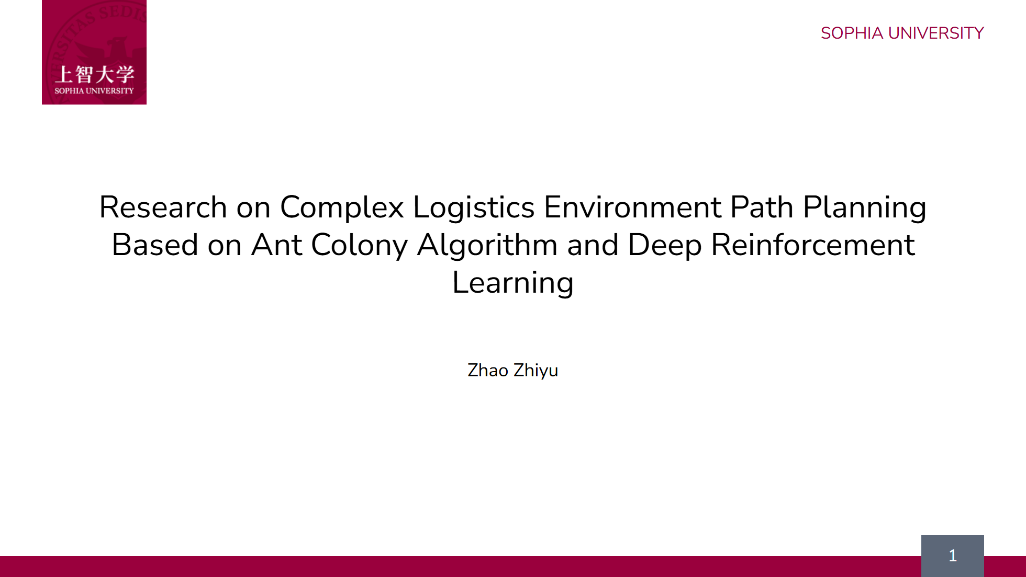
Notes:
Hello everyone. My name is Zhao Zhiyu. My research is about helping robots find the best path in a busy warehouse.

Slide 2
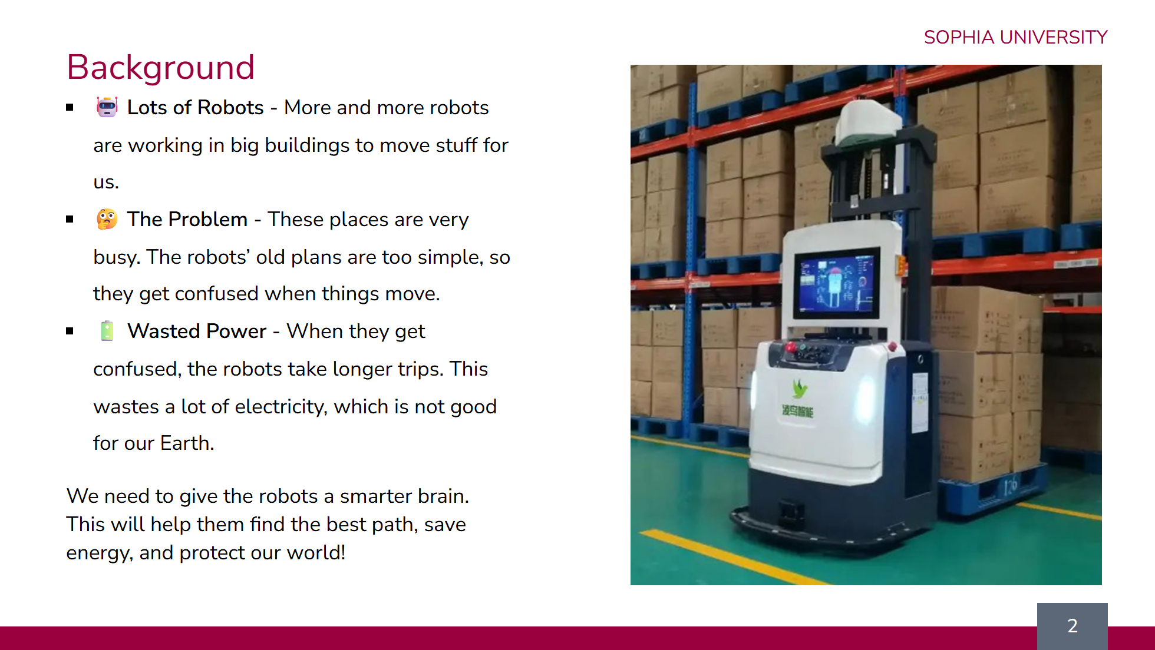
Notes:
So, let's look at the background for my research. First, there are lots of robots. Because we all shop online more, companies use more robots in their warehouses to move things quickly. But there is a problem. These warehouses are very busy and always changing. The robots' plans are too simple, like a basic map. They get confused when something unexpected blocks their way. This confusion causes them to take long, inefficient trips. This wastes a lot of battery power. With thousands of robots, it's a big waste of electricity and bad for the environment. So, the goal of my research is to give these robots a smarter brain. A brain that can see the busy environment and make smart decisions. This will help them find the best path, save energy, and create a greener system.

Slide 3
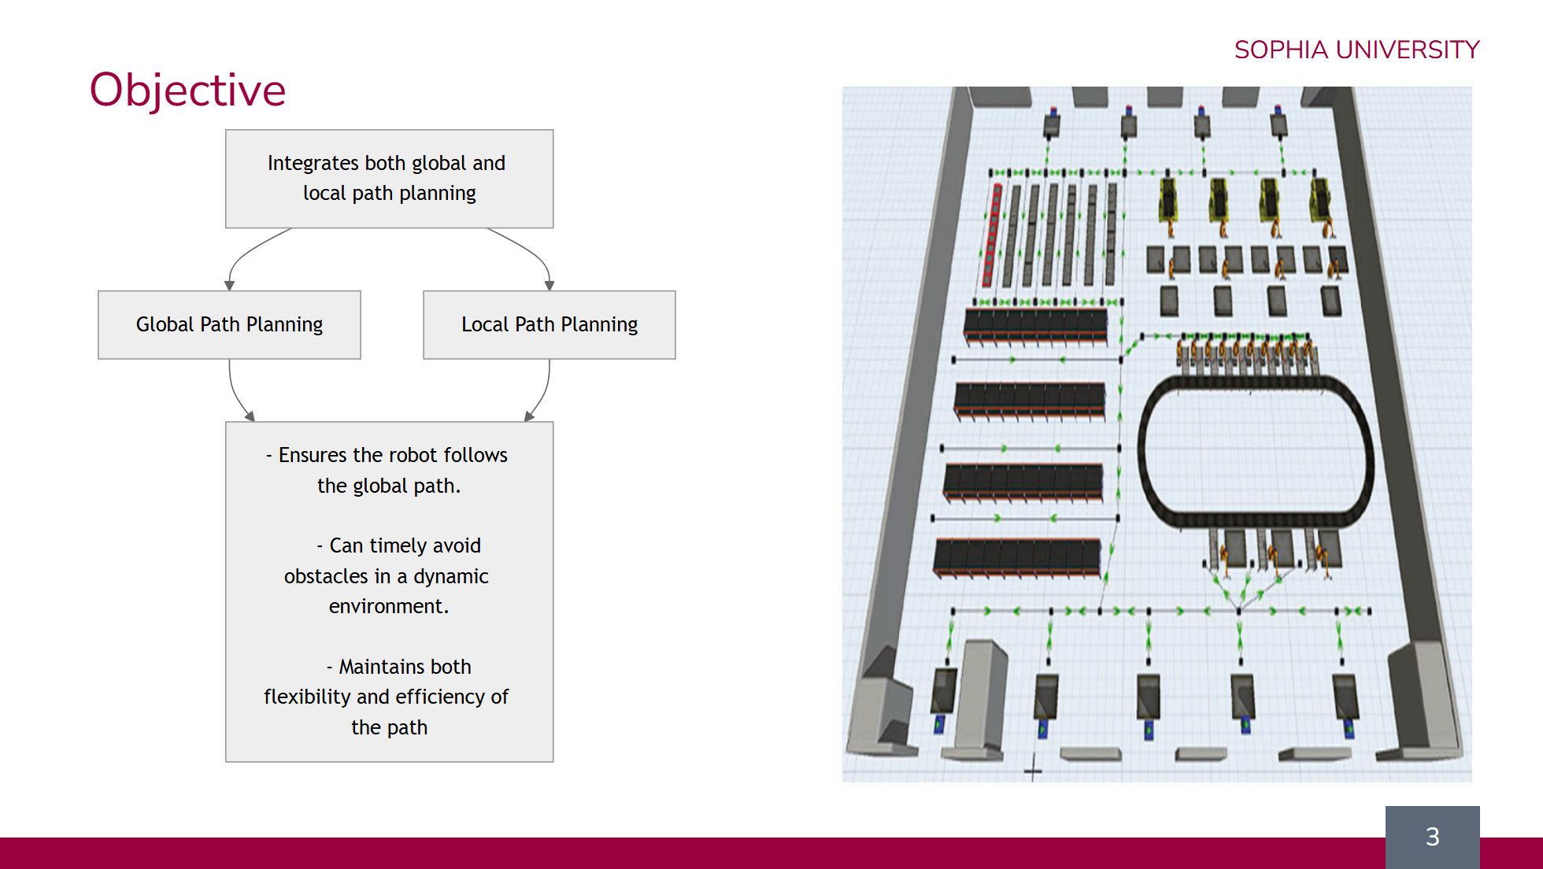
Notes:
So, what is the objective of my research? My goal is to create a system that combines two kinds of planning. You can think of it as a "big plan" and a "quick reaction" plan. The "big plan" is Global Path Planning. It's like using a map to find the best main route for a long trip. The "quick reaction" is Local Path Planning. This helps the robot see and avoid sudden obstacles, like another robot that is in the way. When we combine these two plans, we get three good results: The robot follows the best and most efficient main path. It can quickly and safely avoid any surprises. This makes the robot's final path both fast and flexible. This is the main goal.

Slide 4
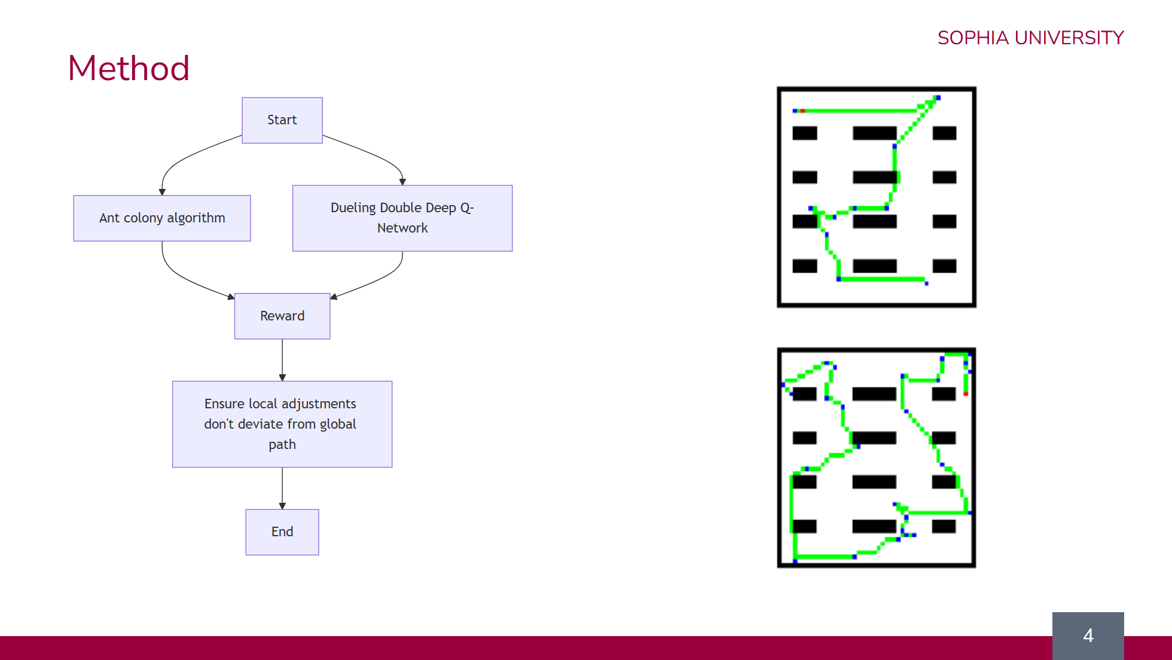
Notes:
Now, I will explain my method. It uses two main parts that work together. First, the Ant Colony Algorithm creates the "big plan." It finds the best and most efficient order to visit all the targets on the map. Second, the Dueling Double Deep Q-Network is for the "quick reactions." It is the robot's smart brain that helps it make decisions in real-time to avoid any surprise obstacles. The robot learns by getting rewards. It gets points for good actions, like following the big plan and avoiding walls. A key rule is that the robot's quick, local moves should not go too far away from the efficient main path. On the right, you can see an example. The top image shows the simple global path. The bottom image shows the robot's final path. It makes small changes to avoid things, but it still follows the main route.

Slide 5
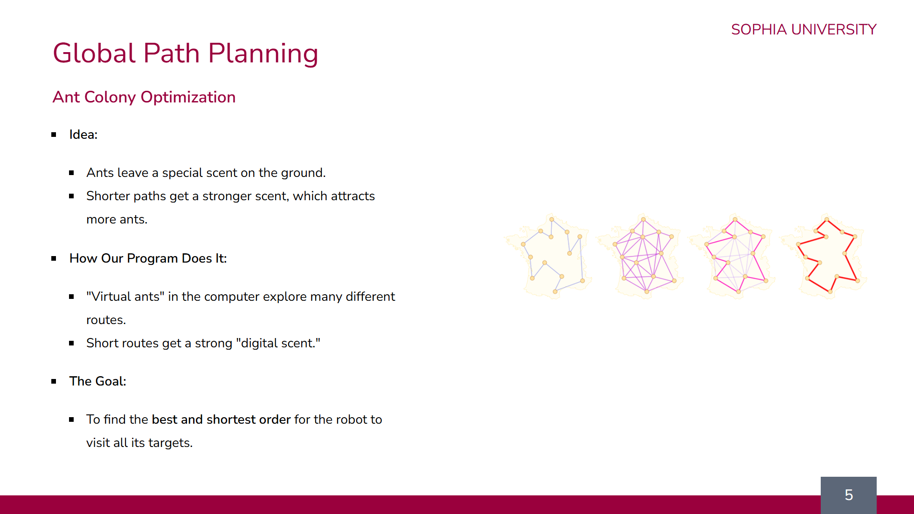
Notes:
First, let's look at Global Path Planning. I used the Ant Colony Optimization algorithm for this part. The main idea comes from how real ants find food. When an ant finds a good, short path, it leaves a special scent. This scent gets stronger as more ants use the path, and it attracts even more ants. My computer program does the same thing. I create "virtual ants" that explore many different routes to the robot's targets. When they find a short route, they leave a strong "digital scent." The pictures on the right show this process. At first, the paths are random. But slowly, the shorter, better paths get a stronger scent, and the bad paths are forgotten. So, the final goal of this method is to find the single best and shortest order for the robot to visit all of its targets.

Slide 6
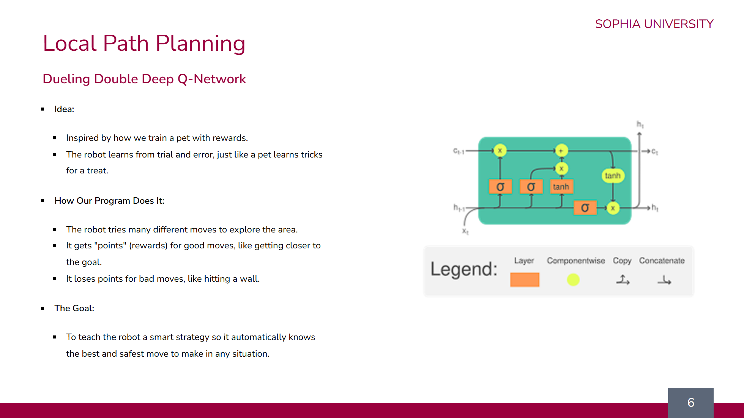
Notes:
Next is Local Path Planning. This is the "quick reaction" part of my method, and I used a technique called the Dueling Double Deep Q-Network. The main idea is very similar to how we train a pet. The robot learns from trial and error. If it does something good, it gets a reward, and it learns to avoid bad actions. In my program, the robot explores by trying many different moves. It gets points, or rewards, for good moves, like getting closer to its goal. And it loses points for bad moves, like hitting a wall. The diagram on the right shows a small piece of the robot's "brain." This brain learns from all the rewards and punishments. The final goal is to teach this brain a smart strategy. After a lot of training, the robot will automatically know the best and safest move to make in any situation.

Slide 7
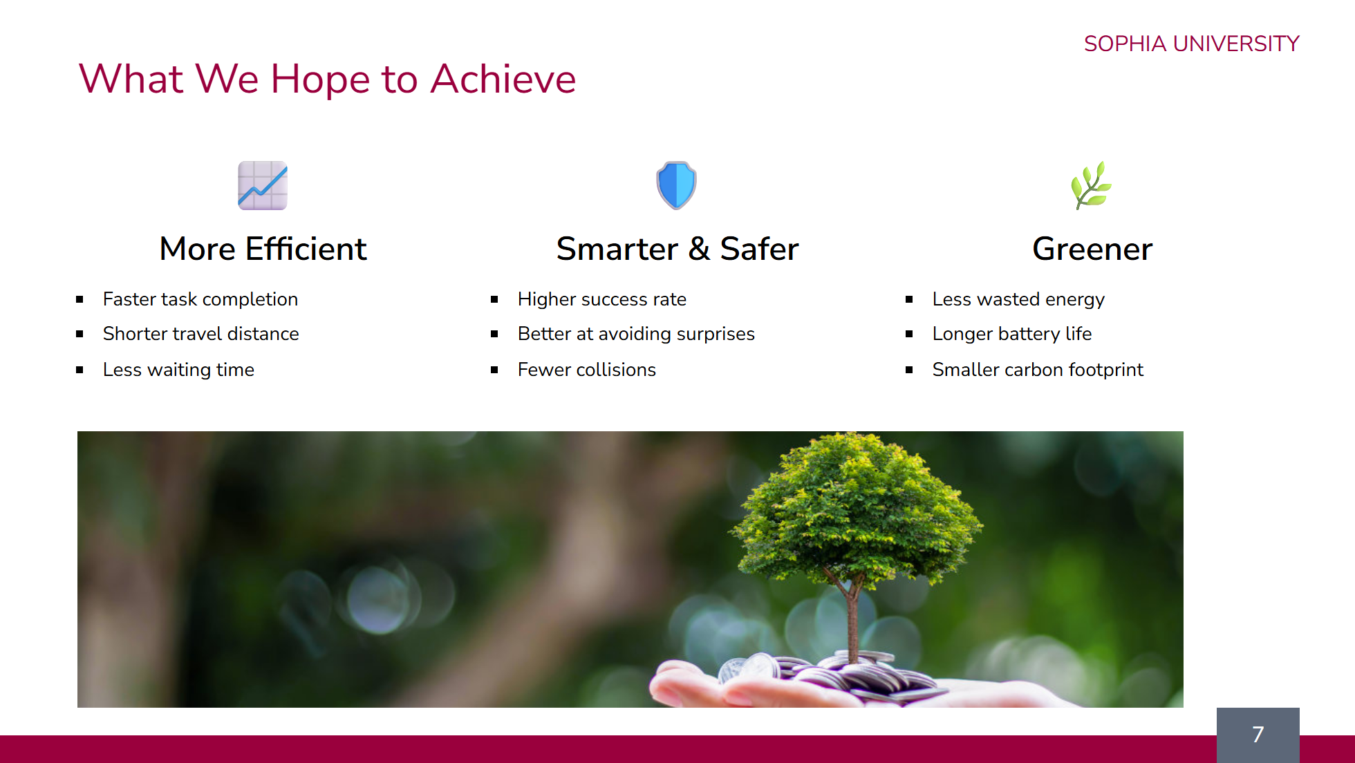
Notes:
So, what do we hope to achieve with this research? There are three main benefits. First, the robots will be more efficient. This means they will finish their tasks faster, travel shorter distances, and spend less time waiting. Second, they will be smarter and safer. They will be much better at avoiding surprise obstacles. This leads to a higher success rate and, most importantly, fewer collisions. Finally, being more efficient also makes the robots greener. When they use less energy, their batteries last longer. This reduces electricity waste and helps lower the warehouse's carbon footprint, supporting sustainability.

