Slide 1
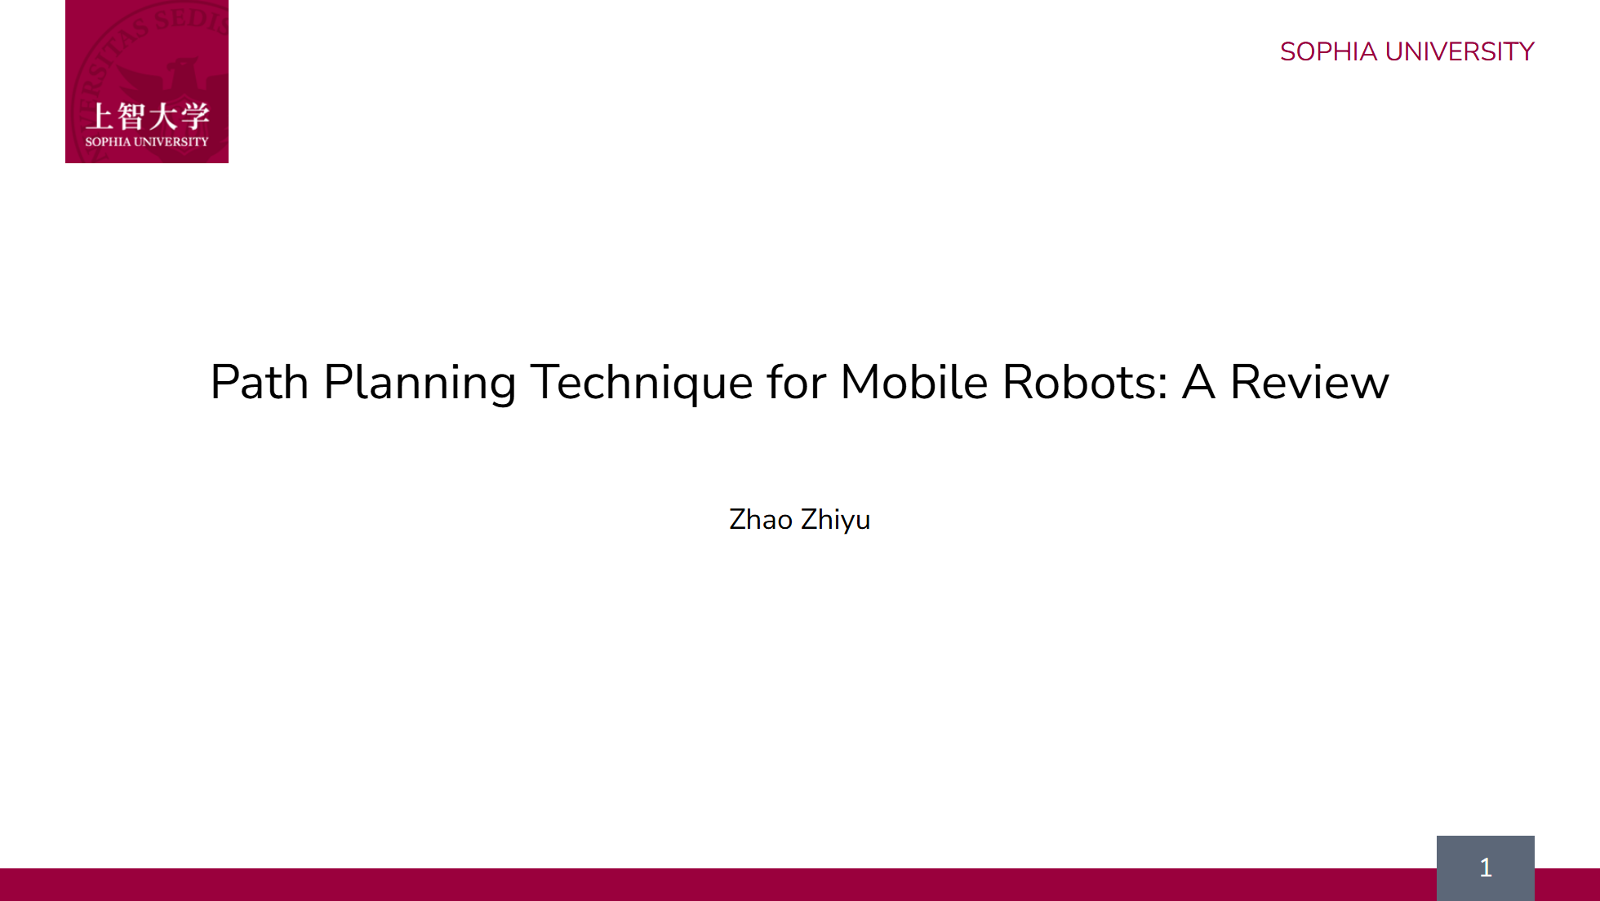
Notes:
Hello everyone. My name is Zhao Zhiyu. My research is about helping robots find the best path in a busy warehouse.

Slide 2
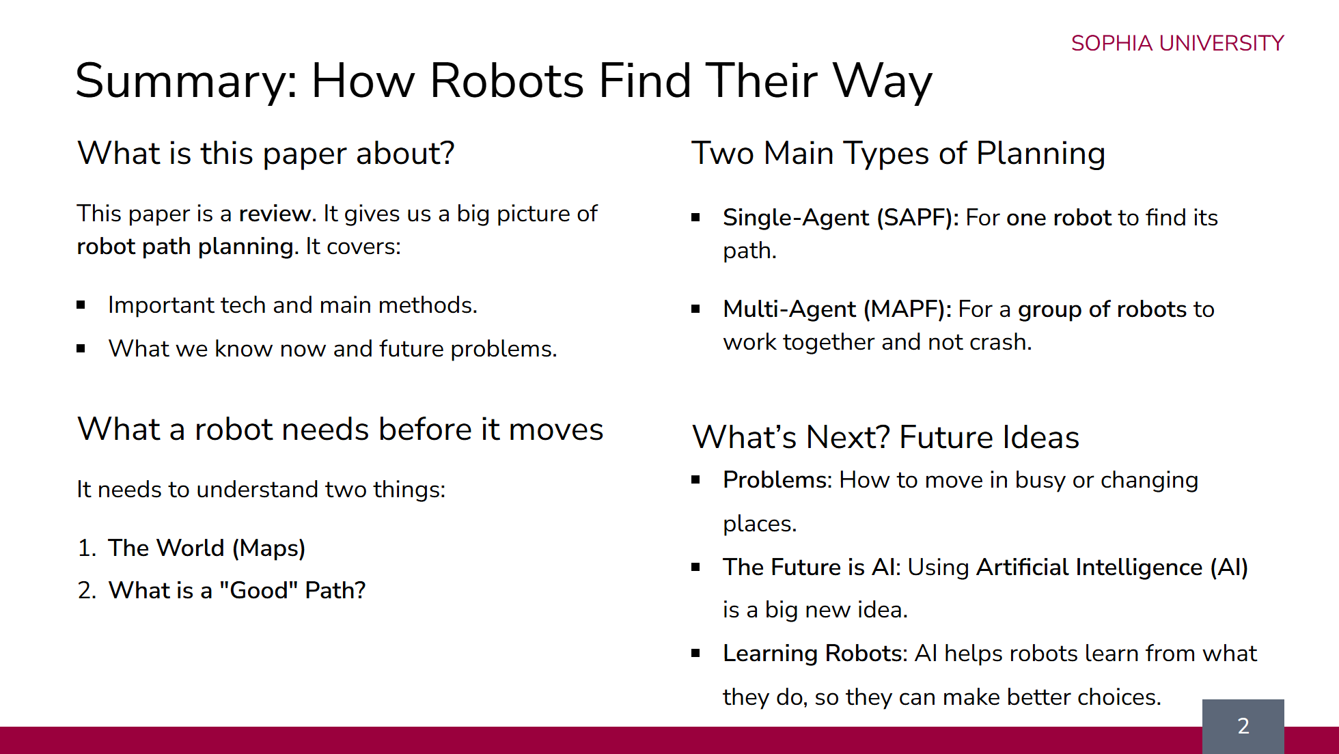
Notes:
So, let's look at the background for my research. First, there are lots of robots. Because we all shop online more, companies use more robots in their warehouses to move things quickly. But there is a problem. These warehouses are very busy and always changing. The robots' plans are too simple, like a basic map. They get confused when something unexpected blocks their way. This confusion causes them to take long, inefficient trips. This wastes a lot of battery power. With thousands of robots, it's a big waste of electricity and bad for the environment. So, the goal of my research is to give these robots a smarter brain. A brain that can see the busy environment and make smart decisions. This will help them find the best path, save energy, and create a greener system.

Slide 3
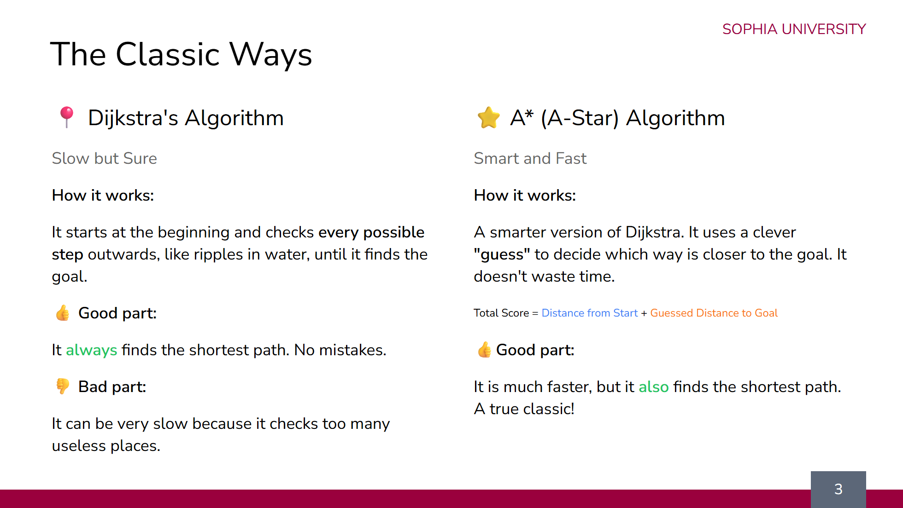

Slide 4
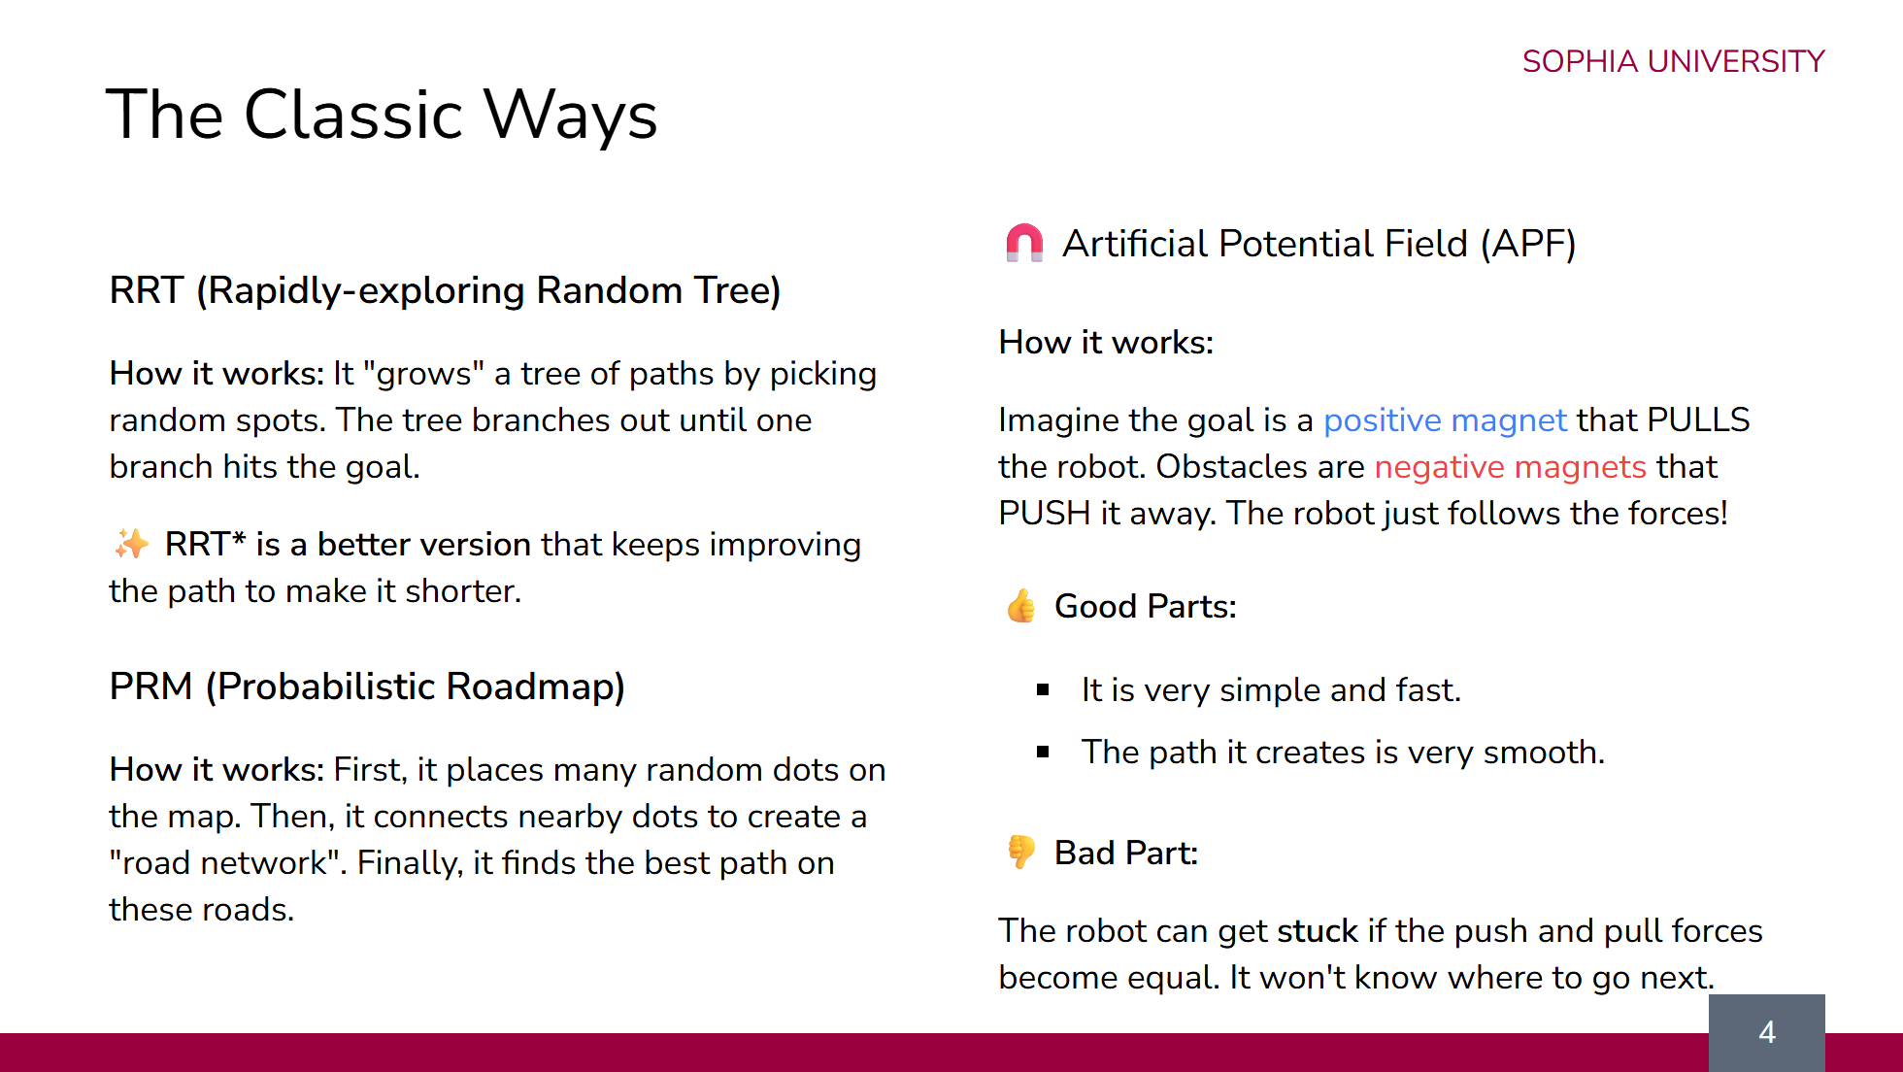

Slide 5
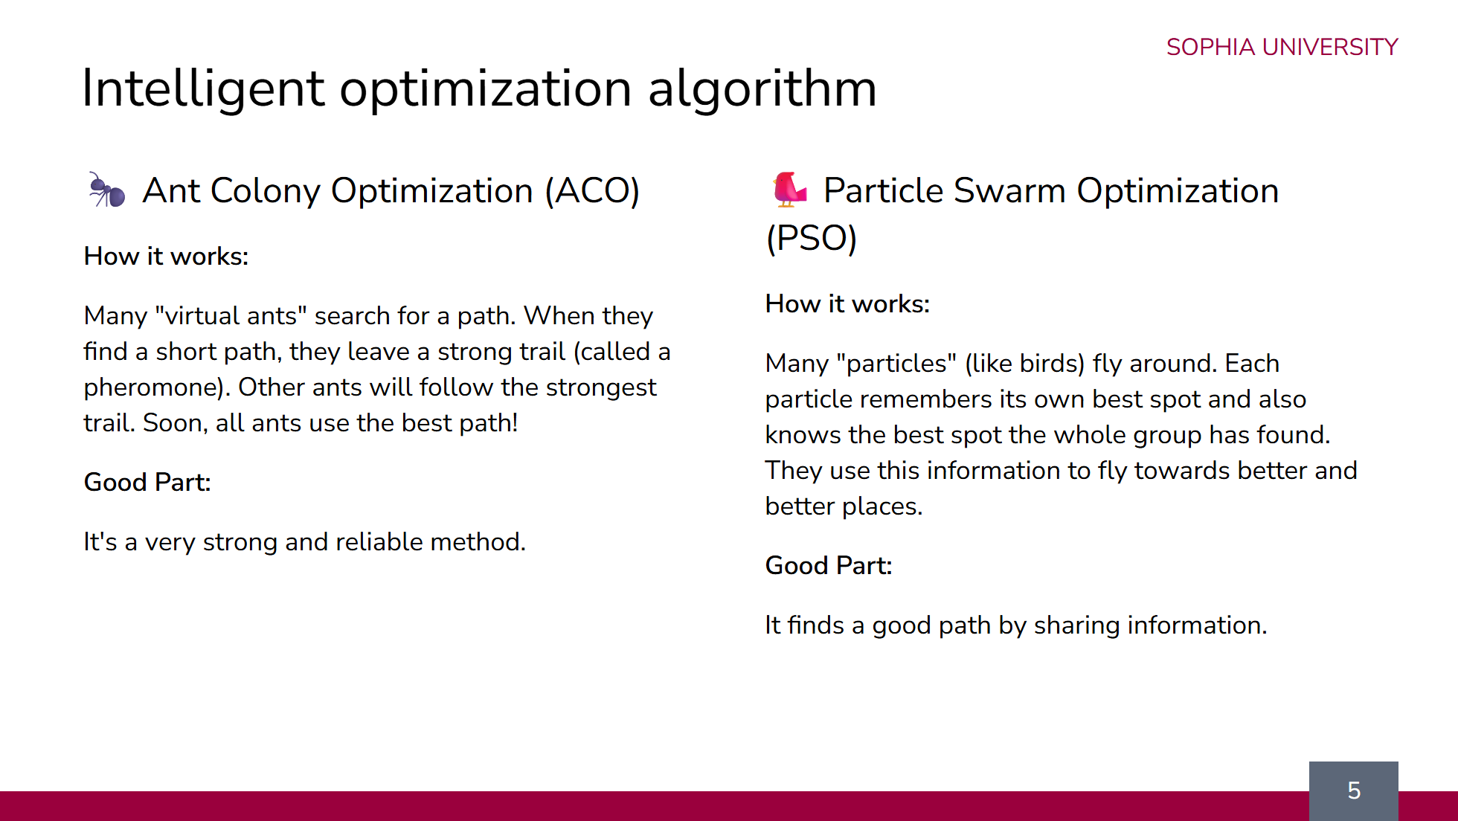

Slide 6
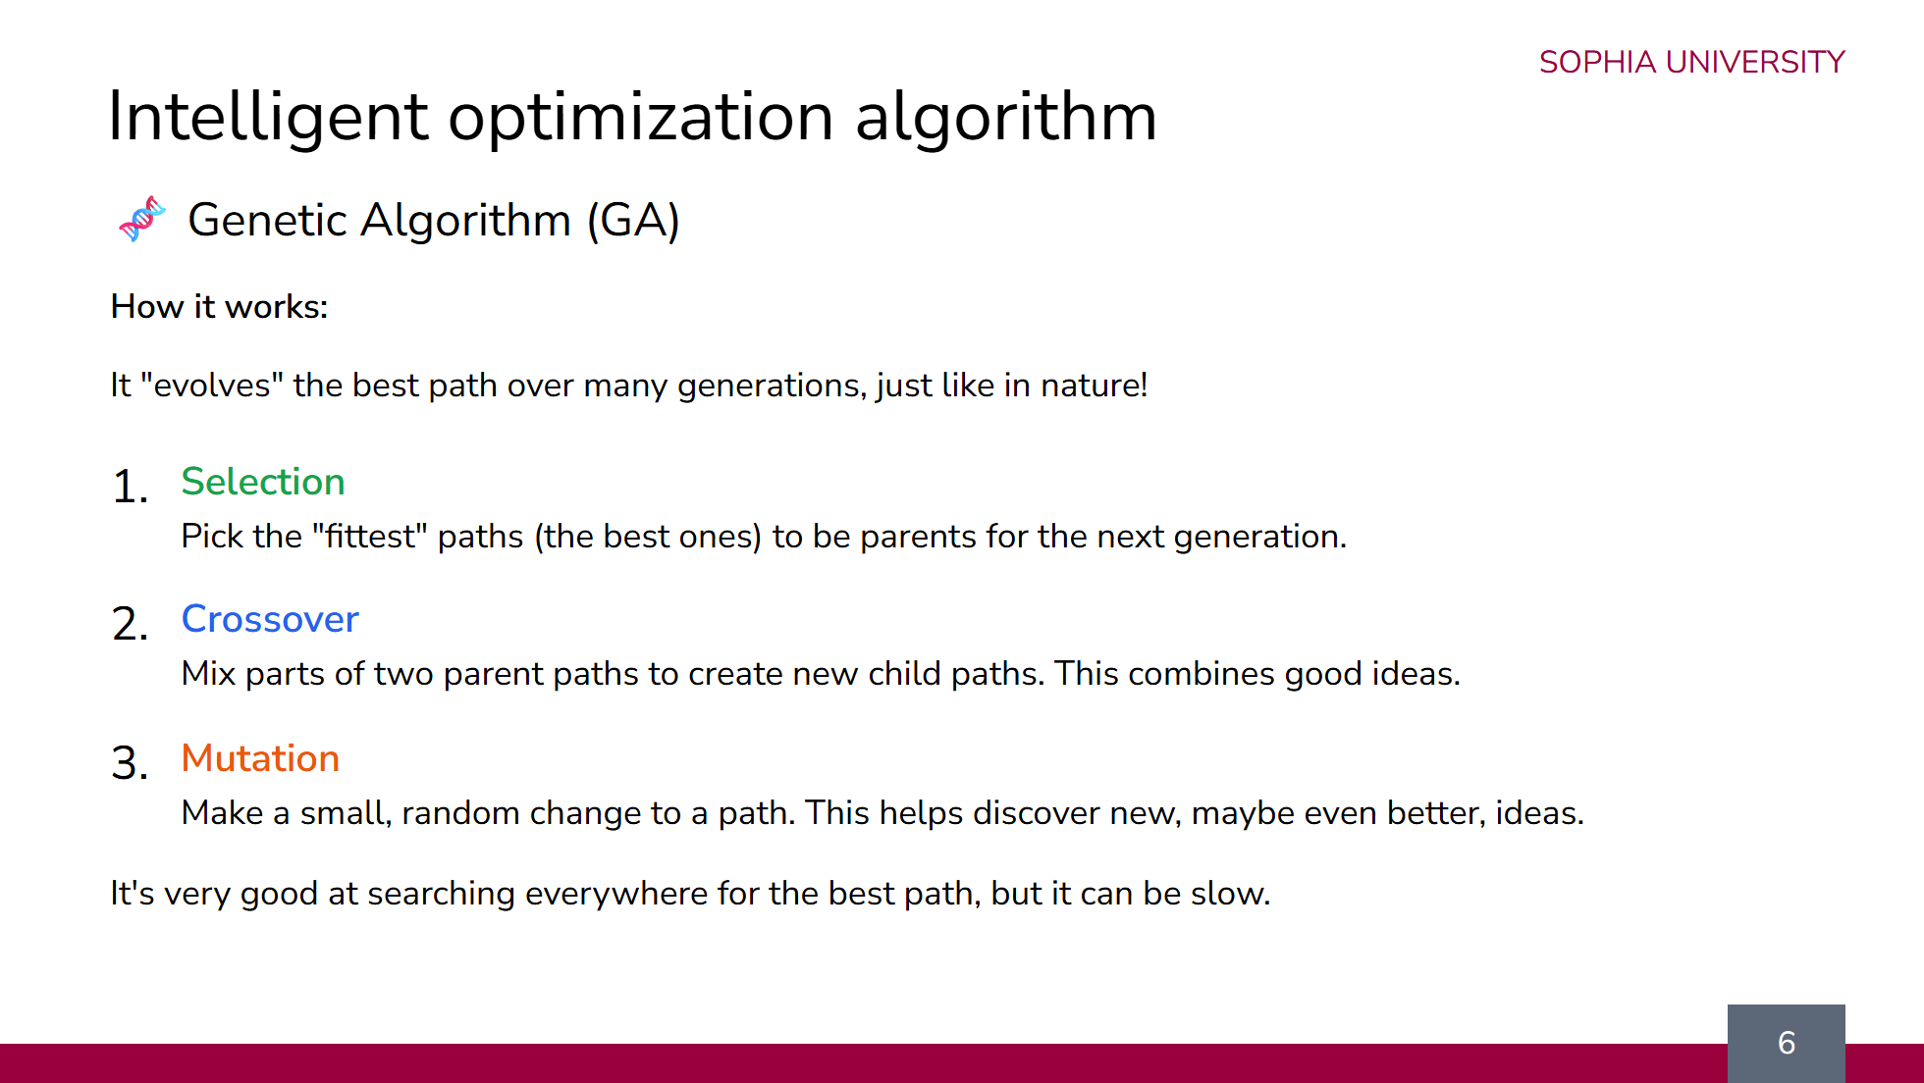

Slide 7
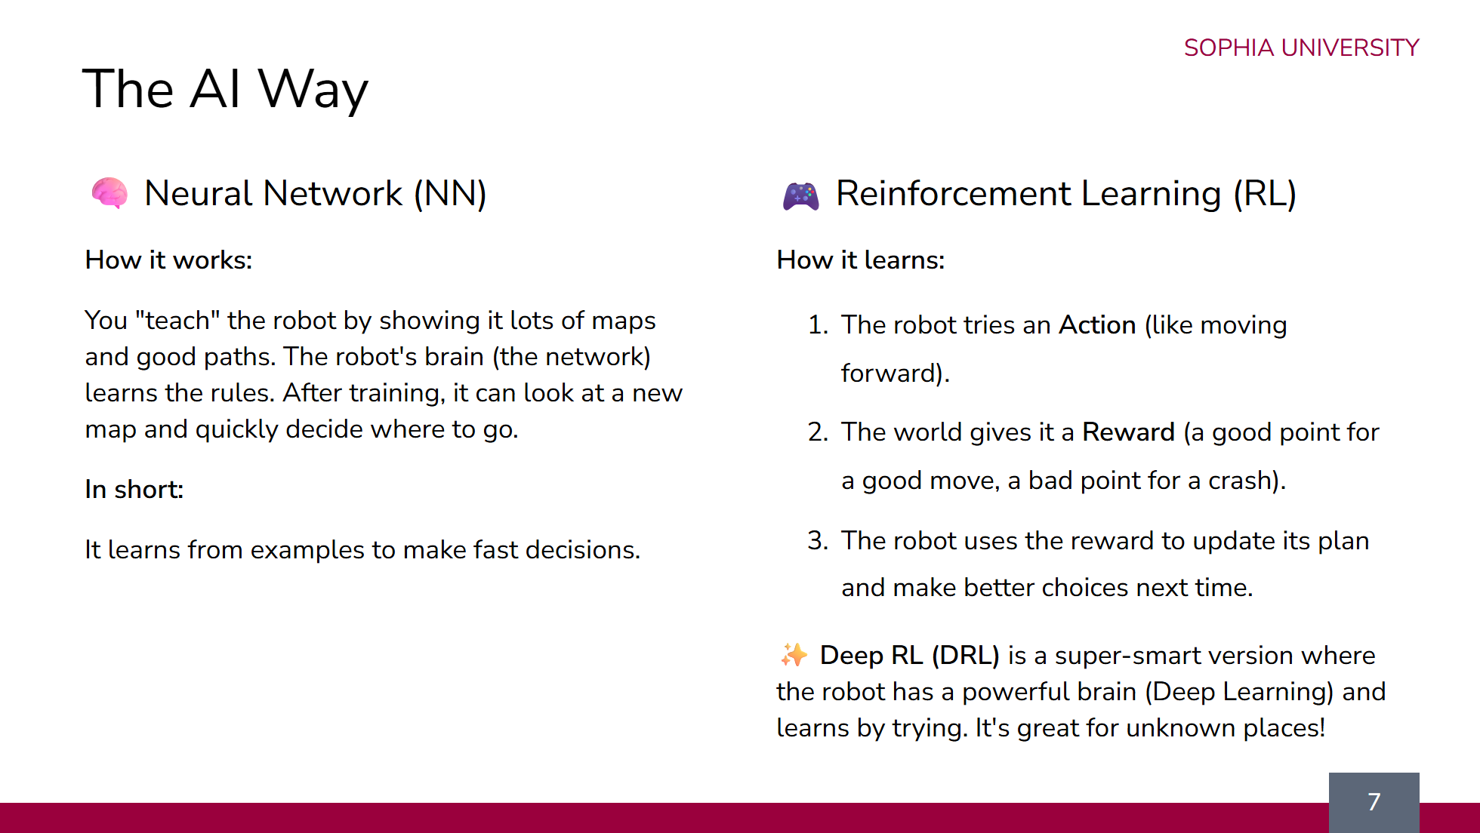

Slide 8
