Slide 1

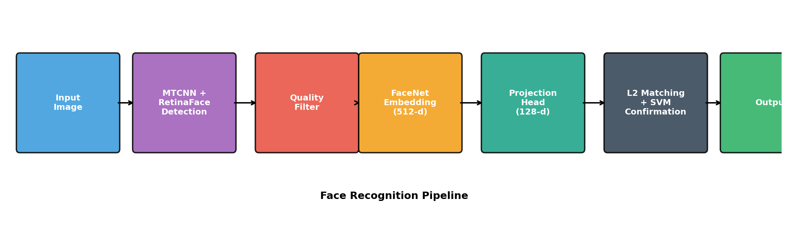
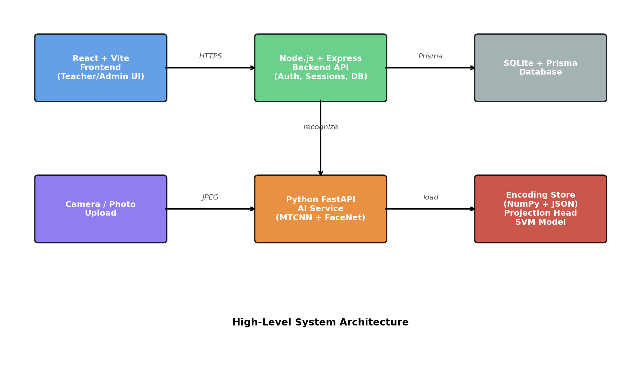
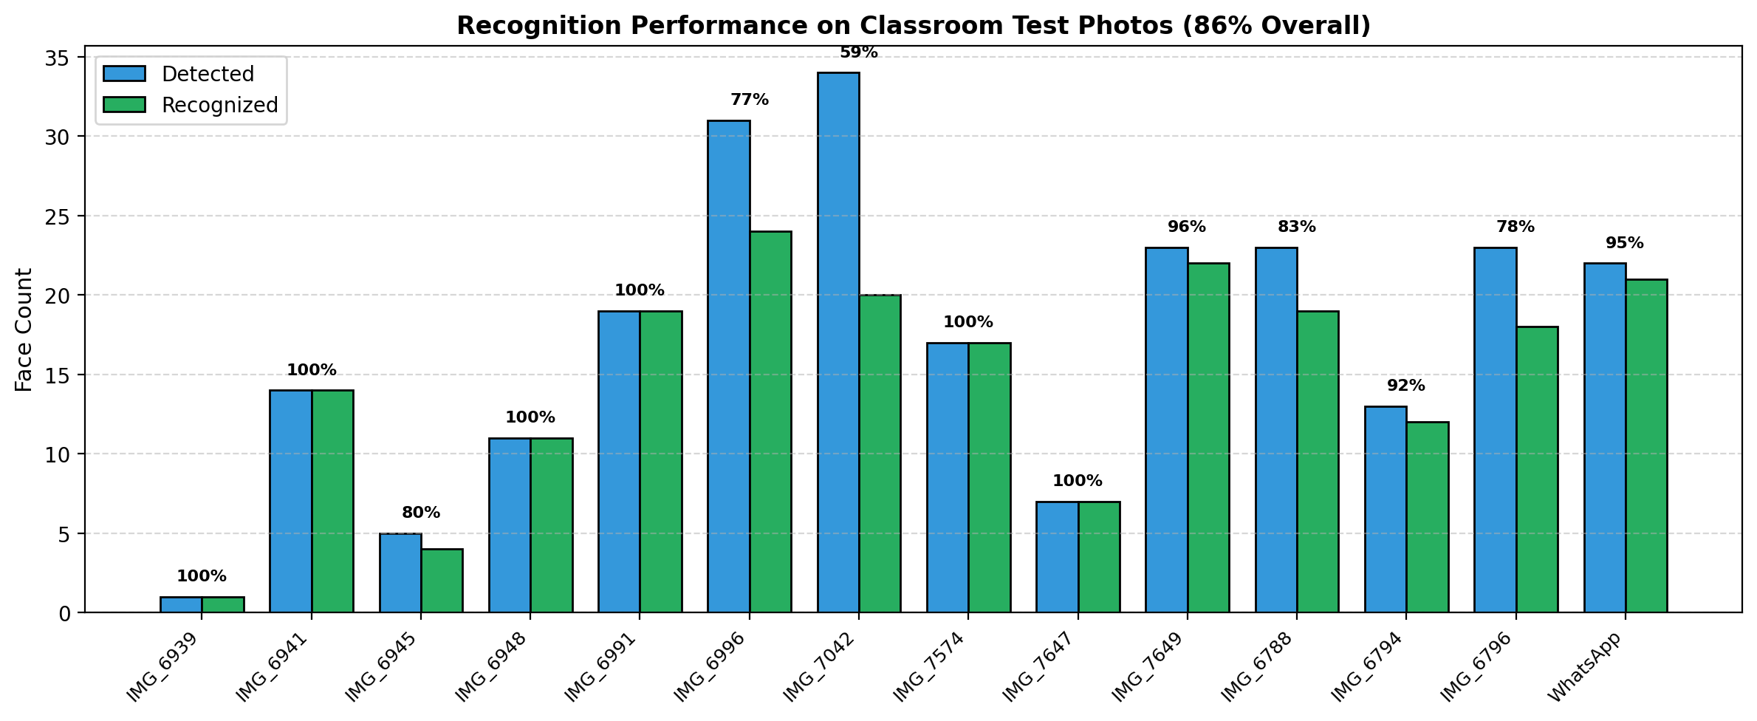
GHULAM ISHAQ KHAN INSTITUTE OF ENGINEERING SCIENCES AND TECHNOLOGY
FACULTY OF ELECTRICAL ENGINEERING
SMART ATTENDANCE SYSTEM
USING FACIAL IMAGE RECOGNITION
ABSTRACT
This project replaces manual classroom attendance with a single classroom photograph. A teacher uploads the image via a web dashboard; the system detects every face using MTCNN with a RetinaFace fallback, filters low-quality crops, embeds each face with FaceNet (512-d) followed by a learned 128-d projection head, and matches the embeddings against an enrollment store using minimum L2 distance with an SVM confirmation layer. The pipeline reaches 86% recognition on unseen classroom photos while processing each image in 1–5 seconds on commodity hardware.
OBJECTIVES
PIPELINE
▸ Eliminate roll call from classroom lectures.
▸ Reduce proxy / fraudulent attendance.
▸ Deliver auditable attendance records.
▸ Run on-premises with zero recurring cost.
▸ Preserve student privacy — no raw photos stored.
APPLICATIONS
KEY TOOLS
▸ University lectures & tutorials.
▸ Examination hall attendance & identity verification.
▸ Event / workshop registration checks.
▸ Seminar & guest-lecture tracking.
▸ Faculty-level analytics on absenteeism trends.
▸ Python 3 — FastAPI, TensorFlow, OpenCV, scikit-learn
▸ FaceNet (keras_facenet), MTCNN, RetinaFace
▸ Custom projection head (triplet loss, 128-d)
▸ Node.js + Express + TypeScript + Prisma ORM
▸ React 18 + Vite + TypeScript (frontend)
▸ SQLite (development), PostgreSQL-ready (production)
▸ Nginx + Let's Encrypt + systemd (deployment)
SYSTEM ARCHITECTURE
RESULTS
86%
243
Recognition rate
Faces evaluated
113
1–5 s
Students enrolled
Per-photo latency
CONCLUSION
The Smart Attendance System demonstrates that a single classroom photograph, processed by an on-premises deep-learning pipeline, is a practical replacement for manual roll call. The design is privacy-respecting (no raw images stored), cost-free to operate (open-source stack on a free-tier VM), and ships with a teacher-review step that guards against residual recognition errors.
Built at GIK Institute • Faculty of Electrical Engineering • Senior Design Project 2025-26
GROUP MEMBERS
ADVISOR
Hassaan Ahmed
Osaid Khan Afridi
Dr. Zaiwar Ali
FCSE
FCSE
CO-ADVISOR
Dr. Arbab Abdur Rahim
Saad Khan
Najaf
FEE
FEE

