Slide 1
Detector
Generator
GAN

Slide 2
Encoder
Decoder
Detector
VAE
Generator
GAN

Slide 3




Slide 4
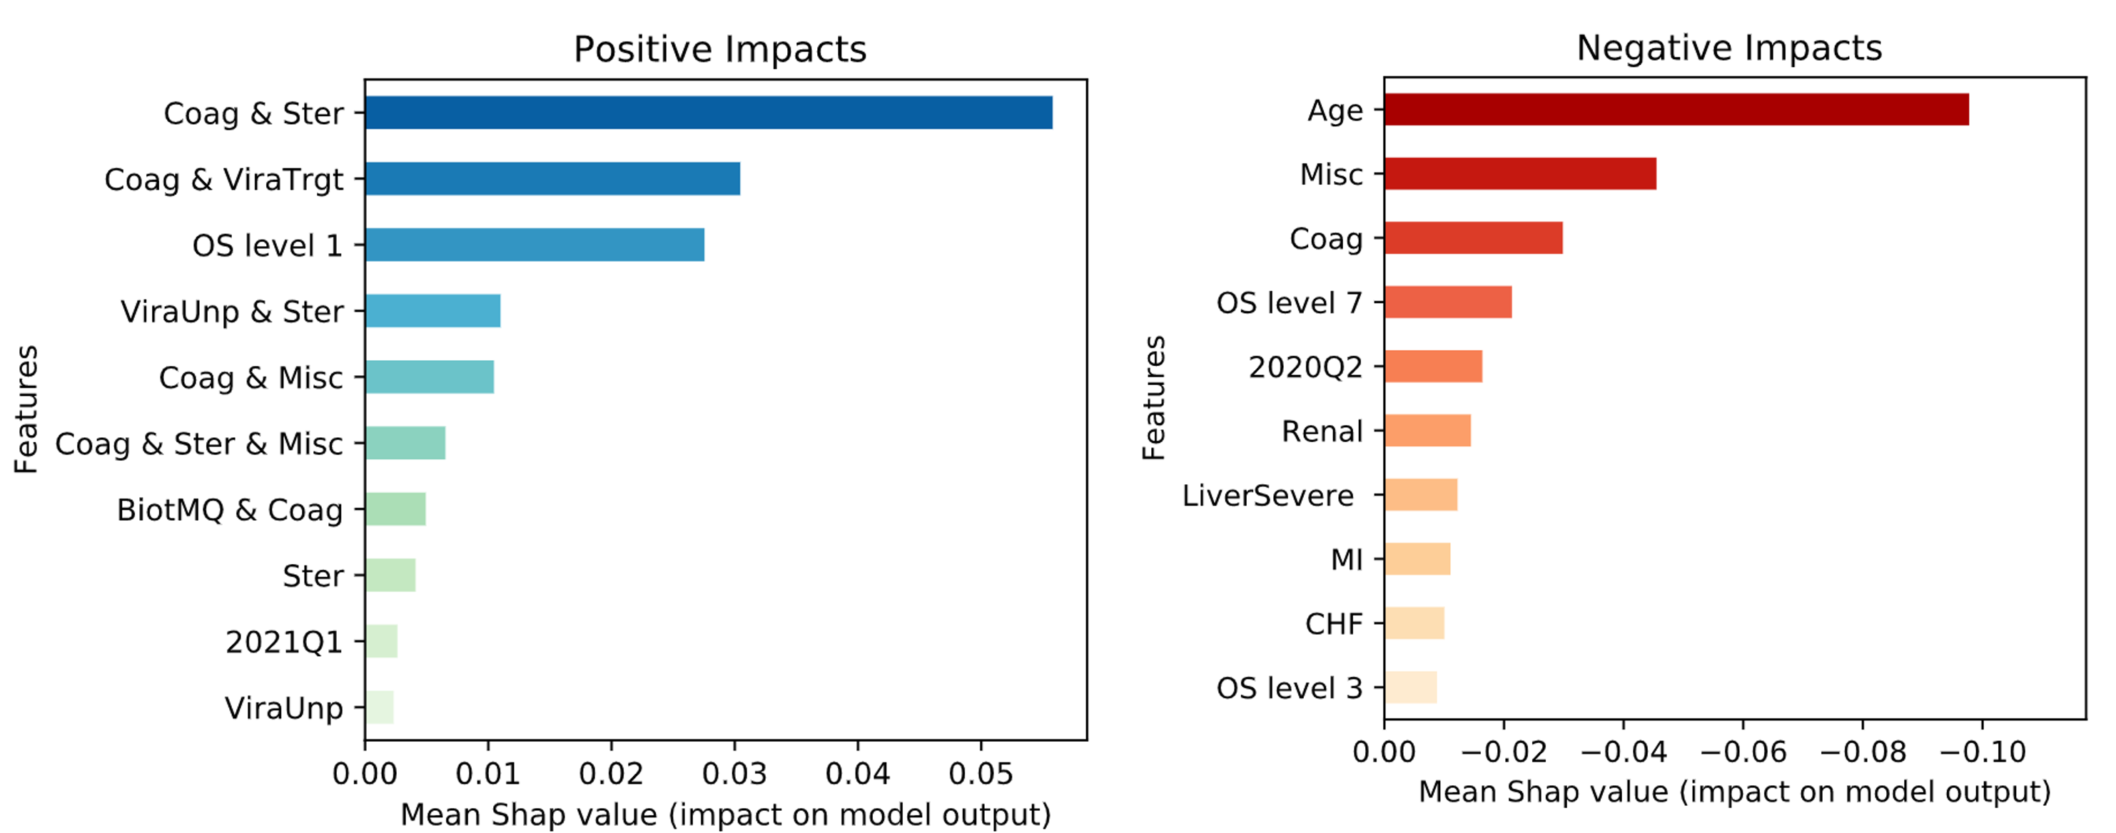
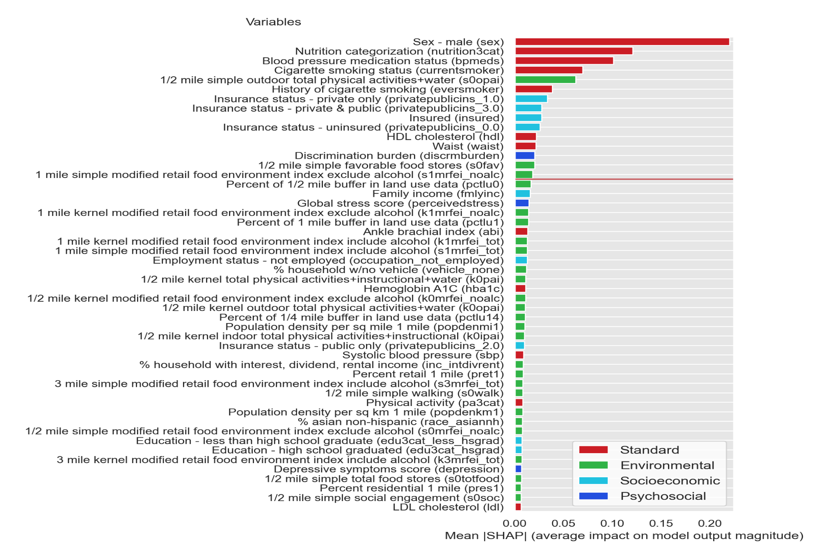
Predictive models and the effect of features of predicted outcome
NIH/N3C COVDI-19 Dataset
Jackson Heart Study Data
Notes:
Predictive models and the effect of features of predicted outcome

Slide 5
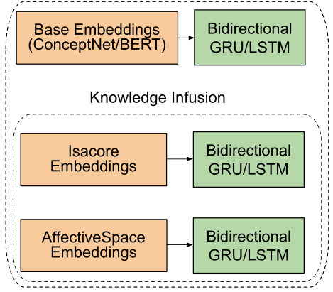

Slide 6
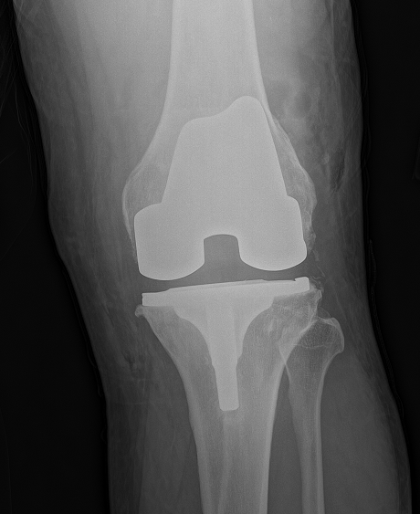

Slide 7

TBD

Slide 8
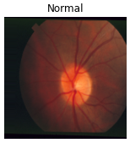
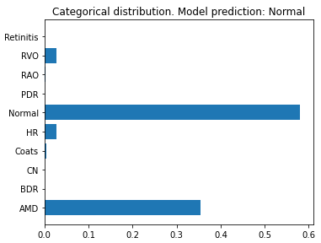
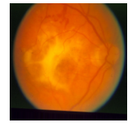
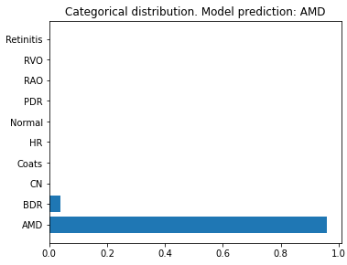

Slide 9
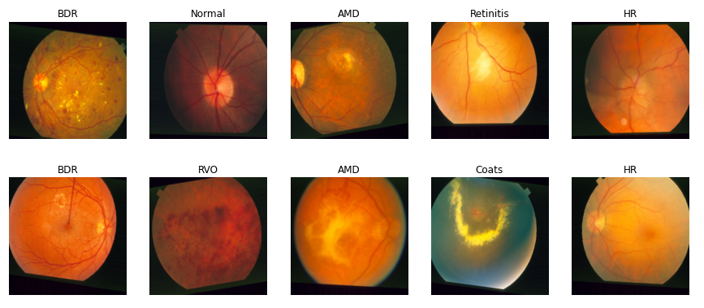

Slide 10
