Slide 1


EMMA
EMPLOYEE MANAGEMENT MADE ACCESSIBLE
Team Zest
ADITYA S
FERWIN LOPEZ
GOWRI S
V VANY SURIA

Slide 2


PROBLEM STATEMENT
An efficient employee management system is crucial for businesses to streamline their human resources processes. The challenge is to create a web application with REST API endpoints that allow CRUD (Create, Read, Update, Delete) operations on employee and department data. Additionally, the system should include functionality to assign employees to departments and promote eligible employees to manager positions based on experience criteria.

Slide 3
CHALLENGES
SECURITY
PERFORMANCE
1
2
3
2
4
DATA INTEGRITY
COMPLIANCE &
REGULATIONS

Slide 4
FUTURE ENHANCEMENTS
The Employee Management Made Accessible System (EMMA) delivers a comprehensive and efficient solution for modern organizations to streamline workforce management. As the system evolves, future enhancements may include attendance tracking and reporting, clock in/clock out time, leave request, performance-based incentives, and integration with other HR tools.

Slide 5
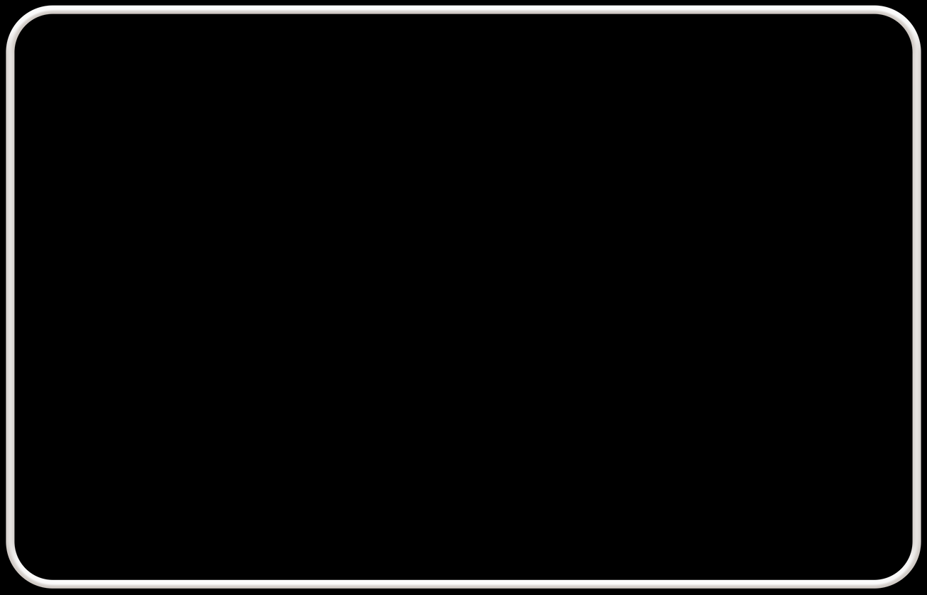
FUNCTIONALITY
1
2
EMPLOYEE-
DEPARTMENT-
CREATING
READING
UPDATING
DELETING
CREATING
READING
UPDATING
DELETING
3
4
LISTS EMPLOYEES THAT CAN
BE PROMOTED WITH
FIVE OR MORE YEARS OF EXPERIENCE
ANALYTICS

