Slide 1


FIREFIGHTING
ROBOT
GUIDED BY:
GROUP MEMBERS:
Ms.Nitya Mohanan
Devanandana B
Gowri S
Rohin Sabu
Sruthy P J
1

Slide 2

OVERVIEW
01
MOTIVATION AND BACKGROUND
02
PROBLEM STATEMENT
03
LITERATURE SURVEY
04
METHODOLOGY
05
DESIGN
06
COMPONENTS REQUIRED AND BUDGET
07
WORK PLAN
2
08
REFERENCE

Slide 3
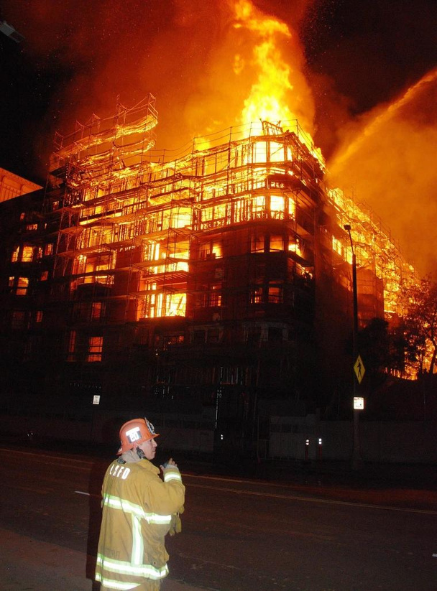
In recent years, the integration of robotics and automation has significantly transformed various industries, including firefighting.
Traditional firefighting methods often face challenges in effectively combating fires in confined spaces or hazardous environments. The Mini Firefighting Robot project aims to develop a compact and efficient solution for detecting and suppressing fires in small-scale environments.
3

Slide 4
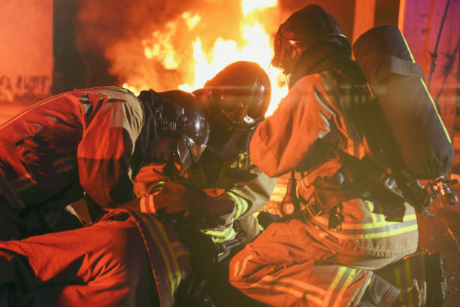

MOTIVATION AND BACKGROUND
Fire accidents are very dangerous. They can occur suddenly, spread rapidly, and threaten people's lives.
Research indicates that up to 25% of firefighter deaths are caused by structural collapse and an additional 23% are a result of overexertion and stress (including heart attacks). Lung and skin diseases account for 15% of firefighter fatalities.
Thus using our project we can minimize the risks.
4

Slide 5
PROBLEM STATEMENT
The main problem to be addressed is the need for an efficient and autonomous fire-fighting solution that can quickly detect and suppress fires in hard-to-reach or dangerous areas.
Existing firefighting methods often require human intervention, which can be risky and time-consuming. This project aims to develop a mini firefighting robot that can navigate and extinguish fires without human control.
5

Slide 6

LITERATURE SURVEY
"Design and Implementation of a Firefighting Robot Based on Arduino and Zigbee Wireless Network" by Hossam M. Aboshosha, Waleed M. Talaat, and Naser S. Al-Maliki. (IEEE Access)
This paper presents a detailed design and implementation of a firefighting robot utilizing Arduino and Zigbee wireless network technology.
It describes the hardware setup, including the selection of sensors, actuators, and the Arduino microcontroller board. The authors discuss the communication architecture based on Zigbee technology, enabling wireless control and monitoring of the robot's operations.
Additionally, the paper explores the software algorithms developed for fire detection, localization, and suppression.
6

Slide 7
LITERATURE SURVEY
2."A Review of Autonomous Firefighting Robots: Challenges and Solutions" by Hamed Khorasgani, Reza Abbasi-Asl, and Nader Meskin. (2021 IEEE International Conference on Industrial Cyber-Physical Systems)
This review paper provides a comprehensive overview of autonomous firefighting robots, discussing the challenges faced in their development and potential solutions.
The authors analyze existing research and identify key issues such as sensor accuracy, navigation in dynamic environments, and effective fire suppression strategies.
The paper highlights future research directions and suggests areas for further investigation to improve the capabilities and performance of firefighting robots.
7

Slide 8
LITERATURE SURVEY
3."Design and Development of an Intelligent Fire Fighting Robot using Wireless Sensor Network" by R. Bhuvaneswari and R. Prasanna Lakshmi. (2016 IEEE International Conference on Circuit, Power and Computing Technologies)
This paper presents the design and development of an intelligent firefighting robot utilizing wireless sensor networks for communication and coordination.
The authors describe the architecture of the robot, which consists of multiple sensor nodes deployed in the environment to detect and localize fires.
8

Slide 9

METHODOLOGY
91

Slide 10
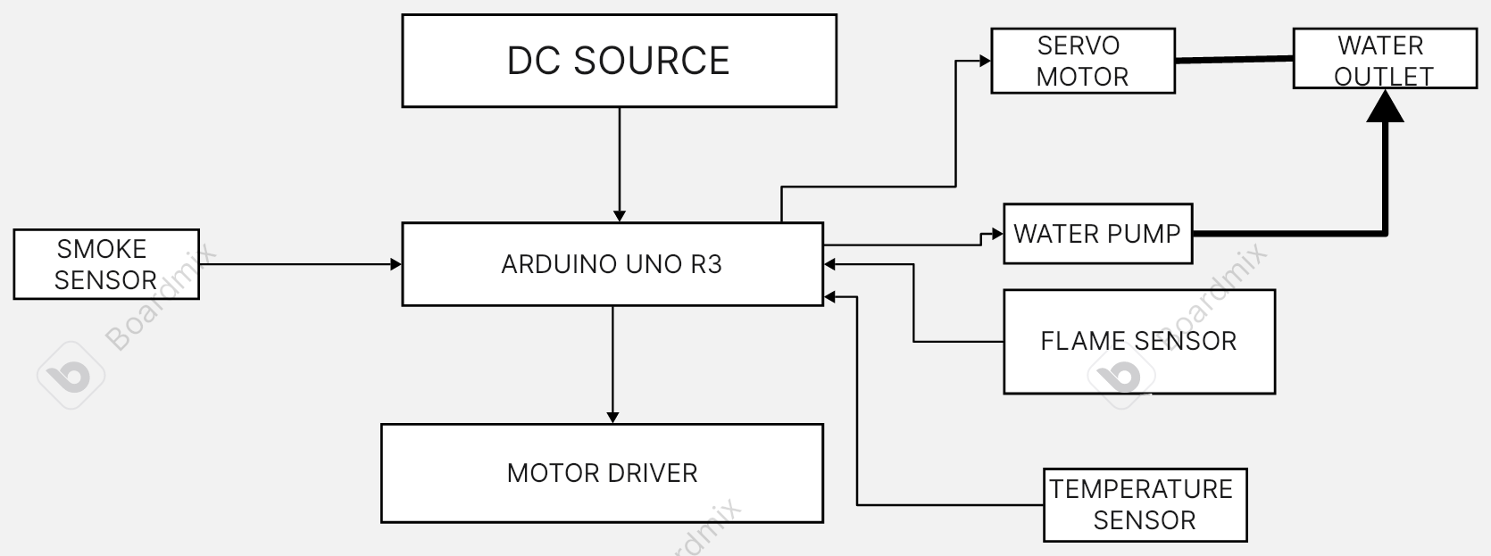
BLOCK DIAGRAM
10

Slide 11
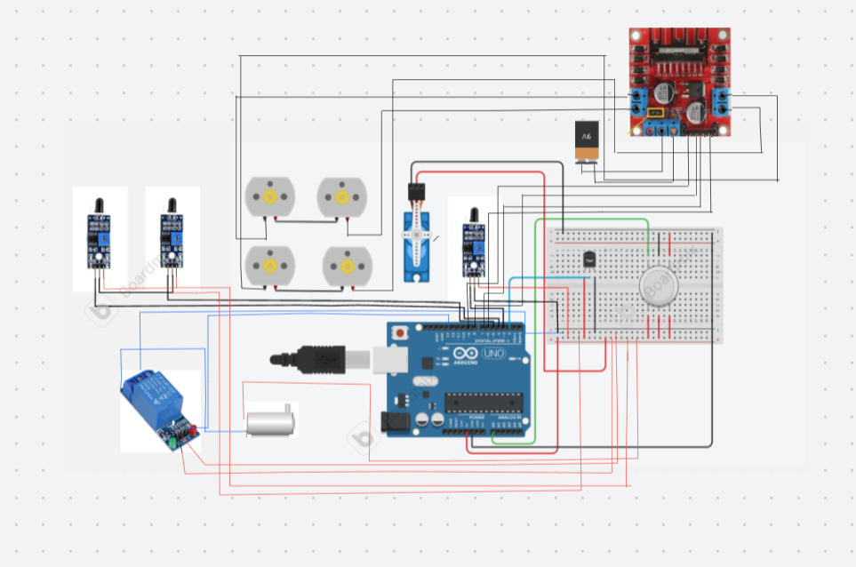
CIRCUIT DIAGRAM
11

Slide 12
STEPS AND PROCEDURE
ASSEMBLY
1
● Assemble the chassis and attach the wheels, motors, and water pump according to the robot's design.
● Connect the flame sensors to the Arduino Uno R3. Make sure to use digital pins for simplicity.
● Connect the water pump to the Arduino Uno R3. Use a relay module if the pump requires higher voltage or current than the Arduino can provide directly.
● Connect the DC motor for the wheels to the Arduino Uno R3 using a motor driver module to control its speed and direction.
12

Slide 13
2.
Coding
● Write the Arduino code to read data from the flame sensors and determine if a fire is detected. Use conditional statements to trigger actions based on sensor readings.
●Implement logic to control the movement of the robot towards the fire. This may involve using proportional control to adjust the motor speed based on the distance from the flame.
● Program the Arduino to stop the robot at a safe distance from the flame using input from the flame sensors.
● Write code to activate the water pump when the robot is within range of the flame to extinguish it. Ensure that the pump is turned off after a certain duration to conserve water.
12

Slide 14
3.
Testing
● Test the individual components of the robot, including the flame sensors, motors, and water pump, to ensure they are functioning correctly.
● Assemble the robot and conduct comprehensive tests to verify its ability to detect fires, navigate towards them, stop at a safe distance, and extinguish them with water.
4.
Optimization
● Fine-tune the robot's behavior by adjusting parameters such as sensor thresholds, motor speeds, and stopping distances.
● Address any issues encountered during testing and debugging, such as false fire detections or difficulties in movement.
14

Slide 15


DESIGN
1.IR Flame Sensor:
- Operating Voltage: 3.3V - 5V
- Detection Range: Typically around 100cm
- Output: Digital signal
- Interface: Typically digital output (depends on specific model)
2.MQ2 Smoke Detector
- Operating Voltage: 5V
- Sensing Element: Tin dioxide (SnO2)
- Sensitivity Adjustable via Potentiometer
- Output: Analog and Digital (TTL compatible)
- Detection Range: Varies based on concentration of smoke/gas
2.
15

Slide 16

DESIGN
3.DHT11 Temperature and Humidity Sensor:
- Operating Voltage: 3.3V - 5.5V
- Temperature Measurement Range: 0°C to 50°C
- Humidity Measurement Range: 20% to 90%
RH
- Accuracy: ±2°C for temperature, ±5% for humidity
- Output: Digital signal
4.5V Relay
- Operating Voltage: 5V (controlled by Arduino)
- Maximum Load: Depends on the specific relay (usually up to 10A at 250VAC or 30VDC)
2.
16

Slide 17
DESIGN
5.Water Pump
- Operating Voltage: Typically 3V - 6V
- Flow Rate: Depends on the specific model
6.Bo Motor:
- Operating Voltage: Typically 3V - 12V
- Speed: Depends on the voltage and motor specifications
7.Servo Motor:
- Operating Voltage: Typically 4.8V - 6V
8.Arduino Uno R3:
Microcontroller: ATmega328P
Operating Voltage: 5V
17

Slide 18
COMPONENTS REQUIRED AND BUDGET
01
9V BATTERY ₹ 50.00
08
SMOKE SENSOR
=₹160
02
ARDUINO UNO R3 ₹ 400.00
09
TEMPERATURE SENSOR-
₹150
TOTAL:₹1250
03
MOTOR DRIVER ₹100.00
04
RELAY ₹50.00
05
FLAME SENSOR MODULE
50 x 3=₹150.00
06
SERVO MOTOR
₹90.00
07
BO MOTORS
₹ 50×2 = ₹100.00
18

Slide 19
REFERENCE
IEEE Xplore Digital Library:
M. I. Cabrera and J. M. Armingol, "Fire detection and extinguishing system based on an autonomous mobile robot," 2014 IEEE International Conference on Robotics and Biomimetics
M. A. Hannan, M. F. R. Mahmud, M. A. Mannan, and M. A. H. M. Imran, "Design and implementation of a fire fighting robot," 2017 IEEE Region 10 Humanitarian Technology Conference (R10-HTC), Dhaka, Bangladesh,
19

Slide 20
THANK YOU
20

