Slide 1
Neural Network Compression

Slide 2
Outline
Introduction
Knowledge Distillation
Quantization
Architecture Design

Slide 3
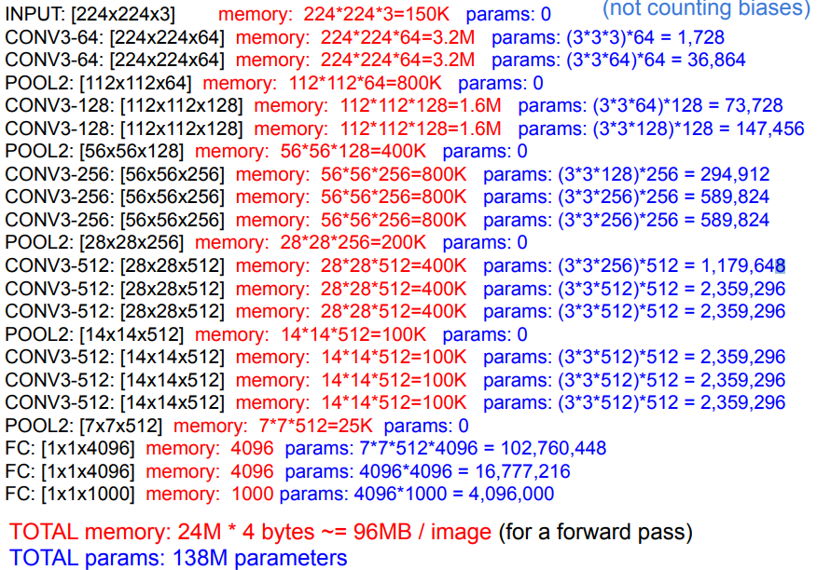
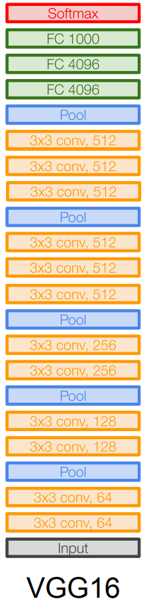
A Case

Slide 4
Knowledge Distillation

Slide 5
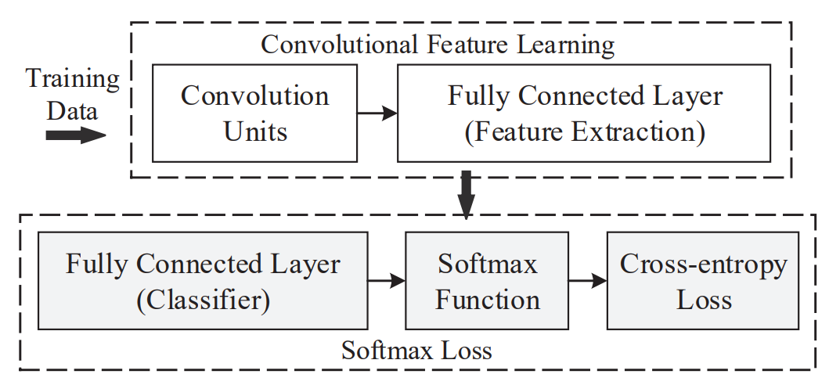
CNN Structure
Standard CNNs can be viewed as convolutional feature learning machines that are supervised by the softmax loss.
Class 1: 0.1
Class 2: 0.89
Class 3: 0.01
Cross-entropy
Class 1: 0.1
Class 2: 0.89
Class 3: 0.01

Slide 6
Knowledge Distillation
Cross-entropy
Cross-entropy
P: 0.1, 0.85, 0.05
Q: ?, ?, ?
Label (y): 0, 1, 0
Teacher Net
Student Net
Input
Input

Slide 7
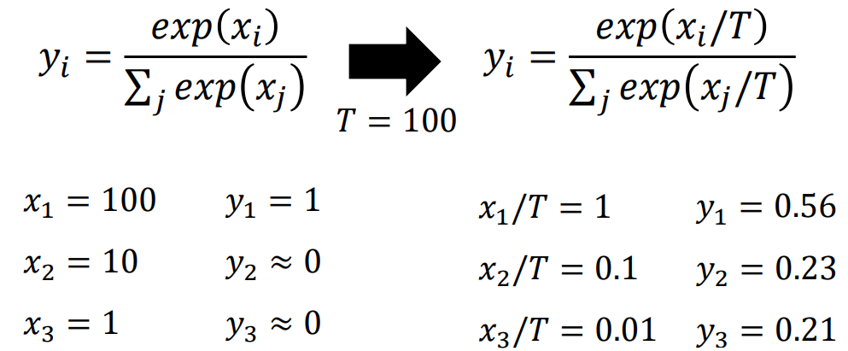

Knowledge Distillation
Temperature
Full Loss
$L_{KD, α}\left(P, Q;y\right)=α⋅H\left(y, P\right)+\left(1−α\right)H(P, Q)$

Slide 8
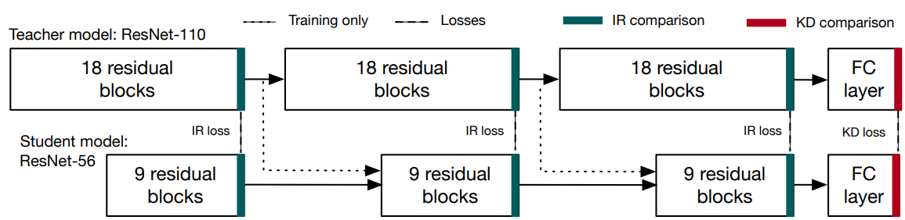
LIT: Learned Intermediate Representation （ICML 19）
Figure: A schematic of LIT. The teacher model’s intermediate representations are used as input to the student model’s blocks during training, except for the first block

Slide 9
Quantization

Slide 10
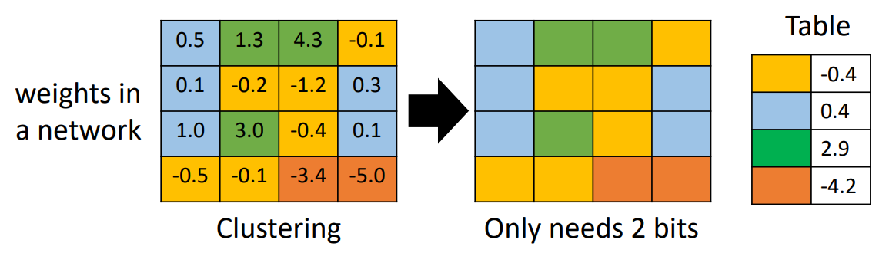
Quantization
Using less bits to represent value.
Weight clustering
Represent frequent clusters by less bits (Huffman encoding).

Slide 11
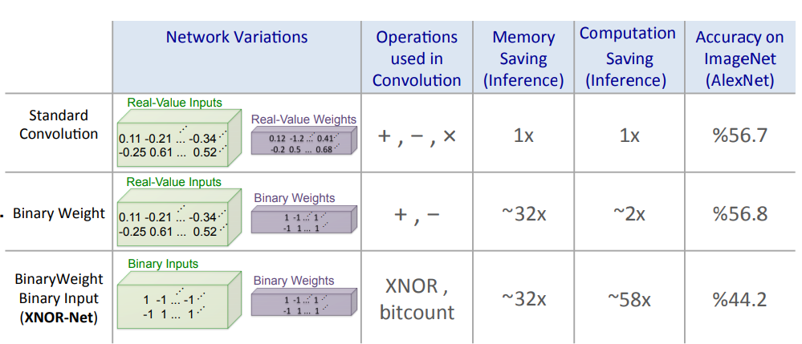
Binary Weight
Figure: BinaryWeight-Networks, when the weight filters contains binary values. XNOR-Networks, when both weigh and input have binary values.

Slide 12
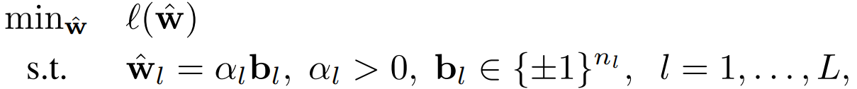


Loss-Aware Binarization (ICLR 17)
$${\hat{w}}^{k+1}={prox}_{I_{C}}^{γ}({\hat{w}}^{k}−γ∇l({\hat{w}}^{k}))$$

Slide 13
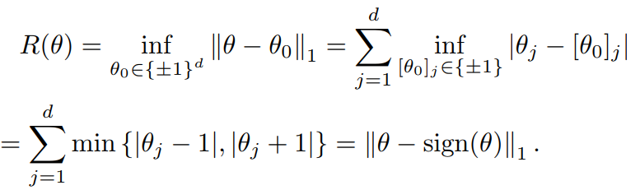
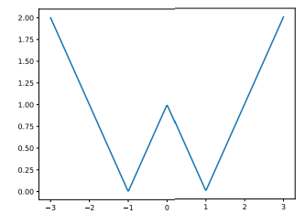

ProxQuant (ICLR 19)
Formulation
$$\min_{θ}{L\left(θ\right)+λR(θ)}$$
where
Prox of R:
Fig: W-shape func

Slide 14
Architecture Design

Slide 15
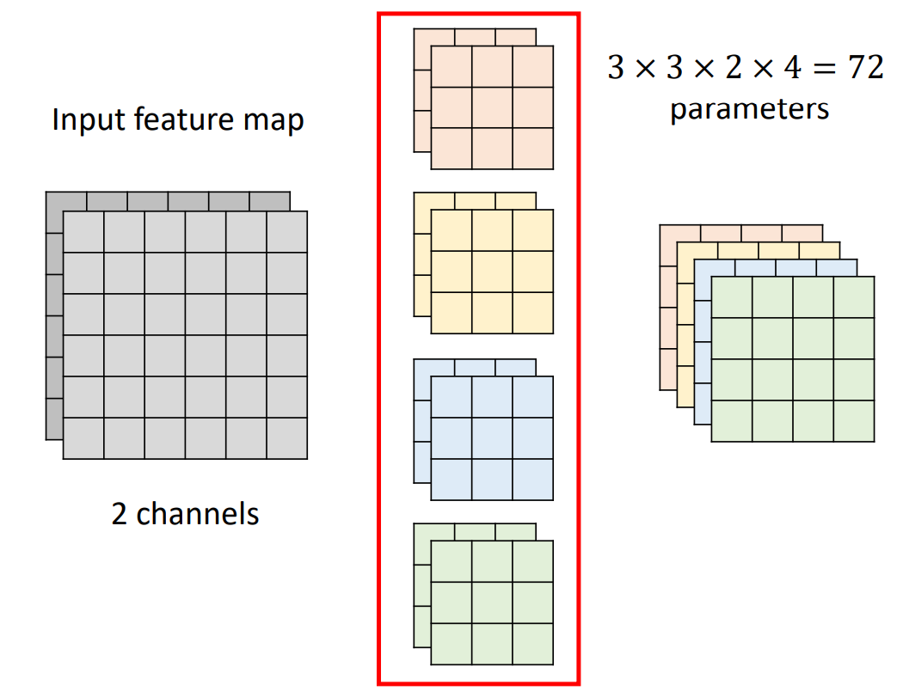
Standard CNN

Slide 16
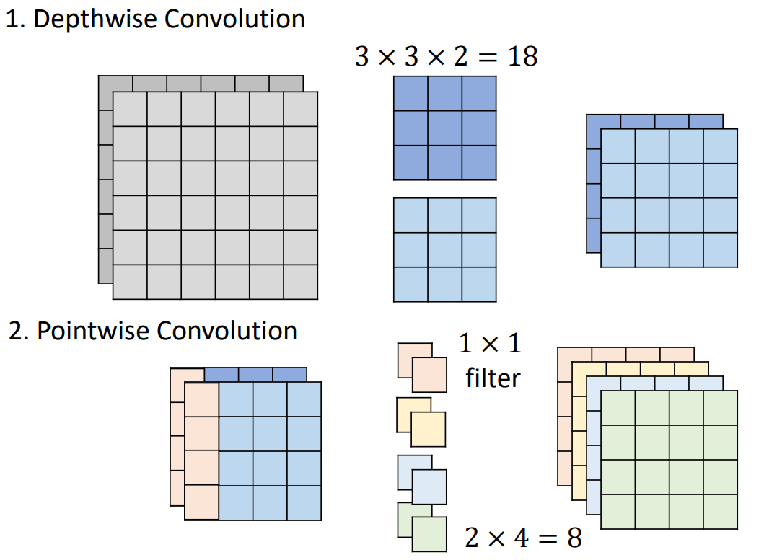
Depthwise Separable Convolution

Slide 17
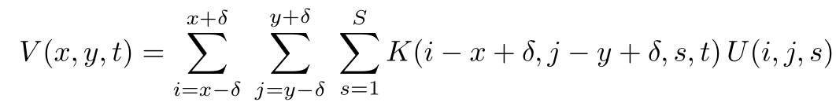
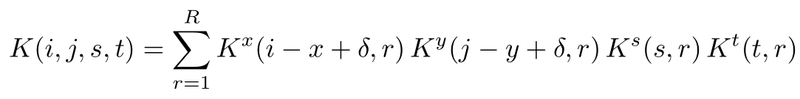
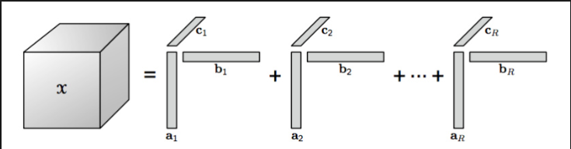
CP-Decomposition (ICLR 15)
Convolution
CP-Decomposition
$n$ input tensor $U(·,·,·)$of size $X×Y ×S$into an output tensor $V(⋅,⋅,⋅)$of size $\left(X−d+1\right)×\left(Y −d+1\right)×T. K\text{: }\text{4-}\text{D} \text{kernel}\text{.}$

Slide 18
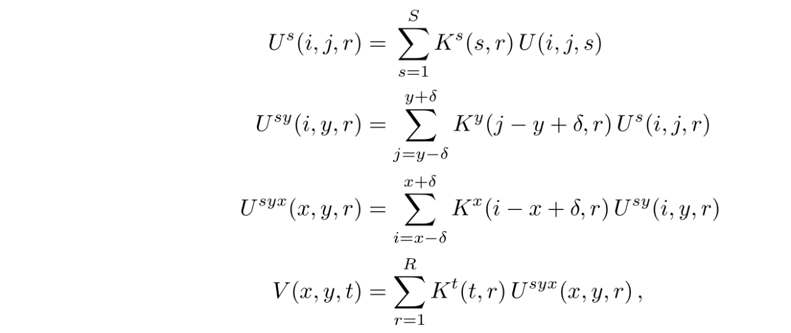

CP-Decomposition
New convolution
We can get
where $U^{s}$, $U^{sy}$ and $U^{syx}$ are intermediate tensors (map stacks)

Slide 19
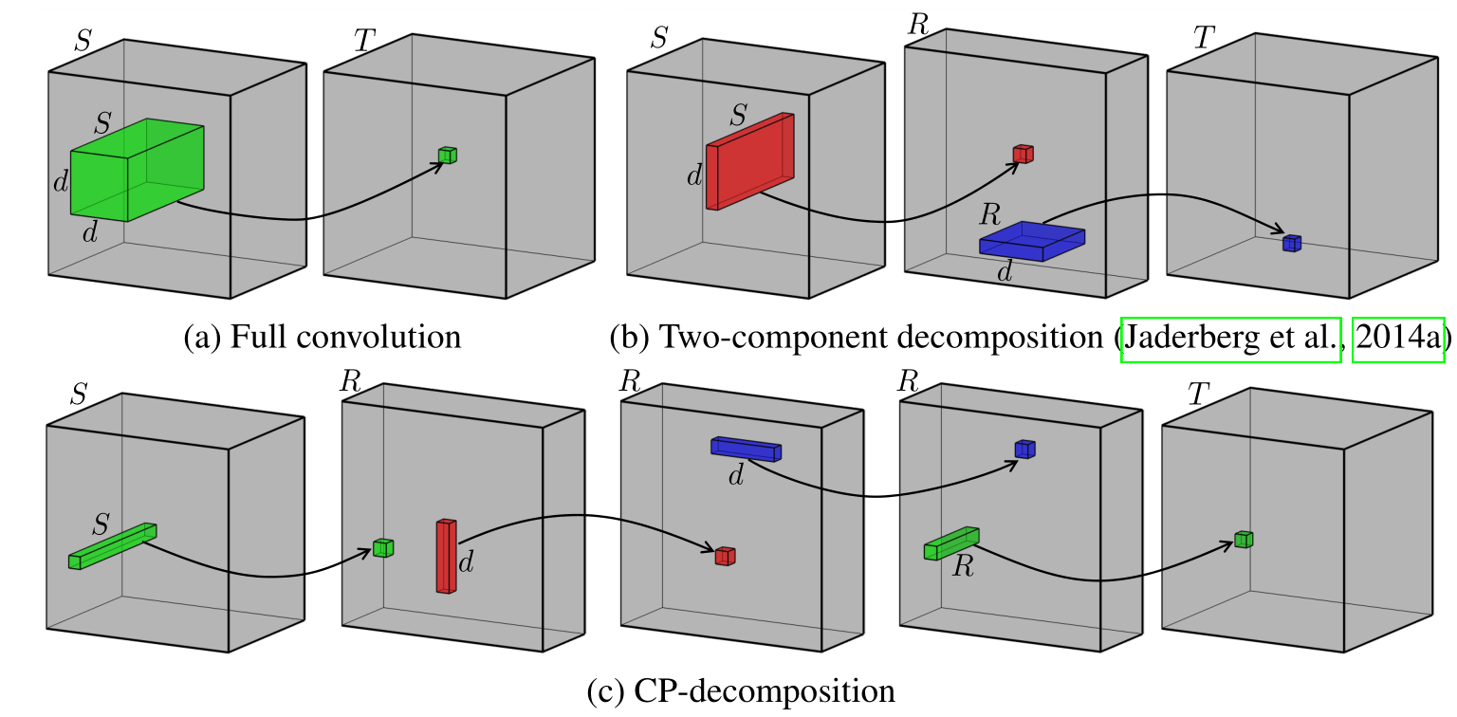
CP-Decomposition
Figure: Illustration of CP decomposition based convolution.

Slide 20
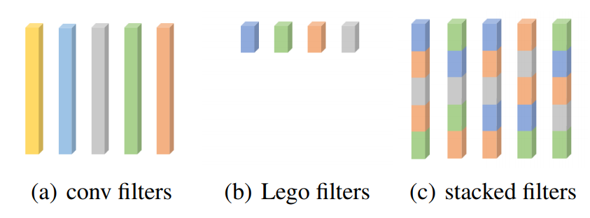
LegoNet (ICML 19)
Figure: The diagram of convolution filters represented by Lego filters. From left to right are conventional convolution filters, Lego filters with smaller sizes, and convolution filters stacked by exploiting a series of Lego filters

Slide 21
Q & A

