Slide 1
Proximal Algorithms
A modern CONVEX optimization algorithms

Slide 2
Overview
Introduction
Interpretations of proximal operator
Proximal algorithms
Summary
Q & A

Slide 3
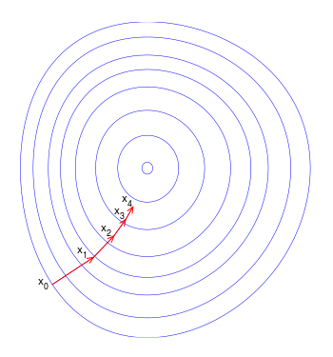

Optimize smooth function
Support $f\left(x\right)$ is a convex and smooth function
Gradient descent: $x^{k+1}=x^{k}−λ_{k}∇f(x^{k})$
Newton’s methods: $x^{k+1}=x^{k}−λ_{k}{\left(∇^{2}f\left(x^{k}\right)\right)}^{−1}∇f\left(x^{k}\right)$

Slide 4
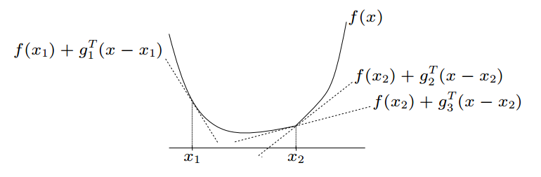

Subgradient
$g$ is a subgradient of $f$ at x if
$f\left(y\right)≥f\left(x\right)+g^{T}\left(y−x\right)$ for all $y$
$g_{2}$,$g_{3}$are subgradients at $x_{2}$; $g_{1}$is a subgradient at $x_{1}$

Slide 5
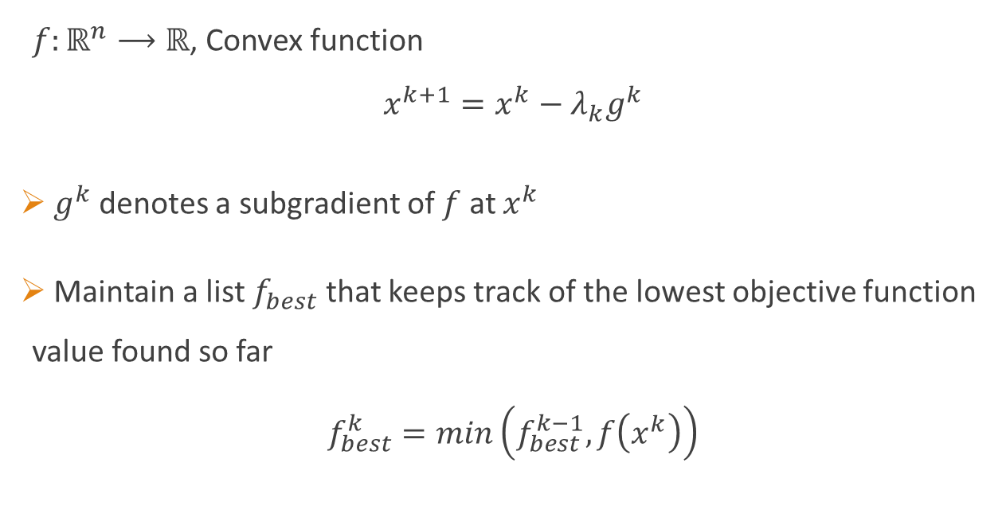
Subgradient descent
$f:ℝ^{n}⟶ℝ$, Convex function
$$x^{k+1}=x^{k}−λ_{k}g^{k}$$
$g^{k}$ denotes a subgradient of $f$ at $x^{k}$
Maintain a list $f_{best}$ that keeps track of the lowest objective function value found so far
$$f_{best}^{k}=min\left(f_{best}^{k−1}, f\left(x^{k}\right)\right)$$

Slide 6
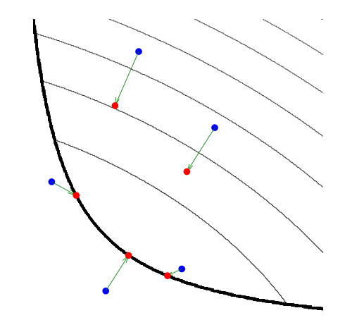
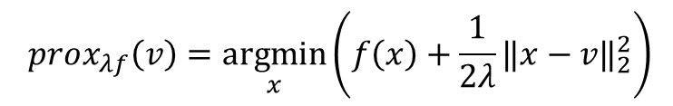

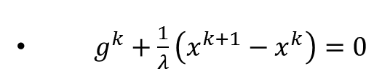
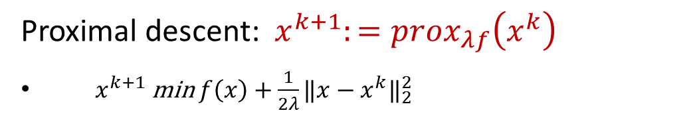
Proximal operator
$$prox_{λf}\left(v\right)=\underset{x}{argmin}\left(f\left(x\right)+\frac{1}{2λ}{‖x−v‖}_{2}^{2}\right)$$
Proximal descent: ${ x}^{k+1}:={prox}_{λf}\left(x^{k}\right)$
$x^{k+1}$ min $f\left(x\right)+\frac{1}{2λ}{‖x−x^{k}‖}_{2}^{2}$
$g^{k}+\frac{1}{λ}\left(x^{k+1}−x^{k}\right)=0$
$x^{k+1}=x^{k}−λg^{k}$
Evaluating a proximal operator at various points

Slide 7

Interpretations of proximal operator
When $f$ is the indicator function
Fixed point
Moreau envelop
Relationship with $∂f$
Gradient flow

Slide 8

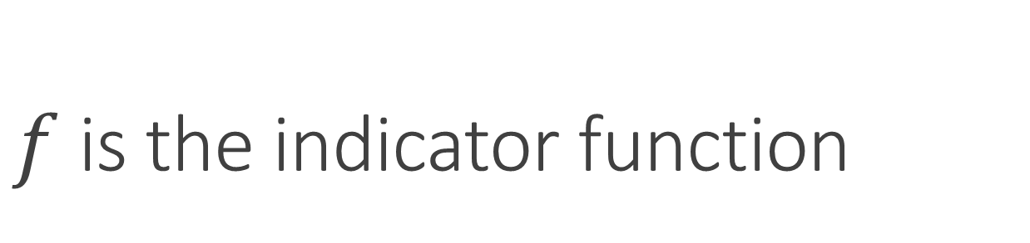
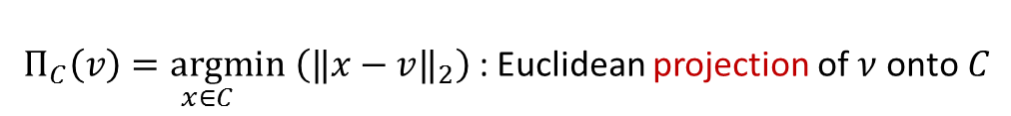
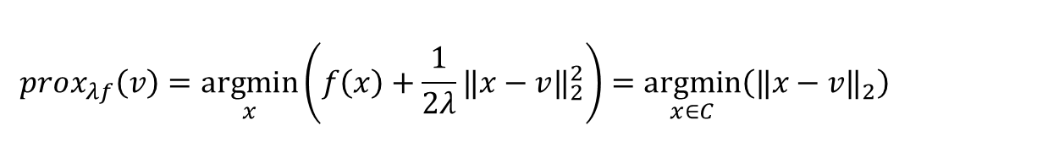
$f$ is the indicator function
$f: I_{C}=\left\{\begin{aligned}0 x∈C \\ +∞ x∉C\end{aligned}\right.$
$$prox_{λf}\left(v\right)=\underset{x}{argmin}\left(f\left(x\right)+\frac{1}{2λ}{‖x−v‖}_{2}^{2}\right)=\underset{x∈C}{argmin}\left({‖x−v‖}_{2}\right)$$
$Π_{C}\left(v\right)\underset{x∈C}{=argmin}\left({‖x−v‖}_{2}\right)$ : Euclidean projection of $ν$ onto$C$

Slide 9
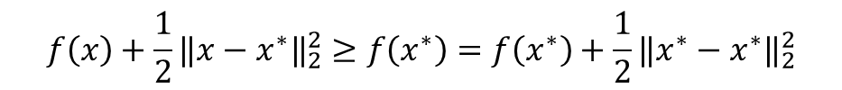


Fixed point
point $x^{∗}$minimizes $f$ if and only if
$x^{∗}={prox}_{f}\left(x^{∗}\right)$
proof: 1) if $f\left(x\right)≥f\left(x^{∗}\right)$ for any $x$, then
$x^{∗}$ min $f\left(x\right)+\frac{1}{2}{‖x−x^{∗}‖}_{2}^{2}$, i.e. $x^{∗}={prox}_{f}\left(x^{∗}\right)$
2) $x^{∗}$ min $f\left(x\right)+\frac{1}{2}{‖x−x^{∗}‖}_{2}^{2}$ if any only if
$0∈∂f\left(x^{∗}\right)+\left(x^{∗}−x^{∗}\right)$, i.e. $0∈∂f\left(x^{∗}\right)$
So $x^{∗}$ min $f\left(x\right)$
$$f\left(x\right)+\frac{1}{2}{‖x−x^{∗}‖}_{2}^{2}≥f\left(x^{∗}\right)=f\left(x^{∗}\right)+\frac{1}{2}{‖x^{∗}−x^{∗}‖}_{2}^{2}$$
$$prox_{λf}\left(x^{∗}\right)=\underset{x}{argmin}\left(f\left(x\right)+\frac{1}{2λ}{‖x−x^{∗}‖}_{2}^{2}\right)$$

Slide 10
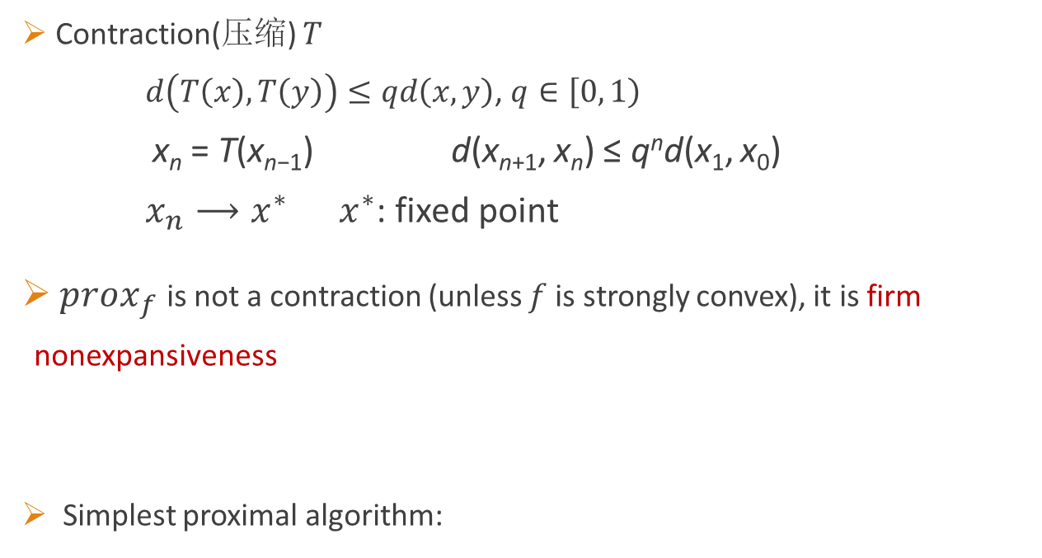

Fixed point Ⅱ
Contraction(压缩) $T$
$d\left(T\left(x\right), T\left(y\right)\right)≤qd\left(x,y\right)$, $q∈\left[0,\left.1\right)\right.$
x_{n} = T(x_{n−1}) d(x_{n+1}, x_{n}) ≤ q^{n}d(x₁, x₀)
$x_{n}⟶x^{∗}$ $x^{∗}$: fixed point
${prox}_{f}$ is not a contraction (unless $f$ is strongly convex), it is firm nonexpansiveness
Simplest proximal algorithm:
$${‖prox_{f}\left(x\right)−prox_{f}\left(y\right)‖}_{2}^{2}≤{\left(x−y\right)}^{T}\left(prox_{f}\left(x\right)−prox_{f}\left(y\right)\right)$$
$$x^{k+1}:={prox}_{λf}\left(x^{k}\right)$$

Slide 11
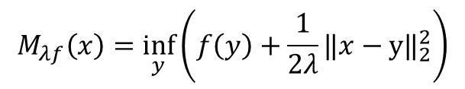



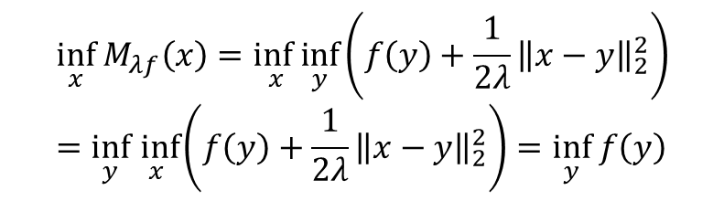
Moreau envelope
Moreau envelop
$x^{∗}$ min $f\left(x\right)$ iff $x^{∗}$ min $M_{λf}\left(x\right)$
$$M_{λf}\left(x\right)=\inf_{y}\left(f\left(y\right)+\frac{1}{2λ}{‖x−y‖}_{2}^{2}\right)$$
$$\inf_{x}{ M}_{λf}\left(x\right)=\inf_{x}\inf_{y}\left(f\left(y\right)+\frac{1}{2λ}{\left\|x−y\right\|}_{2}^{2}\right)=\inf_{y}\inf_{x}\left(f\left(y\right)+\frac{1}{2λ}{\left\|x−y\right\|}_{2}^{2}\right)=\inf_{y} f\left(y\right)$$
$$M_{λf}\left(x\right)=\inf_{y}\left(f\left(y\right)+\frac{1}{2λ}{‖x−y‖}_{2}^{2}\right)$$
$$prox_{λf}\left(x\right)=\underset{y}{argmin}\left(f\left(y\right)+\frac{1}{2λ}{‖x−y‖}_{2}^{2}\right)$$

Slide 12

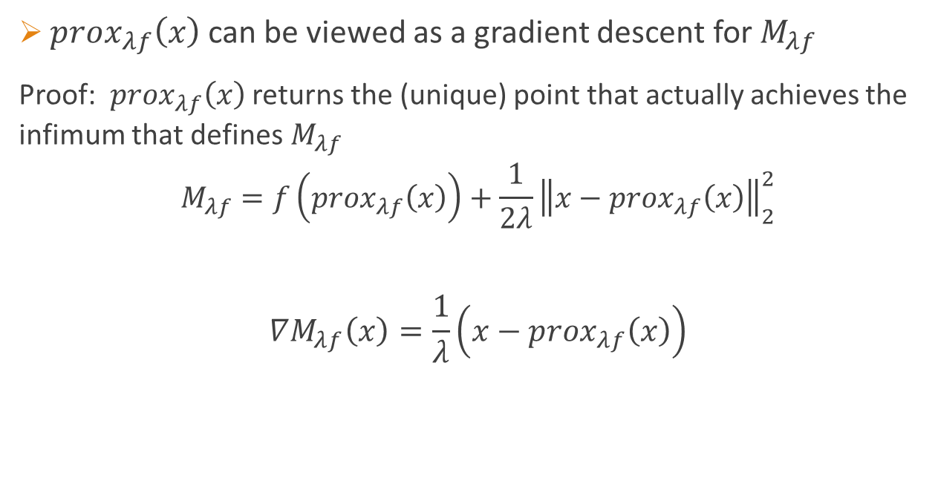
Moreau envelope Ⅱ
${prox}_{λf}\left(x\right)$ can be viewed as a gradient descent for $M_{λf}$
Proof: ${prox}_{λf}\left(x\right)$ returns the (unique) point that actually achieves the infimum that defines$M_{λf}$
$$M_{λf}=f\left({prox}_{λf}\left(x\right)\right)+\frac{1}{2λ}{\left\|x−{prox}_{λf}\left(x\right)\right\|}_{2}^{2}$$
$$∇M_{λf}\left(x\right)=\frac{1}{λ}\left(x−{prox}_{λf}\left(x\right)\right)$$
$${prox}_{λf}\left(x\right)=x−λ∇M_{λf}\left(x\right)$$
$$prox_{λf}\left(x\right)=\underset{y}{argmin}\left(f\left(y\right)+\frac{1}{2λ}{‖x−y‖}_{2}^{2}\right)$$

Slide 13






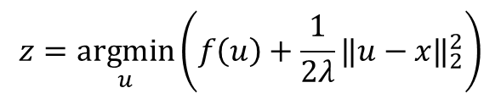
Relationship with $∂f$
${prox}_{λf}={\left(I+λ∂f\right)}^{−1}$
Proof: $z∈{\left(I+λ∂f\right)}^{−1}\left(x\right)$ $x∈\left(I+λ∂f\right)\left(z\right)=z+λ∂f\left(x\right)$
$$0∈∂f\left(z\right)+\frac{1}{λ}\left(z−x\right)$$
$$0ε∂_{z}\left(f\left(z\right)+\frac{1}{2λ}{\left\|z−x\right\|}_{2}^{2}\right)$$
$${\left(I+λ∂f\right)}^{−1} is single−valued$$
$$z=\underset{u}{argmin}\left(f\left(u\right)+\frac{1}{2λ}{‖u−x‖}_{2}^{2}\right)$$
$$z∈{\left(I+λ∂f\right)}^{−1}\left(x\right)$$
$$z={prox}_{λf}\left(x\right)$$
$$prox_{λf}\left(x\right)=\underset{u}{argmin}\left(f\left(u\right)+\frac{1}{2λ}{‖x−u‖}_{2}^{2}\right)$$

Slide 14

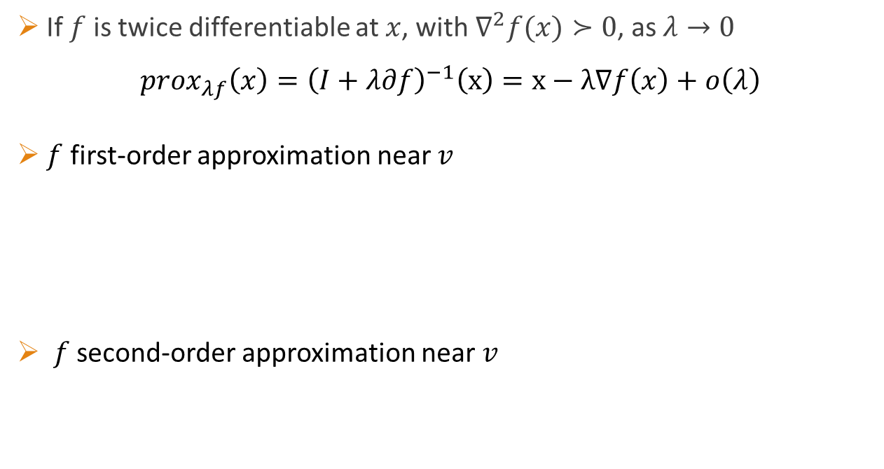
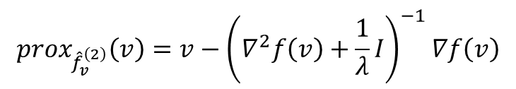



Relationship with $∂f$ Ⅱ
If $f$ is twice differentiable at $x$, with $∇^{2}f(x)≻0$, as $λ→0$
$${prox}_{λf}\left(x\right)={\left(I+λ∂f\right)}^{−1}\left(x\right)=x−λ∇f\left(x\right)+ο\left(λ\right)$$
$f$ first-order approximation near $v$
$f$ second-order approximation near $v$
$${\hat{f}}_{v}^{\left(1\right)}\left(x\right)=f\left(v\right)+∇f{\left(v\right)}^{T}\left(x−v\right)$$
$$prox_{{\hat{f}}_{v}^{\left(1\right)}}\left(v\right)=v−λ∇f\left(v\right)$$
$${\hat{f}}_{v}^{\left(2\right)}\left(x\right)=f\left(v\right)+∇f{\left(v\right)}^{T}\left(x−v\right)+\frac{1}{2}{\left(x−v\right)}^{T}∇^{2}f\left(v\right)\left(x−v\right)$$
$$prox_{{\hat{f}}_{v}^{\left(2\right)}}\left(v\right)=v−{\left(∇^{2}f\left(v\right)+\frac{1}{λ}I\right)}^{−1}∇f\left(v\right)$$
Tikhonov-
regularized Newton update
$$prox_{λf}\left(v\right)=\underset{x}{argmin}\left(f\left(x\right)+\frac{1}{2λ}{‖x−v‖}_{2}^{2}\right)$$

Slide 15
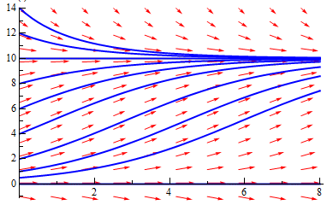
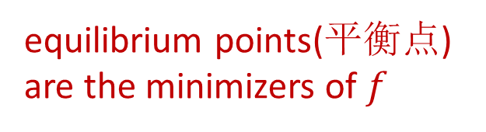
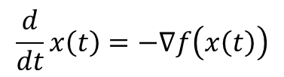




Gradient flow
gradient flow for $f$
$$\frac{d}{dt}x\left(t\right)=−∇f\left(x\left(t\right)\right)$$
$$x\left(t\right)$$
equilibrium points(平衡点) are the minimizers of $f$
$$t$$
$\frac{d}{dt}x\left(t\right)=\frac{1}{2}\left(1−\frac{x}{10}\right)x$ 轨迹线

Slide 16


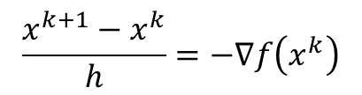


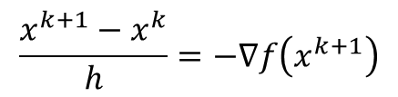
Gradient flow Ⅱ
Forward Euler discretization
Backward Euler discretization
$$\frac{x^{k+1}−x^{k}}{h}=−∇f\left(x^{k}\right)$$
$$x^{k+1}:=x^{k}−h∇f\left(x^{k}\right)$$
$$\frac{x^{k+1}−x^{k}}{h}=−∇f\left(x^{k+1}\right)$$
$$x^{k+1}+h∇f\left(x^{k+1}\right)=x^{k}$$
$$x^{k+1}={\left(I+h∇f\right)}^{−1}\left(x^{k}\right)=prox_{hf}\left(x^{k}\right)$$
$$\frac{d}{dt}x\left(t\right)=−∇f\left(x\left(t\right)\right)$$

Slide 17
Proximal gradient method

Slide 18
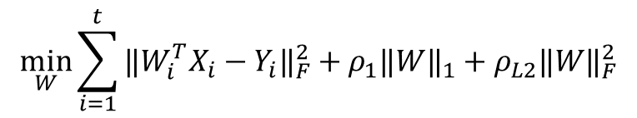


Problem
min $f\left(x\right)+g\left(x\right)$
$f$: convex & differentiable(smooth) $g$: convex
Lasso: $\frac{1}{2}{\left\|Ax−b\right\|}_{2}^{2}+γ{\left\|x\right\|}_{1}$
MTL:
Matrix decomposition
$$\min_{W}\sum_{i=1}^{t}{{‖W_{i}^{T}X_{i}−Y_{i}‖}_{F}^{2}}+ρ_{1}{‖W‖}_{1}+ρ_{L2}{‖W‖}_{F}^{2}$$
min
$${‖A−\left(X_{2}+X_{3}\right)‖}_{F}^{2}+γ_{2}{‖X_{2}‖}_{1}+γ_{3}{‖X_{3}‖}_{∗}$$

Slide 19
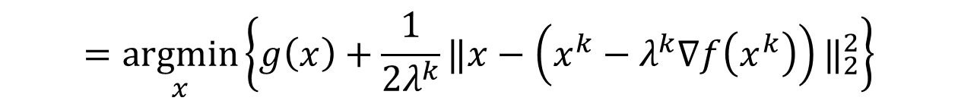

Proximal gradient method
$$x^{k+1}:=prox_{λ^{k}g}\left(x^{k}−λ^{k}∇f\left(x^{k}\right)\right)$$
$$=\underset{x}{argmin}\left\{g\left(x\right)+\frac{1}{2λ^{k}}{‖x−\left(x^{k}−λ^{k}∇f\left(x^{k}\right)\right)‖}_{2}^{2}\right\}$$

Slide 20
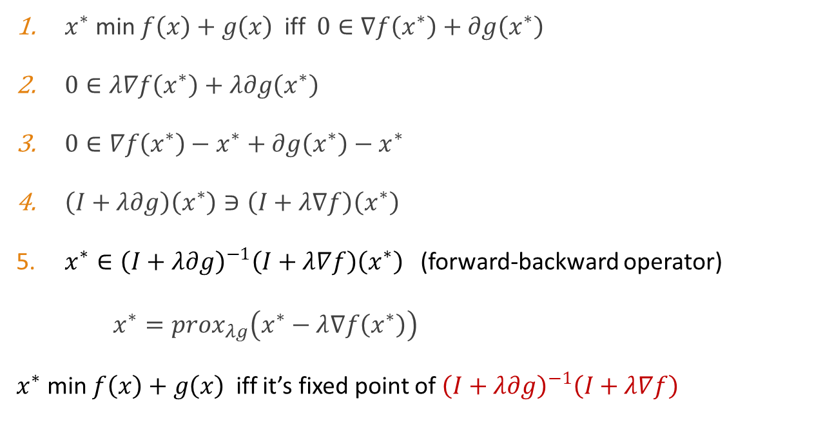
Interpretation: fixed point
$x^{∗}$ min $f\left(x\right)+g\left(x\right)$ iff $0∈∇f\left(x^{∗}\right)+∂g\left(x^{∗}\right)$
$0∈λ∇f\left(x^{∗}\right)+λ∂g\left(x^{∗}\right)$
$0∈∇f\left(x^{∗}\right)−x^{∗}+∂g\left(x^{∗}\right)−x^{∗}$
$\left(I+λ∂g\right)\left(x^{∗}\right)∋\left(I+λ∇f\right)\left(x^{∗}\right)$
$x^{∗}∈{\left(I+λ∂g\right)}^{−1}\left(I+λ∇f\right)\left(x^{∗}\right)$ (forward-backward operator)
$x^{∗}={prox}_{λg}\left(x^{∗}−λ∇f\left(x^{∗}\right)\right)$
$x^{∗}$ min $f\left(x\right)+g\left(x\right)$ iff it’s fixed point of ${\left(I+λ∂g\right)}^{−1}\left(I+λ∇f\right)$

Slide 21
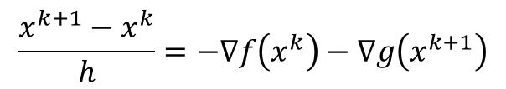
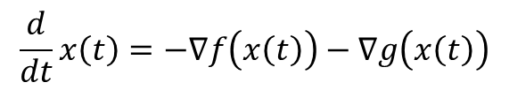

Interpretation: gradient flow
$$\frac{d}{dt}x\left(t\right)=−∇f\left(x\left(t\right)\right)−∇g\left(x\left(t\right)\right)$$
$$\frac{x^{k+1}−x^{k}}{h}=−∇f\left(x^{k}\right)−∇g\left(x^{k+1}\right)$$
$$x^{k+1}={\left(I+h∇g\right)}^{−1}\left(I−h∇f\right)x^{k}$$

Slide 22




ADMM
min $f\left(x\right)+g\left(x\right)$ $f,g$: convex, may nonsmooth
alternating direction method of multipliers (ADMM)
$$x^{k+1}:=prox_{λf}\left(z^{k}−u^{k}\right)$$
$$z^{k+1}:=prox_{λg}\left(x^{k+1}+u^{k}\right)$$
$$u^{k+1}:=u^{k}+x^{k+1}−z^{k+1}$$

Slide 23
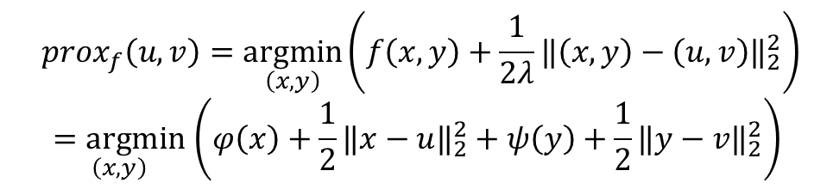

Separable sum
If $f\left(x,y\right)=φ\left(x\right)+ψ\left(y\right)$, then
${prox}_{f}\left(u,v\right)=\left({prox}_{φ}\left(u\right),{prox}_{ψ}\left(v\right)\right)$
If $f\left(x\right)=\sum_{i=1}^{n}{f_{i}\left(x_{i}\right)}$, then
$${\left({prox}_{f}\left(v\right)\right)}_{i}={prox}_{f_{i}}\left(v_{i}\right)$$
Tip:
$$prox_{f}\left(u,v\right)=\underset{\left(x,y\right)}{argmin}\left(f\left(x,y\right)+\frac{1}{2λ}{‖\left(x,y\right)−\left(u,v\right)‖}_{2}^{2}\right)$$
$$\underset{\left(x,y\right)}{=argmin}\left(φ\left(x\right)+\frac{1}{2}{‖x−u‖}_{2}^{2}+ψ\left(y\right)+\frac{1}{2}{‖y−v‖}_{2}^{2}\right)$$

Slide 24





Parallel and Distributed
$$\sum_{i=1}^{N}{f_{i}}\left(x_{c_{i}}\right)+\sum_{j=1}^{M}{g_{j}}\left(x_{d_{j}}\right)$$
min $f\left(x\right)+g\left(x\right)$ min
$$x_{c_{i}}^{k+1}:=prox_{λf_{i}}\left(z_{c_{i}}^{k}−u_{c_{i}}^{k}\right)$$
$$z_{d_{i}}^{k+1}:=prox_{λg_{j}}\left(x_{d_{i}}^{k}+u_{d_{j}}^{k}\right)$$
$$u^{k+1}:=u^{k}+x^{k+1}−z^{k+1}$$

Slide 25
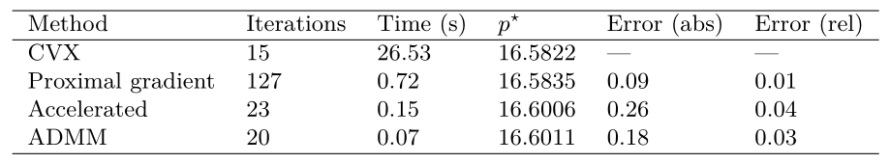

Experiment - LASSO
$A∈ℝ^{m×n}$, $m=500$ examples, $n=2500$ features
$A_{ij}\sim N\left(0,1\right)$, sample $x^{true}$
$b=Ax^{true}+v$, $v\sim N\left(0,{10}^{−3}I\right)$
Comparing algorithms for solving the lasso

Slide 26
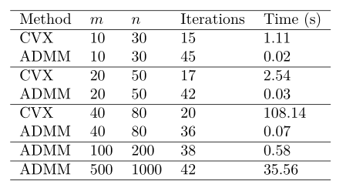

Experiment – Matrix decomposition
$A=L+S+V$, $L$: rank 4, $S$: sparse, V: noise
$L=L_{1}L_{2}$, $L_{1}∈ℝ^{m×4}$, $L_{2}∈ℝ^{4×n}$, $L_{1}, L_{2}\sim N\left(0,1\right)$ independently
$S$: density 0.05, sampled uniformly from $\left\{−10,10\right\}$
$V\sim N\left(0,{10}^{−3}\right)$
Comparing CVX and ADMM for solving a matrix decomposition problem

Slide 27
Summary & Resource
Boyd et.al:
Much like Newton’s method is a standard tool for solving unconstrained smooth optimization problems of modest size, proximal algorithms can be viewed as an analogous tool for nonsmooth, constrained, large-scale, or distributed versions of these problems.
Resource: http://stanford.edu/~boyd/admm.html

Slide 28
Q&A

