Slide 1
Switching and Routing project 2018/2019
Prof. Guido Maier
Tutor. Sebastian Troìa
MPLS route management
Leone Giuseppe, 10518770
Petocchi Alessandro, 10661410
Sodano Marco, 10495166
Villa Veronica, 10503254

Slide 2
Outline
Introduction
Flow chart of the algorithm
Mininet example
Differences testbed-mininet simulator
Statistics

Slide 3
Introduction
GOAL
The goal is to implement a Ryu application to set up a pair of MPLS link‐disjoint tunnels to connect two hosts in a network.
ASSUMPTIONS
The MPLS connection is based on source and destination MACs
The application is able to re‐route traffic on the back‐up path in case of a failure of a link of the default path
The project works both on mininet and the testbed

Slide 4


Objective of the project
CONTROLLER
host1
host2
host1 wants to establish an IP connection with host2
All the flow tables of the switches inside the network are empty (only table-miss rules are installed)

Slide 5
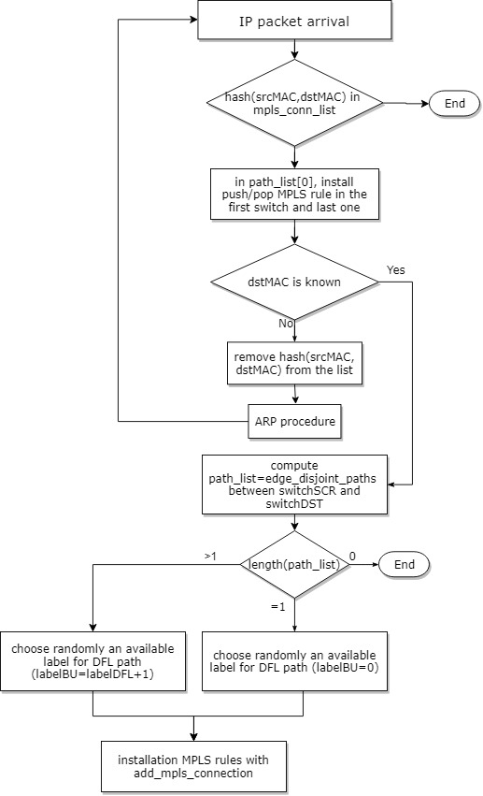
Flow chart of the algorithm(1)
Yes
No
add hash (srcMAC,dstMAC) in the list
Compute the path_list (edge_disjoint_paths)
between source and destination

Slide 6
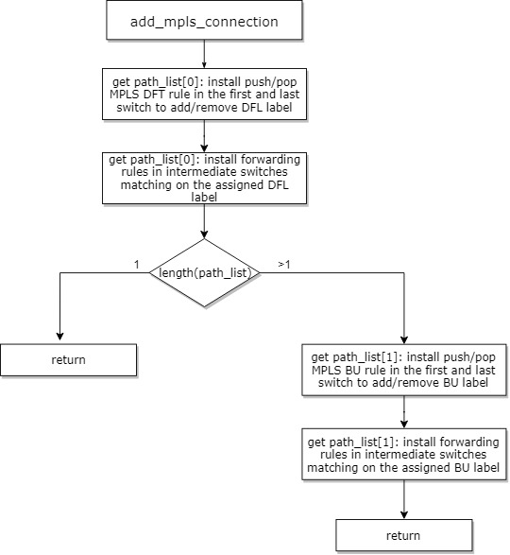
Flow chart of the algorithm(2)

Slide 7

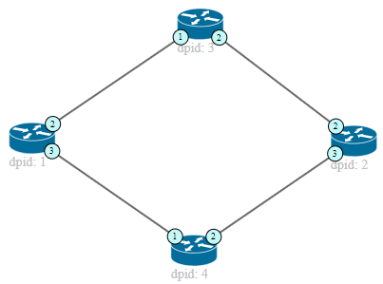
Path configuration example (mininet)
CONTROLLER
Default path Backup path
IP PACKET
Action set on switch 3:
In port 1 (label=1) => out port 2
In port 2 (label=1) => out port 1
The next packets will be
forwarded directly by the switches, since the new rules are installed
IP PACKET
IP PACKET
Action set for switch 1: PUSH MPLS (label=1) out port 2, priority 2 (default)
PUSH MPLS (label=2) out port 3, priority 1 (backup)
POP MPLS (label=1) out port 1, priority 2 (default) POP MPLS (label=2) out port 1, priority 1 (backup)
Action set for switch 2: PUSH MPLS (label=1) out port 2, priority 2 (default)
PUSH MPLS (label=2) out port 3, priority 1 (backup)
POP MPLS (label=1) out port 1, priority 2 (default) POP MPLS (label=2) out port 1, priority 1 (backup)
Action set on switch 4:
In port 1 (label=2) => out port 2
In port 2 (label=2) => out port 1
Notes:
Parlare qui delle diverse priorità dei path

Slide 8
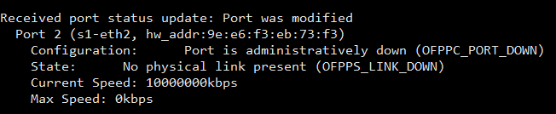
Port detection
When a link goes up/down, the port status of the switches involved in the connection will change consequently
The switches notify the event to the controller with port status messages

Slide 9
Link down/up (mininet)
CONTROLLER
Default path Backup path
Action set on switch 3:
In port 1 (label=1) => out port 2
In port 2 (label=1) => out port 1
IP PACT
Action set for switch 1: PUSH MPLS (label=1) out port 2, priority 2 (default)
PUSH MPLS (label=2) out port 3, priority 1 (backup)
POP MPLS (label=1) out port 1, priority 2 (default) POP MPLS (label=2) out port 1, priority 1 (backup)
Action set for switch 2: PUSH MPLS (label=1) out port 2, priority 2 (default)
PUSH MPLS (label=2) out port 3, priority 1 (backup)
POP MPLS (label=1) out port 1, priority 2 (default) POP MPLS (label=2) out port 1, priority 1 (backup)
Action set on switch 4:
In port 1 (label=2) => out port 2
In port 2 (label=2) => out port 1
Notes:
Parlare qui delle diverse priorità dei path

Slide 10
Differences mininet simulator-testbed
MININET SIM. | TESTBED
Open vSwitch switches | Zodiac FX switches
Access directly to the host | Access to RaspPi via SSH
ARP tables always filled | ARP tables may be empty
Matching on MPLS label | Doesn’t match on label field
Topology is completely reliable | Topology is instable
Virtual topology | Real topology with physical links among switches
No broadcast IP msg. | Switches periodically send broadcast IP msg.
No specific event is triggered when a port becomes active | Switches notify with an OFPPS_LIVE event when a port becomes active
Notes:
Testbed matching: ETH_TYPE_MPLS, src_MAC, dst_MAC, in_port (in intermediate switches, label still present)
Topology instable= store 2 network, one updated to compute edge disjoint and another for getting info about ports, detapath…
OFPPS_LIVE triggered when a port is active

Slide 11
Statistics collection: experiment procedure
Run the controller and then activate the topology
Verify whether ARP tables are full
Establish an IP connection between 2 hosts
Once MPLS rules have been installed, collect statistics about RULE INSTALLATION TIME
Simulate a link failure
Collect statistics about PATH MODIFICATION TIME
Restore the link
Collect statistics about PATH MODIFICATION TIME
Notes:
For both mininet7testbed

Slide 12
Testbed statistics vs mininet: rules installation time
In case of empty ARP table, rule installation takes several seconds
Notes:
Rule installation delayed by arp procedure

Slide 13
Testbed statistics vs mininet: path modification time
Notes:
Plug followed by unplug…?

Slide 14
Testbed statistics: packet loss during path change
Back-up Path
Default Path
∆t=0.08s
Transitions between paths generate packet losses. The tests were performed with iperf (UDP): the results in the table are an average over multiple experiments.
Packet loss (%)
Bandwidth | 10 kbit/s | 100 kbit/s | 1 Mbit/s | 10 Mbit/s
Mininet | 0.19% | 0.27% | 0.50% | 1,71%
Testbed | 0,42% | 0,78% | 1,39% | 3,28%

Slide 15
END

