Slide 1
Switching and Routing project 2018/2019
Prof. Guido Maier
Ph.D. student Sebastian Troìa
MPLS route management
Leone Giuseppe, 10518770
Petocchi Alessandro, 10661410
Sodano Marco, 10495166
Villa Veronica, 10503254

Slide 2
Outline
Introduction
…
…
…

Slide 3
Introduction
Starting from a multipath network with multiple disjoint paths from a source and a destination, a Ryu application has been implemented to set up a pair of MPLS link‐disjoint tunnels to connect the source with the destination.
One tunnel is the default path, the other is the back‐up path.
The application is able to re‐route traffic on the back‐up path in case of a failure of a link of the default path and to restore the original ruleset when the default path returns to a working state.

Slide 4
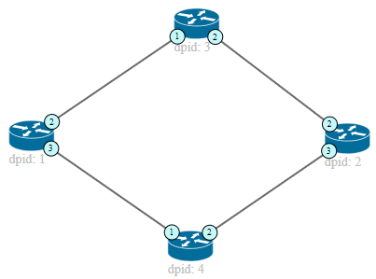
Path configuration example (1)
Default path Backup path
Action set for switch 1: PUSH MPLS, output 2, priority 2 (default)
PUSH MPLS, output 3, priority 1 (backup)
POP MPLS, output 1, priority 2 (default) POP MPLS, output 1, priority 1 (backup)
Action set for switch 2: PUSH MPLS, output 2, priority 2 (default)
PUSH MPLS, output 3, priority 1 (backup)
POP MPLS, output 1, priority 2 (default) POP MPLS, output 1, priority 1 (backup)
The paths are identified by a MPLS label: the end switches add and remove the label,
while the intermediate switches route the packets according to the label

Slide 5
END
Questions?

