Slide 1
Switching and Routing project 2018/2019
Prof. Guido Maier
Ph.D. student Sebastian Troìa
MPLS route management
Leone Giuseppe, 10518770
Petocchi Alessandro, 10661410
Sodano Marco, 10495166
Villa Veronica, 10503254

Slide 2
Outline
Introduction
MPLS connection setup
Packet in handler
Rule installation
Port detection
Link down/up
Differences testbed-mininet simulator
Statistics

Slide 3
Introduction
Starting from a multipath network with multiple disjoint paths from a source and a destination, a Ryu application has been implemented to set up a pair of MPLS link‐disjoint tunnels to connect the source with the destination.
One tunnel is the default path, the other is the back‐up path.
MPLS connection is based on source and destination MACs
The application is able to re‐route traffic on the back‐up path in case of a failure of a link of the default path and to restore the original ruleset when the default path returns to a working state.

Slide 4


Objective of the project
CONTROLLER
host1
host2
host1 wants to establish an IP connection with host2
All the flow tables of the switches inside the network are empty (only the default rule is installed)

Slide 5
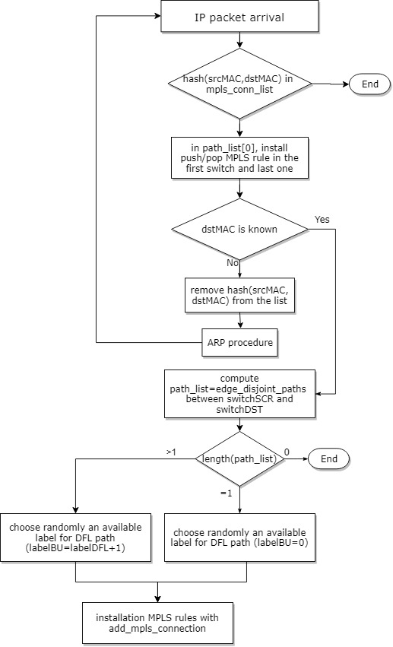
Packet in handler
Yes
No
add hash (srcMAC,dstMAC) in the list

Slide 6
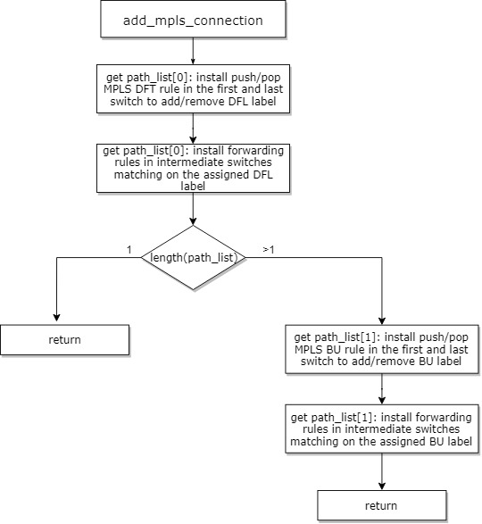
Rule installation

Slide 7

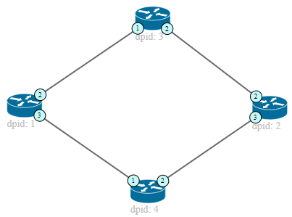
Path configuration example (mininet)
CONTROLLER
Default path Backup path
IP PACKET
Action set on switch 3:
In port 1 (label=1) => out port 2
In port 2 (label=1) => out port 1
The next packets will be
forwarded directly by the switches, since the new rules are installed
IP PACKET
IP PACKET
Action set for switch 1: PUSH MPLS (label=1) out port 2, priority 2 (default)
PUSH MPLS (label=2) out port 3, priority 1 (backup)
POP MPLS (label=1) out port 1, priority 2 (default) POP MPLS (label=2) out port 1, priority 1 (backup)
Action set for switch 2: PUSH MPLS (label=1) out port 2, priority 2 (default)
PUSH MPLS (label=2) out port 3, priority 1 (backup)
POP MPLS (label=1) out port 1, priority 2 (default) POP MPLS (label=2) out port 1, priority 1 (backup)
Action set on switch 4:
In port 1 (label=2) => out port 2
In port 2 (label=2) => out port 1
Notes:
Parlare qui delle diverse priorità dei path

Slide 8
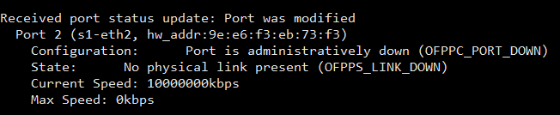
Port detection
When a link goes up/down, the port status of the switches involved in the connection will change consequently
The switches notify the event to the controller with port status messages

Slide 9
Link down/up (mininet)
CONTROLLER
Default path Backup path
Action set on switch 3:
In port 1 (label=1) => out port 2
In port 2 (label=1) => out port 1
IP PACT
Action set for switch 1: PUSH MPLS (label=1) out port 2, priority 2 (default)
PUSH MPLS (label=2) out port 3, priority 1 (backup)
POP MPLS (label=1) out port 1, priority 2 (default) POP MPLS (label=2) out port 1, priority 1 (backup)
Action set for switch 2: PUSH MPLS (label=1) out port 2, priority 2 (default)
PUSH MPLS (label=2) out port 3, priority 1 (backup)
POP MPLS (label=1) out port 1, priority 2 (default) POP MPLS (label=2) out port 1, priority 1 (backup)
Action set on switch 4:
In port 1 (label=2) => out port 2
In port 2 (label=2) => out port 1
Notes:
Parlare qui delle diverse priorità dei path

Slide 10
Differences testbed-mininet simulator
In the testbed version of the code, MPLS rules don’t match on label field
Scrivere differenze mininet testbed, le prossime slide incentrate più sul testbed

Slide 11
Testbed statistics vs mininet: rules installation time

Slide 12
Testbed statistics vs mininet: path modification time

Slide 13
Testbed statistics: packet loss during switching events
Notes:
Solo un grafico con bw/pkt loss per testbed e mininet

Slide 14
END
Do you have any questions?

