Slide 1
Switching and Routing project 2018/2019
Prof. Guido Maier
Ph.D. student Sebastian Troìa
MPLS route management
Leone Giuseppe, 10518770
Petocchi Alessandro, 10661410
Sodano Marco, 10495166
Villa Veronica, 10503254

Slide 2
Outline
Introduction
…
…
…

Slide 3
Introduction
Starting from a multipath network with multiple disjoint paths from a source and a destination, a Ryu application has been implemented to set up a pair of MPLS link‐disjoint tunnels to connect the source with the destination.
One tunnel is the default path, the other is the back‐up path.
The application is able to re‐route traffic on the back‐up path in case of a failure of a link of the default path and to restore the original ruleset when the default path returns to a working state.

Slide 4


MPLS connection setup
CONTROLLER
host1
host2
h1 wants to establish an IP connection with h2
All the flow tables of the switches inside the network are empty (only default rule is installed)
When the firtst IP packet comes to the switch connected to h1, the controller installs MPLS rules in the switches of default and backup paths

Slide 5
Packet in handler
Once topology and border switches are known, the controller computes a list of paths without links in common sorted by increasing number of edges
The first one is selected as default path assigning a label value chosen randomly
The second element is the backup path with label equal to default one increased by a unit
If the list contains just one element, only the default path is avaliable

Slide 6
Rule installation

Slide 7
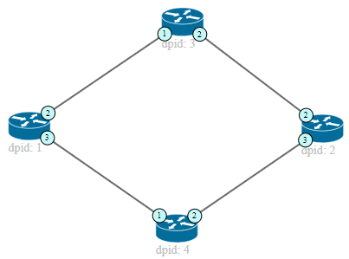
Path configuration example
Default path Backup path
Action set for switch 1: PUSH MPLS, output 2, priority 2 (default)
PUSH MPLS, output 3, priority 1 (backup)
POP MPLS, output 1, priority 2 (default) POP MPLS, output 1, priority 1 (backup)
Action set for switch 2: PUSH MPLS, output 2, priority 2 (default)
PUSH MPLS, output 3, priority 1 (backup)
POP MPLS, output 1, priority 2 (default) POP MPLS, output 1, priority 1 (backup)
The paths are identified by a MPLS label: the end switches add and remove the label,
while the intermediate switches route the packets according to the label

Slide 8
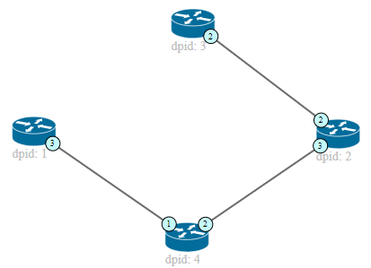
Link down
Action set for switch 1:
PUSH MPLS, output 3, priority 1 (backup) POP MPLS, output 1, priority 1 (backup)
Action set for switch 2:
PUSH MPLS, output 3, priority 1 (backup) POP MPLS, output 1, priority 1 (backup)
When link goes down, default MPLS rules are deleted

Slide 10
END
Questions?

