Slide 1
Switching and Routing project 2018/2019
Prof. Guido Maier
Ph.D. student Sebastian Troìa
MPLS route management
Leone Giuseppe, 10518770
Petocchi Alessandro, 10661410
Sodano Marco, 10495166
Villa Veronica, 10503254

Slide 2
Outline
Introduction
MPLS connection setup
Packet in handler
Rule installation
Link up/down
Port detection
Additional checks
TestBed results

Slide 3
Introduction
Starting from a multipath network with multiple disjoint paths from a source and a destination, a Ryu application has been implemented to set up a pair of MPLS link‐disjoint tunnels to connect the source with the destination.
One tunnel is the default path, the other is the back‐up path.
MPLS connection is based on source and destination MACs
The application is able to re‐route traffic on the back‐up path in case of a failure of a link of the default path and to restore the original ruleset when the default path returns to a working state.

Slide 4


MPLS connection setup
CONTROLLER
host1
host2
h1 wants to establish an IP connection with h2
All the flow tables of the switches inside the network are empty (only the default rule is installed)
When the first IP packet comes to the switch connected to h1, the controller installs the MPLS flows in the switches of the default and backup paths

Slide 5
Packet in handler
Once the topology and border switches are known, the controller computes a list of link-disjoint path, which is sorted by increasing number of edges
The first entry in the list is selected as the default path, assigning a label value chosen randomly
The second entry is the backup path. Its label is the default one incremented by 1
If the list contains just one element, only the default path will be available

Slide 6
Rule installation
The controller installs a MPLS PUSH rule in order to add labels on packets passing through the node directly connected to the host
Intermediate nodes contain only forwarding rules based on label matching
In the last node a POP MPLS rule is installed in order to remove the label from the packet and deliver it to the host
At the same time symmetrical rules are placed to allow packets to come back on the same path
Intermediate switches are able to recognize the direction of the packets by checking the input port
The same procedure is applied to the backup path, but its rules have a lower priority than the default ones

Slide 7
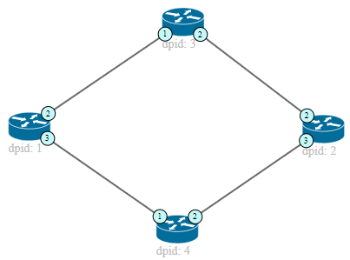
Path configuration example
Default path Backup path
Action set on switch 3:
Inport 1 (label=1) => outport 2
Inport 2 (label=1) => outport 1
Action set for switch 1: PUSH MPLS (label=1) outport 2, priority 2 (default)
PUSH MPLS (label=2) outport 3, priority 1 (backup)
POP MPLS (label=1) outport 1, priority 2 (default) POP MPLS (label=2) outport 1, priority 1 (backup)
Action set for switch 2: PUSH MPLS (label=1) outport 2, priority 2 (default)
PUSH MPLS (label=2) outport 3, priority 1 (backup)
POP MPLS (label=1) outport 1, priority 2 (default) POP MPLS (label=2) outport 1, priority 1 (backup)
Action set on switch 4:
Inport 1 (label=2) => outport 2
Inport 2 (label=2) => outport 1
Notes:
Host 1 host 2

Slide 8
Link down
Action set for switch 1:
PUSH MPLS (label=2) outport 3, priority 1 (backup) POP MPLS (label=2) outport 1, priority 1 (backup)
Action set for switch 2:
PUSH MPLS (label=2) outport 3, priority 1 (backup) POP MPLS (label=2) outport 1, priority 1 (backup)
Action set on switch 4:
Inport 1 (label=2) => outport 2
Inport 2 (label=2) => outport 1
When a link goes down, the controller detects which MPLS connection was using that link and deletes the corresponding rules
Packets will be automatically routed on the backup path

Slide 9
Link up
When the link returns active, all of the default rules are re-installed and packets will be routed again on the previous path

Slide 10
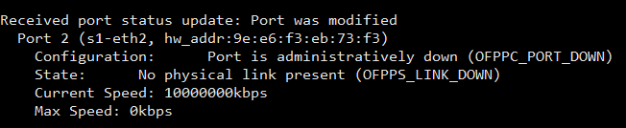
Port detection
The user is warned about the link status through a set of messages that come up every time the topology is modified
When a link goes up/down, the port status of the switches involved in the connection will change consequently
The switches notify the event to the controller with port status messages

Slide 11
Additional checks
The code provides also some additional checks
If:
Only one path exists, the controller will install only the default one
Either one or both default and back-up paths aren’t available anymore, the relative rules on the switches are temporarily deleted until the connections return active
The user is always notified about all issues
Notes:
Se va giu quello di bu, port detect

Slide 12
END
Questions?

