Slide 1
Switching and Routing project 2018/2019
Prof. Guido Maier
Tutor. Sebastian Troìa
MPLS route management
Leone Giuseppe, 10518770
Petocchi Alessandro, 10661410
Sodano Marco, 10495166
Villa Veronica, 10503254

Slide 2
Outline
Introduction
Flow chart of the algorithm
Mininet example
Differences testbed-mininet simulator
Statistics

Slide 3
Introduction
GOAL
The goal is to implement a Ryu application to set up a pair of MPLS link‐disjoint tunnels to connect two hosts in a network.
ASSUMPTIONS
The MPLS connection is based on source and destination MACs
The application is able to re‐route traffic on the back‐up path in case of a failure of a link of the default path
The project works both on mininet and the testbed

Slide 4


Initial conditions
CONTROLLER
host1
host2
Arbitrary network composed of rings
host1 wants to establish an IP connection with host2
All the flow tables of the switches inside the network are empty (only table-miss rules are installed)

Slide 5
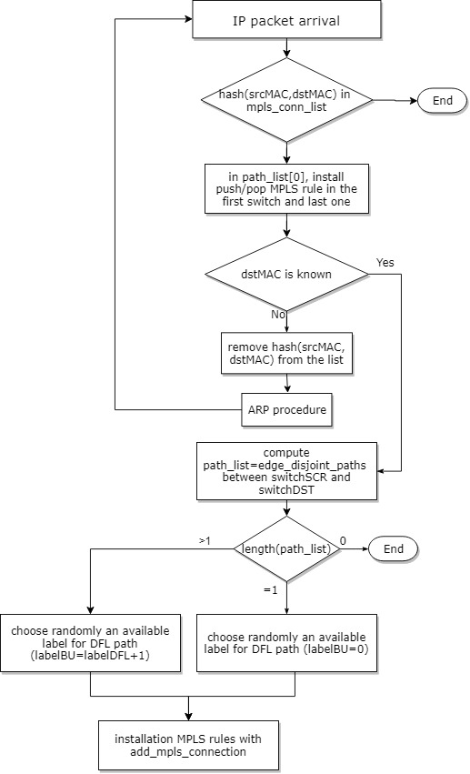
Flow chart of the algorithm(1)
Yes
No
add hash (srcMAC,dstMAC) in the list
Compute the path_list (edge_disjoint_paths)
between source and destination

Slide 6
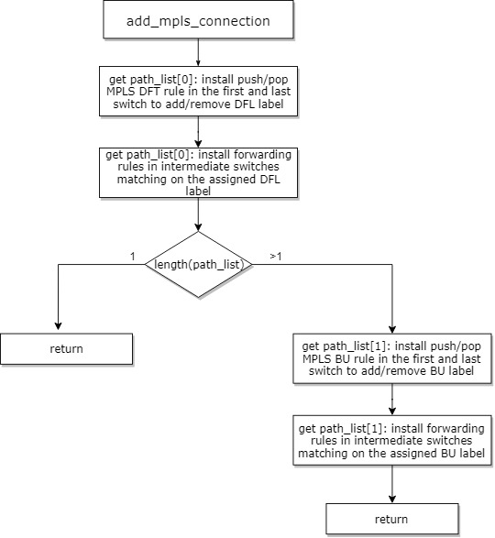
Flow chart of the algorithm(2)

Slide 7

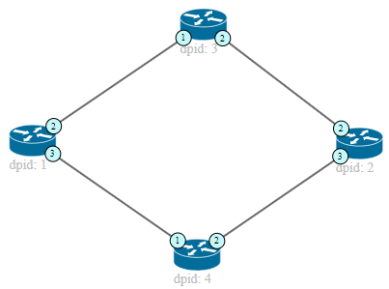
Path configuration example (mininet)
CONTROLLER
Default path Backup path
IP PACKET
Action set on switch 3:
In port 1 (label=1) => out port 2
In port 2 (label=1) => out port 1
The next packets will be
forwarded directly by the switches, since the new rules are installed
IP PACKET
IP PACKET
Action set for switch 1: PUSH MPLS (label=1) out port 2, priority 2 (default)
PUSH MPLS (label=2) out port 3, priority 1 (backup)
POP MPLS (label=1) out port 1, priority 2 (default) POP MPLS (label=2) out port 1, priority 1 (backup)
Action set for switch 2: PUSH MPLS (label=1) out port 2, priority 2 (default)
PUSH MPLS (label=2) out port 3, priority 1 (backup)
POP MPLS (label=1) out port 1, priority 2 (default) POP MPLS (label=2) out port 1, priority 1 (backup)
Action set on switch 4:
In port 1 (label=2) => out port 2
In port 2 (label=2) => out port 1
Notes:
Parlare qui delle diverse priorità dei path

Slide 8
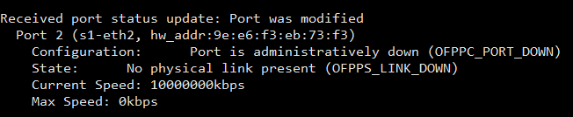
Port detection
When a link goes up/down, the port status of the switches involved in the connection will change consequently
The switches notify the event to the controller with port status messages

Slide 9
Link down/up (mininet)
CONTROLLER
Default path Backup path
Action set on switch 3:
In port 1 (label=1) => out port 2
In port 2 (label=1) => out port 1
IP PACT
Action set for switch 1: PUSH MPLS (label=1) out port 2, priority 2 (default)
PUSH MPLS (label=2) out port 3, priority 1 (backup)
POP MPLS (label=1) out port 1, priority 2 (default) POP MPLS (label=2) out port 1, priority 1 (backup)
Action set for switch 2: PUSH MPLS (label=1) out port 2, priority 2 (default)
PUSH MPLS (label=2) out port 3, priority 1 (backup)
POP MPLS (label=1) out port 1, priority 2 (default) POP MPLS (label=2) out port 1, priority 1 (backup)
Action set on switch 4:
In port 1 (label=2) => out port 2
In port 2 (label=2) => out port 1
Notes:
Parlare qui delle diverse priorità dei path

Slide 10
Differences mininet simulator-testbed
MININET SIM. | TESTBED
Open vSwitch switches | Zodiac FX switches
Access directly to the host | Access to RaspPi via SSH
ARP tables always filled | ARP tables may be empty
Matching on MPLS label | Doesn’t match on label field
Topology is completely reliable | Topology is instable
Virtual topology | Real topology with physical links among switches
No broadcast IP msg. | Switches periodically send broadcast IP msg.
No specific event is triggered when a port becomes active | Switches notify with an OFPPS_LIVE event when a port becomes active
Notes:
Testbed matching: ETH_TYPE_MPLS, src_MAC, dst_MAC, in_port (in intermediate switches, label still present)
Topology instable= store 2 network, one updated to compute edge disjoint and another for getting info about ports, detapath…
OFPPS_LIVE triggered when a port is active

Slide 11
Statistics collection: experiment procedure
Run the controller and then activate the topology
Verify whether ARP tables are full
Establish an IP connection between 2 hosts
Once MPLS rules have been installed, collect statistics about RULE INSTALLATION TIME
Simulate a link failure
Collect statistics about PATH MODIFICATION TIME
Restore the link
Collect statistics about PATH MODIFICATION TIME
Notes:
For both mininet7testbed

Slide 12
Testbed statistics vs mininet: rules installation time
In case of empty ARP table, rule installation takes several seconds
Notes:
Rule installation delayed by arp procedure

Slide 13
Testbed statistics vs mininet: path modification time
Notes:
Plug followed by unplug…?

Slide 14
Testbed statistics: packet loss during path change
Back-up Path
Default Path
∆t=0.08s
Transitions between paths generate packet losses. The tests were performed with iperf (UDP): the results in the table are an average over multiple experiments.
Packet loss (%)
Bandwidth | 10 kbit/s | 100 kbit/s | 1 Mbit/s | 10 Mbit/s
Mininet | 0.19% | 0.27% | 0.50% | 1,71%
Testbed | 0,42% | 0,78% | 1,39% | 3,28%

Slide 15
END

