Slide 1

Big Data Healthcare
Big Data decision support system for the CHU group — Data Warehouse & Analytics
1

Slide 2
Table of Content
Project Context
Project Phases
1
2
CHU context & digital transformation goals
Architecture · Integration · Analytics · Viz
Data Sources
Data Warehouse Design
3
4
PostgreSQL · CSV · FTP flat files
Conceptual · Physical · ETL jobs
Performance & Optimization
Dashboard & Storytelling
5
6
Partitioning · Bucketing · Query tuning
KPIs · Visualizations · Decision insights
2

Slide 3




Project Context
The CHU (Cloud Healthcare Unit) group has launched a major digital transformation initiative. Our team has been tasked with building a scalable Big Data decision support system to harness data from healthcare management systems and FTP sources across France.
Our mission: design a secure, elastic data warehouse that empowers practitioners & administrators with actionable healthcare analytics
Smarter healthcare decisions start here !
3

Slide 4
Project Methodology
Architecture Study
Project Requirements Met
Dimensional modeling · Star schema · Data mart design
✓ Secure data governance enforced
Conceptual Modeling
✓ Distributed architecture (HDFS / Hadoop)
Bus matrix · Fact tables · Dimension tables defined
✓ Multi-source data integration
(For example: PostgreSQL · CSV · FTP)
ETL Development
Extraction · Transformation · Loading jobs built in Talend
✓ Star schema dimensional model designed
✓ ETL jobs validated and documented
Physical Implementation
Tables created in Hive · Partitioning & bucketing applied
✓ Partitioning & bucketing implemented
✓ Dashboard storytelling delivered
Performance Measurement
Query response times benchmarked before & after optimization
✓ Talend · Hive · Power BI · PostgreSQL
4

Slide 5
Project Phases
Phase 1
Phase 2
Phase 3
Phase 4
Architecture
Data Modeling
Implementation
Visualization
› Requirements study
› Conceptual model
› Hive tables
› Power BI reports
› Source analysis
› ETL pipeline
› KPI dashboards
› Bus matrix
› Tech stack choice
› Data loading
› Storytelling
› ETL job design
› Star schema design
› Partitioning
› Oral presentation
5

Slide 6
Data Sources
Integration Challenge
PostgreSQL Database & CSV files
Patients table
Medical records · Administrative care mngmt
Data is distributed, heterogeneous, and sensitive. Unified integration requires secure ETL pipelines and schema harmonization before loading into the warehouse.
Hospital stays
Admissions · diagnoses · discharge dates
Doctors & visits
Consultation records · professional ID
Distributed sources
PostgreSQL · CSV exports · FTP files
CSV Hospital Data
French hospital management export
Heterogeneous formats
Satisfaction Files
FTP flat files · patient ratings per facility
Relational DB · flat files · structured CSV
Death Registry
FTP flat files · national death records
ETL Tooling
Data Sensitivity
GDPR · role-based access control
Talend jobs for extraction & transformation
6

Slide 7
Data Warehouse Architecture
Conceptual Model
Staging Layer
Star schema centered on patient activity.
Fact tables: Consultations, Hospitalizations, Deaths.
Dimensions: Patient, Time, Facility, Doctor, Diagnosis.
Raw data landed in HDFS staging zone.
Data validated and cleansed before DW load.
Talend jobs orchestrate the full pipeline.
Data Mart Layer
Security & Governance
Subject-oriented marts per analysis domain.
Patient activity · Mortality · Satisfaction.
Optimized for BI tool consumption.
Role-based access: practitioners vs admins.
Data anonymization for sensitive patient records.
Audit trail on all ETL operations.
7

Slide 8
ETL & Data Integration
PostgreSQL Extraction
CSV Hospital Import
1
JDBC connector pulls patients, stays, consultations.
Incremental load strategy for operational tables.
2
Flat file ingest with schema mapping.
FTP File Processing
Data Transformation
3
4
Satisfaction & death files retrieved via FTP.
Parsed and validated before staging ingestion.
Lookup joins for dimension keys.
Null handling, deduplication, type casting.
Aggregation Jobs
Load & Scheduling
5
Pre-aggregated fact summaries for common KPIs.
Speeds up dashboard queries significantly.
6
Full refresh vs delta load modes.
Talend job scheduler for nightly runs.
8

Slide 9
Architecture
Architecture Principles
SOURCES LAYER
PostgreSQL · CSV exports · FTP flat files
Separation of Concerns
Sources, staging, DW & BI layers distinct
STAGING LAYER
HDFS staging zone · Talend ETL jobs · Data validation
Scalability
HDFS distributed storage handles the growth
Security by Design
Hive fact tables · Dimension tables · Star schemaPartitioned & bucketed for performance
Role-based access, data encryption at rest
DATA WAREHOUSE
Performance First
Partitioning & bucketing reduce query times
PRESENTATION
Power BI dashboards · HiveQL queries · Reports
Subject Orientation
Data marts aligned to user analysis needs
9

Slide 10
Performance & Optimization
Partitioning Strategy
Bucketing for Joins
⚠ Large tables slow to scan for date-range queries
⚠ Joins between large fact & dimension tables slow
Tables partitioned by year/month on date columns. Query pruning reduces scanned data by up to 80%.
ORC format with built-in column statistics. Hive predicate pushdown enabled for all query types.
Index Optimization
Query Benchmarking
⚠ Ad-hoc queries on raw columns return full scans
⚠ No baseline to measure optimization impact
ORC format with built-in column statistics. Hive predicate pushdown enabled for all query types.
Response times measured for 8 key queries before and after partitioning. Graphs show improvement per KPI.
10

Slide 11
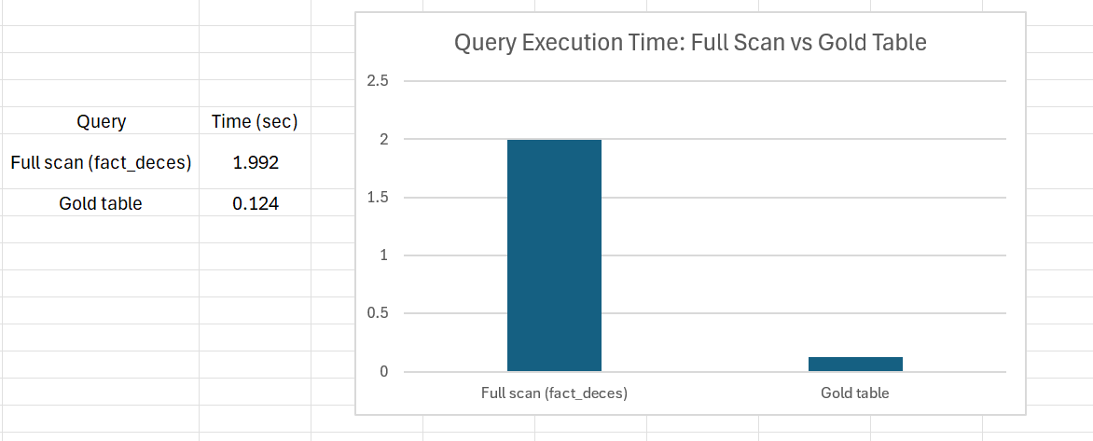
Performance & Optimization
11

Slide 12
Dashboard & Storytelling
Patient Consultation KPIs
Mortality Analytics
Rate per facility, per diagnosis, per period.
Trends surface overloaded units and peak times.
Deaths by region and year (2019 focus).
Geospatial view enables regional comparisons.
Impact ★★★★★
Audience: Practitioners
Impact ★★★★☆
Audience: Administrators
Satisfaction Index
Hospitalization Rates
Overall satisfaction rate by region for 2020.
Identifies facilities needing quality improvement.
By gender, age group, diagnosis category.
Supports resource planning & clinical decisions.
Impact ★★★★☆
Audience: Quality teams
Value ★★★☆☆
Audience: Practitioners
12

Slide 13
CHU Big Data — Mission Accomplished
Thank you for your time and attention !
Now let’s see our live demonstration of the Power BI dashbord with all the graphs, enjoy !
13

