Slide 1
Wenn
Schnittstellen
alt werden...
claus.straube@muenchen.de

Slide 2
A
B
API
API
Provider
Consumer

Slide 3
Request
A
B
API
API
Response
Provider
Consumer

Slide 4
Payload
Request
A
B
API
API
Response
Provider
Consumer

Slide 5
Payload
Request
A
B
API
API
Response
Provider
Consumer

Slide 6
Payload
Request
A
B
API
API
Response
Provider
Consumer

Slide 7

Payload
Request
A
B
API
API
Response
Provider
Consumer

Slide 8
Payload
Request
A
B
API
API
Response
Provider
Consumer

Slide 9
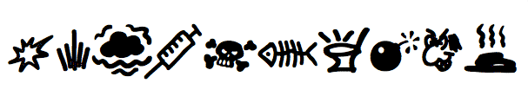
Payload
Request
A
B
API
API
Response
Provider
Consumer

Slide 10

Payload
Request
A
B
API
API
Response
Provider
Consumer

Slide 11
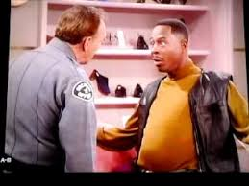
Payload
Request
A
B
API
API
Response
Provider
Consumer

Slide 12
B kennt A
B kennt die
Payload Struktur
von A
Request
A
B
API
API
Response
B kennt die
API Struktur
von A
Provider
Consumer

Slide 13
System B muss ziemlich viel von System
A kennen, damit die Kommunikation funktioniert!

Slide 14
WARUM???
Payload
Request
A
B
API
API
Response
Provider
Consumer

Slide 15

Payload
Request
A
B
API
API
Response
Provider
Consumer

Slide 16
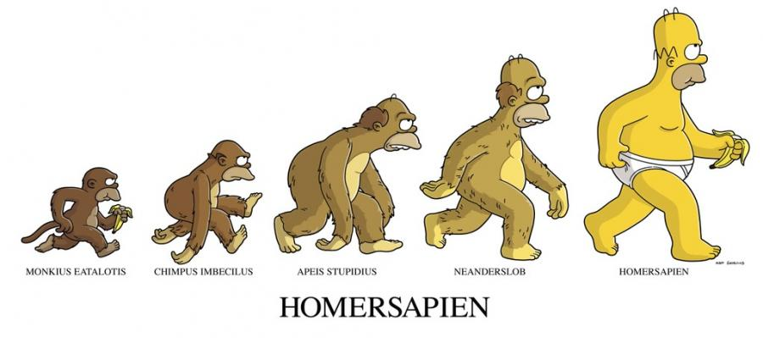
Evolution

Slide 17
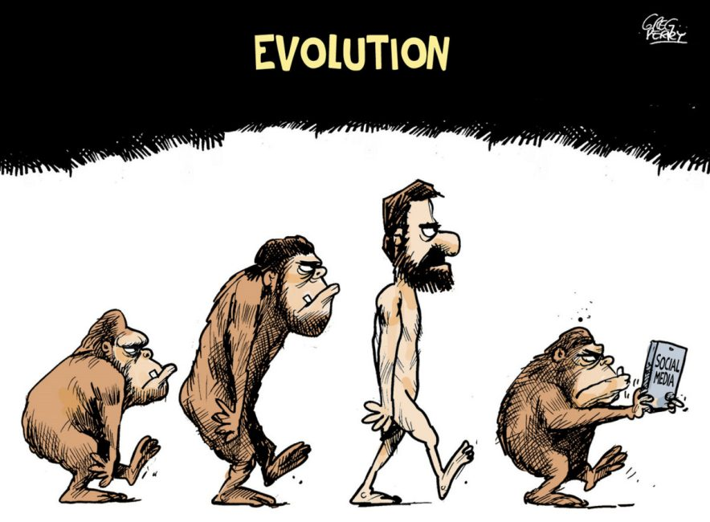
Evolution 2.0

Slide 18
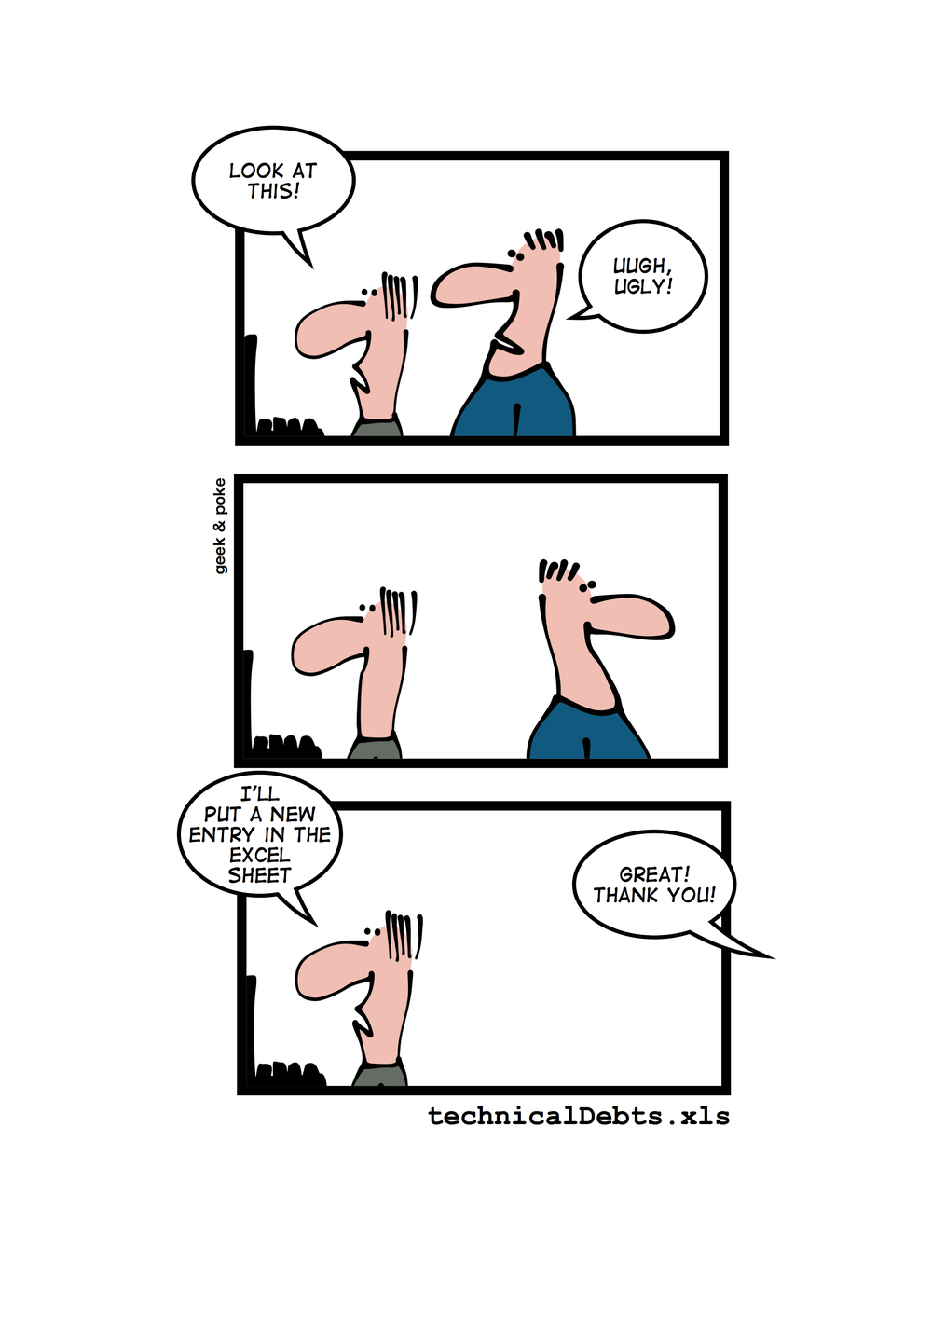

Slide 19
Technical
Dept

Slide 20

Payload
Request
A
B
API
API
Response
Provider
Consumer

Slide 21
B kennt A
B kennt die
Payload Struktur
von A
Request
A
B
API
API
Response
B kennt die
API Struktur
von A
Provider
Consumer

Slide 22
Request
A
B
API
API
Response
Provider
B kennt die
API Struktur
von A
Consumer

Slide 23

RestBucks, the sample
http://codebetter.com/glennblock/2011/06/06/rest-in-practice-the-book-restbucks-the-sample
https://github.com/olivergierke/spring-restbucks
https://speakerdeck.com/olivergierke
http://olivergierke.de/2016/04/benefits-of-hypermedia/

Slide 24

https://RESTBUCKS.io/v1/create_order

Slide 25
https://RESTBUCKS.io/v2/create_order

Slide 26
https://RESTBUCKS.io/v2/order/{id}
POST = create order
PATCH = update order
DELETE = delete order
GET = read order

Slide 27
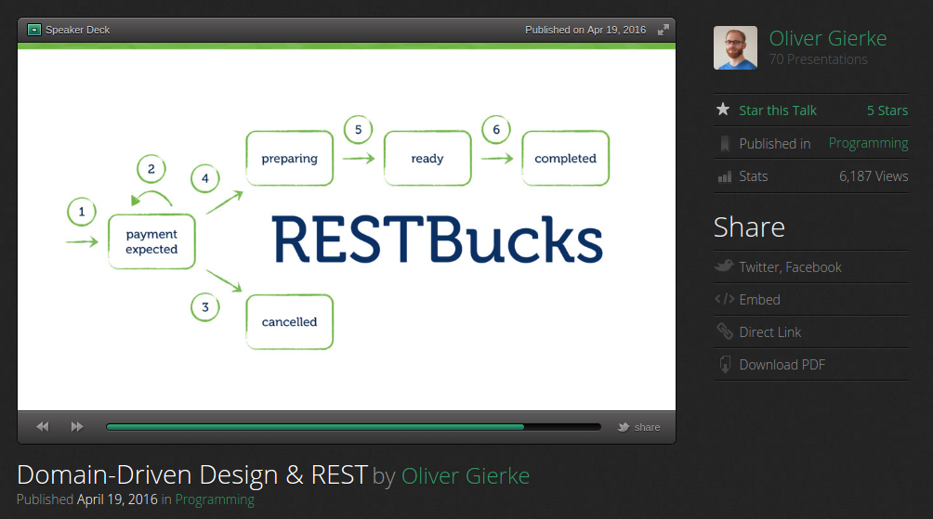

Slide 28
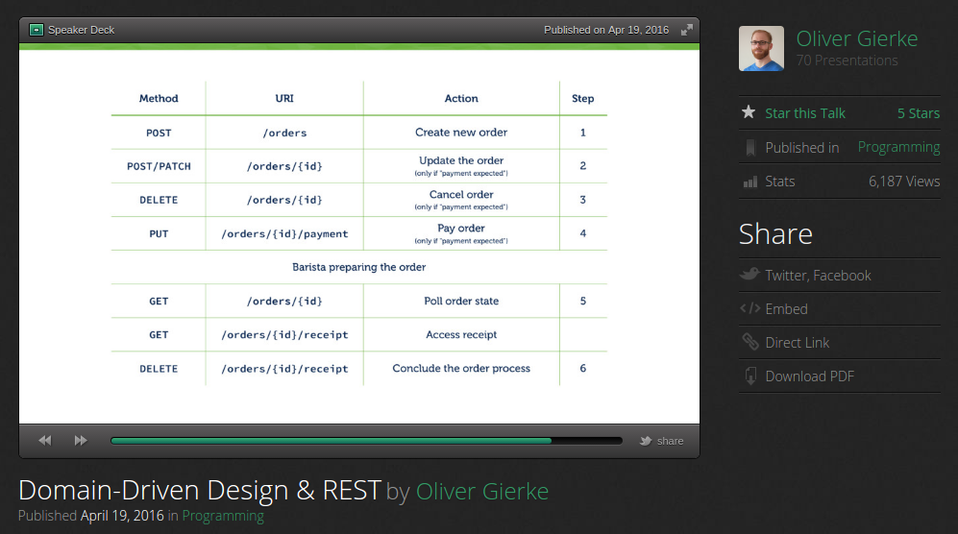

Slide 29
Barista
Hi
Hallole
Kunde

Slide 30
Schritt 1
Schritt 2
Schritt 3
update order
order
pay order
prepare order
cancel order

Slide 31
Schritt 4
Schritt 5
completed
drink

Slide 32
Hateoas
Hypermedia
As
The
Engine
Of
Application
State

Slide 33
Schritt 1
Request
Response
self
GET: RESTBUCKS.io/v2/order/1
RESTBUCKS.io/v2/order/{id}
update_order
POST/PATCH: RESTBUCKS.io/v2/order/1
RESTBUCKS.io/v2/order/{id}
cancel_order
DELETE: RESTBUCKS.io/v2/order/1
RESTBUCKS.io/v2/order/{id}
pay_order
PUT: RESTBUCKS.io/v2/order/1/payment
RESTBUCKS.io/v2/order/{id}/payment
order
POST: RESTBUCKS.io/v2/order

Slide 34
Schritt 1
Request
Response
self
GET: RESTBUCKS.io/v2/order/1
RESTBUCKS.io/v2/order/{id}
update_order
POST/PATCH: RESTBUCKS.io/v2/order/1
RESTBUCKS.io/v2/order/{id}
cancel_order
DELETE: RESTBUCKS.io/v2/order/1
RESTBUCKS.io/v2/order/{id}
pay_order
PUT: RESTBUCKS.io/v2/order/1/payment
RESTBUCKS.io/v2/order/{id}/payment
order
POST: RESTBUCKS.io/v2/order

Slide 35
Schritt 2
Request
Response
update order
PATCH: RESTBUCKS.io/v2/order/1
RESTBUCKS.io/v2/order/{id}

Slide 36
Schritt 2
Request
Response
self
GET: RESTBUCKS.io/v2/order/1
RESTBUCKS.io/v2/order/{id}
update_order
POST/PATCH: RESTBUCKS.io/v2/order/1
RESTBUCKS.io/v2/order/{id}
cancel_order
DELETE: RESTBUCKS.io/v2/order/1
RESTBUCKS.io/v2/order/{id}
pay_order
PUT: RESTBUCKS.io/v2/order/1/payment
RESTBUCKS.io/v2/order/{id}/payment
update order
PATCH: RESTBUCKS.io/v2/order/1
RESTBUCKS.io/v2/order/{id}

Slide 37
B kennt A
B kennt die
Payload Struktur
von A
Request
A
B
API
API
Response
B kennt die
API Struktur
von A
Provider
Consumer

Slide 38
B kennt A
Request
A
B
API
API
Response
Provider
Consumer

Slide 39
B kennt A
Request
A
B
API
API
Response
Provider
Consumer

Slide 40
Message
Broker
A
B
API
API
Provider
Consumer

Slide 41
Message
Broker
A
?
B
API
API
Provider
Consumer

Slide 42
Schritt 1
Schritt 2
Schritt 3
update order
order
pay order
prepare order
cancel order

Slide 43
Schritt 1
Schritt 2
Schritt 3
update order
event
order
event
pay order
event
prepare order
event
cancel order
event

Slide 44
FooEvent-Listener
SomeEvent-Listener
BarEvent-Listener
SomeEvent-Listener
Message
Broker
A
FooEvent
Topic
B
API
API
BarEvent
Topic
SomeEvent
Topic
Provider
Consumer

Slide 45
B kennt A
B kennt die
Payload Struktur
von A
Request
A
B
API
API
Response
B kennt die
API Struktur
von A
Provider
Consumer

Slide 46
B kennt die
Payload Struktur
von A
Request
A
B
API
API
Response
Provider
Consumer

Slide 47
1 Kaffee ohne Milch
2 Kaffee mit Milch

Slide 48
Order
1 Kaffee ohne Milch
2 Kaffee mit Milch
LineItem

Slide 49
Order
LineItem
1
1..*
Name : String
Quantity : int
Milk : Boolean
Size : Size

Slide 50
Schema
Evolution

Slide 51


Slide 52


Slide 53
Writer
Reader

Slide 54
Writer
Order
Schema
{JSON}
V1.0

Slide 55
Writer
Order
Schema
{JSON}
V1.0
Reader
Order
Schema
{JSON}
V1.0

Slide 56
Version 1.0
[
{ "namespace": "de.muenchen.jfs17",
"type": "record",
"name": "LineItem",
"fields": [
{"name": "name", "type": "string",
"default": "coffee"},
{"name": "quantity", "type": "int",
"default": "1"},
{"name": "milk", "type": "boolean",
"default": "false"}
]
},
{ "namespace": "de.muenchen.jfs17",
"type": "record",
"name": "Order",
"fields": [
{"name": "item", "type": "LineItem"}
]
}
]

Slide 57
Version 1.0
[
{ "namespace": "de.muenchen.jfs17",
"type": "record",
"name": "LineItem",
"fields": [
{"name": "name", "type": "string",
"default": "coffee"},
{"name": "quantity", "type": "int",
"default": "1"},
{"name": "milk", "type": "boolean",
"default": "false"}
]
},
{ "namespace": "de.muenchen.jfs17",
"type": "record",
"name": "Order",
"fields": [
{"name": "item", "type": "LineItem"}
]
}
]
LineItem Type

Slide 58
Version 1.0
[
{ "namespace": "de.muenchen.jfs17",
"type": "record",
"name": "LineItem",
"fields": [
{"name": "name", "type": "string",
"default": "coffee"},
{"name": "quantity", "type": "int",
"default": "1"},
{"name": "milk", "type": "boolean",
"default": "false"}
]
},
{ "namespace": "de.muenchen.jfs17",
"type": "record",
"name": "Order",
"fields": [
{"name": "item", "type": "LineItem"}
]
}
]
Order Type

Slide 59
Servus
Hallole

Slide 60
Writer
Order
Schema
{JSON}
V2.0

Slide 61
Writer
Reader
Order
Schema
{JSON}
V2.0
Order
Schema
{JSON}
V1.0

Slide 62
Writer
Reader
Neu
Alt
Vorwärtskompatibilität

Slide 63
Writer
Reader
Alt
Neu
Rückwärtskompatibilität

Slide 64
Version 2.0
[
{ "namespace": "de.muenchen.jfs17",
"type": "enum",
"name": "Sizes",
"symbols": ["LARGE", "MIDDLE", "SMALL"]
},
{ "namespace": "de.muenchen.jfs17",
"type": "record",
"name": "RechnungsPosten",
"aliases": ["LineItem"],
"fields": [
{"name": "name", "type": "string",
"default": "coffee"},
{"name": "quantity", "type": "int",
"default": "1"},
{"name": "milk", "type": "boolean",
"default": "false"},
{"name": "size", "type": "Sizes",
"default": "MIDDLE"}
]
},
{ "namespace": "de.muenchen.jfs17",
"type": "record",
"name": "Bestellung",
"aliases": ["Order"],
"fields": [
{"name": "item", "type": "RechnungsPosten"}
]
}
]

Slide 65
Schema
Server
Order
Schema
{JSON}
V2.0
Order
Schema
{JSON}
V1.0
1 gr. Kaffee ohne Milch
2 kl. Kaffee mit Milch

Slide 66
Schema
Server
Order
Schema
{JSON}
V2.0
Order
Schema
{JSON}
V1.0
Message
Broker
A
B
Message Converter
OrderEvent
Topic
Message Converter

Slide 67
Schema
Server
Order
Schema
{JSON}
V2.0
Order
Schema
{JSON}
V1.0
GET /{subject}/{format}
GET /{subject}/{format}
Message
Broker
A
B
Message Converter
OrderEvent
Topic
Message Converter

Slide 68
Schema
Server
Order
Schema
{JSON}
V2.0
Order
Schema
{JSON}
V1.0
GET /{subject}/{format}
GET /{subject}/{format}
Message
Broker
Avro
Message
Avro
Message
A
B
Message Converter
OrderEvent
Topic
Message Converter

Slide 69
Schema
Server
Order
Schema
{JSON}
V2.0
Order
Schema
{JSON}
V1.0
GET /{subject}/{format}
GET /{subject}/{format}
Message
Broker
Avro
Message
Avro
Message
A
B
Message Converter
OrderEvent
Topic
Message Converter
https://cloud.spring.io/spring-cloud-stream/

Slide 70


Slide 71
DEMO

Slide 72

Herzlichen Dank
Für die
Aufmerksamheit!
Claus Straube
Landeshauptstadt München
it@M
Agnes-Pockels-Bogen 21
80992 München
claus.straube@muenchen.de
@clausstraube

