Slide 1
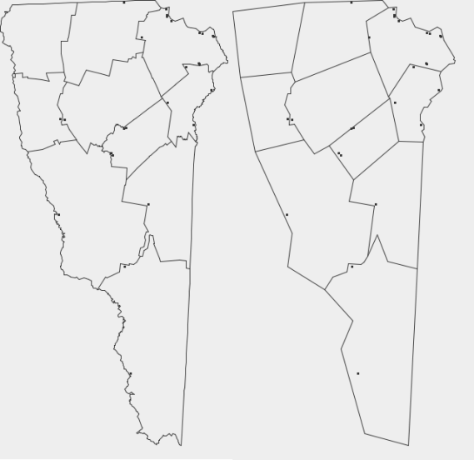
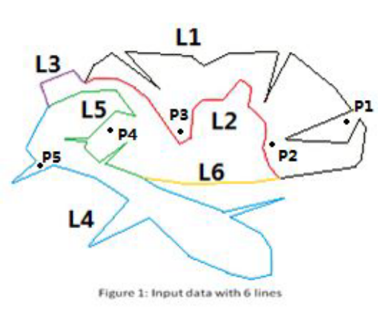
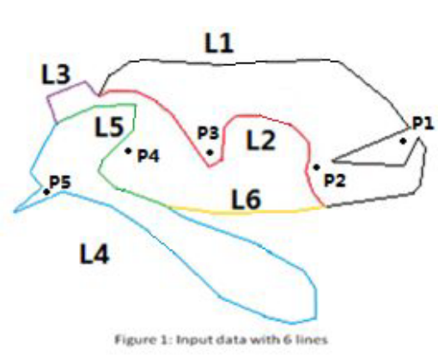
SIGSpatial 2014
Problem Defination
INPUT: A set of linear geometries that bound polygonal regions and a set of constraining points.
OBJECTIVE: Simplify the linear geometries (map) through removing vertices
  Lines should not intersect (include itself)
  Maintain constrian points(cities) in
  their original regions

Slide 2
Evaluation method
Score=0;
For each result file Output.txt
{
For each Line_i in Output.txt
{
If (Line_i violates any topological constraints)
{
Score=0;
}
Else
{
Score=Score+#Vertices(Original_Line_i) - #Vertices(Line_i);
}
}
}
If (Score < PointsToRemove)
Grade=0;
Else
Grade=Score/ExecutionTime;

Slide 3
To Win SIGCUP2014
Main Challenges
Performance
Accuracy
Data Strucure & Indexing
When to stop
Coding skills
Which vertex
can be removed
Which vertex should
be removed earlier
Tool choices
Other algorithms
Visvalingam-Whyatt
Point(city) constriant
Topological
constraint
Ramer–Douglas–Peucker
We are here

Slide 4
Timeline
Task | Current Status | Check Point
Identify key-problems | Have been done, but there may be more problems to add | May 1st - May 8th
Propose candidate algorithms | 1: Greedy version has been implemented (Louis); 2: Design heuristic algorithm (QiuLei). | May 1st - June 1st
Propose candidate index methods | 1: Already have quadtree index version( Louis), still optimising it. 2: Sorting index(QiuLei). 3: Range Tree(QiuLei). | May 1st - June 1st

Slide 5
Timeline
Task | Current Status | Check Point
Implement all candidate algorithms and index methods | 1: New Algorithms (Louis) 2: Optimize Heuristic Algorithm (Louis, QiuLei) | May 1st - July 1st
Establish testing platform for different algorithms and indices | Initial version platform has been implemented, long way to go to optimise it. | May 1st - July 1st
Decide final scheme and optimise the whole system | None | June 1st - August 1st

Slide 6
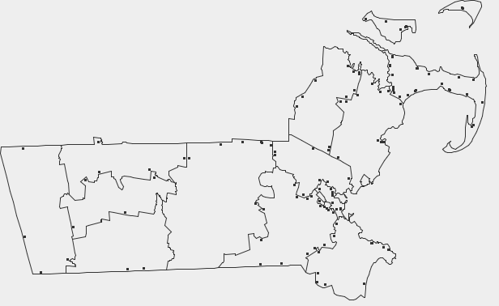
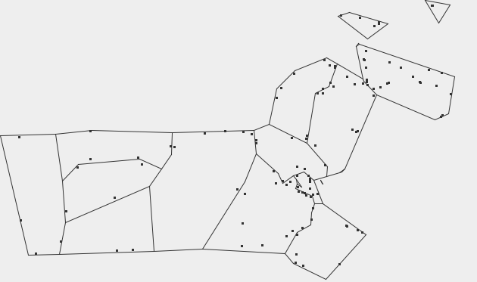
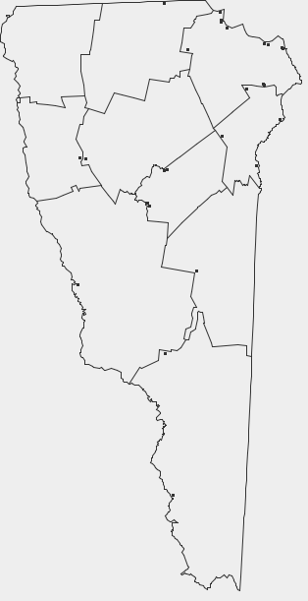
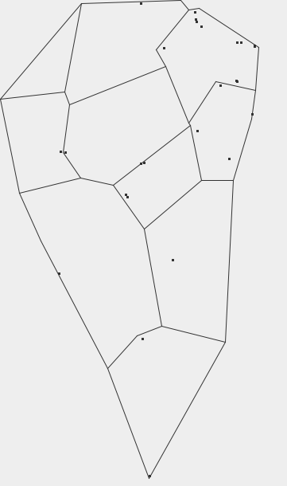
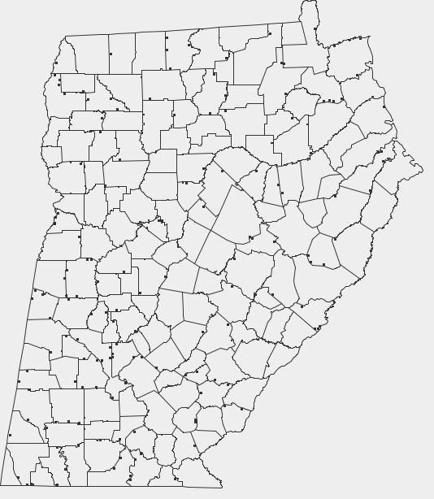
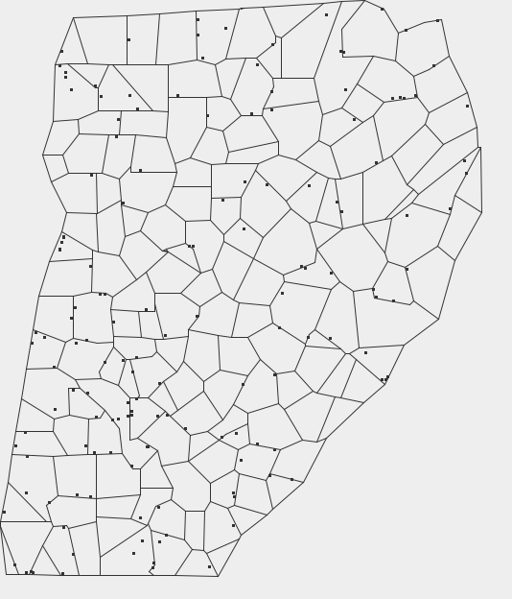
Current results
Time cost:
30% construct data
21% build up index
37% remove points
12% output into file
1429 points/42ms
928 points/27ms
7545 points/175ms

Slide 7
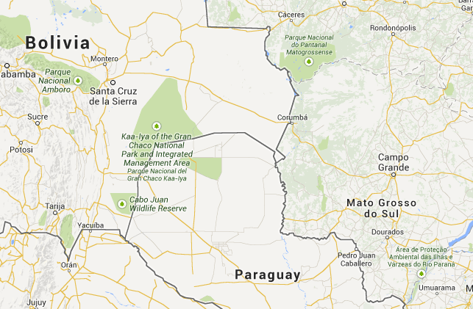
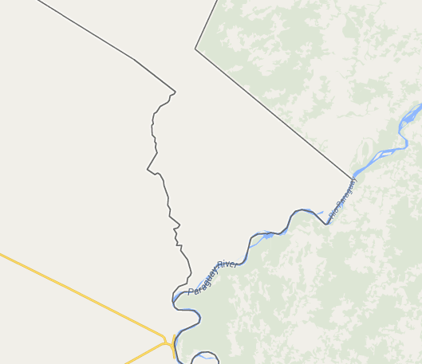
Constriant Example
Intersect with another line
Intersect with
another line
after simplify

Slide 8
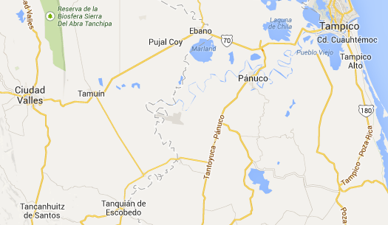
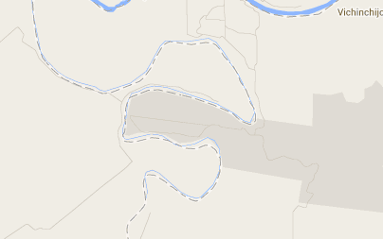
Constriant Example
Self-intersection
Intersect to itself
after simplify

Slide 9
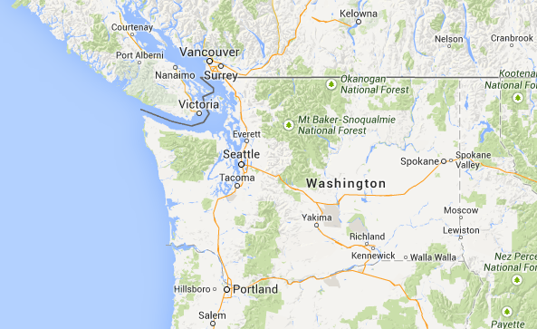
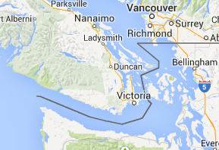
Constriant Example
Constriant point violation
Canadian city jumps
into U.S. after simplify

Slide 10
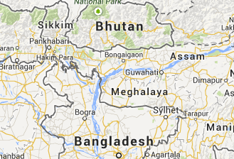
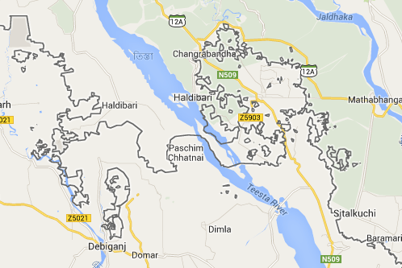
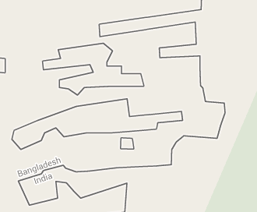
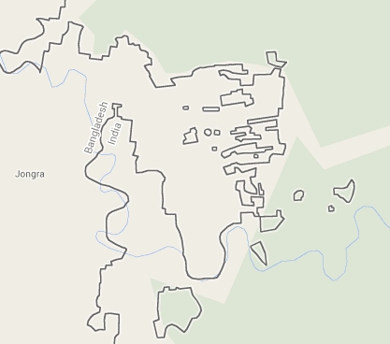
Constriant Example
There can be
multiple intersections
after simplify

Slide 11


Constriant Example
There is no constraint point in this area
So it degenerates to a single segment

Slide 12
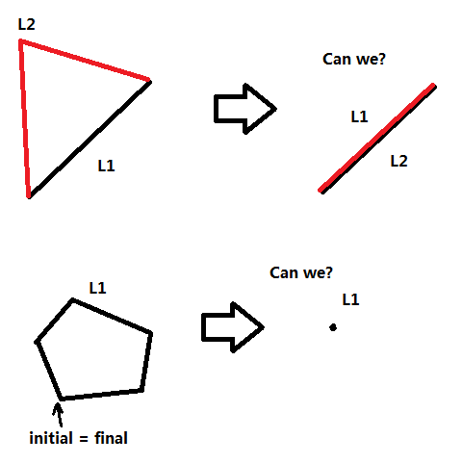
Constriant Example

Slide 13
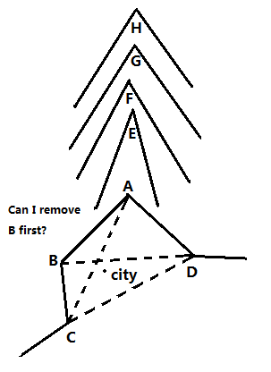
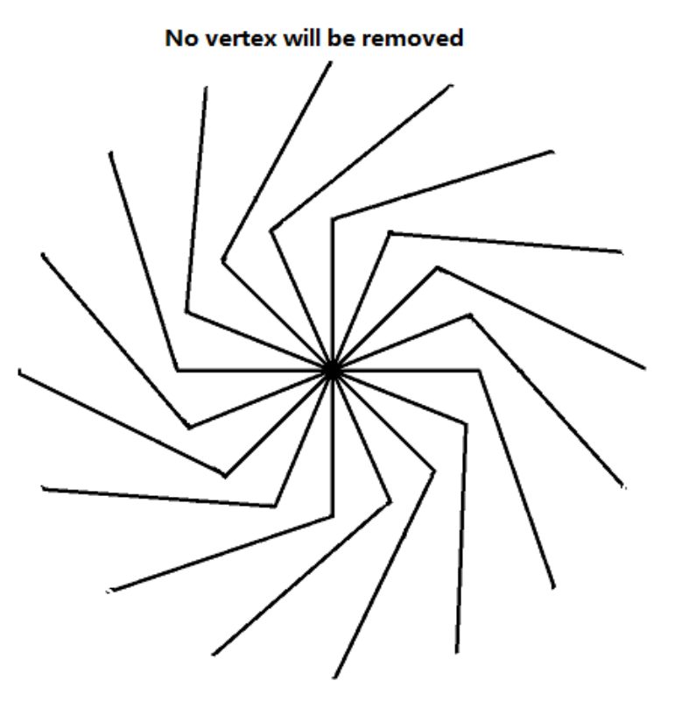
Constriant Example
Whether to consider these cases?

Slide 14
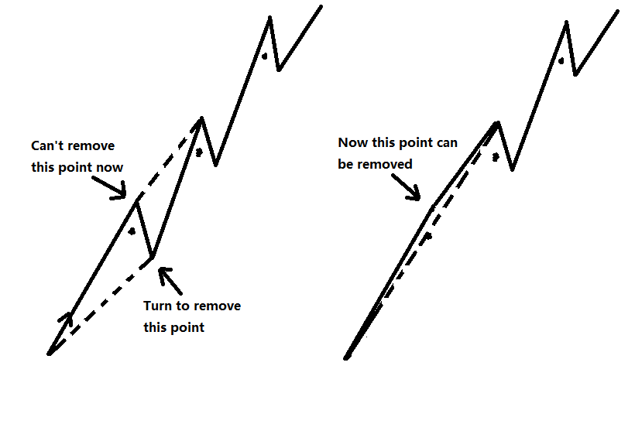
Additional problem

