Slide 1
KAU/RH PhD supervision
Status update and planning for next meeting
by Frey Alfredsson
Status update
  Home network
  Karlstad University
  Project
Plan for next meeting

Slide 2
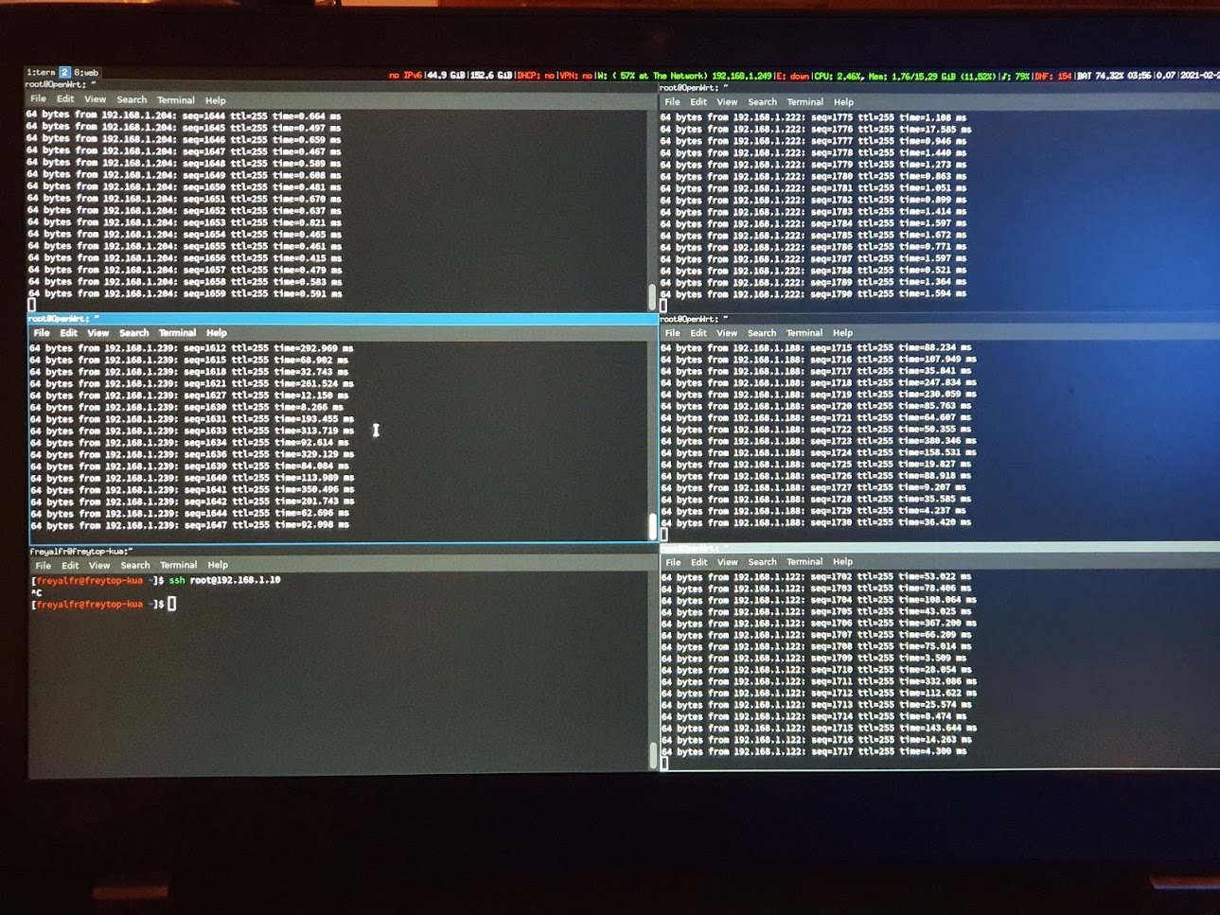
Home network: The problem is the extenders
Directly connected AP
Main AP
AP extender
AP extender
AP extender

Slide 3
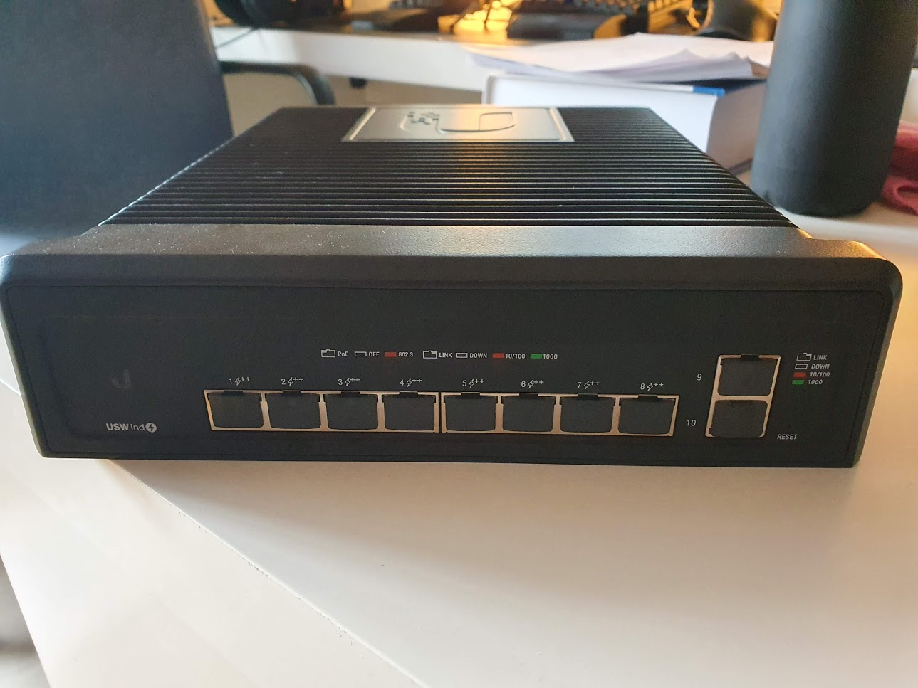
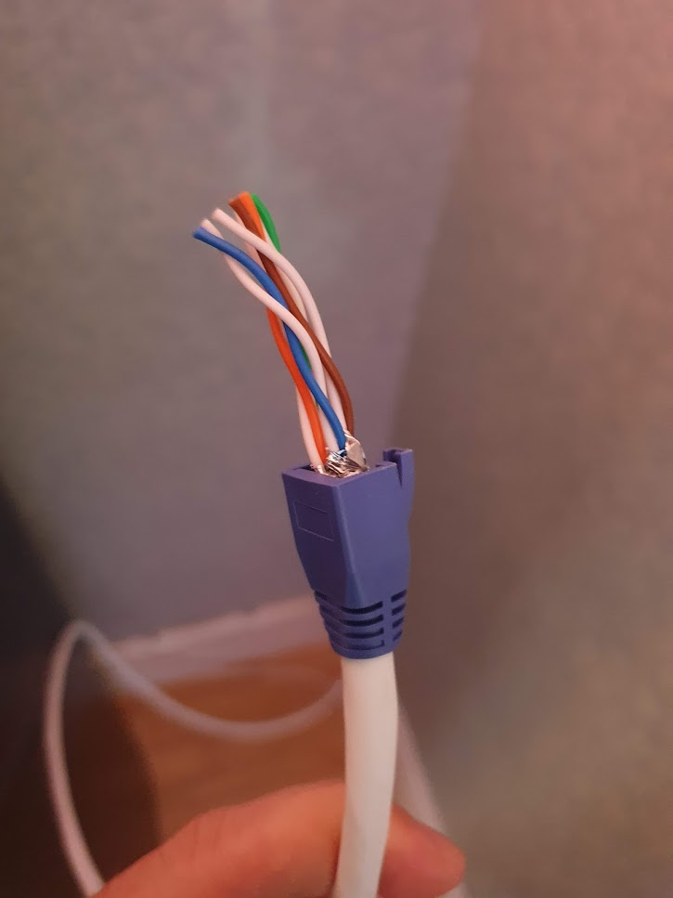

Home network: Solution
New network equipment
  UniFi industrial switch
  CAT6a cables ready
    Missing RJ45 heads
  New router has arrived
    Unfortunately, it is broken

Slide 4
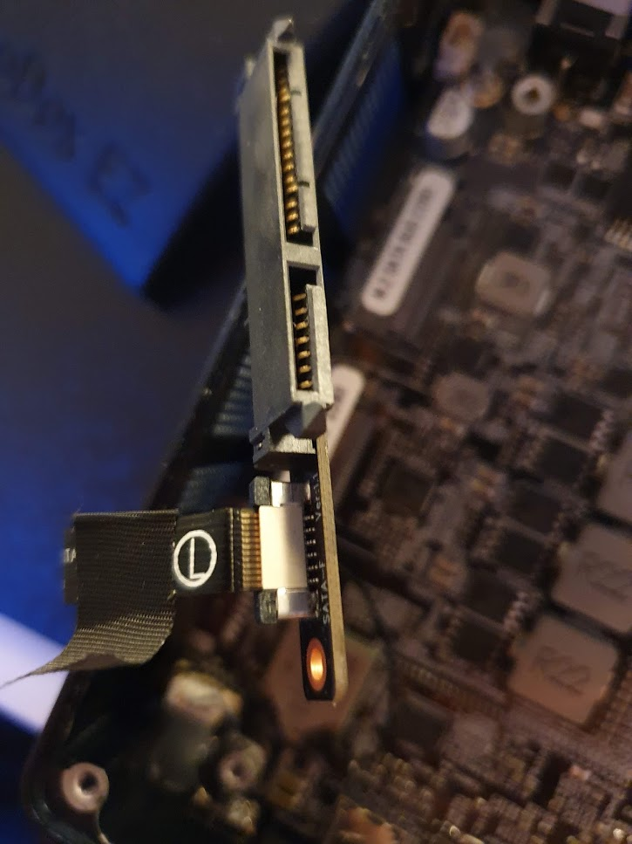
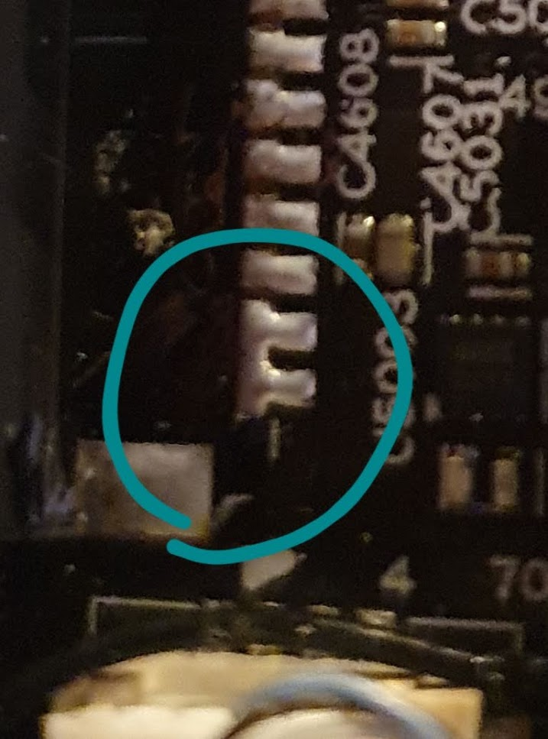
Home network: Router problem
Beelink GR5 without RAM and disk
  Is not able to see the SSD
  Seems to have a short circuit

Slide 5
Karlstad University and Project
Karlstad University
  Informationssökning V21INF06
    More crammed reading than anticipated
  TA in Computer Networking
    Grading of assignment 1
    Assignment 2 started (emulate a simple layer 4)
Project
  Qdisc eBPF filter: 99% finished
    Finishing documentation before submitting a PR

Slide 6
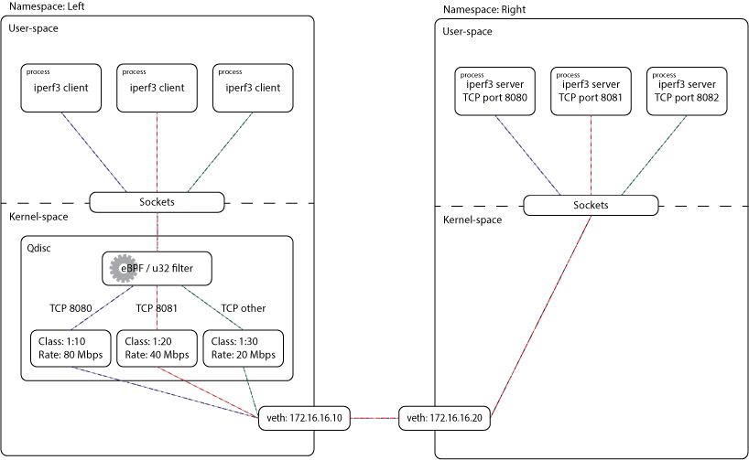
eBPF Filter example diagram

Slide 7
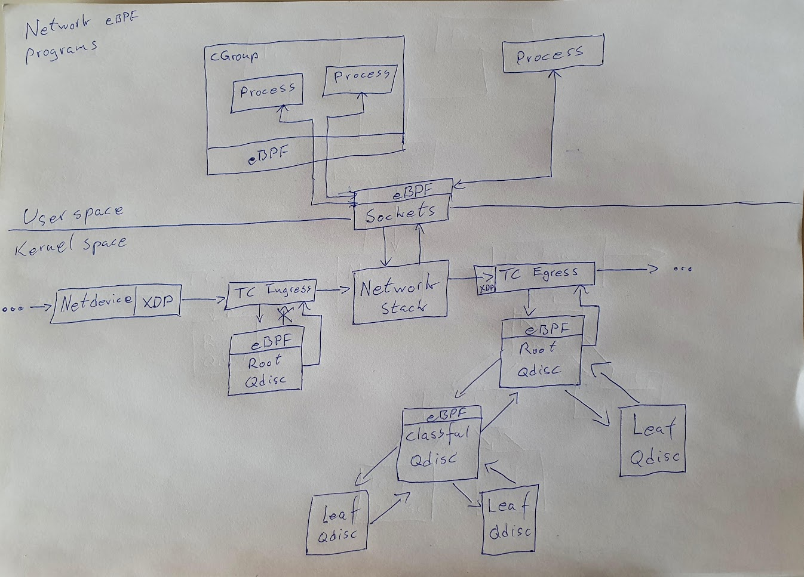
Report diagram: eBPF network programs

Slide 8
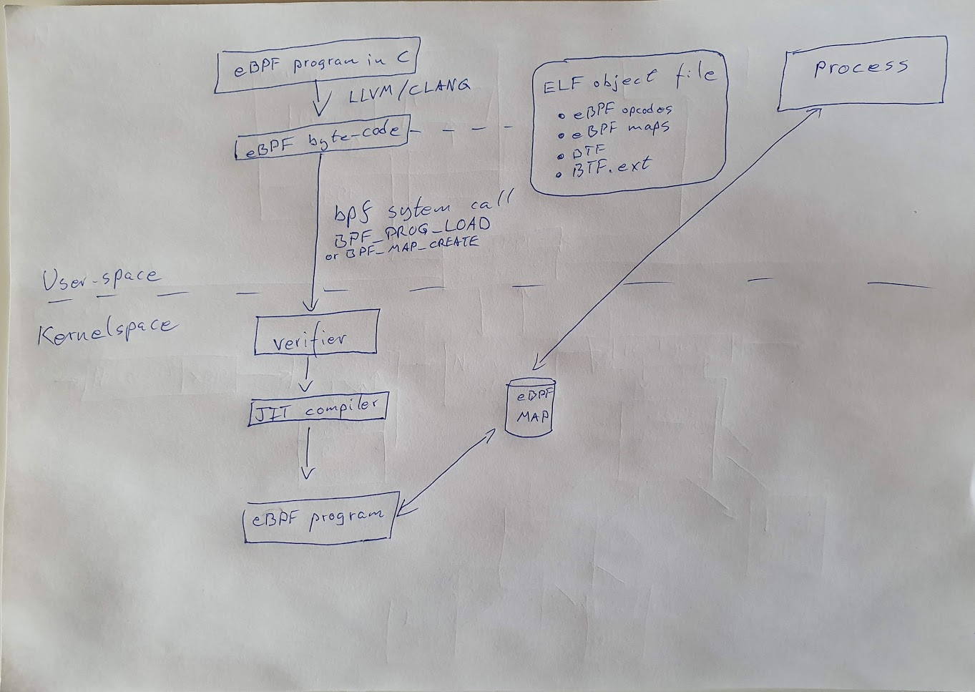
Report diagram: eBPF programs

Slide 9
Plan
Project
    eBFP filter
      Push PR to XDP-Project: bpf-examples
    Send initial draft of the technical report to supervisors
Next meeting
  Push the initial draft to a common Github repo / Overleaf

