Slide 1
KAU/RH PhD supervision
Status update and planning for next meeting
by Frey Alfredsson
Status update on Toke’s Python Packet Simulator
  PIFO
  Eiffel
Plan for next meeting

Slide 2
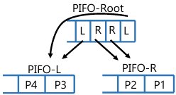
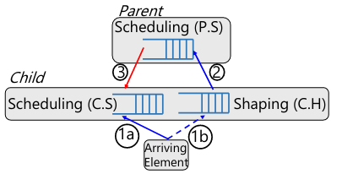
Status Toke’s Python Packet Simulator
PIFO implementation
  HPFQ: As I understand it, each node has a different classifier
  Shaping PIFO or Calendar Queue needed for delayed packets in parent

Slide 3
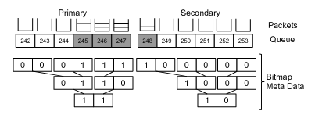
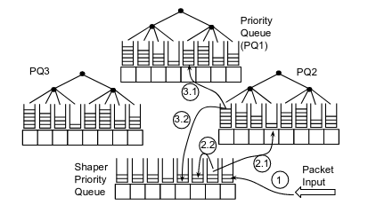
Status Toke’s Python Packet Simulator
Eiffel implementation
  I am still unsure when the Eiffel structure cycles, and how it dequeues
  Shaping seems to be the same as in the PIFO paper, except, adding a space optimizer that uses only one shaper

Slide 4
Plan
Project and agenda for next meeting
    Change the queue-exp Python code
      Update flow control
      Add HPFQ
      Change Eiffel implementation
      Add draft of pFabric using Eiffel

